Slide 1
Can Diabetes Apps Make Our Lives Easier?
Adam Brown
Head, Diabetes Technology & Connected Care, Close Concerns Senior Editor, diaTribe.org
Author, Bright Spots & Landmines
ADA 2018 Scientific Sessions – June 23, 2018

Slide 2
Presenter Disclosure
Adam Brown
Other – Speaking
Ascensia
Dexcom
Insulet
Tandem

Slide 3
Slides posted at
diaTribe.org/Apps2018

Slide 4
Are people using diabetes apps now?
Which ones?

Slide 5

Do you currently use* any apps to help you better manage your diabetes? (*at least 1x/week)
Type 2 Diabetes N=2,776
Type 1 Adults N=1,592
Parents (T1 Kids) N=135
Yes
Yes
Yes
dQ&A US Patient Survey, Q1, 2018

Slide 6









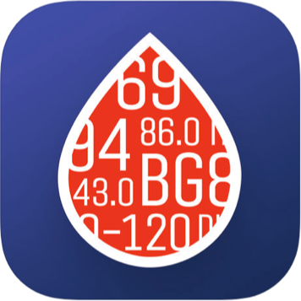
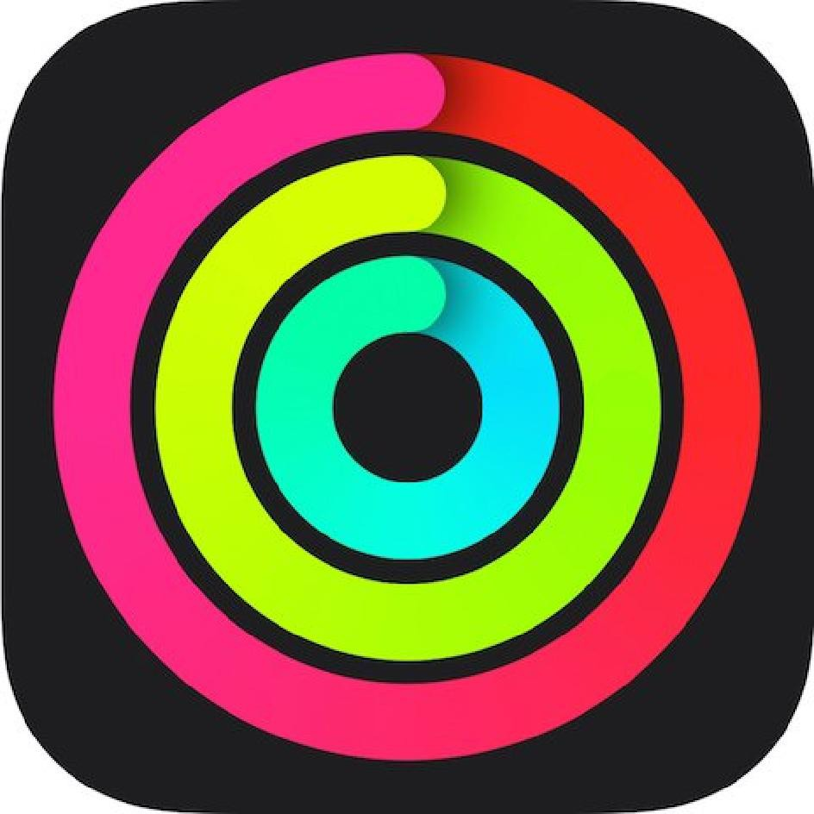


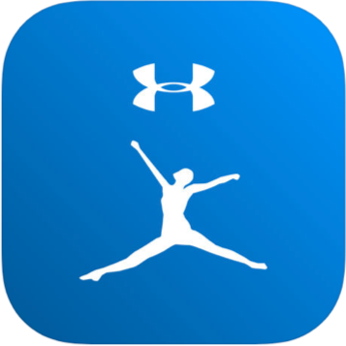
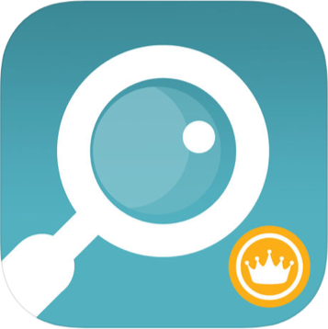


Most popular apps: dQ&A, Q1 2018 (N=890)
CGM
BGM
Data
Exercise
Food
Pharmacy
dQ&A US Patient Survey, Q1, 2018: Respondents using an app to help them manage their diabetes: T1A (n=463), T1K (n=76), T2I (n=193), T2NI (n=158)

