Slide 1
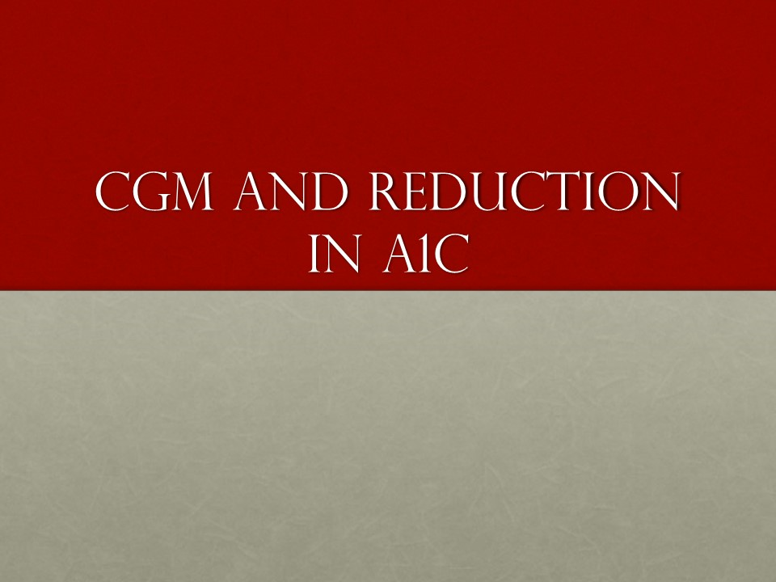
Practical Use of CGM To Improve Clinical Outcomes

Slide 2


Slide 3
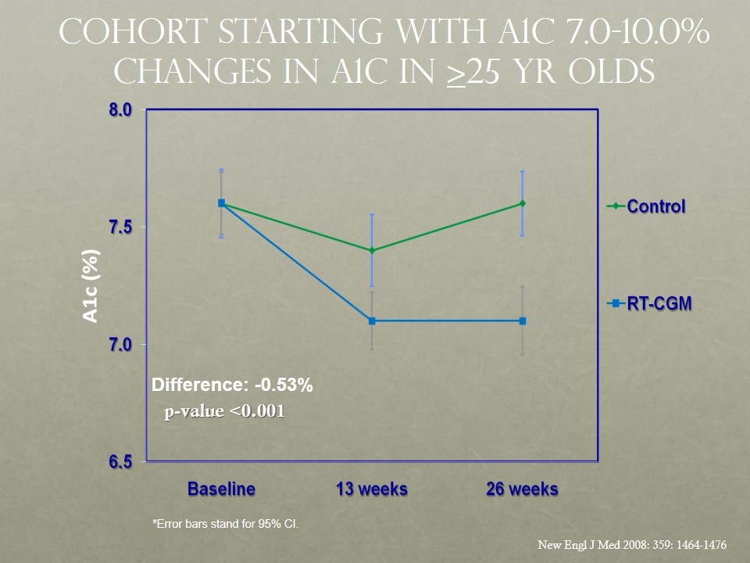

Slide 4
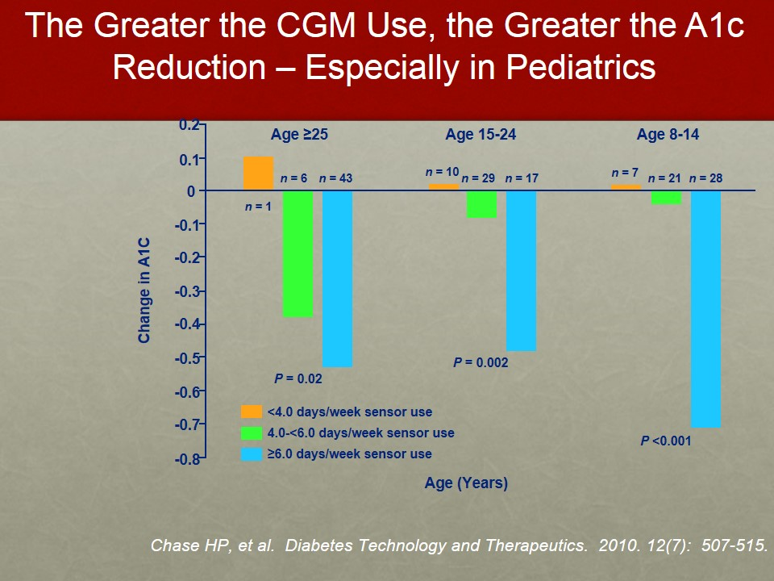

Slide 5
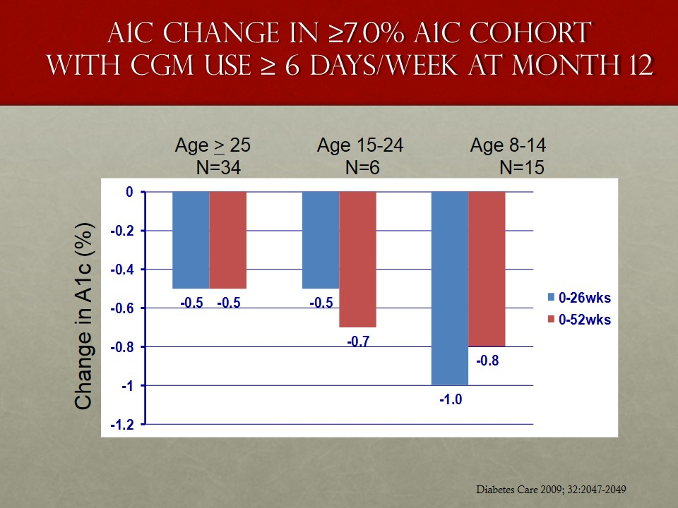

Slide 6


Slide 7
