Slide 1
Clinical Performance

Slide 2
The PRECISE Studies
A Prospective, Multicenter Evaluation of the Accuracy of a Novel Continuous Implanted Glucose Sensor
PRECISE – 2015 Europe (up to 180 days, unblinded, 71 subjects)
PRECISE II – 2016 U.S. (up to 90 days, blinded, 90 subjects)
Notes:
Segue into PRECISE II with prior pivotal trial in Europe that led to algorithm change in product used in US study

Slide 3
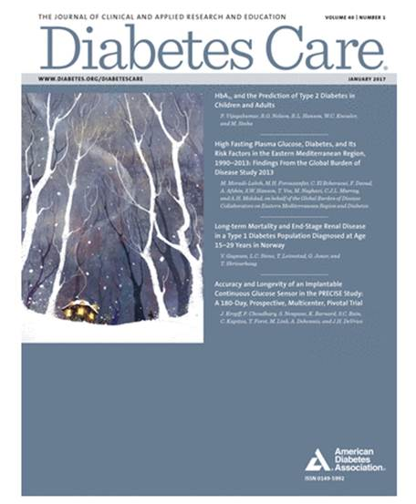






PRECISE – 2015 Europe
J. Kropff, P. Choudhary, S. Neupane, K. Barnard, S.C. Bain, C. Kapitza, T. Forst, M. Link, A. Dehennis, J.H. DeVries
Diabetes Care 2017;40:63-68
Notes:
Segue into PRECISE II with prior pivotal trial in Europe that led to algorithm change in product used in US study

Slide 4
Study Details
Prospective, single-arm
Accuracy and safety over 6 months
Venous YSI® glucose as reference
Two sensors, one in each upper arm
Calibration twice daily
CGM data unblinded
Accuracy Session | 1 | 2 | 3 | 4 | 5 | 6 | 7 | 8
Day | 1 | 14 | 30 | 60 | 90 | 120 | 150 | 180
Notes:
Accuracy and safety assessed over 6 months during 8h and 24 inclinic sessions.

Slide 5
In/Exclusion Criteria
Age | ≥18 years
Diagnosis | DM, MDI or insulin pump therapy
Excluded for Medical Conditions | • Severe hypoglycaemia (past 6 months) • Ketoacidosis (past 6 months) • Known active microvascular complications • Requiring MRI • Chronic infection requiring antibiotic use
Excluded for Concomitant Meds | • Chemotherapy • Immunosuppressant therapy • Chronic systemic glucocorticoids • Anti-coagulant therapy
Notes:
People using medications that are known to impact glucose metabolism or using anti-agulant therapy were excluded from participation.

Slide 6
Baseline Characteristics
Variable | n=71 | SD or %
Age (years)(SD) | 41.7 | 12.6
Sex, male (n) | 42 | 59%
Diabetes duration (years)(SD) | 22.2 | 12.5
Baseline HbA1c (mmol/mol)(SD) | 60.0 | 12.0
Baseline HbA1c (%)(SD) | 7.6% | 1.1
Insulin pump-use (n) | 42 | 59%
CGM use before study (n) | 32 | 45%

Slide 7
Primary Effectiveness: Accuracy
CGM to YSI ( Clinic Sessions )
Glycaemic Range | Overall (40-400 mg/dL) | Hypoglycaemia (<75 mg/dL) | Euglycaemia (75-180 mg/dL) | Hyperglycaemia (>180 mg/dL)
MARD (95% CI) | 11.6% (11.5 – 11.8%) | 21.7% (20.4 – 23.0%) | 11.9% (11.8 – 12.1%) | 9.2% (9.0 – 9.4%)

Slide 8
Full Enrollment Safety Summary
  Total of 292 skin incisions for insertion /removal
  No device/procedure related SAE
6 device or insertion/removal procedure-related AE’s
  2 cases of insertion site redness
  2 cases of insertion site infection occurred, 1x antibiotics
  2 cases of insertion site discomfort
3 cases of transmitter related skin reaction
Notes:
180 days study duration. 292 incisions/removals, no SAE, 19 AE.

Slide 9
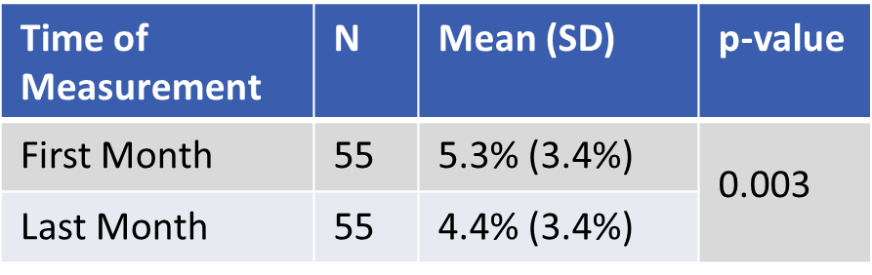
Improvements in Diabetes Control
Hypoglycemia reduction
HbA1c overall
Time of Measurement | N | Mean (SD) | p-value
Screening | 55 | 7.5% (1.1%) | <0.001
End of Study | 55 | 7.2% (0.9%)

Slide 10
Eversense Development Status
Data was used to update glucose algorithm
PRECISE II Study (U.S.)
  3 month study started Jan 2016
  Same CGM system with the new, updated algorithm
  Data used for PMA Submission to FDA

Slide 11








PRECISE II Study (US 2016)
Mark P Christiansen, MD; Leslie j Klaff, MD, PhD; Ron Brazg, MD; Anna R Chang, MD; Carol J Levy, MD; David Lam, MD; Douglas S Denham, DO; George Atiee, MD; Bruce W Bode, MD; Steven Walters, MS; Timothy S Bailey, MD

Slide 12
Primary Accuracy Metrics
16,653 paired CGM and YSI points
Metric | Level | Result
Mean AD (mg/dL) | ≤ 80 mg/dL | 9.6
Mean ARD (%) | > 80 mg/dL | 8.2
Mean RD (%) | All Results | -1.0
Mean ARD (%) | All Results | 8.8
16,653 paired CGM and YSI points
Notes:
We show here the primary accuracy results based on a very large number of paired points at over 16 thousands. The device showed excellent accuracy across the 90 patient population for the full 90 days of the study.
The Mean ARD (or MARD) was determined to be 8.8%.
In the low range (< 80 mg/dL) the Mean AD (MAD) was also very strong 9.6 mg/dL. Mean absolute relative
Backround info:
Over 2.3 Million CGM Measurements

Slide 13
Full Enrollment Safety Summary
  No infections
    212 insertion / removal procedures
No adhesive skin irritations/reactions
  Over 9,773 sensor wear days
  Median 90 day wear time 23.4 hrs/day
14 device or procedure related adverse events in 7 subjects
  1 Musculoskeletal (pain)
  2 Neurological (paresthesia, syncope-vasovagal)
  3 Procedure-Related (1 SAE)
  8 Dermatological (mild bruising or erythema)
Notes:
The safety analysis of the 90 subjects over the 90 day duration accounted for 212 insertion and removal procedures and about 9800 sensor wear days.
The median wear time per day for the full 90 day duration was 23.4 hrs/day
Importantly, there were no incisional infections either at insertion or removal. And unlike other CGM systems, there were no complaints of skin irritation or reaction to the adhesive patch.
Fourteen (14) device or procedure related adverse events occurred in 7 (7.8%) subjects. 1 subject had musculoskeletal or pain , 2 had paresthesia or syncope-vasovagal. There were 3 procedure-related events with 1 being an SAE, of the clinician having difficulty locating the sensor during removal and requiring a second attempt.
The most common adverse events were mild bruising or erythema.
Similar to the European PRECISE study, our study results demonstrated strong safety profile of the Eversense system.

