Slide 1
Sensor Procedure
Notes:
Conducted by Senseonics Clinical Training Manager (CTM)
At least 2 doctors plus nurses
Conducted same day as first patient insertion
About 45-60 mins long
Tool and procedure overview
Equipment check
Sterile technique
CTM demo on fake skin
Doctor practice on fake skin
CTM observes doctor and nurse with first insertions

Slide 2
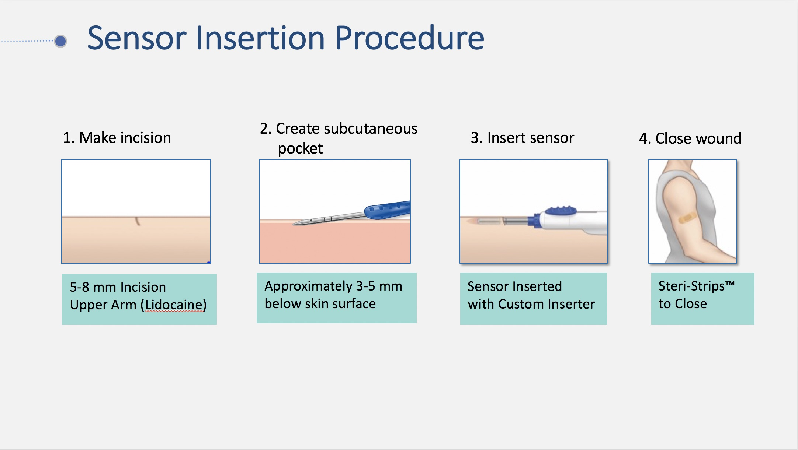
Notes:
A thorough training program is provided to the clinician by Senseonics that describes the appropriate placement procedures in detail. Briefly, the insertion procedure includes cleaning and preparation of the skin and anesthetization of the insertion area. Next, a small, shallow incision is made in the upper arm at the Sensor insertion site. Then, the blunt dissector (trocar) is used to create a subcutaneous pocket that is just large enough to fit the 0.72-inch-long sensor. The Sensor is then placed into the pocket using a Sensor insertion tool to aid with proper placement . The incision is closed with Steri-strips. And a tegaderm is placed over it to not get it wet. Patient should not get the site wet for 3-5 days.
Creation of Subcutaneous Pocket Using the Dissector Tool
Blunt dissector is moved in the subcutaneous space through the small incision site with close contact between the tool and the skin to ensure the smallest possible angle of the pocket with respect to the skin
Dissector is advanced through the incision site is between the first and second markings on the rod of the blunt dissector
Sensor Placement Using the Sensor Insertion Tool
Sensor housed in insertion tool and placed under the skin through point of incision
Insertion tool thumb slider retracted (black arrow), uncovering and leaving the Sensor in the subcutaneous pocket

Slide 3
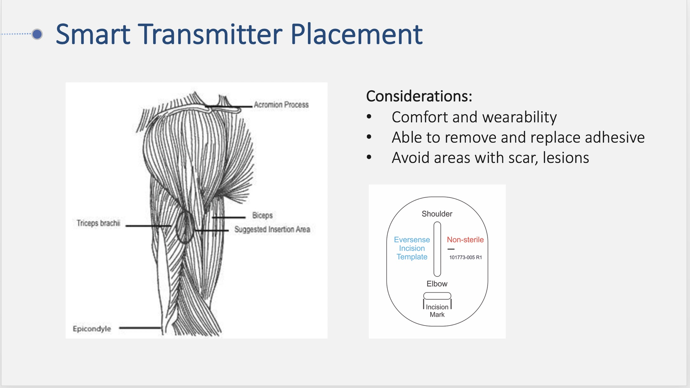

Slide 4
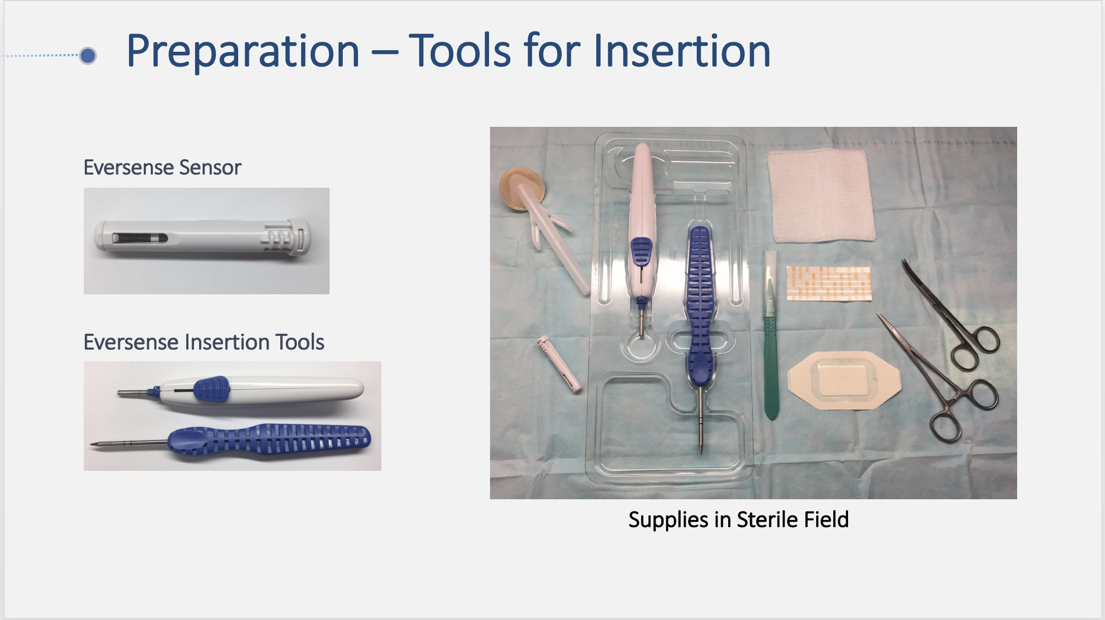
Notes:
Discuss minor procedure – importance of sterile field. Senseonics supplies the insertion tools and sensor
Non-sterile:
STx
Marker
Incision template
Lidocaine syringe – about 5/8” needle, 3 cc
Saline

Slide 5
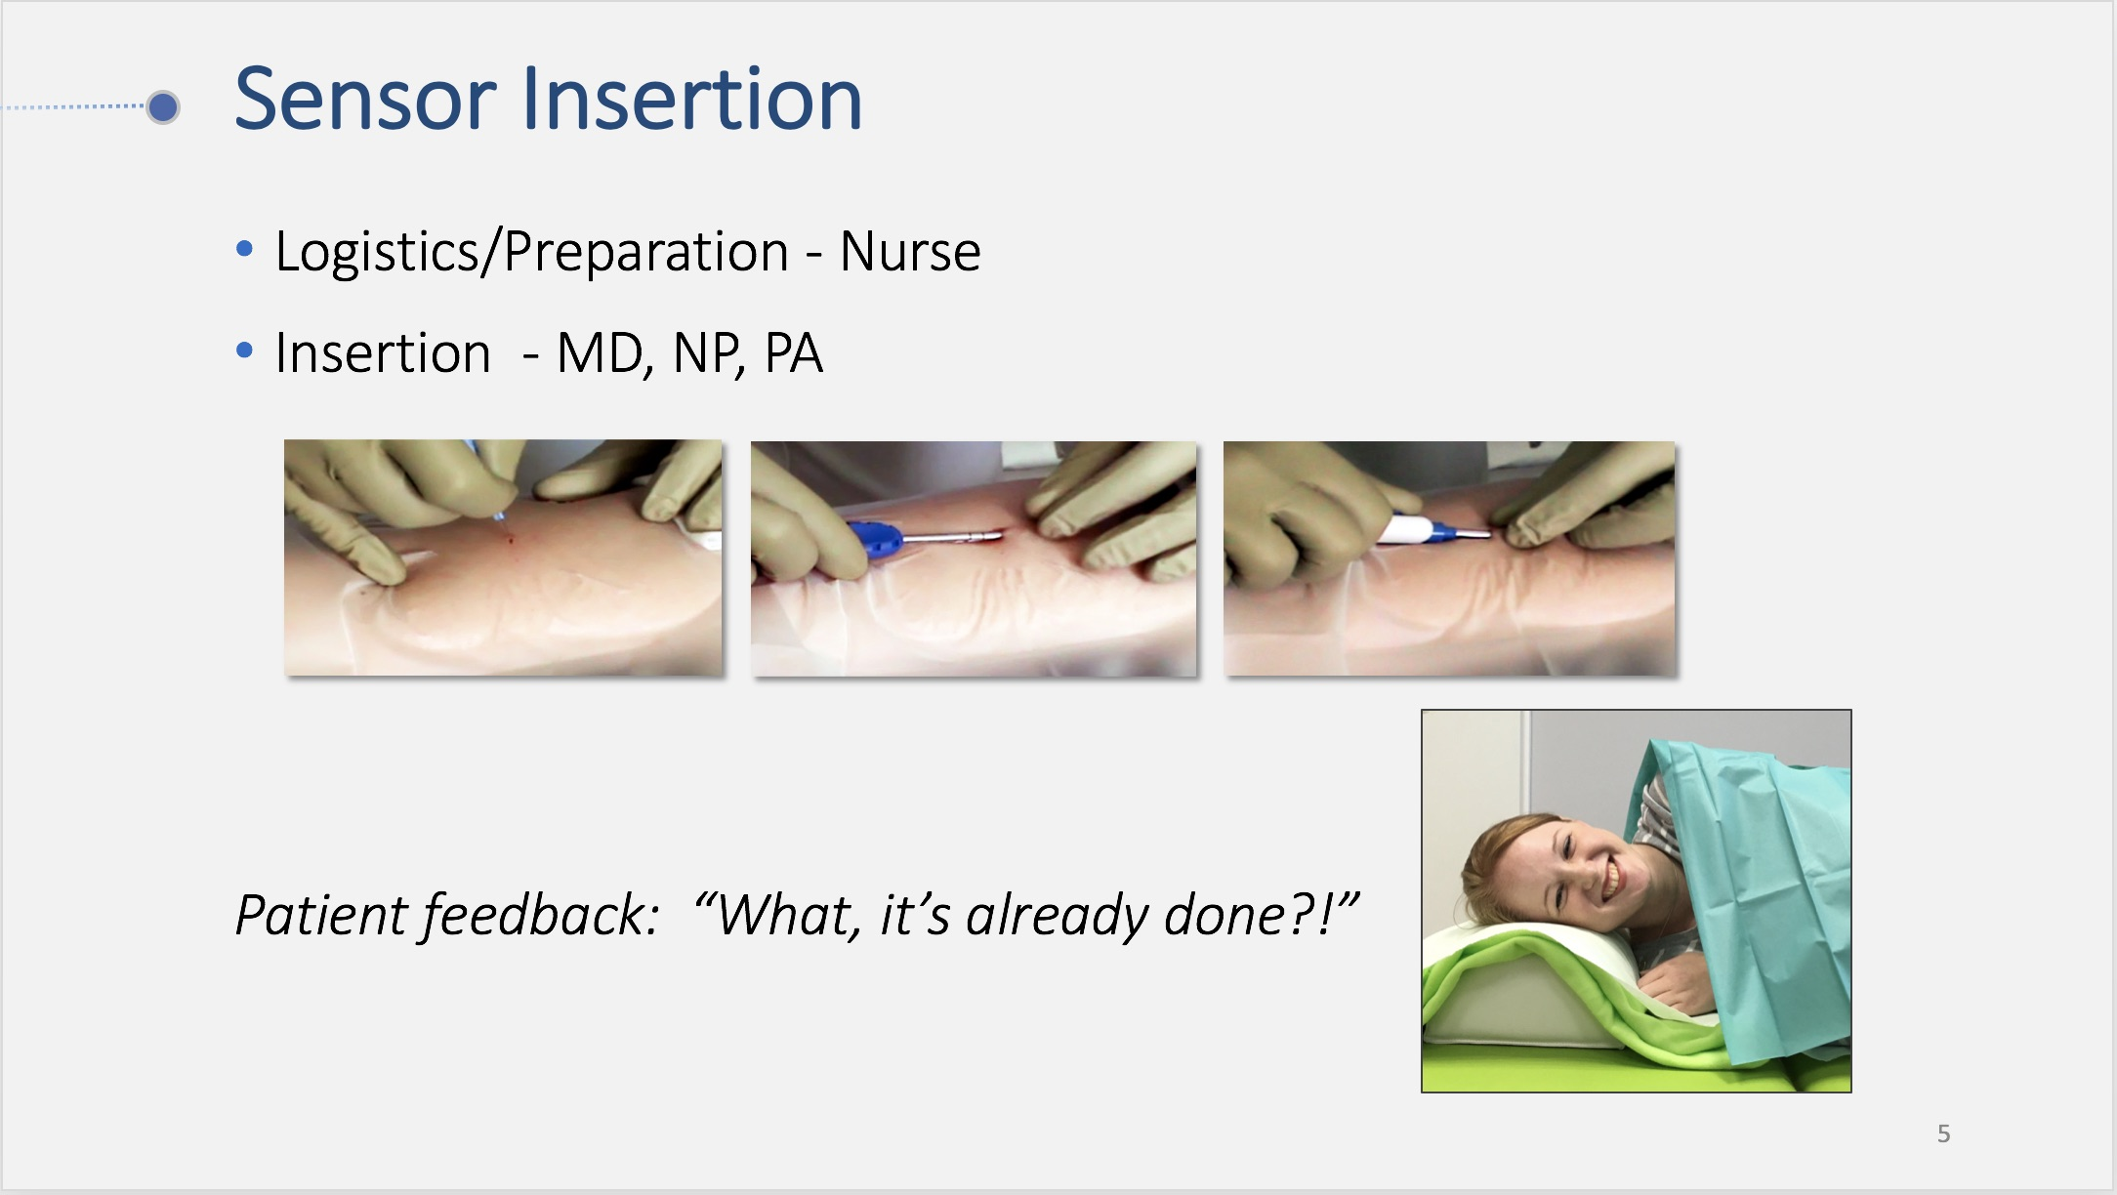

Slide 6
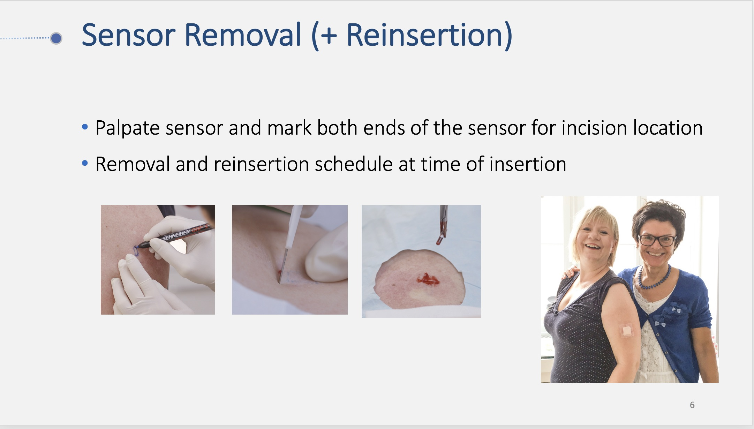

Slide 7
