Slide 1
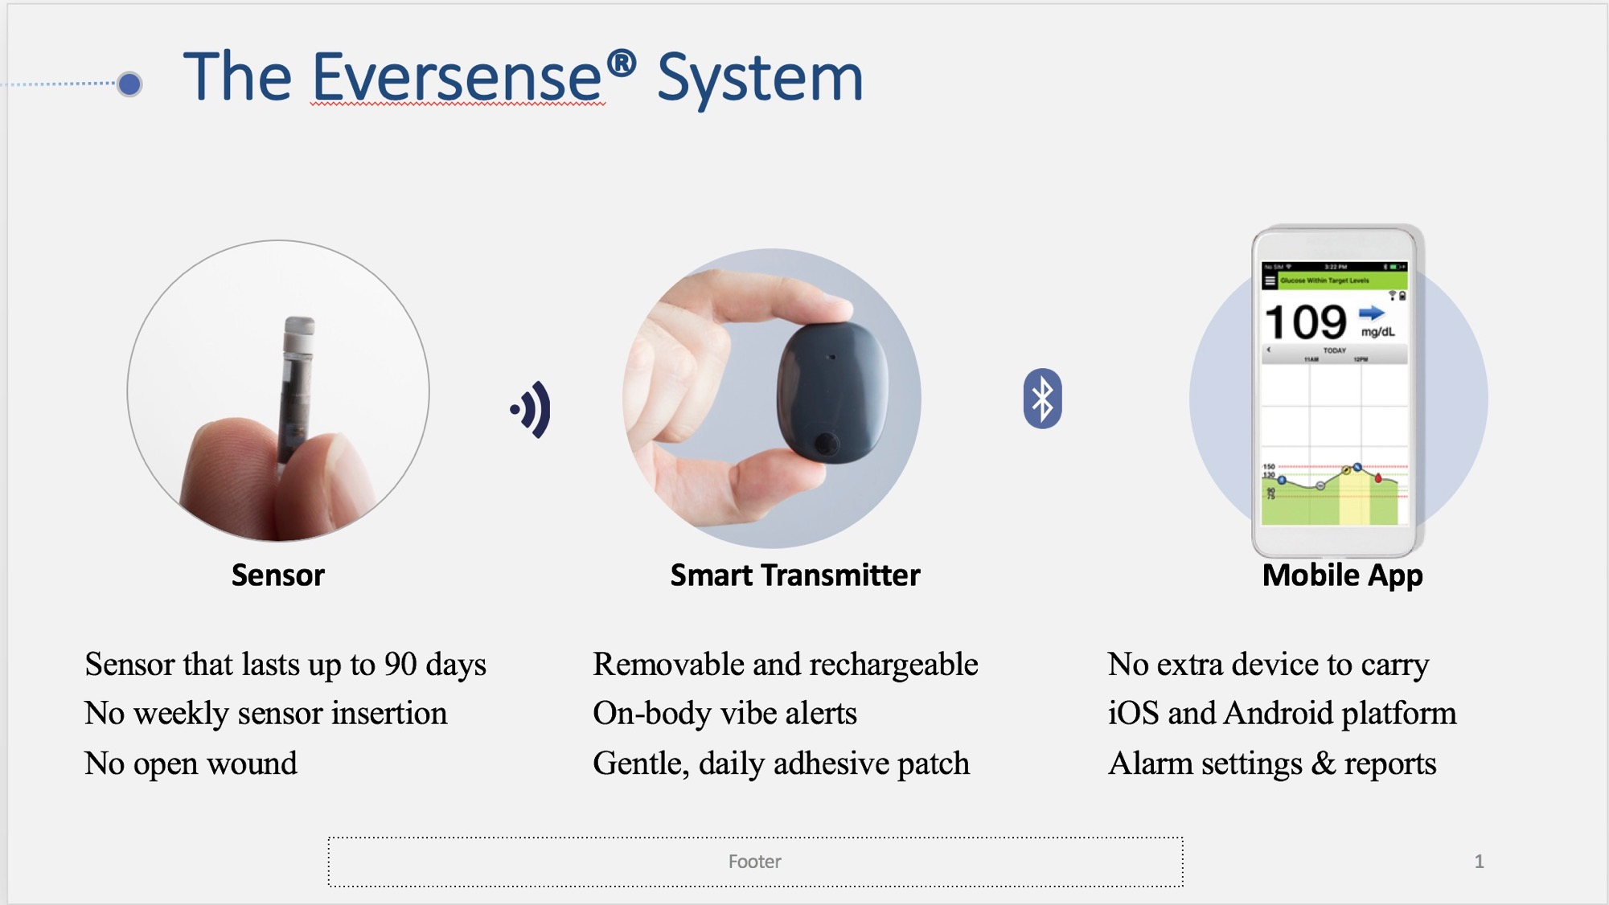
Notes:
Sensor – inserted in upper arm (this is only indication in the labeling). All biocompatible materials. Outer capsule material is made of same material as windshield of airplane. Indestructible.
Smart transmitter – lightweight and water resistant. Can shower and swim (underwater no more than 30 minutes); rechargeable (takes 15 mins to fully charge and fully charged transmitter lasts 36 hours of use); affixed to the skin with the use of adhesive patch which is made of silicone-based so very gentle on the skin; the patch is changed daily so fresh and hygenienic use; the transmitter provides vibration alerts when pre-set high and low glucose settings are reached or when predicted to reach at 10, 20 or 30 minutes prior to reaching the high or low glucose setting (the smartphone provides audio and written alerts but transmitter only provides vibration alert so as to be more discreet; the transmitter can provide the alert even when the smartphone is not nearby.)
Mobile app – works on iPhone, iPad or Android phones; no other reader required

Slide 2
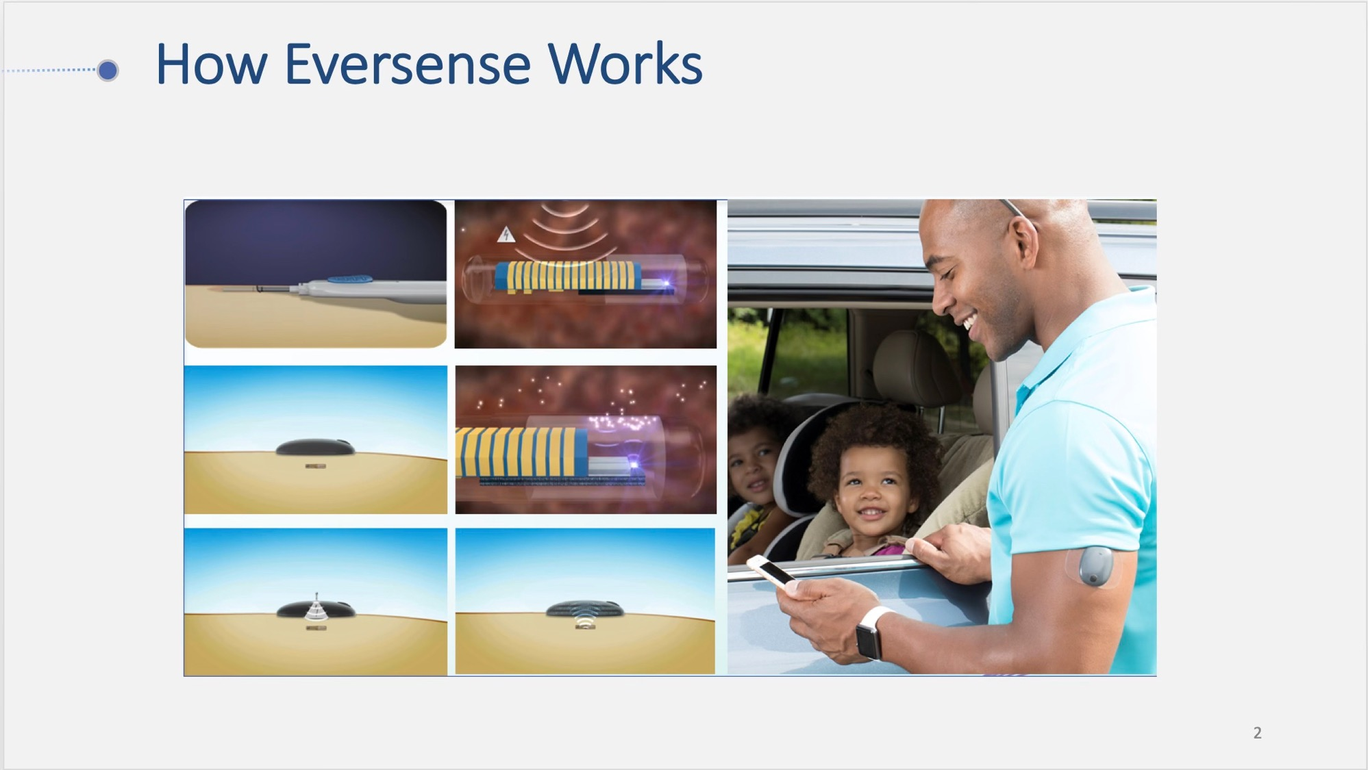
Notes:
The Eversense Sensor technology uses selective, fully reversible binding between glucose and a fluorescent indicator hydrogel to measure interstitial glucose. Glucose binding by the indicator hydrogel results in an increase in fluorescence intensity, which is measured by the Sensor’s optical system.
1) The sensor is inserted subcutaneously just under the skin.
2) The transmitter is placed over the sensor to power the sensor. The Sensor is activated to measure interstitial fluid glucose when it receives radio frequency (RF)-power from the Transmitter using near field communication (NFC), and this initiates the measurement sequence by powering up the LED technology.
3-5) Once powered, the sensor’s optical system uses a light-emitting diode (LED) to excite the fluorescent indicator hydrogel and photodiodes to capture the resulting fluorescence intensity. Changes in fluorescence are measured by the Sensor’s optical system
6) The fluorescent signal captured by the sensor is then sent to the transmitter who calculates the sensor data and produces glucose reading which is then sent via Bluetooth to the smartphone app.

Slide 3
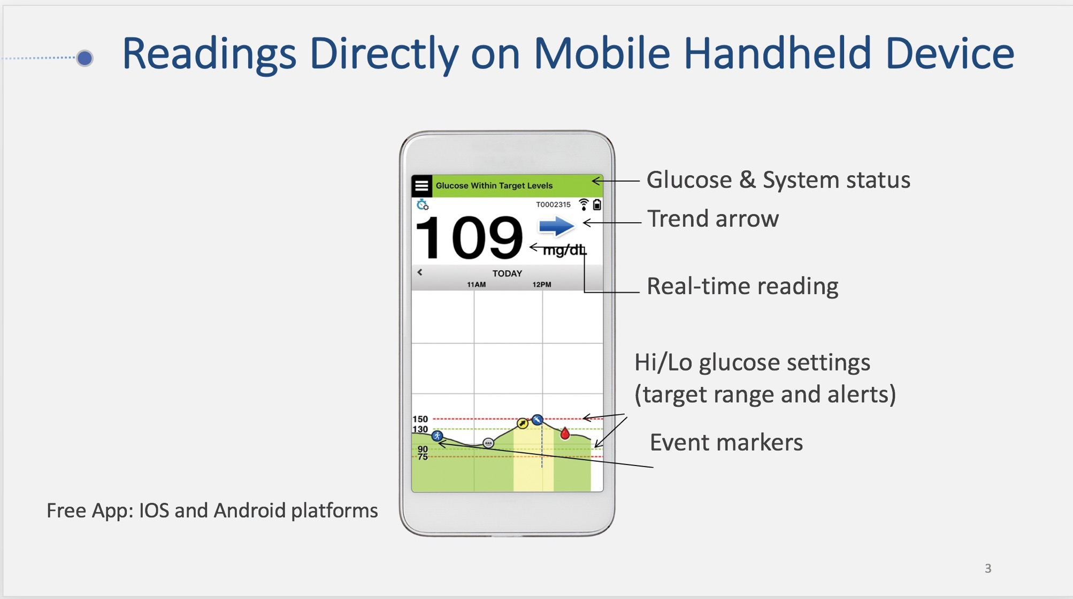
Notes:
Unit of measure is dependent on the region.
Real-time reading every 5 minutes
5 different trend arrows:
↑ = rising fast (> 2 mg/dL per minute)
↓ = falling fast (>2 mg/dL per minute)
/ = rising moderate (between 1-2 mg/dL per minute)
\ = falling moderate (between 1-2 mg/dL per minute)
Can set high or low glucose target range and alerts
Can manually log events such as meal carbs, exercise duration, etc …

Slide 4
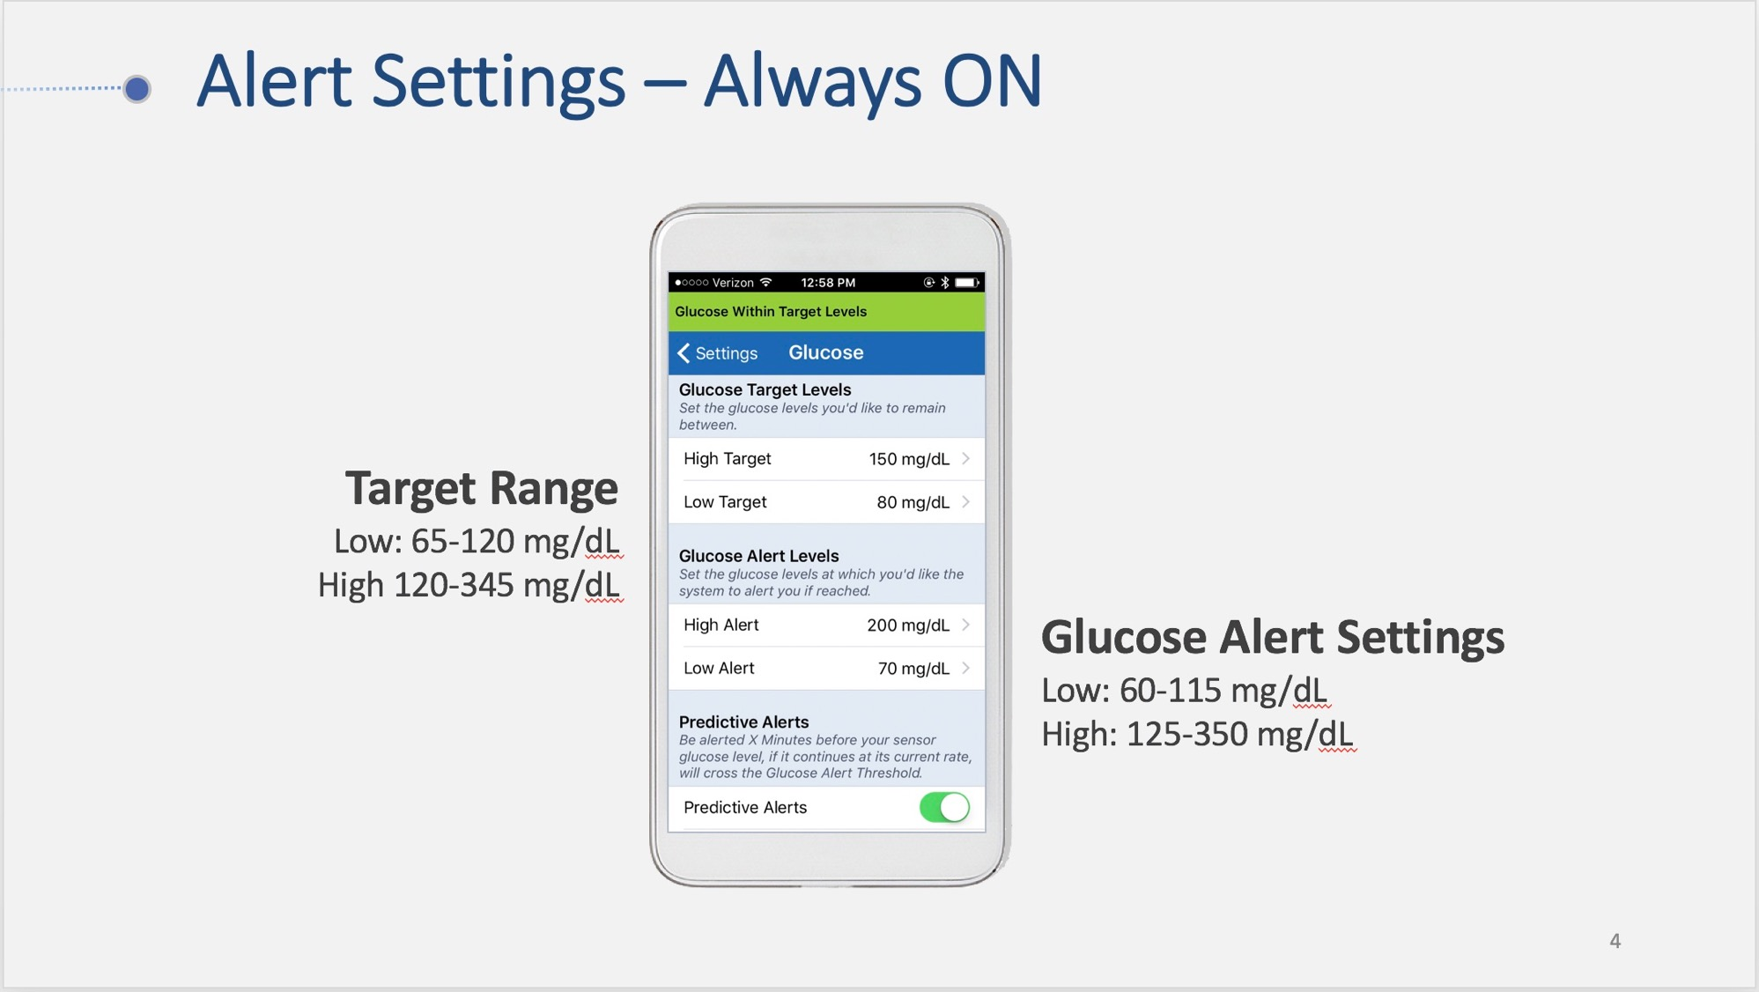

Slide 5
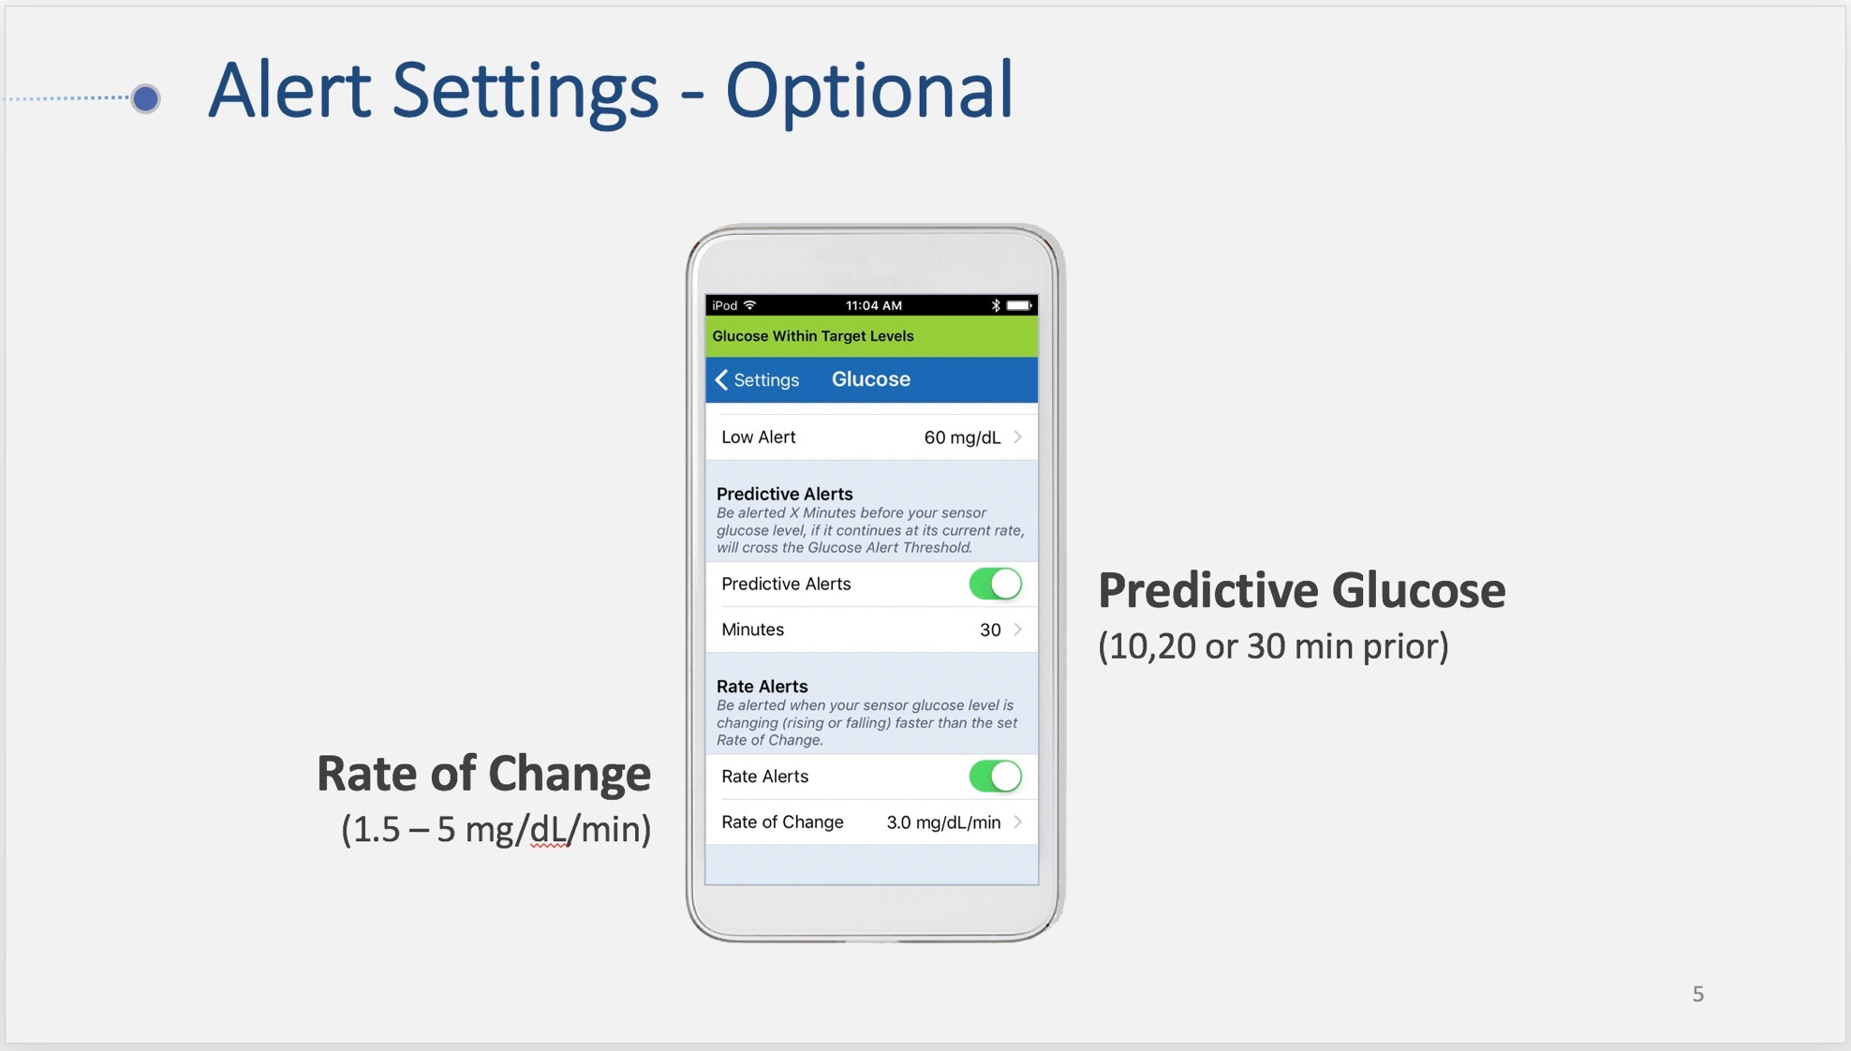

Slide 6
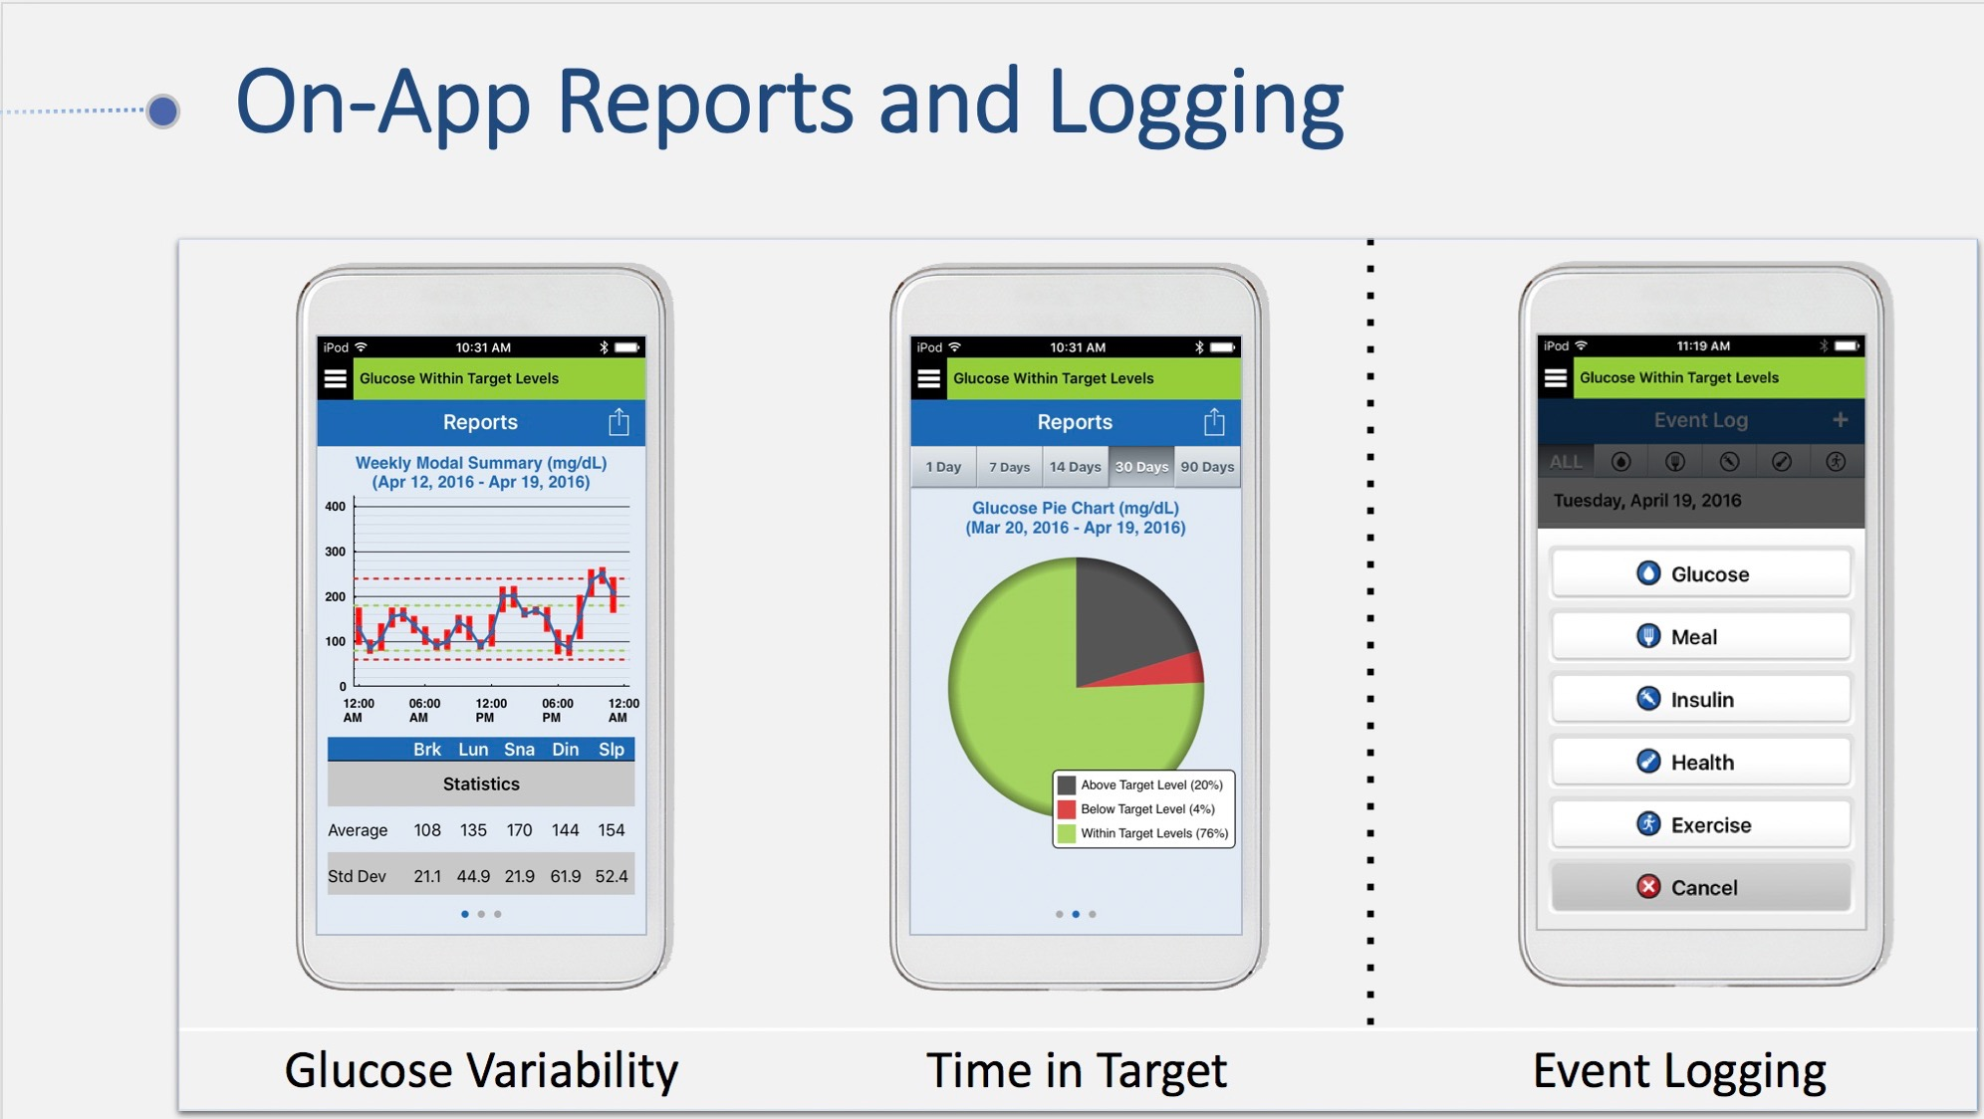
Notes:
Preformatted glucose summary reports available directly on the app. Can show 1 – 90 day reports.

Slide 7
