Slide 1
IMPLANTABLE CGM
A review of the new Eversense CGM System
Name
Title
Date

Slide 2
AGENDA
Current State of CGM
Implantable Medical Devices
The Eversense® System
Sensor Procedure
Clinical Performance

Slide 3
Review of CGM Successes
Reduction of A1c
Reduction in the risk of hypoglycemia
Studies across multiple patient populations
Benefit is directly proportional for frequency of use
Can be synergistic with benefits associated with insulin pumps
Can be cost-effective
Single digit accuracy
Rodbard, D. Continuous Glucose Monitoring: A Review of Successes, Challenges and Opportunities. Diabetes Tech & Therapeutics; 18(2); 2016

Slide 4
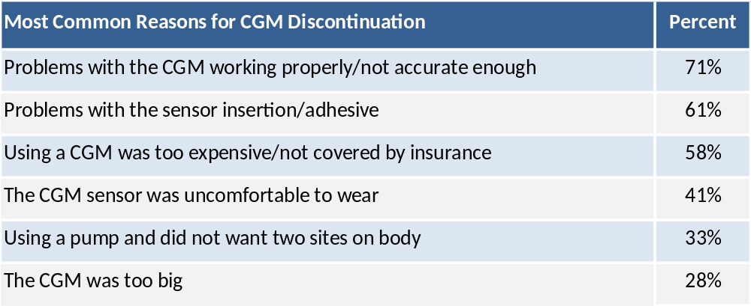
CGM Adoption - T1D Exchange
Why Do Some People with T1D Stop Using CGM?
2016 Apr; https://t1dexchange.org/pages/why-do-some-people-with-t1d-stop-using-a-pump-and-cgm
Notes:
Despite progress, the currently available CGM systems are only used by a small minority of people who could benefit from them such as people with type 1 diabetes and people with type 2 diabetes on intensive regimens using insulin. Currently Less than 10 % of the people with Type 1 diabetes utilize CGM as a tool in the management of their diabetes (Wong, 2014). Utilization in Type 2 diabetes is significantly lower than that of Type 1 even though many could benefit from its use. One limitation is the requirement for repeated, frequent transcutaneous insertion of a Sensor by the patient. In addition, fatigue of use and the complexity of long-term use adds to the sub-optimal use and adherence. Discomfort, issues with sensor insertion, and skin irritations with other systems are also reported, and may lead to discontinuation and low utilization .
In a survey assessing CGM device utilization, 41% of participants discontinued use in the first year due to discomfort when wearing the CGM system. They cite the following reasons for discontinuing:
(see above)
An additional limitation is related to the transmitter unit. For the currently approved systems, the transmitter unit cannot be temporarily removed without also removing and replacing the sensor. Thus, patients are tethered to the transmitter unit.

Slide 5
CGM – An Implantable Option

Slide 6
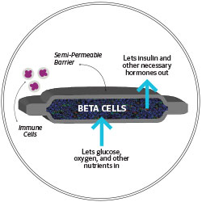
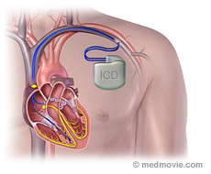
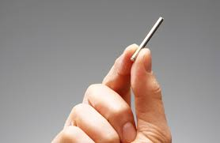
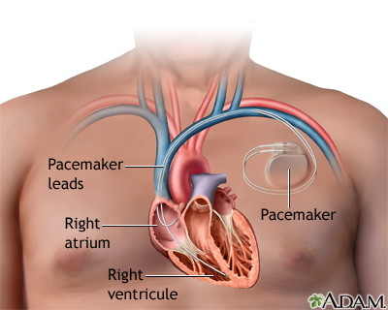
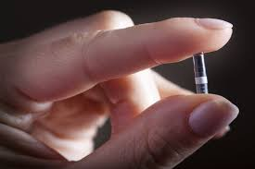
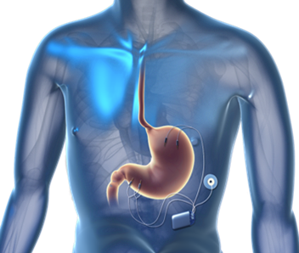
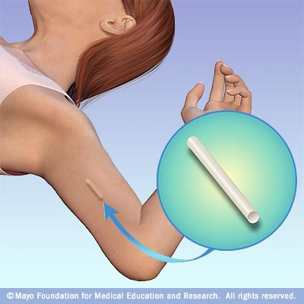
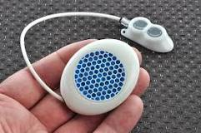
Implantables – Current and Future
Unique to Diabetes
Commonplace
viacyte.com
www.intarcia.com
www.renfrewgroup.com
www.eversensediabetes.com
Notes:
Many diabetes patients are already receiving the benefit of commonplace implantable medical devices – cardiac defibrillators, pacemakers; and many endocrinologists are already familiar with the procedure for implanting long term contraceptive devices.
Diabetes – like all other areas of medicine – is experiencing a growth in implantable treatments:
Gastric stimulators – use increasing for gastroparesis
Intarcia – product is ITCA 650 - continuous subcutaneous delivery of exenatide. Currently in Phase III trials.
ViaCyte – produce is PEC-Direct and PEC-Encap - stem cell‐derived betacell replacement therapies. Currently in various phases of pre-clinical and Phase I/II trials.
De Montfort University (UK) - product is InSmart. Implanted into the peritoneal cavity will automatically release the correct amount of insulin in response to varying blood sugar levels. The ‘artificial pancreas’ is currently in prototype form and undergoing pre-clinical trials.
Senseonics – product is Eversense (CE mar in Europe) – long-term implantable glucose sensor and CGM system. Currently PMA with the FDA.

Slide 7

An Implantable Long-Term Wear CGM
mg/dL
Sensor Continuous Life
Notes:
In diabetes technology, implantable leads to a long-term continuous glucose monitoring.
Where instead of 7 days with 1 sensor, patients can now see single sensor use lasts up to 90 days.

