Slide 1
The Answer:
Structure provided by
Health and Disease Management
Programs

Slide 2
Health and Disease Management
System of care integrating an evidence-based best practice approach to care in a comprehensive manner
A clinical improvement process aimed at insuring that the best practices known to medical sciences are incorporated and applied with minimal variation over the entire continuum of care
Includes prevention, early diagnosis, optimal acute and chronic treatment

Slide 3
Disease Management Principles
1. Physician Standard's / Process of Care
Triage/Stratify Risk
3.Education
4.Establish Outcomes to follow

Slide 4
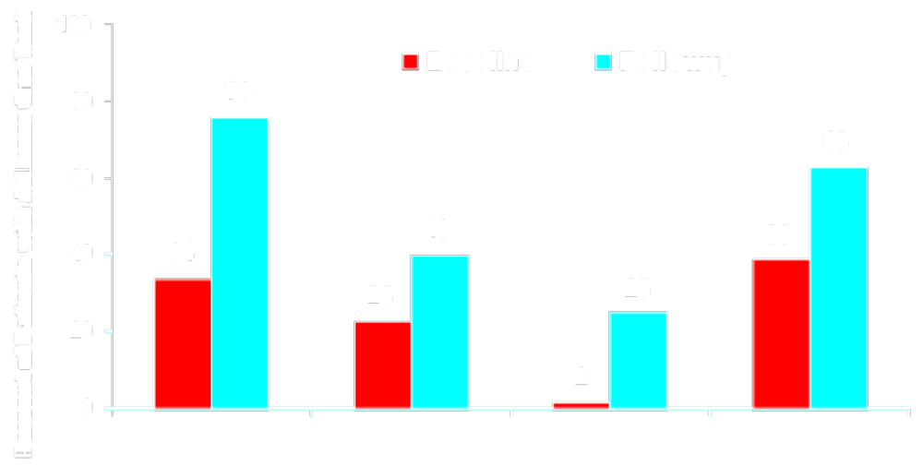
Improved Processes of Care with Structured Program
HbA_{1c} Dilated Eye Exam Foot Exam Cholesterol
Measurement Measurement
Rubin et al. JCEM 83:2635-2642. 1998.

Slide 5
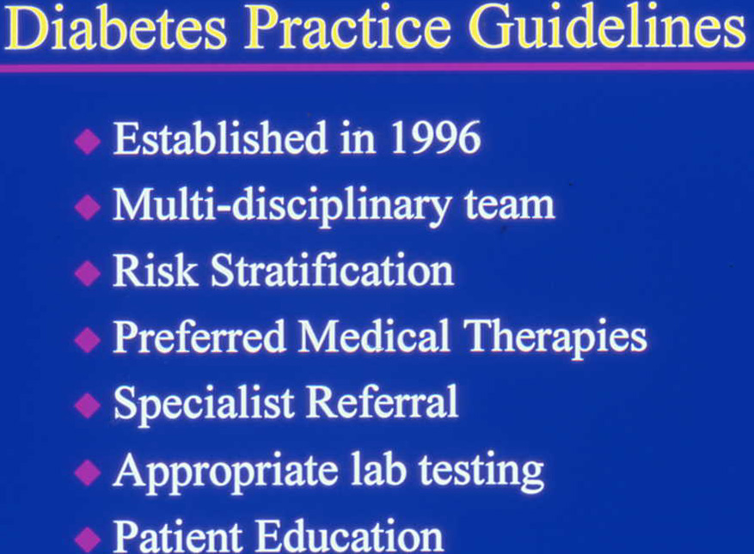
University of Pennsylvania Health System

Slide 6
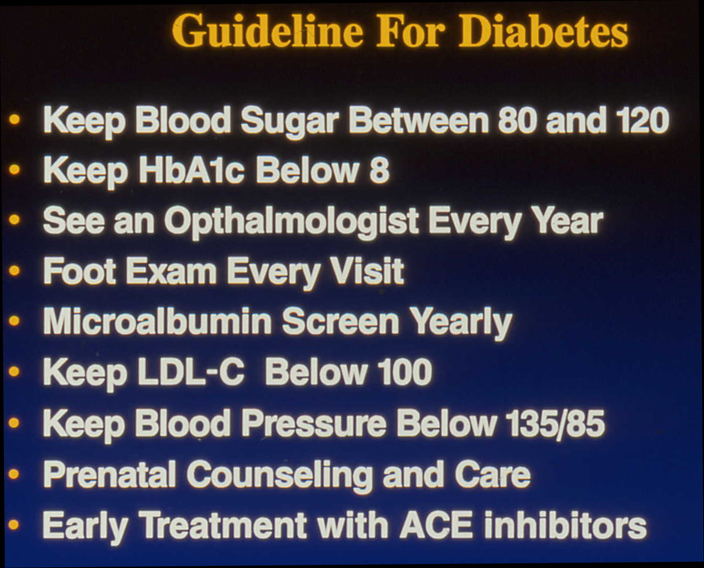

Slide 7
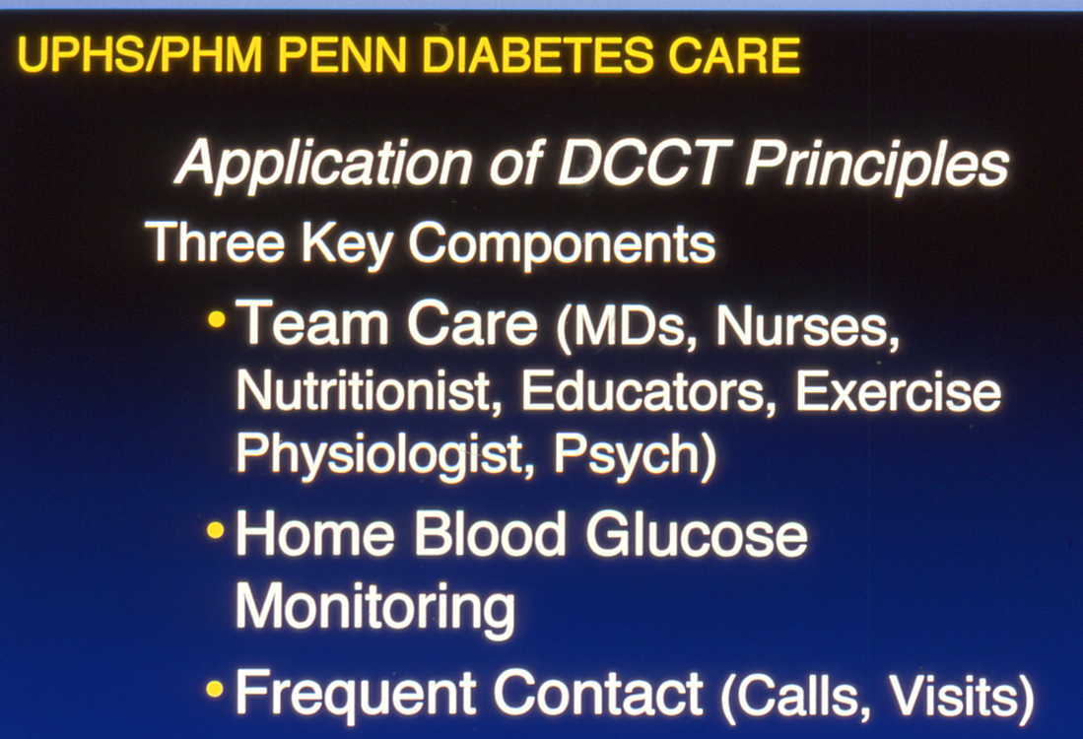
But seeds of cost failure may have been laid here

