Slide 1
Conundrum:
How to Translate Knowledge and Implications of Pathophysiology, Progression and Complications of Diabetes to
Prevention,Early Diagnosis and Optimal Treatment of Diabetes and its Complications…….

Slide 2
Especially when One looks at the:
Reality of Diabetes Care Practices, USA

Slide 3
Diabetes in the United States
15.6 million individuals with diabetes (~7.8% )
    >30% of individuals > 60 yrs have DM or IFG
    Only ~ 2/3 are diagnosed and under Rx
    Only ~ 5.1 million are appropriately treated
    Less than 8% are under the care of an endocrinologist or diabetologist -
    and we can’t take care of them all
Harris. Ann Int Med. 1996; 124:117

Slide 4
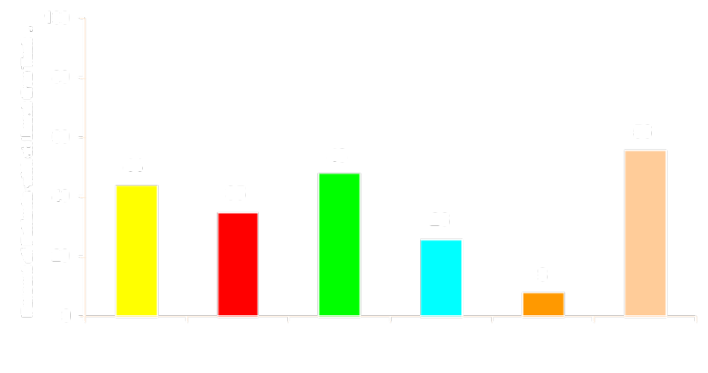
Diabetes Care in an HMO Setting
Frequency of Assessment
HbA1c FPG Urine Prot Eye Exam Foot Exam Chol
Peters AL et al. Diabetes Care. 1996;19:601-606.

Slide 5
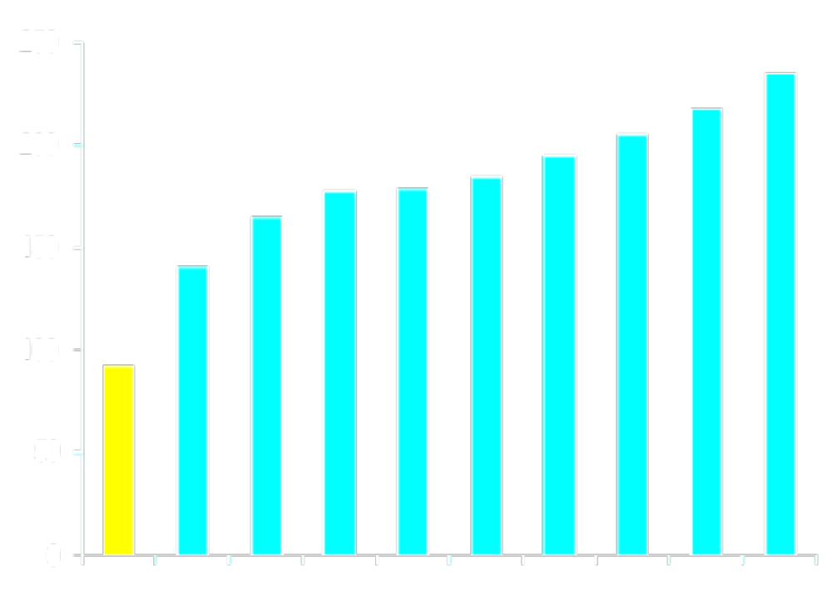
Mean FPG in Type 2 Diabetes - USA Community Studies
13.9
11.1
Mean
FPG
(mg/dL)
8.3
Mean
FPG
(mmol/L)
5.6
2.8
0
Non
Diab
9 Studies of Diabetic Populations in USA
Diabetes in America 1995.

Slide 6
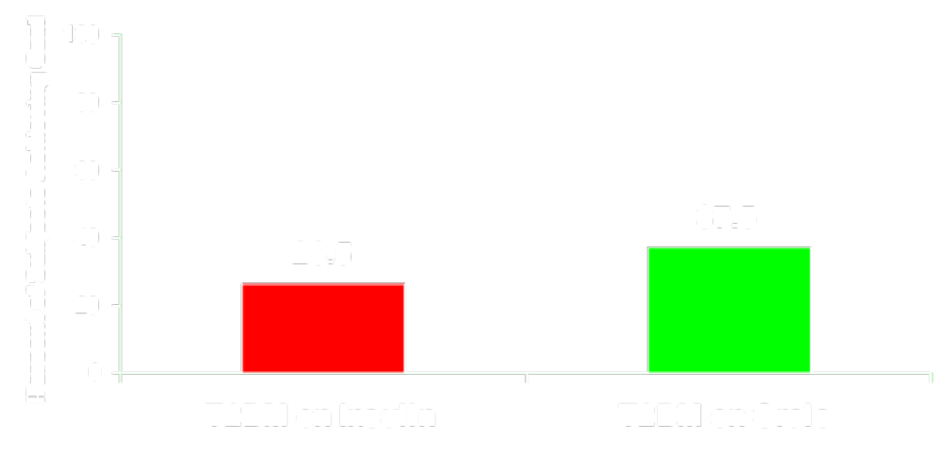
Glycemic Control in A Population Based Sample of Type 2 Diabetes
NHANES III Sample: 1480 People with Type 2 Diabetes
% Achieving ADA Goal of HbA_{1c} < 7.0%
Harris et al. Diabetes Care. 1999;22:403.

