Slide 1
Diabetes Risk Scores
Prediabetes Screening and Monitoring

Slide 2
Finnish Diabetes Risk Score (FINDRISC)
Risk assessment tool based on random samples of patients 35-64 years of age, followed for 5 years
  1987 cohort (n=4746)
  1992 cohort (n=4615)
Score range: 0-26
  Score ≥9 predicts development of drug-treated diabetes within 10 years
    Sensitivity 0.81 (1992 cohort)
    Specificity 0.76 (1992 cohort)
    Predictive value = 0.05 (1992 cohort)
Lindstrom J, Tuomilehto J. Diabetes Care. 2003;26:725-731.

Slide 3
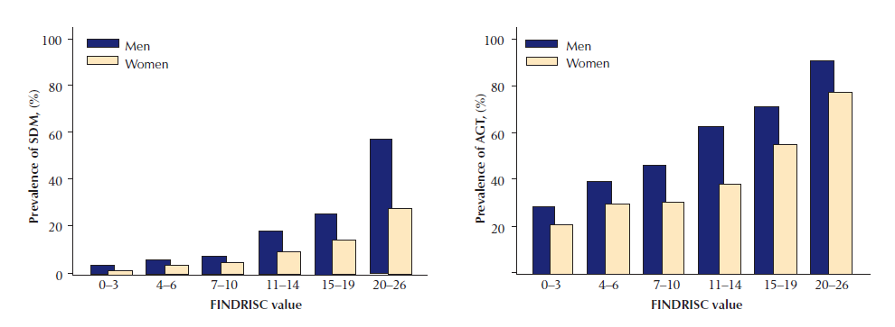
FINDRISC Scores and Abnormal Glucose Tolerance
Prevalence of Diabetes and Abnormal Glucose Tolerance in Finnish Population (N=4622)
Diabetes prevalence (%)
AGT prevalence (%)
AGT, abnormal glucose tolerance; FINDRISC, Finnish Diabetes Risk Score.
Saaristo T, et al. Diabetes Vasc Dis Res. 2005;2:67-72.

Slide 4
Finnish Diabetes Risk Score (FINDRISC)
Question | Score
Age (years)
45-54 | 2
55-64 | 3
≥65 | 4
BMI (kg/m²)
25-30 | 1
≥30 | 3
Waist circumference (cm)
94-102 (men), 80-88 (women) | 3
>102 (men), >88 (women) | 4
Physical activity, <30 min per day
No | 2
Consumption of vegetables and fruit
Not every day | 1
Question | Score
Hypertension medication
Yes | 2
History of blood glucose elevations
Yes | 5
Family history of T1 or T2DM
2nd degree relative | 3
1st degree relative | 5
Total (maximum) | 26
Total Risk Score | Risk of developing T2DM in 10 years
<7 | 1%
7-11 | 4%
12-14 | 17%
15-20 | 33%
≥20 | 50%
Finnish Diabetes Association. Available at: http://www.diabetes.fi/files/1100/Type2diabetesRiskTest_.jpg.

Slide 5
ADA Diabetes Risk Score
Risk assessment tool based on NHANES 2006 cohort ≥20 years of age (N=5258) and validated with ARIC and CHS cohorts (N=19,728 combined)
Score range: 0-10
  Score ≥5 predicts undiagnosed T2DM
    Sensitivity 0.79
    Specificity 0.67
    Predictive value = 0.10
ARIC, Atherosclerosis Risk in Communities; CHS, Cardiovascular Health Study;
NHANES, National Health and Nutrition Examination Survey.
Ban H, et al. Ann Intern Med. 2009;151:775-783.

Slide 6
ADA Risk Scores and Prevalence of Undiagnosed Diabetes
Undiagnosed diabetes prevalence (%)
Diabetes risk score
AGT, abnormal glucose tolerance; ARIC, Atherosclerosis Risk in Communities; CHS, Cardiovascular Health Study; NHANES, National Health and Nutrition Examination Survey.
Ban H, et al. Ann Intern Med. 2009;151:775-783.

Slide 7
ADA Diabetes Risk Score
Question | Score
Age (years)
40-49 | 1
50-59 | 2
≥60 | 3
Sex
Male | 1
Woman with history of gestational DM | 1
Family history of T1 or T2DM
1st degree relative | 1
Hypertension diagnosis
Yes | 1
Question | Score
Physical activity
No | 1
BMI
25-30 | 1
30-40 | 2
≥40 | 3
Total (maximum) | 10
Total Risk Score | Risk of developing T2DM in 10 years
≥4 | High risk of having prediabetes or diabetes
≥5 | High risk of having diabetes
Ban H, et al. Ann Intern Med. 2009;151:775-783.
American Diabetes Association. Available at: http://www.diabetes.org/assets/pdfs/at-risk/risk-test-paper-version.pdf.

