Slide 1
Rules:Reminders
1. Process measures HgA1c ,eye exam
2. Lipid panel /urine microalbumin
3. If BP > 130/80, consider therapy
4. If LDL >100 or TG >150, or HDL <40 male/<50 female,
consider therapy
5. If urine microalbumin >30 mg/ mg Cr, consider therapy
6. Not on aspirin therapy, please consider

Slide 2
Rules to Prevent Errors of Commission
1. Metformin and Creatinine, or Cr clearance <70 or age >70
2.Metformin and CPT codes for liver disease, cirrhosis, hepatitis
3. Metformin and CHF- (message- inc risk lactic acidosis)
4.Metformin and order for radiologic study with Iodine contrast
5.Sulfonylureas/insulin rx and increase cr >.5 between visits or in 1 year (message inc. risk of hypoglycemia)
6. Pioglitazone/rosiglitazone and CPTs for venous insufficiency, CHF,nephrotic syndrome, edema
7. Pioglitazone/rosiglitazone and drugs COX-2 inh., NSAIDS, b-blockers, Ca+ channel blockers

Slide 3
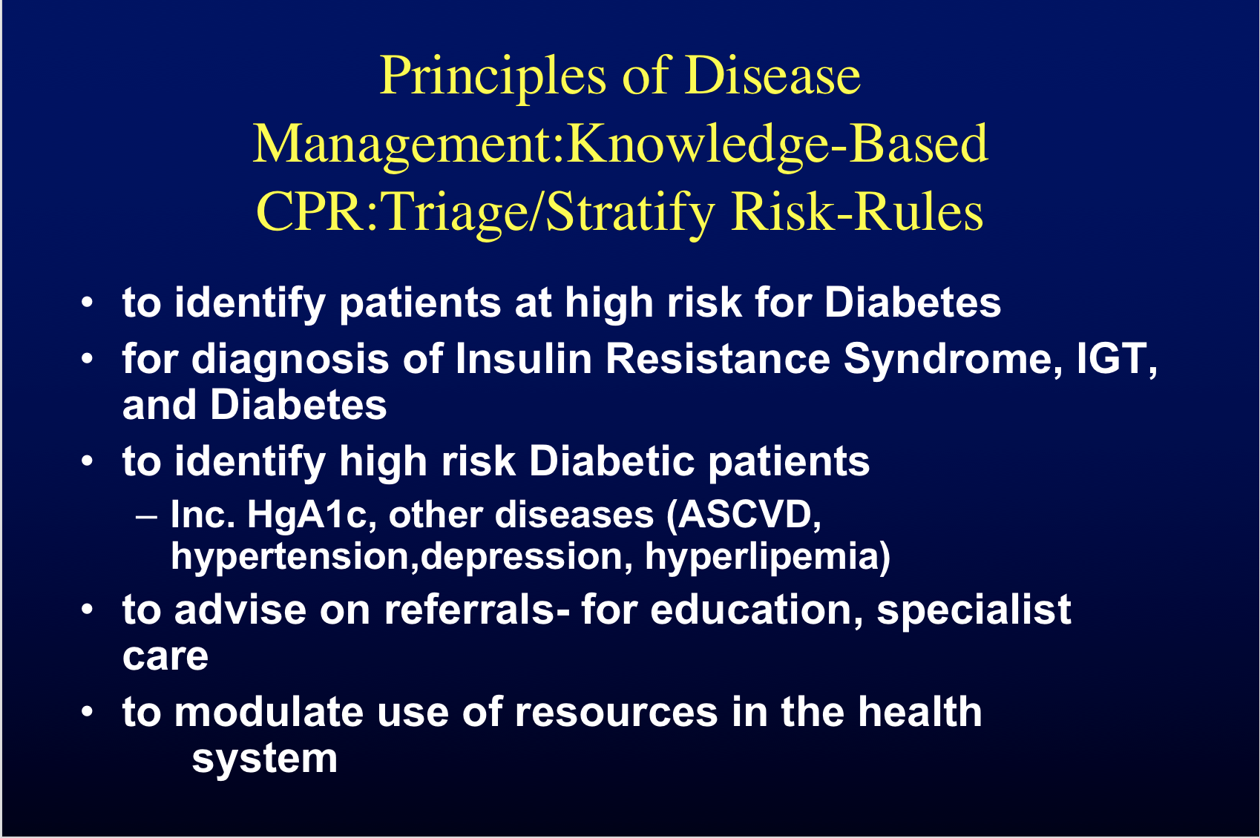

Slide 4
Principles of Disease Management:Knowledge-Based CPR:Triage/Stratify Risk
Triage Rules can run- Eliminate or Minimize Need for a Triage Center
Rules for Stratification - can be modified to modulate resource utilization (case managers, education programs)
Computerization of case manager work flow-managing their patient list
  scheduling appointments for referrals, education
  (1-on-1, classes for patient)

Slide 5
Principles of Disease Management: Knowledge-Based CPR: Education
MDs- links to on-line CMEs; on-line lectures; slide shows; Pubmed; guidelines (Cochrane, etc.)
Nurses, Case managers- ditto
Patients- patient-specific Web-page- general information, push technology based on rules and their own history (system reads discrete data from CPR and push patient-specific content to their personal site)

Slide 6
Principles of Disease Management:
Patient Interaction with KNOWLEDGE-BASED, OUT-PATIENT COMPUTERIZED PATIENT RECORD SYSTEM-
Patient Interaction
MD, Case manager, Nutritionist, Nurse Educator, other Health care providers
Person-person, telephone, fax
E-Health Portal- (EPICs ‘My Chart’)

Slide 7
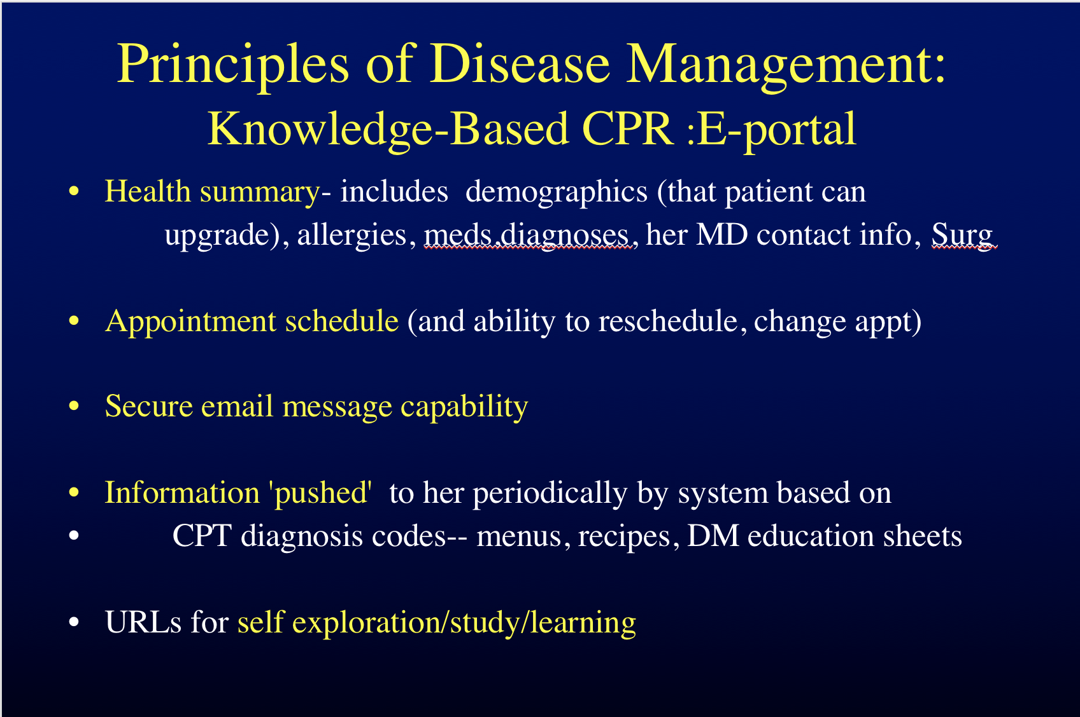

Slide 8



Schedule for Dec 14, 2002
Health Library
Electronic Medical Record
Message Center
Test Result
From: HUP Medical Lab
Rec: Dec 14, 2002 / 12:30 pm
Here are the results from your
appt this morning
6am
7am Take Aspirin
8am Yoga
9am Appt: Dr. Schwartz
10am
11am Blood Test
.
.
.
+ Add Scheduled Event
Daily
- Disease Info
- Drug Info
Events/Seminars
- Online Chats
Websites
- WebMD
- CNN Health
Archived Content
- Clinical Trials
- Research on Diabetes
+ Add Library Item
Personal Information
My Medication
My Results
My Lifestyle
Medical History
T
M
L
L
M
T
View Result
Add to EMR
Vital Sign Tracking
Appt Request
From: Randy Taylor
Rec: Dec 14, 2002/ 4:00 pm
Please confirm an appt for
next Tuesday at 12 noon
Medications +Add
M
Blood Pressure
Blood Glucose
Add to Schedule
Task List
Tests +Add
T
View Encounter Prep
Today (Dec 14, 2002)
☑ Call Trainer
This Week
◻ Call Lab
☑ Get Tenormin Refill
+ Add Task
Lab Test Results
Home Test (Insulin)
Info Request
From: Dr. Schwartz
Rec: Dec 12, 2002 / 10:00 am
Please provide glucose self -test
results below and send.
L
T
T
Lifestyle +Add
L
M
Calorie Chart
Exercise Charts
Test 1:
Test 2:
Test 3:
☑ add to EMR
Send Info
My Health Providers
Account Manager
Dr. Schwartz Primary Care
Dr. John Smith Specialist
Dr. Debra Jones Specialist
Randy Taylor Physical Trainer
+ Add Provider
Password
Access Levels
Preferences
Reference Material
From: HUP Diabetes
Rec: Dec 11, 2002 / 12:30 am
Read about Pfizer’s new
Diabetes Drug
M
Add to Health Library

Slide 9
Principles of Disease Management: Knowledge-Based CPR: Evaluation
Evaluate defined process/outcome measures= report generator
Administrative Decision Support
  Tells us where/how to redirect resources cost-effectively
  Suggests where new innovation/emphasis needs to be applied to achieve desired outcomes

Slide 10
Episode Scenario
Patient- in office- fills out interval hx. Form- Discrete data capture
MA- checks form, vital signs, fingerstick sugar- Records data
MD-opens chart- Rules fire for reminders, safety (metformin-recent Cr 1.6)- option to look at guidelines data= Education
MD- fills out Hx, PE form-Discrete data capture
MD- requests or Dynamic Decision Support fires offering recommended therapy
MD- safety rules fires as orders TZD (CHF)
MD- triage rules fire as closes chart
Patient- home- E-WEB portal use- report sugars-reviews chart-schedules- reviews/searches for information re:diagnoses,care- patient education, reminders sent to patient (less obtrusive to MD)

Slide 11
Other Uses
Research capabilities
Process and Outcome measure Review
Potential Increased payment (Leapfrog, etc)- Pay for Performance
(Non-Threatening) MD Compliance
Universal Health Record

Slide 12
Challenges
Enough rules to get improved outcomes vs too many that MDs complain= # of rules
‘Forced’ vs. ‘unforced’ reminders
Get / keep MD ‘buy-in’- make system ‘seamless’ as possible- (part of a ‘natural’ work flow)
When to show the alerts during the MD- patient-computer interaction
Where to set HgA1c triage’ rule for 1-on-1 case manager help- cost/benefit
Dynamic decision support effort will be great

Slide 13
Summary
Chronic Diseases (such as Diabetes) carry significant morbidity, premature mortality, cost (to patients, third-party players, society)
Best practices , for purposes of safety and improved outcomes, are difficult to keep abreast of and implement in busy practices
Disease Management principles have proven efficacy in improving outcomes, but there is still significant room for improvement and they are costly
Decision support, using principles of Disease Management , in an Integrated Computerized Patient Record, are likely to have major further improvement in outcomes in patients with Chronic Diseases such as Diabetes Mellitus

