Slide 1
Principles of Disease Management: Physician View (paper-based)
in office documentation- patient risk questionnaire,H&P form/guide (focused materials increase efficientcy) eg:
Reminders to MDs- for elements of history, physical exam, lab,treatment plan elements
guidelines- drugs, referrals, recognition/care of co-morbidities
Monitor and compare performance to peers

Slide 2
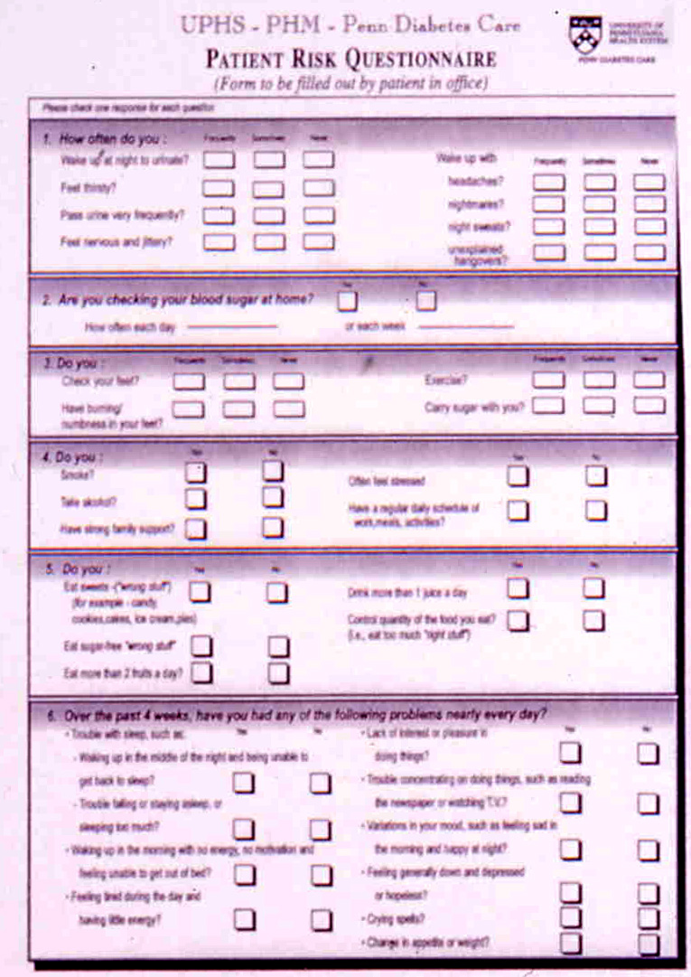
Sx’s hyper-,hypoglycemia
Glucose monitoring
Diet, exercise, ETOH, smoking
Depression sx’s

Slide 3
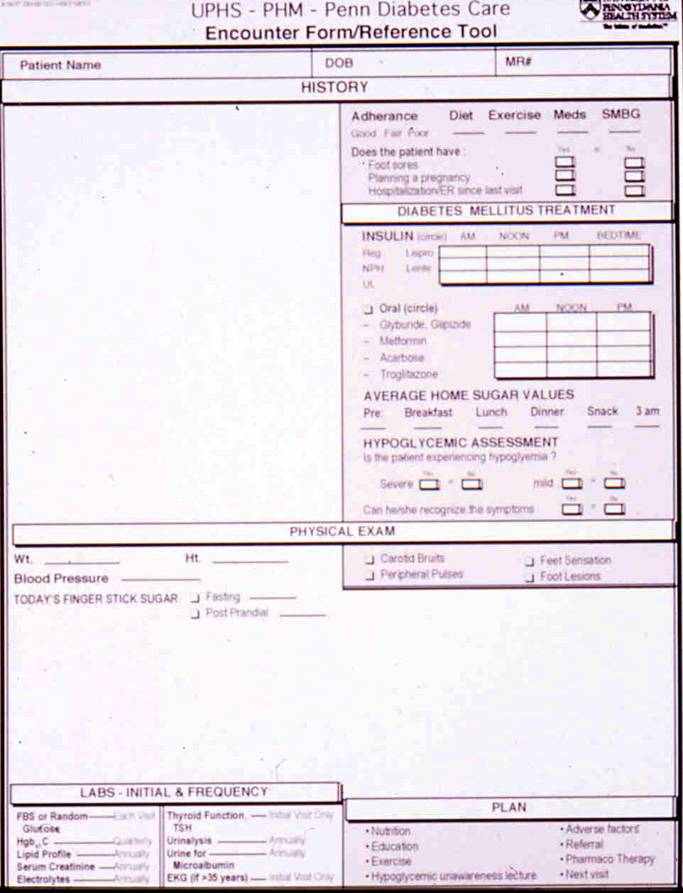

Slide 4
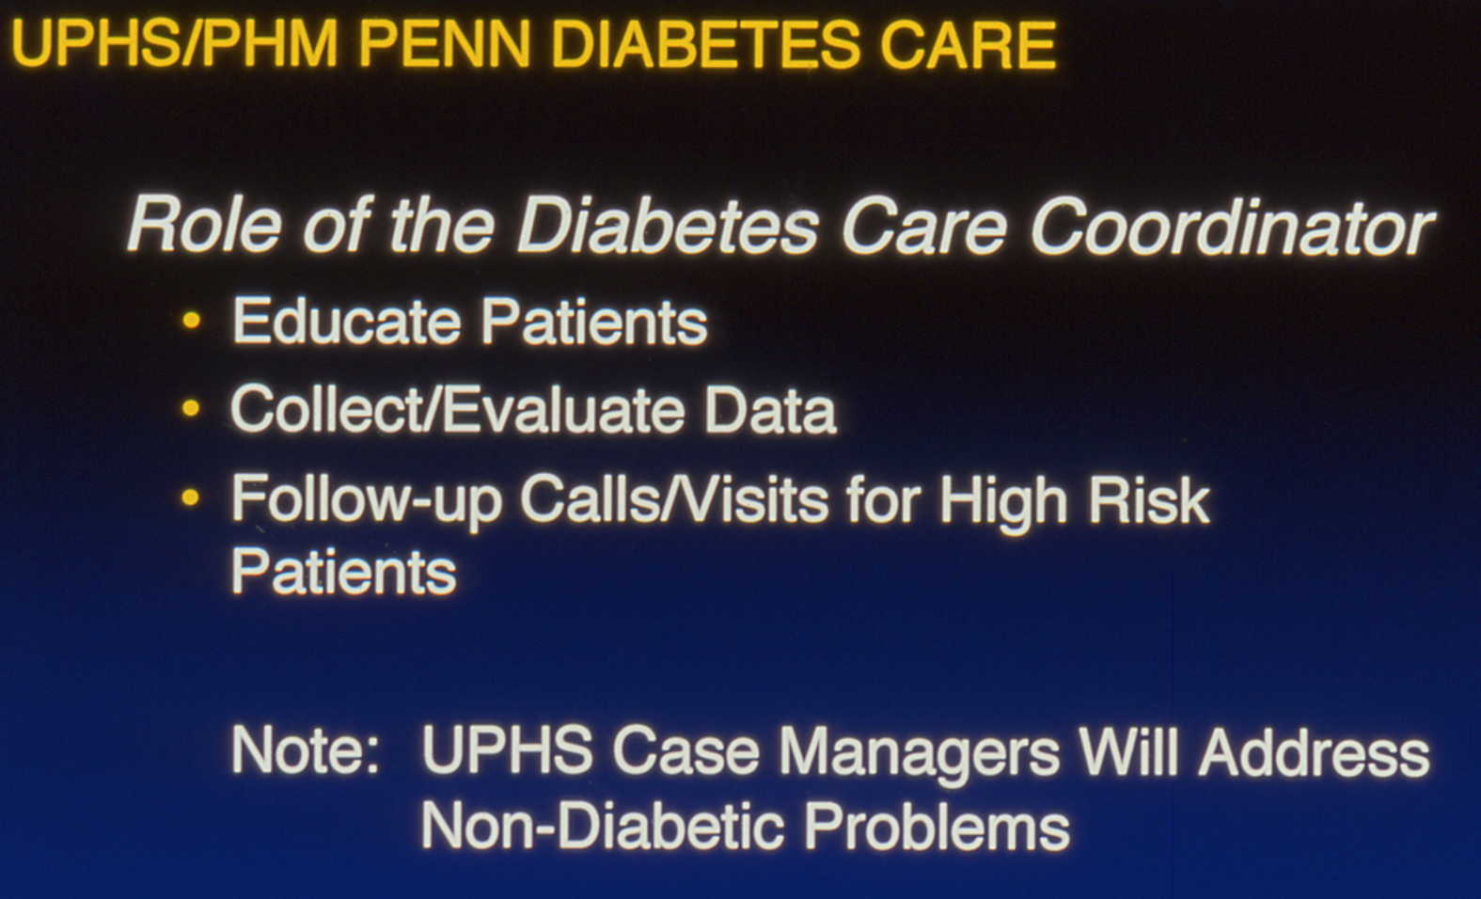
eg: Triage center integrated multiple disease management programs, at a cost

Slide 5
Principles of Disease Management: Triage/Stratify Risk
Triage center:
  based on DM Disease Management Program Referral Guidelines-
  based on call from MD for urgent referrals -
  center’s review of data after MD selects 'enroll' on encounter sheet
a.nml risk- 'routine education',classes
b. adverse factors- specific care- eg:bp, lipids, cardiac etc
c. High risk- HIGH RISK Program- one-on one,
    follow up calls

Slide 6
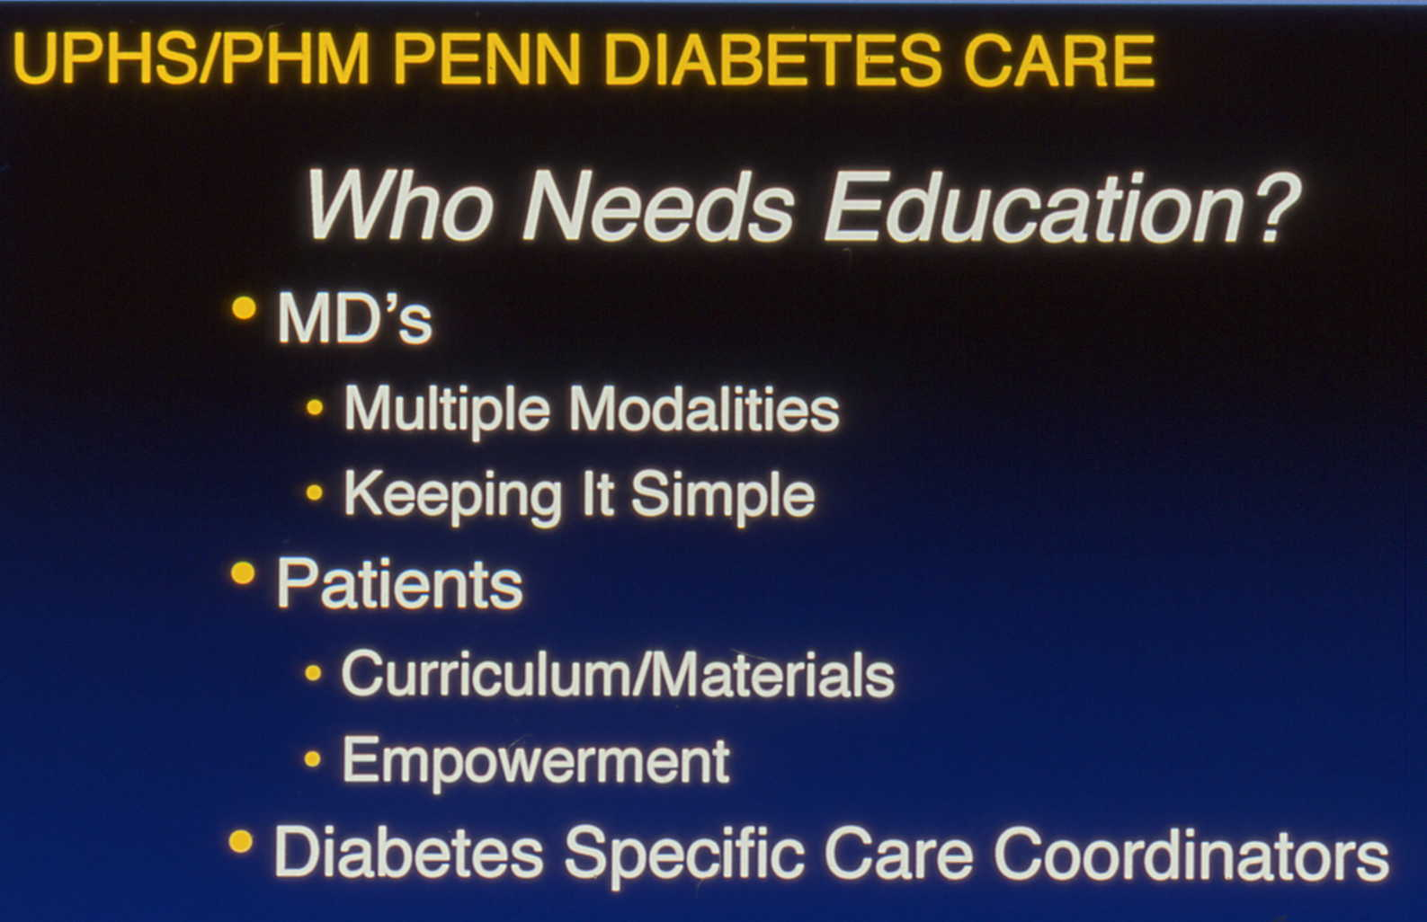

Slide 7
Principles of Disease Management:
Patient Interaction with System
MD, Case manager, Nutritionist, Nurse Educator, other Health care providers
Person-person, telephone, fax

Slide 8
Principles of Disease Management: Establish Outcomes to Follow
Process outcomes
Clinical result outcomes- eg: HgA1c, BP, Microalbumin, Lipids
Establish goals of program - ie- how many patients achieve process / outcome goals
Create monitoring/reporting mechanism

Slide 9
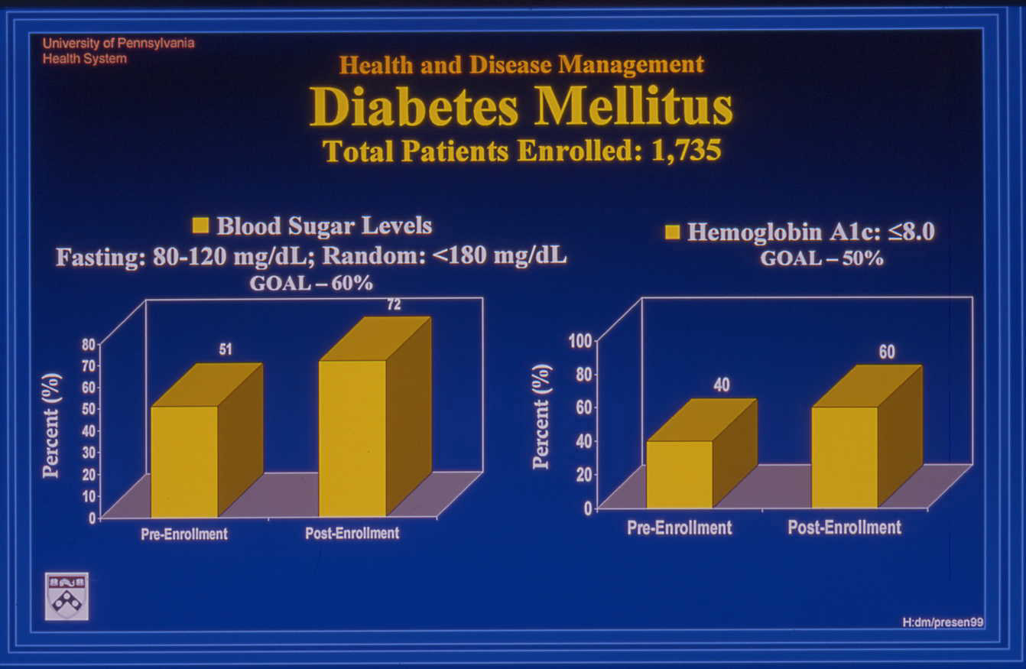

Slide 10
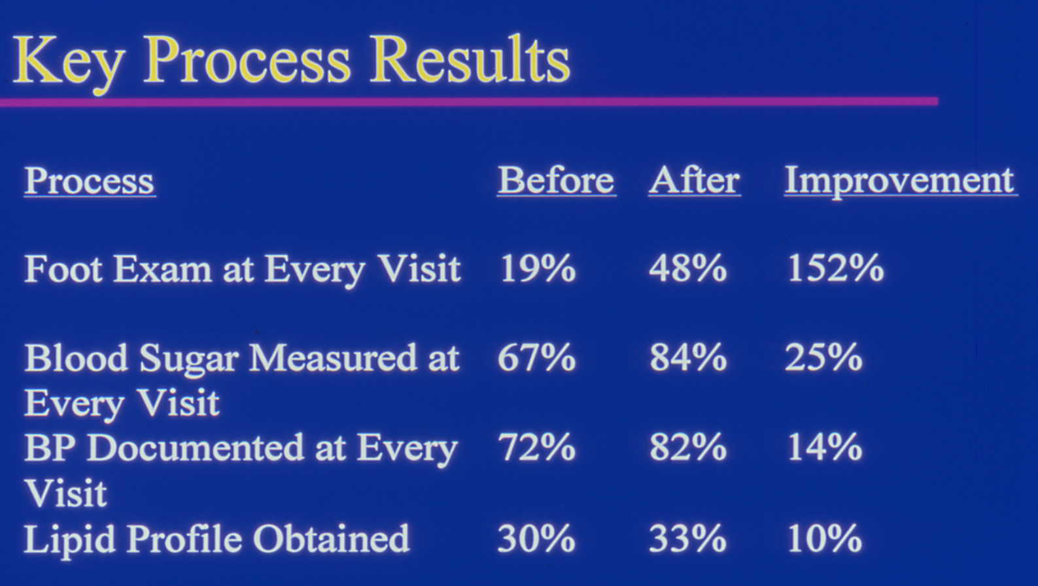

Slide 11
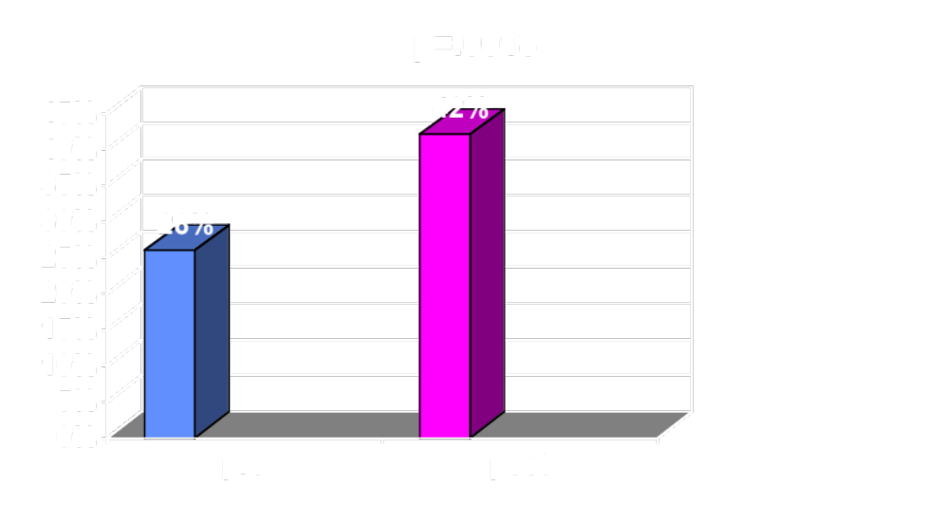
Percent of Patients at Target BP Goal (<135/<85), initial cohort (n=121)

Slide 12
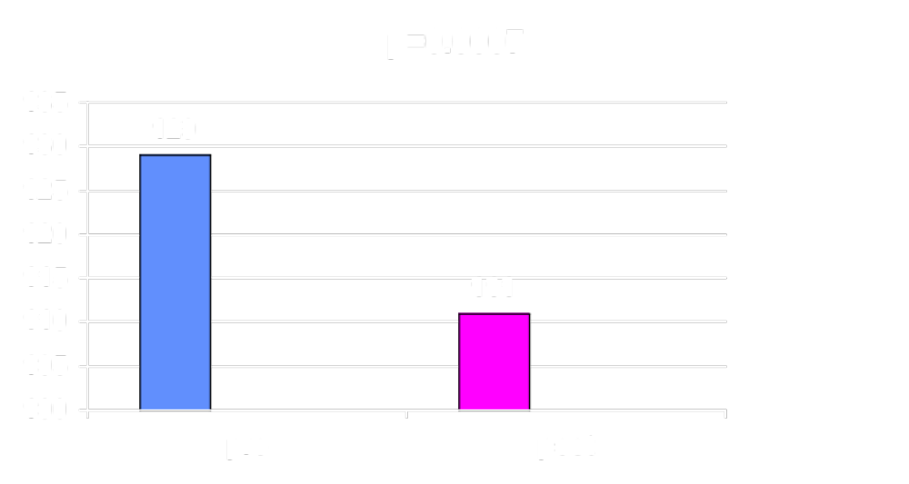
Mean LDL Concentrations (Target<100mg/dl), initial cohort (n=121)

Slide 13
