Slide 1
Natural History of Type2 Diabetes:
Implications for Prevention,
Progression
Age 0-15 15-40+ 15-50+ 25-70+
Genes
Envir.+ Other Disease
Macrovascular Complications
Insulin Resistance
Obesity
Poor Diet
Inactivity
IR phenotype
Atherosclerosis
obesity
hypertension
↓HDL,↑ TG
Endothelial dysfunction
PCO
Disability
MI
CVA
Amp
IGT Type II DM
DEATH
↓ Beta Cell Secretion
Blindness
Amputation
CRF
Eye
Nerve
Kidney
Risk of Dev. Complications
ETOH
BP
Smoking
Disability
Microvascular Complications

Slide 2
Type 2 Diabetes Is a Progressive Disease
Often present for >5 years prior to diagnosis-implications for PREVENTION and SCREENING
Patients may present with diabetic complications- implications for PREVENTION and SCREENING
Incidence of microvascular and macrovascular
complications increases with time-GLYCEMIC CONTROL can decrease risk
Progressive hyperglycemia is typical (NATURAL HISTORY) and requires increasing therapeutic intervention (MANAGEMENT)
Treating DM,inc. BP, Lipids decreases CV outcomes 50% ,Steno 2 (MANAGEMENT)
2
Notes:
The UKPDS confirmed that type 2 diabetes is a progressive disease with an occult onset. People who develop type 2 diabetes often have few or no symptoms. Impaired fasting glucose with glucose levels just above normal—under 126 mg/dL but above 110 mg/dL, is followed by impaired glucose tolerance, and then frank diabetes.
Patients may actually present with complications. In the UKPDS, 20% had retinopathy when diabetes was first diagnosed.
The incidence of microvascular and macrovascular complications increases with time.
Finally, hyperglycemia is progressive and requires progressive interventions. Polypharmacy and often insulin may be needed to improve outcome.
In other words, a patient with type 2 diabetes may be treated effectively with one drug initially, but with disease progression and loss of beta cell function over time, additional therapeutic approaches to manage the hyperglycemia may be expected.

Slide 3
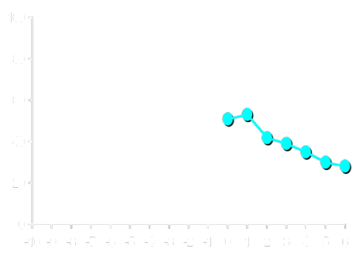
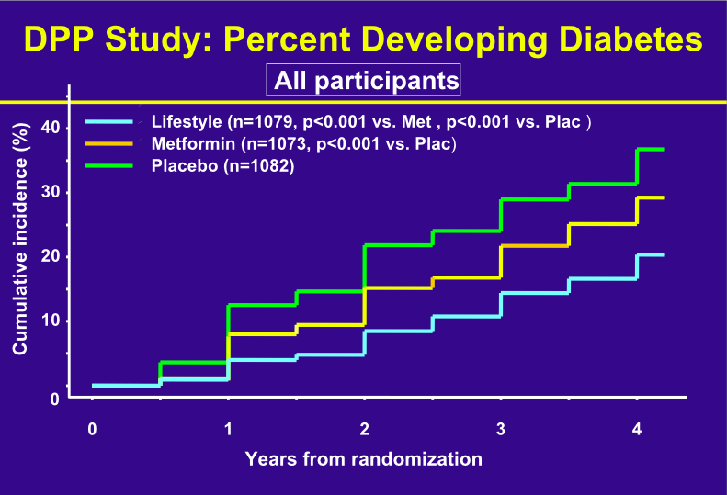
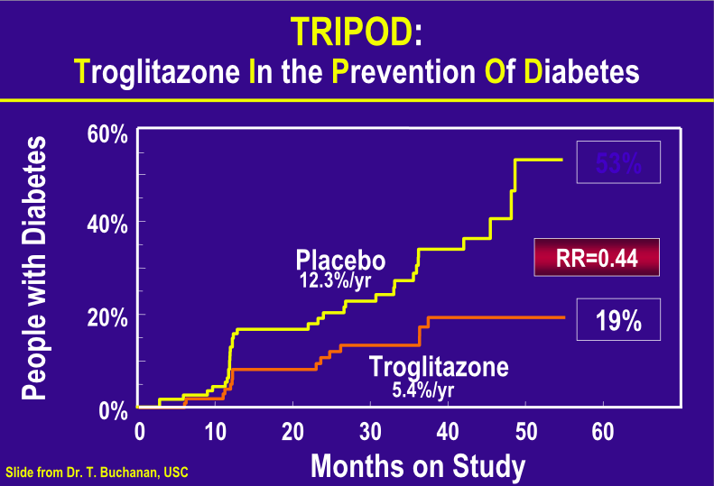
Preserve β-cell Function in Patients with Insulin Resistance Syndrome
Strongly Genetic- yet skips generations
Weight loss:
  50% dec. with 8 Lb. Wt. loss/yr
Exercise- 50% dec. with 20 min,fast walk 3x/wk
Combined weight loss/exercise- DPT-2-58%
Statins--CARE
ACE-Inhibitors--HOPE (ramipril),Captopril
Metformin--DPT-2
Acarbose--Stop NIDDM
Xenical
TZD--TRIPOD,DPT-2

Slide 4
Good Glycemic Control (Lower HbA_{1c})
Reduces Incidence of Complications
DCCT
9 → 7%
63%
54%
60%
41%*
Kumamoto
9 → 7%
69%
70%
–
–
UKPDS
8 → 7%
17-21%
24-33%
–
16%*
HbA_{1c}
Retinopathy
Nephropathy
Neuropathy
Macrovascular disease
* not statistically significant
DCCT Research Group. N Engl J Med. 1993;329:977-986.
Ohkubo Y et al. Diabetes Res Clin Pract. 1995;28:103-117.
UKPDS 33: Lancet. 1998;352:837-853.
4
Notes:
Three independent studies: DCCT (type 1), Kumamoto (type 2-lean), UKPDS (type 2-typical) showed significant benefits of similar magnitude by decreasing HbA_{1c}.
In the DCCT, when all major cardiovascular and peripheral vascular events were combined, intensive therapy reduced the risk of cardiovascular disease by 41%, although this reduction was not statistically significant. The relative youth of the patient cohort made the detection of a difference between treatments unlikely.
The 16% reduced risk incidence of coronary heart disease in the UKPDS had a P value of 0.052, not quite statistically significant.

Slide 5
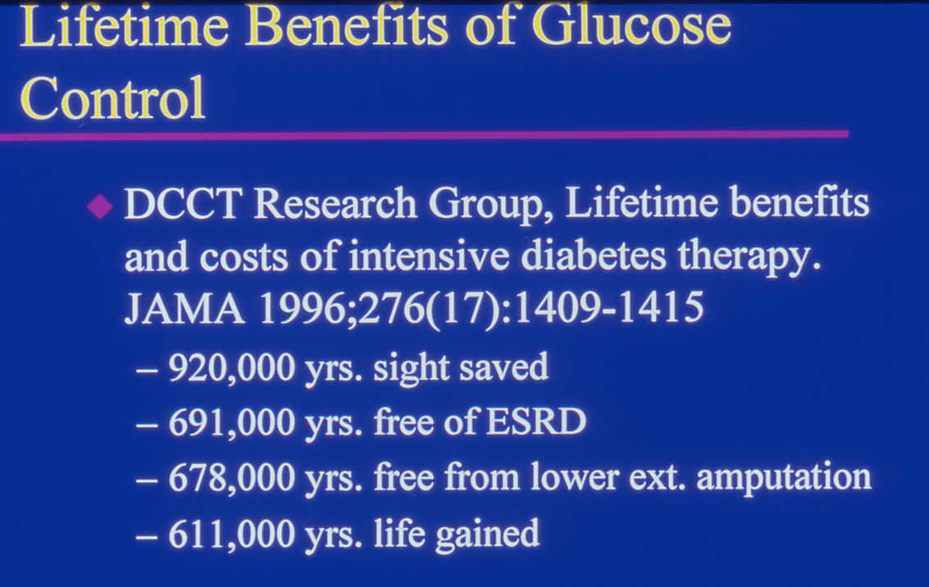

Slide 6
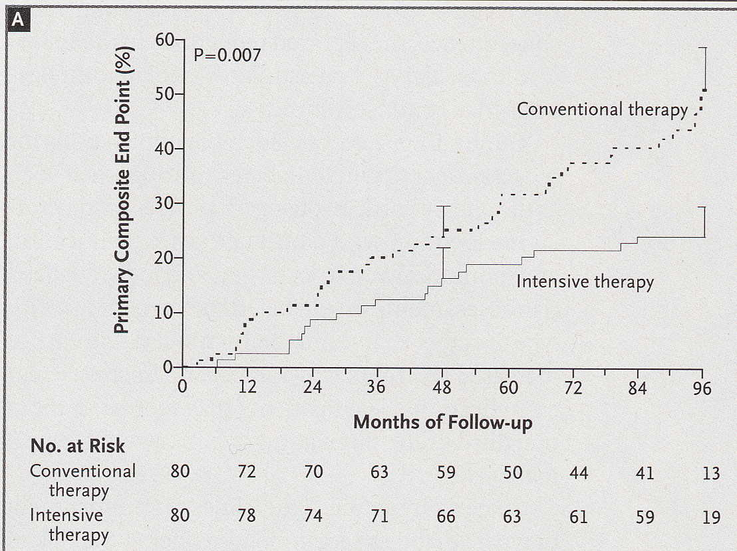
Gaede,NEJM 348:383,2003

Slide 7
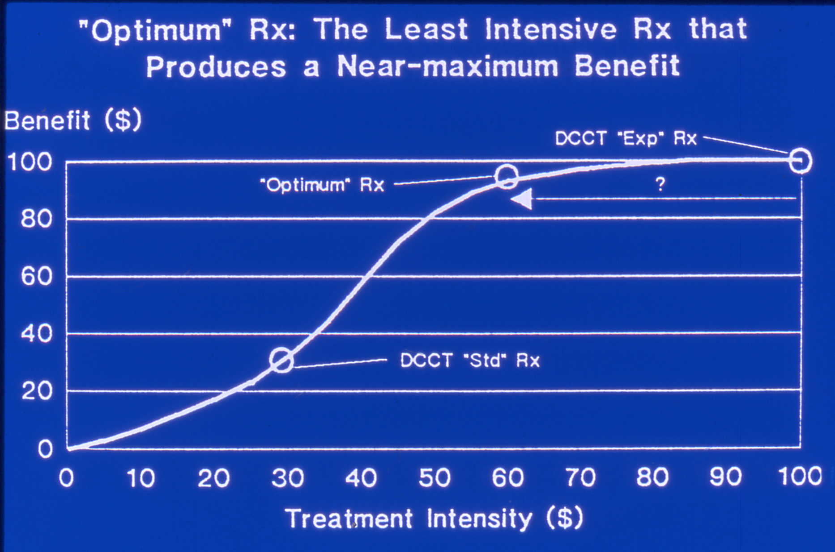
%
of
Pts.
HgA1c

