Slide 1
The Future Use of
Technology in Outpatient Care
Using the Computerized Patient Record to Implement Principles of Disease Management:
Focus on the Diabetes Mellitus Model
Stan Schwartz, M.D.
Clinical Assoc. Professor of Medicine
Department of Endocrinology, Diabetes and Metabolism
University of Pennsylvania, School of Medicine

Slide 2
Burden of Diabetes USA:
Incidence & Prevalence
15.7 Million Americans have diabetes
  Nearly 6% of the population
5.4 Million of these people are unaware they have diabetes
Each year, 798,000 Americans develop diabetes
  2200 each day

Slide 3
Burden of Diabetes USA Costs
1 in every 7 healthcare dollars spent
19% of Medicare population has diabetes, but 30% of Medicare budget spent on diabetes (accounts for CMS interest in Disease Management)
Total costs attributable to diabetes (direct & indirect) estimated at $97 billion in 1997,$132 billion in 2002
Costs greater if have Diabetes complications

Slide 4

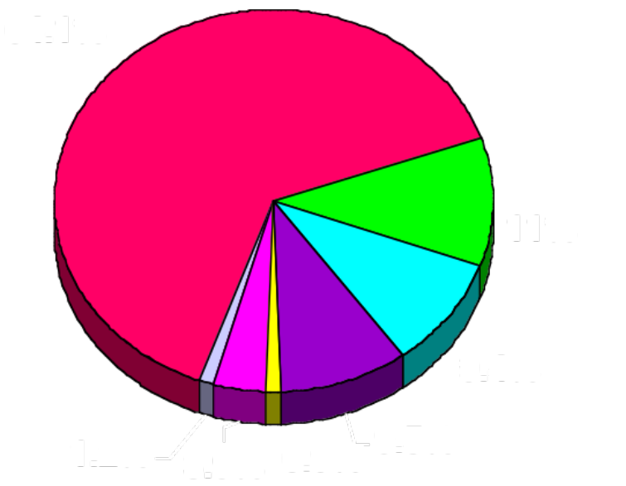
Per Capita Economic Costs by Diabetes Status, 1992,2002
Confirmed Diabetes
Nondiabetes
Total Expenditures per person = $11,157,13,243
in-pt 47.6%
drugs 12.8%
Total Expenditures per Person = $2604,2560
(Rubin RJ et al. J Clin Endrocrinol Metab. 1994;78:809A – 809F)

Slide 5
Burden of Diabetes: Mortality
Mortality: 57,000 deaths directly attributable to diabetes—#7 cause
Mortality: more than 193,000 deaths linked to diabetes—makes it the #3 cause
Death rate in the population with diabetes decreased 9% between 1980 and 1994. However, mortality is still high because of the increasing prevalence of diabetes
Center for Disease Control and Prevention. Diabetes At-A-Glance, 1999.

Slide 6
Morbidity of Diabetes
Major cause of premature death and disability in the US
Leading cause of new cases of blindness
in working-aged adults
50% of nontraumatic lower extremity amputations
35% of new cases of end-stage renal disease
2- to 4-fold increase in cardiovascular risk
Harris MI, In: Diabetes in America. 2nd ed. 1995. Washington, DC: National Institutes of Health; 1995.
NIH Publication 95-1468. pp.1-14.
Wingard DL, et al. In: Diabetes in America. 2nd ed. 1995. Washington, DC: National Institutes of Health; 1995 NIH publication 95-1468.pp. 429-448.
6
Notes:
Diabetes is a major cause of premature death and disability in the US.
–Type 2: 17% of all reported deaths in people ≥25 years of age
–Type 1: 7-12 times that of the general population
Leading cause of new cases of blindness in working-age adults.
Diabetes:
–Contributes to 50% of nontraumatic lower extremity amputations
– Accounts for about 40% of new cases of end-stage renal disease
– Causes a two- to fourfold increase in the risk of cardiovascular disease
These complications can be minimized or prevented.

