Slide 1

Systolic Blood Pressure
Intervention Trial (SPRINT)
SPRINT was a randomized controlled clinical trial examining the effect of a high blood pressure treatment strategy aimed at reducing systolic blood pressure to a lower goal than is currently recommended.

Slide 2
Why Conduct SPRINT?
High blood pressure is still the #1 cause of death in the world one and is a leading risk factor for stroke, heart disease, chronic kidney disease, and other conditions.
Previous trials demonstrated effectiveness of treating systolic blood pressure to about 140 mmHg.
Observational studies suggest benefits of systolic blood pressure lowering may extend to levels below 120 mmHg.
SPRINT will provide critical evidence regarding feasibility and benefits and potential risks of more intensive blood pressure control.

Slide 3
SPRINT Trial: ↓ All-Cause Mortality
Systolic Blood Pressure <120 vs. <140 mmHg
Hazard Ratio = 0.73 (95% CI: 0.60 to 0.90)
Standard
(210 deaths)
Intensive
(155 deaths)
Include NNT
Number Needed to Treat to prevent one death was 90
Automated office blood pressure (AOBP)
N Engl J Med 2015;373:2103-2116
Intensive

Slide 4
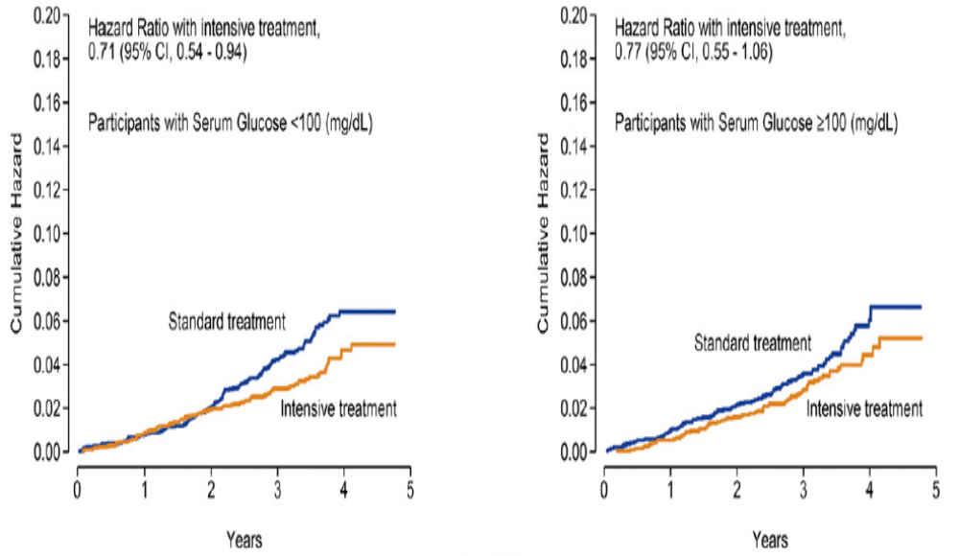
Intensive Treatment of Blood Pressure ↓ All Cause Mortality in Normoglycemic and Prediabetes
Diabetes Care 2017;40:1401-1408
Automated office BP (AOBP)
Notes:
Cumulative incidence of the primary outcome (A) and all-cause mortality (B) by treatment arm stratified by those with normoglycemia and prediabetes at baseline.

Slide 5
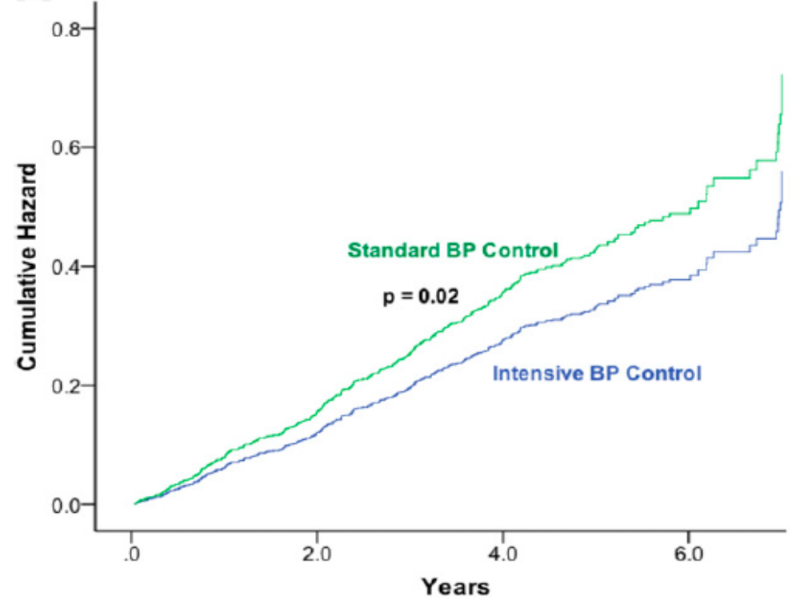
Tight Blood Pressure Control Reduced CVD in Patients with Type 2 DM
(SPRINT-Eligible ACCORD-BP Trial)
Diabetes Care 2017;40:1733-1738
Notes:
Time-to-event analysis for SPRINT-eligible ACCORD-BP trial participants. The time to event between intensive and standard BP control in SPRINT-eligible ACCORD-BP trial participants receiving standard glucose control treatment was compared with Cox proportional hazards regression. The treatment effect of intensive BP control in SPRINT-eligible ACCORD-BP participants is depicted according to two separate definitions: a composite of myocardial infarction, any revascularization, stroke, heart failure, and CVD death (primary outcome of SPRINT) (A) and a composite outcome of CVD death, nonfatal myocardial infarction, and nonfatal stroke (primary outcome of the ACCORD-BP trial) (B). (A high-quality color representation of this figure is available in the online issue.)
Intensive BP control reduced CVD outcomes in a cohort of participants with T2DM and additional CVD risk factors. The “SPRINT-eligible” ACCORD-BP participants were pooled with SPRINT participants to determine whether the effects of intensive BP control interacted with T2DM.

Slide 6
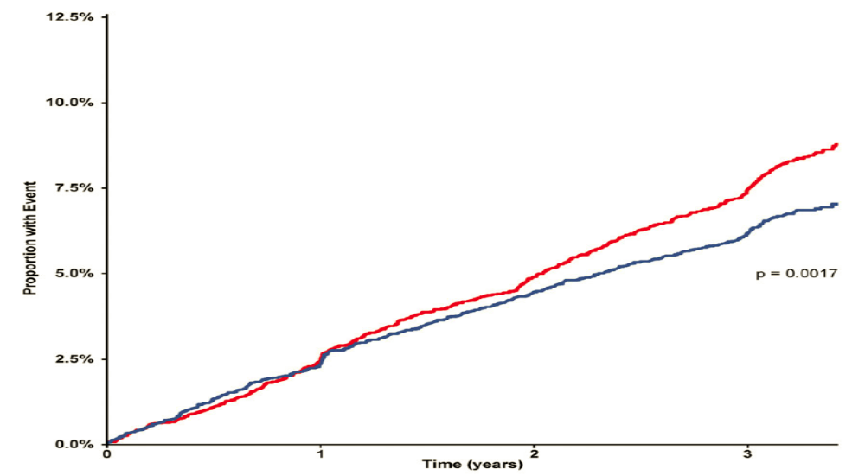
Intensive Blood Pressure Lowering-Systolic < 120 mmHg ↓ CV Events in Both Patients with and without T2DM
Standard
Intensive
Diabetes Care https://doi.org/10.2337/dc17-1722
Notes:
A Kaplan-Meier plot of the composite primary end point in the pooled cohort (n = 14,094). Primary composite end point consists of myocardial infarction, stroke, and cardiovascular death plus unstable angina and acute cardiac decompensation. The hazard ratio for primary end point event is 0.82 (95% CI 0.73–0.93), P = 0.0017. No significant interaction between T2DM and treatment allocation was observed (P for interaction 0.13).

Slide 7
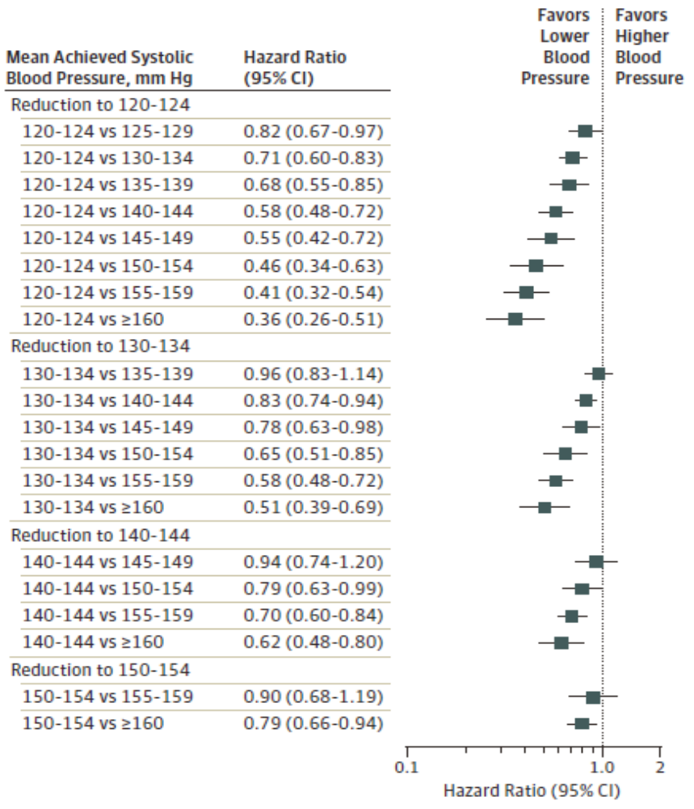
Intensive Control of Systolic Blood Pressure Significantly ↓ Major CVD Events
Lower is
Better!!
JAMA Cardiol 2017;2:775-781
Notes:
Hazard Ratios and 95%CIs for Major Cardiovascular Disease Associated With More Intensive Reductions in Systolic Blood Pressure
Our findings should be interpreted in light of several limitations, most of which have been common to all meta analyses conducted in this topic area. First, we had limited sample size in some mean achieved SBP comparisons. For example, only 3 trials achieved mean SBP levels below 120mm Hg, with a combined sample size of 7333. Thus, most of the evidence in our analyses is based on trials treating participants To achieve SBP levels above 120 mmHg. Second, few trials reported heart failure outcomes, which resulted in an insufficiently connected network to analyze this outcome. Similarly, we were unable to assess the association of intensive SBP reduction with kidney disease outcomes, dementia, or adverse events such as hypotension or falling, which have been concerns with intensive treatment of BP.18 Furthermore, we were unable to conduct subgroup analyses by age, race/ethnicity, history of CVD, stroke, chronic kidney disease, or diabetes owing to insufficient data. Finally, we defined treatment nodes according to the mean achieved SBP in each randomization group, which does not consider the distribution of individual SBP levels within groups. Thus, mean achieved SBP groups may represent a range of SBPs. In addition, analysis of mean achieved SBP does not guide treatment decisions regarding diastolic BP.

Slide 8
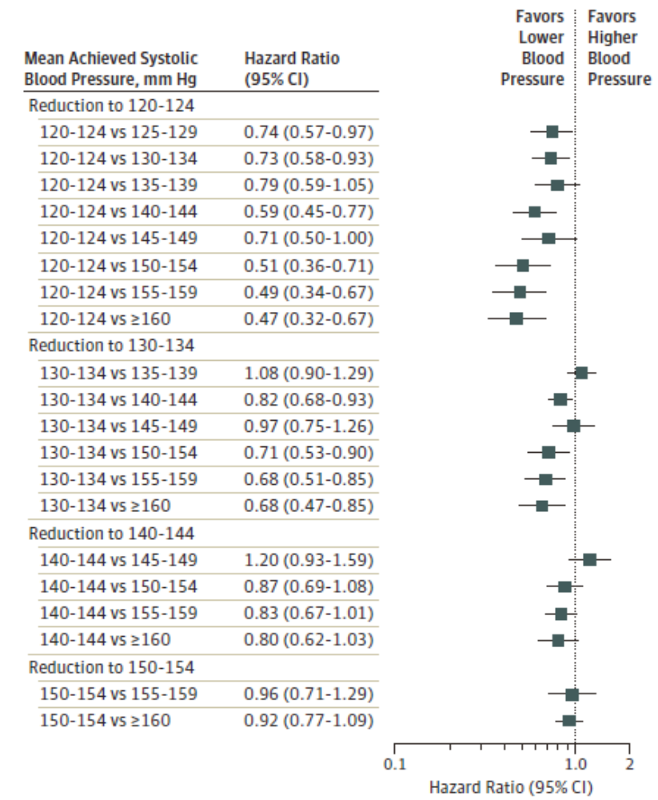
Intensive Control of Systolic Blood Pressure Significantly ↓ All Cause Mortality
Lower is
Better!!
JAMA Cardiol 2017;2:775-781
Notes:
Hazard Ratios and 95%CIs for All-Cause Mortality Associated With More Intensive Reductions in Systolic Blood Pressure

Slide 9
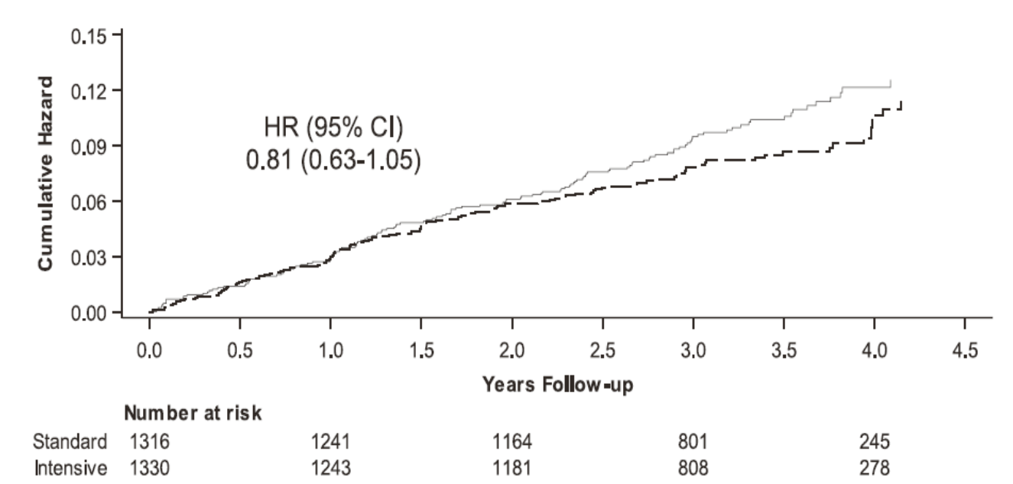

Targeting Systolic Blood Pressure <120 mmHg Decreased Major Cardiovascular Events by 19% in Patients with CKD
Intensive Group
J Am Soc Nephrol 2017;28:2812-2823
Notes:
Among patients with CKD and hypertension without diabetes, targeting an SBP<120 mmHg compared with <140 mmHg reduced rates of major cardiovascular events and all-cause death without evidence of effect modifications by CKD or deleterious effect on the main kidney outcome.
Kaplan-Meier curves for pre-specified outcomes in SPRINT participants with CKD. Panel A shows the primary cardiovascular outcome, defined as the composite of myocardial infarction, acute coronary syndrome, stroke, acute decompensated heart failure, and death from cardiovascular causes. Panel B shows the all-cause death outcome. Panel C shows the main kidney outcome, defined as the composite of a decrease in eGFR of $50% from baseline (confirmed by repeat testing $90 days later) or the development of ESRD. The broken lines depict the intensive group; the solid lines depict the standard group.

Slide 10
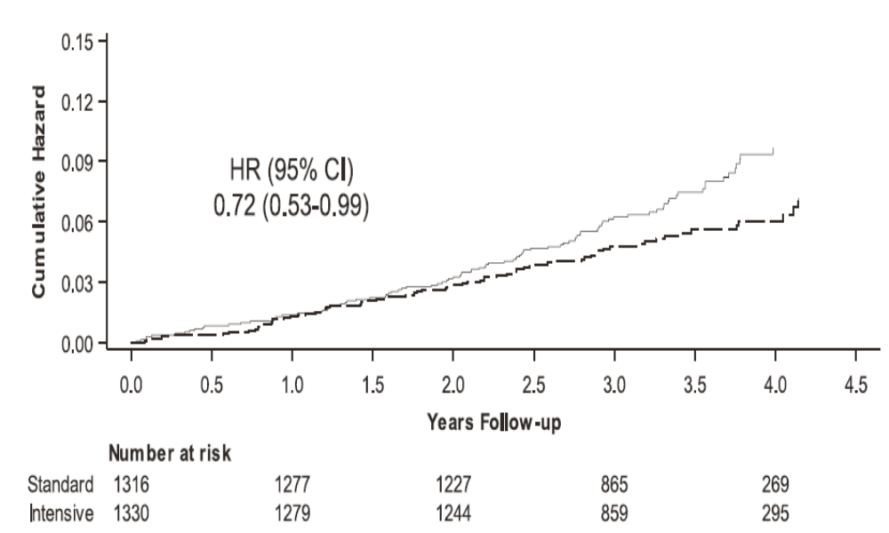
Targeting Systolic Blood Pressure <120 mmHg Decreased All-Cause Mortality in Patients with CKD
Intensive Group
J Am Soc Nephrol 2017;28:2561-2563
Notes:
Among patients with CKD and hypertension without diabetes, targeting an SBP<120 mmHg compared with <140 mmHg reduced rates of major cardiovascular events and all-cause death without evidence of effect modifications by CKD or deleterious effect on the main kidney outcome.
Kaplan-Meier curves for pre-specified outcomes in SPRINT participants with CKD. Panel A shows the primary cardiovascular outcome, defined as the composite of myocardial infarction, acute coronary syndrome, stroke, acute decompensated heart failure, and death from cardiovascular causes. Panel B shows the all-cause death outcome. Panel C shows the main kidney outcome, defined as the composite of a decrease in eGFR of $50% from baseline (confirmed by repeat testing $90 days later) or the development of ESRD. The broken lines depict the intensive group; the solid lines depict the standard group.

Slide 11
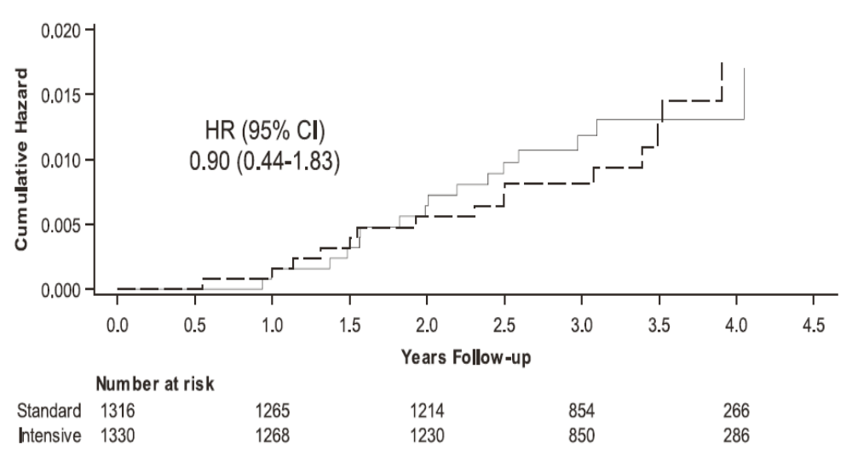
Targeting Systolic Blood Pressure <120 mmHg had NO Deleterious Effect on Kidney Outcome in Patients with CKD
Standard Group
Intensive Group
J Am Soc Nephrol 2017;28:2561-2563
Notes:
Among patients with CKD and hypertension without diabetes, targeting an SBP<120 mmHg compared with <140 mmHg reduced rates of major cardiovascular events and all-cause death without evidence of effect modifications by CKD or deleterious effect on the main kidney outcome.
Kaplan-Meier curves for pre-specified outcomes in SPRINT participants with CKD. Panel A shows the primary cardiovascular outcome, defined as the composite of myocardial infarction, acute coronary syndrome, stroke, acute decompensated heart failure, and death from cardiovascular causes. Panel B shows the all-cause death outcome. Panel C shows the main kidney outcome, defined as the composite of a decrease in eGFR of $50% from baseline (confirmed by repeat testing $90 days later) or the development of ESRD. The broken lines depict the intensive group; the solid lines depict the standard group.

Slide 12
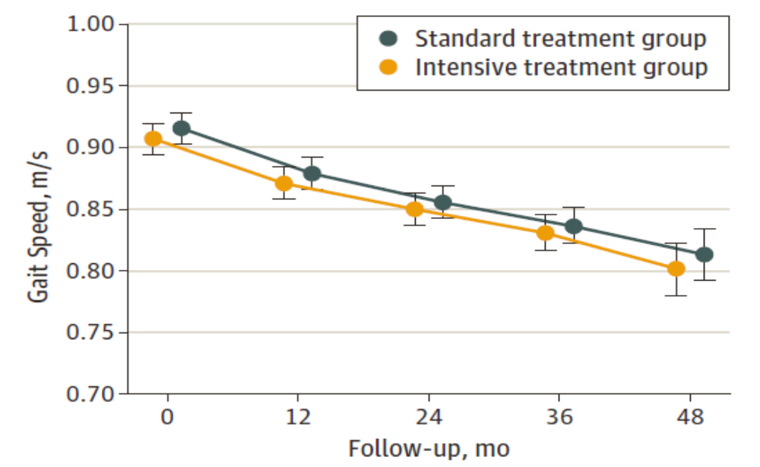
Targeting SBP <120 mmHg had NO Effect on Changes in Gait Speed or Mobility Limitation
JAMA Intern Med 2017;177:500-507.
Notes:
Among adults 75 years or older in SPRINT, treating to a systolic BP target of less than 120mmHg compared with a target of less than 140mmHg had no effect on changes in gait speed and was not associated with changes in mobility limitation.

