Slide 1
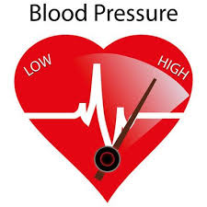
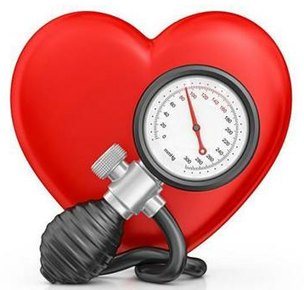

Teaching Tool: Blood Pressure
Classification
JAMA 2003;289:2560-2572

Slide 2
Systolic Blood Pressure Reduction
The Lower, the Better
Meta-analysis of 61 prospective, observational studies
1 million adults, 12.7 million person-years
7% reduction in risk of ischemic heart disease mortality
2 mmHg decrease in systolic blood pressure
10% reduction in risk of stroke mortality
Lancet 2002;360:1903-1913
Notes:
SLIDE SUMMARY: BP REDUCTION IS IMPORTANT; EVEN A LITTLE GOES
A LONG WAY
Perhaps most striking are the practical implications of these data: even a small, 2 mm Hg fall in mean systolic BP would be associated with large absolute reductions in premature deaths and disabling strokes.¹ As shown here, a 2 mm Hg lower mean systolic BP could lead to a 7% lower risk of IHD death and a 10% lower risk of stroke death¹
Data from a meta-analysis of 61 prospective, observational studies provide powerful evidence that throughout middle and old age, BP is strongly and directly related to vascular mortality.¹ For example, a 10 mm Hg lower systolic BP is associated over the long term with a 40% lower risk of stroke death and a 30% lower risk of death from ischemic heart disease (IHD) or other vascular causes¹
Within each decade of life between 40 and 89 years, the proportional difference in the risk of vascular death associated with a given absolute difference in mean BP is roughly equivalent down to at least 115 mm Hg for systolic BP and 75 mm Hg for diastolic BP (below this level there is little evidence). Thus, there was no evidence of a J curve across all middle and older age groups¹
The investigators included studies in data on blood pressure, blood cholesterol, date of birth (or age) and sex had been recorded at baseline and in which a cause and date of death had been sought by study screeners. 33 of the studies were done in Europe (eg, the British Regional Heart Study, the Scottish Heart Health Study, the Tromso Study, assessing the association between blood pressure and serum lipids) 18 in North American or Australia (eg, the Atherosclerotic Risk in Communities Study, the Minnesota Heart Health Program) and 10 studies in China or Japan (eg, the Seven Cities China study on stroke prevention)¹
Lewington S, Clarke R, Qizilbash N, Peto R, Collins R. Age-specific relevance of usual blood pressure to vascular mortality:
a meta-analysis of individual data for one million adults in 61 prospective studies. Lancet 2002;360:1903-1913.
[1/Lewington/
p 1912/C 1/P2/
ln 7-24]
[1/Lewington/
p 1912/C 1/P2/
ln 7-24]
[1/Lewington/
p 1903/Abstract/
Findings]
[1/Lewington/p 1904/C 1/P 3/ln2-6,
/Appendix A, Table A]
[1/Lewington/
p 1912/C 1/P2/
ln 7-24, p 1903/C 2/p 1/ln 1-3, P 2/ln 1-2, Appendix A, References to Studies]

Slide 3
The Relationship between Systolic Blood Pressure and Macrovascular Mortality is Continuous and Increases with Age
256
80-89 yrs
256
80-89 yrs
128
70-79 yrs
128
70-79 yrs
64
60-69 yrs
64
60-69 yrs
32
50-59 yrs
32
50-59 yrs
40-49 yrs
Stroke Mortality
(Floating Absolute Risks and 95% CI)
Cardiovascular Mortality
(Floating Absolute Risks and 95% CI)
16
16
8
8
4
4
2
2
1
1
120
140
160
180
120
140
160
180
Systolic Blood Pressure (mmHg)
Systolic Blood Pressure (mmHg)
Lancet 2002;360:1903-1913
Notes:
Figure 2a: Stroke mortality rate in each decade of age versus usual SBP at the start of that decade.
Rates are plotted on a floating absolute scale, and each square has area inversely proportional to the effective variance of the log mortality rate.

Slide 4
Observational Studies: Cardiovascular Mortality Doubles with Each 20/10mmHg Blood Pressure Increment Starting at 115/75 mmHg
8.0
8
7
JNC8
Goal
6
Cardiovascular
Mortality Risk
4.0
5
4
3
2.0
2
1.0
1
0
115/75
135/85
155/95
175/105
Systolic/Diastolic Blood Pressure (mmHg)
Individuals aged 40-70 years, starting at blood pressure 115/75 mmHg
Lancet 2002;360:1903-1913; JAMA 2003;289:2560-2572
Notes:
Slide Summary
According to a meta-analysis of over 60 prospective studies, the risk of cardiovascular mortality doubles with each rise of 20 mm Hg in systolic blood pressure (BP) and 10 mm Hg in diastolic BP.
Background
In a meta-analysis of 61 prospective, observational studies conducted by Lewington et al involving one million adults with no previous vascular disease at baseline, the researchers found that between the ages of 40-69 years, each incremental rise of 20 mm Hg systolic BP and 10 mm Hg diastolic BP was associated with a twofold increase in death rates from ischemic heart disease and other vascular disease.
The researchers also noted that when attempting to predict vascular mortality risk from a single BP measurement, the average of systolic and diastolic BP was “slightly more informative” than either alone, and that pulse pressure was “much less informative.”
The seventh report Joint National Committee on Prevention, Detection, Evaluation, and Treatment of High Blood Pressure (JNC 7) notes this study result as yet more information linking hypertension to high risk for cardiovascular events.
Lewington S, Clarke R, Qizilbash H, et al. Age-specific relevance of usual blood pressure to vascular mortality: a meta-analysis of individual data for one million adults in 61 prospective studies. Lancet. 2003;361:1903-1913.
JNC 7. JAMA. 2003;289:2560-2572.

Slide 5
Observational Studies: Increased Cardiovascular Mortality in Type 2 Diabetes Even at a Systolic Blood Pressure <120 mmHg
250
Non-diabetes patients
200
Type 2 diabetes patients
150
JNC
Goal
Cardiovascular
Mortality
Rate/10,000
person-yrs
100
**
50
0
<120
120–139
140–159
160–179
180–199
≥200
Systolic Blood Pressure (mmHg)
Why should we accept anything less than NORMAL in patients with type 2 DM?
Diabetes Care 1993;16:434-444

Slide 6
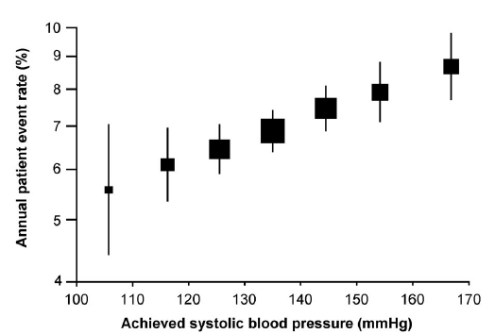
ADVANCE 5 Year Study:
Blood Pressure Arm, the Lower the Blood Pressure the Better!
J Am Soc Nephrol 2009;20:883-892

Slide 7
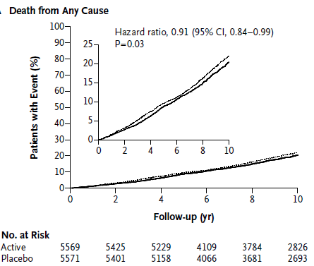
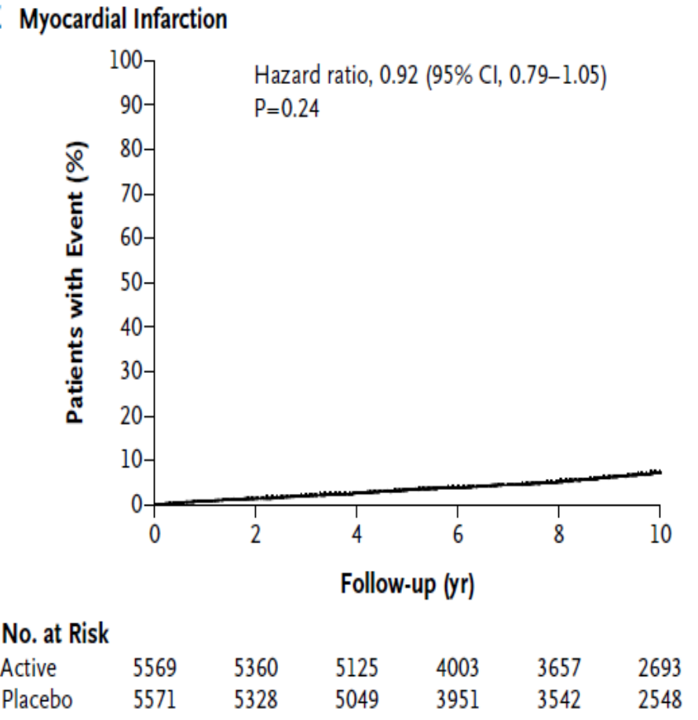
ADVANCE 10 Year Follow Up -
Confirms Lower Blood Pressure Better
Automated office blood pressure (AOBP)
N Engl J Med 2014;371:1392-1406

Slide 8
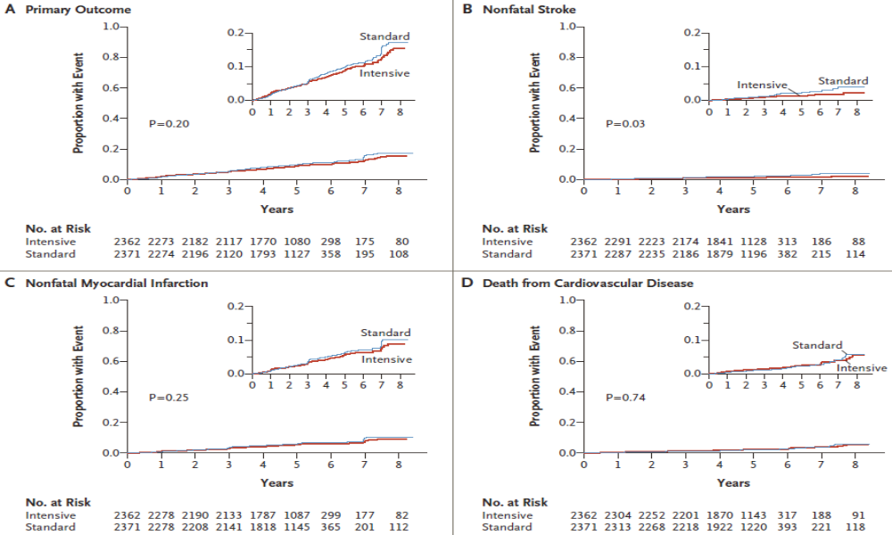
ACCORD Study: Failed to Show Lowering Blood Pressure to <120 Reduce Major Fatal and Nonfatal CV Events; (+) Benefit Stroke
N Engl J Med 2010;362:1575-1585
Office-based semiautomated oscillometric BP
Notes:
Kaplan–Meier Analyses of Selected Outcomes.
Shown are the proportions of patients with events for the primary composite outcome (Panel A) and for the individual components
of the primary outcome (Panels B, C, and D). The insets show close-up versions of the graphs in each panel.
In patients with type 2 diabetes at high risk for cardiovascular events, targeting a systolic blood pressure of less than 120 mm Hg, as compared with less than 140 mm Hg, did not reduce the rate of a composite outcome of fatal and nonfatal major cardiovascular events.

Slide 9
So Why Did the ACCORD Study Fail to Show a CVD Benefit to ↓ Blood Pressure?
The study may have been underpowered. The event rate was only half of what was expected (~2%/year) and mean duration was only 4.7 years.
The relatively wide confidence interval of 27% also diminished the power of the study.
Aggressive treatment of other major CVD risk factors may have lowered the absolute risk to a point from where it was difficult to demonstrate further incremental benefit from more aggressive treatment of blood pressure.
At the end of the study:
- TC/HDL-C ratio = 3.60 - A1c = 7.6%
- most patients were on aspirin - less patients were smoking

