Slide 1
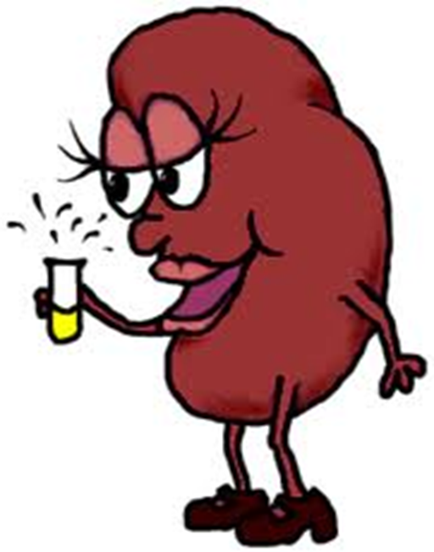
So What is Albuminuria?
An elevated urinary albumin excretion is a marker of endothelial dysfunction that symbolizes the kidney’s way to translate the existence of vascular damage

Slide 2
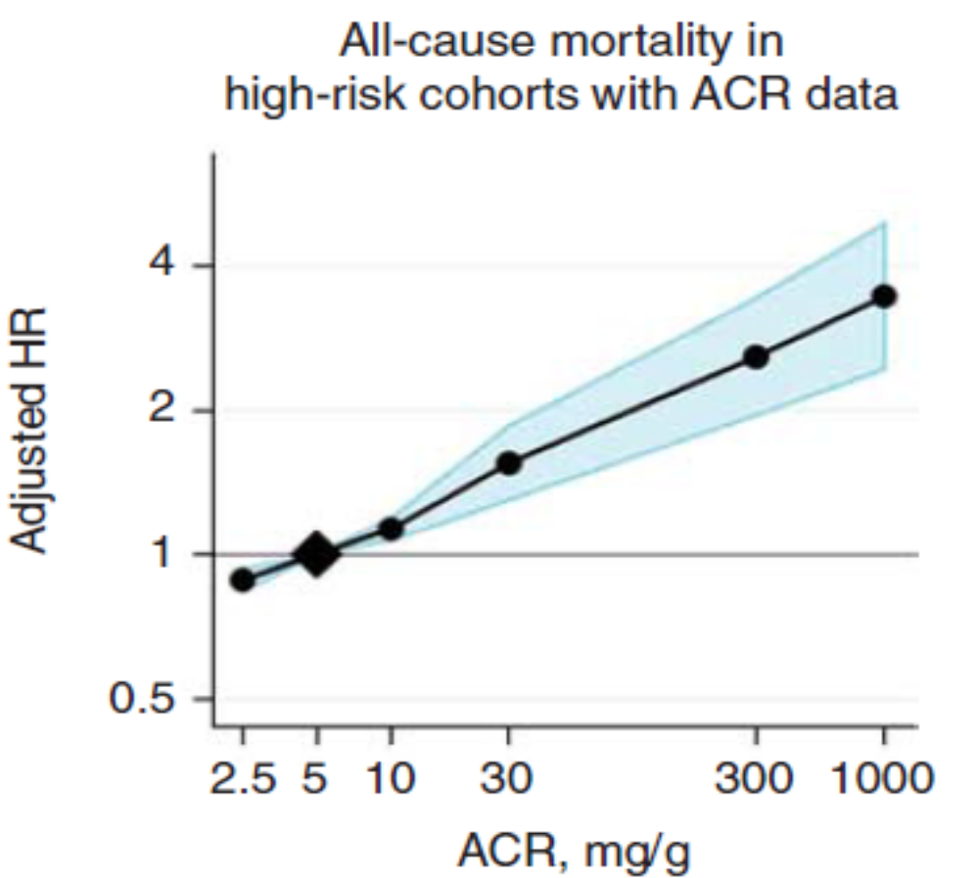
Increased All-Cause Morality with
Albumin Creatinine Ratio Greater > 5
Kidney Int 2011;79:1341-1352

Slide 3
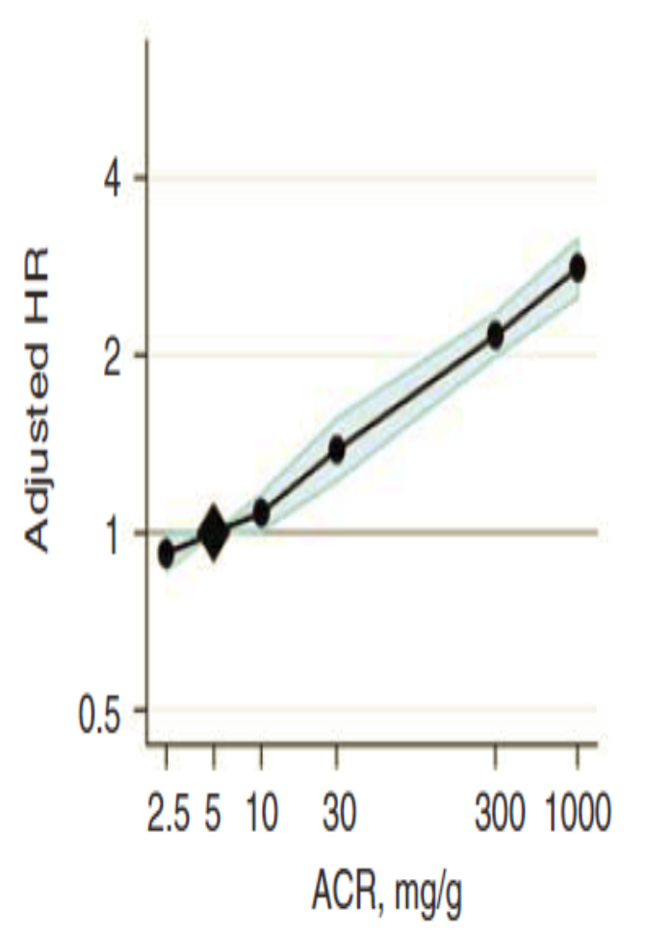
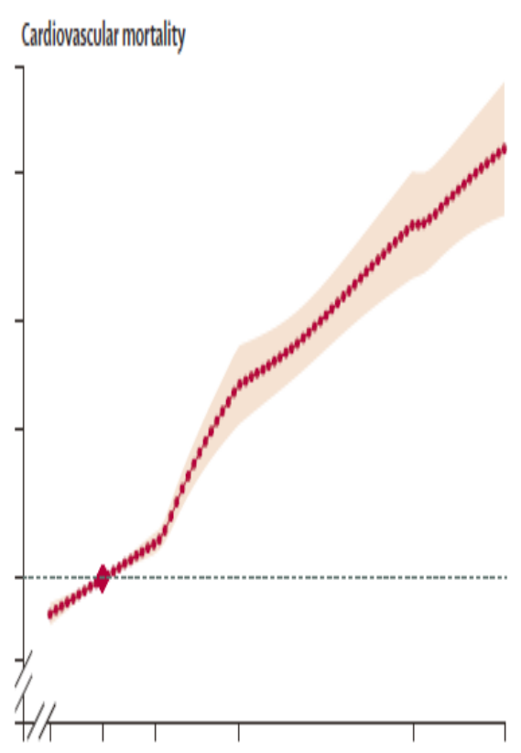
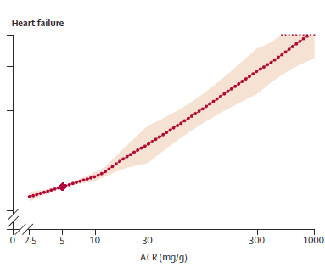
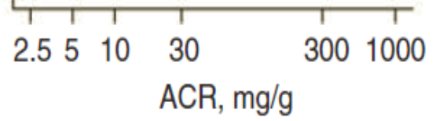
Strong Linear Relationship: Urine Albumin Creatinine with CV Mortality and Heart Failure
Kidney Int 2011;79:1341-1352

Slide 4
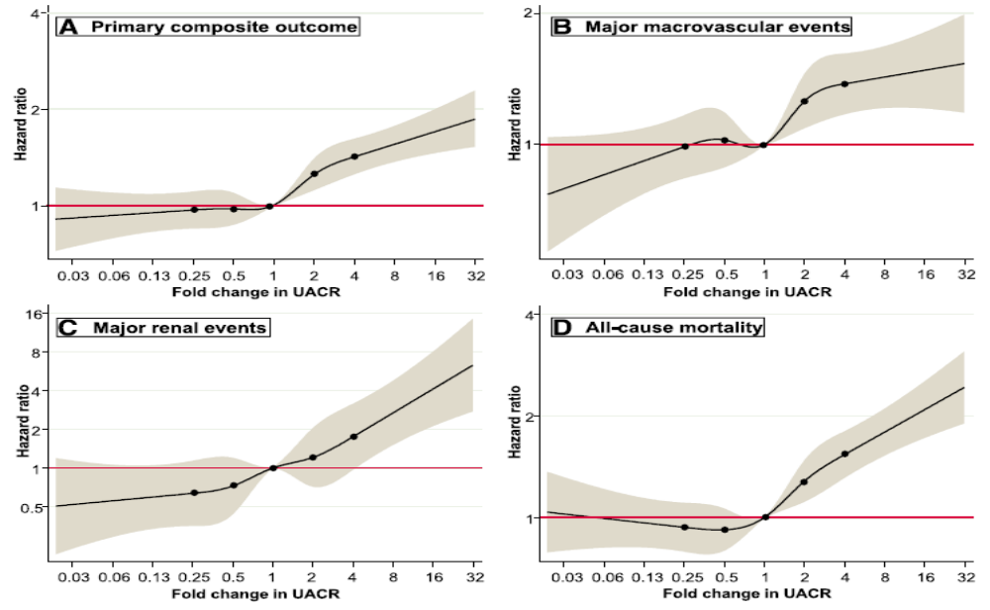
Changes in Albuminuria Predict
Major Clinical Outcomes in Diabetes
Diabetes Care 2018;41:163–170
Notes:
Adjusted HRs and 95% CIs for study outcomes associated with 2-year fold changes in UACR. Adjustments as for Fig. 1A. A: Composite of major macrovascular, renal events and all-cause mortality. B:Majormacrovascular events. C:Major renal events. D: All-cause mortality. The circles represent the points at which knots were placed (0.25, 0.5, 1, 2, and 4-fold change). The areas shaded in grey represent the 95%confidence intervals. (A high-quality color representation of this figure is available in the online issue.)
Changes in UACR predicted changes in the risk of major clinical outcomes and mortality in type 2 diabetes, supporting the prognostic utility of monitoring albuminuria change over time.

Slide 5
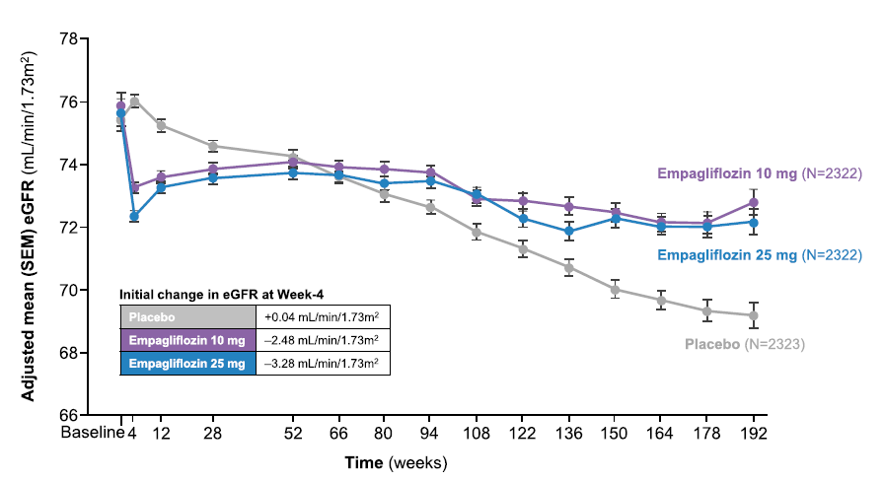
Empagliflozin Reverses the Initial Decline in eGFR
J Am Soc Nephrol 2017;28:1023–1039
Notes:
Renal function trajectory in the EMPA-REG OUTCOME trial. In this study, 7020 patients with T2DM at high cardiovascular risk were randomly assigned to receive the SGLT2 inhibitor empagliflozin (10 or 25 mg once daily) or placebo. After an initial drop in eGFR documented at week 4, renal function stabilized in empagliflozin-treated patients over the ensuing follow-up period, whereas among those patients receiving placebo, a steady decline of 1.67 ml/min per 1.73m2 per year in eGFR was observed. After 34 days of cessation of the study drug, the initial decrease in eGFR in all empagliflozin-treated patients was completely reversed with an adjusted mean difference from placebo in the change from baseline eGFR of 4.7 ml/min per 1.73 m2 (not depicted). Adapted from Wanner and colleagues.86

Slide 6
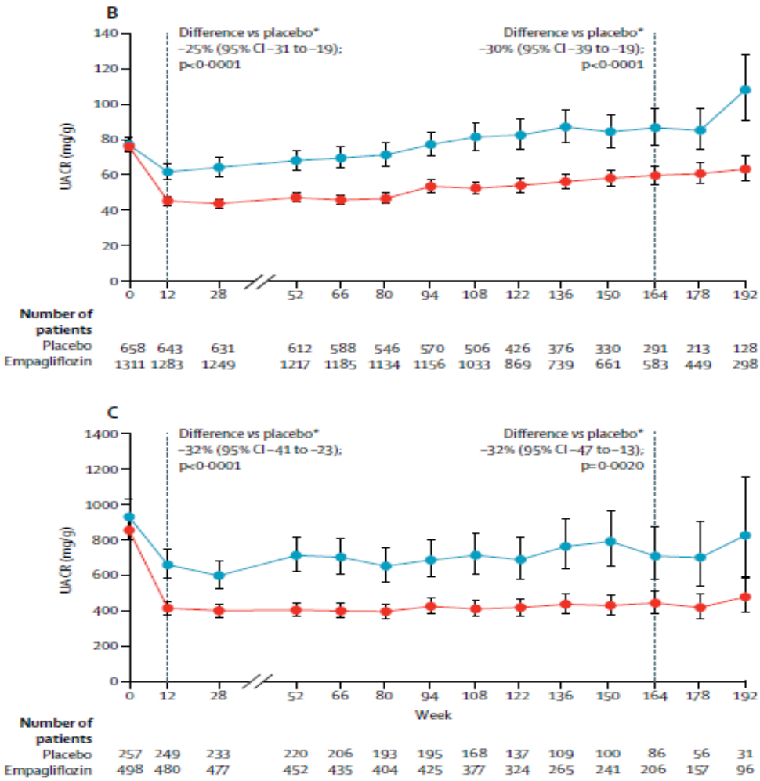
Empagliflozin Significantly Decreased Albuminuria vs. Placebo
Lancet Diabetes Endocrinol 2017;8:610-621
Notes:
Urinary albumin-to-creatinine ratio over 192 weeks
Prespecified endpoint and post-hoc analyses in patients with (A) normoalbuminuria, (B) microalbuminuria, and (C) macroalbuminuria at baseline. Adjusted geometric mean values and 95% CIs are shown. Mixed-model repeated measures analysis using all data obtained until study end in patients treated with at least one dose of study drug. Normoalbuminuria: urinary
albumin-to-creatinine ratio (UACR) <30 mg/g. Microalbuminuria: UACR ≥30 to ≤300 mg/g. Macroalbuminuria: UACR >300 mg/g. Only patients with post-randomisation measurements are included in the figure. *Placebo-corrected adjusted geometric mean ratio (95% CI) of relative change from baseline with empagliflozin. 164 weeks (IQR 115–186) corresponds to the median observation period.

Slide 7
Definitions of “Albuminuria”
 | Normo- albuminuria | Micro-albuminuria | Macro- albuminuria
Urine albumin/ creatinine ratio ‘UACR’ (mg/g creatinine) | < 30 | 30 - 300 | > 300
Diabetes Care 2004;27:S79-S83
Notes:
Definitions of Microalbuminuria and Macroalbuminuria
Measurements of urinary albumin are made from either a timed (4 or 24 hours) urine collection or from a randomly voided “spot” urine. In the former case the urinary albumin concentration is divided by the time of the collection (in minutes) calculate the first parameter. In the latter case, both albumin and creatinine concentrations are measured in the same specimen and a ratio of albumin to creatinine calculated. Numerous studies have demonstrated that the values obtained from both timed and randomly collected specimens correlate well and have the same prognostic significance. Measurements of urine protein concentrations by “dipstick” chemistry are not sufficiently sensitive to identify urine albumin concentrations that meet the criteria for microalbuminuria. Protein in the urine is usually a combination of albumin, globulins, and Tamm-Horsfall protein derived from tubular secretion.
References:
Bianchi S, Bigazzi R, Campese VM. Microalbuminuria in essential hypertension: significance, pathophysiology, and therapeutic implications. Am J Kidney Dis. 1999;34(6):973-995.
Keane WF. Proteinuria: its clinical importance and role in progressive renal disease. Am J Kidney Dis. 2000;35(4suppl1):S97-S105.

Slide 8
Urine Albumin Creatinine Ratio (UACR)* and CVD Risk
Risk when UACR > 7.5 mg/g creatinine in women
and > 4.0 mg/g creatinine in men
End Point
CV event
Hazard ratio
2.92
“p”
<0.001
*simple, inexpensive, independent predictor of CVD
Circulation 2005;112:969-975

Slide 9

Urine Albumin/Creatinine Ratio (UACR)
< 7.5 Women
< 4.0 Men
Notes:
Treatment Targets for Diabetic Renal Disease With Hypertension
The results of clinical trials in diabetic patients at increased risk for cardiovascular and renal events suggest that aggressive control of hypertension may be the most cost-effective in reducing these risks, followed, in rank order, by aggressive management of dyslipidemia, and then by tight blood glucose control.
References:
Agarwal R. Treatment of hypertension in patients with diabetes: lessons from recent trials. Cardiol Rev. 2001;9(1):36-44.
UK Prospective Diabetes Study Group: Tight blood pressure control and risk of macrovascular and microvascular complications in type 2 diabetes: UKPDS 38. BMJ. 1998;317:703-713.

Slide 10
Estimated GFR (eGFR)
Normal 95 (ML/MIN/1.73M2)
Abnormal <60/>105
Notes:
Treatment Targets for Diabetic Renal Disease With Hypertension
The results of clinical trials in diabetic patients at increased risk for cardiovascular and renal events suggest that aggressive control of hypertension may be the most cost-effective in reducing these risks, followed, in rank order, by aggressive management of dyslipidemia, and then by tight blood glucose control.
References:
Agarwal R. Treatment of hypertension in patients with diabetes: lessons from recent trials. Cardiol Rev. 2001;9(1):36-44.
UK Prospective Diabetes Study Group: Tight blood pressure control and risk of macrovascular and microvascular complications in type 2 diabetes: UKPDS 38. BMJ. 1998;317:703-713.

