Slide 1
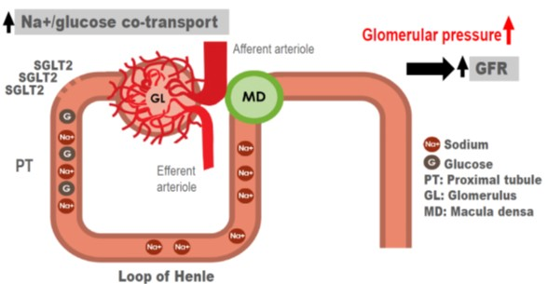
Diabetes and Hypertension Accelerate Glomerular Hypertension
Circulation 2014;129:587-597

Slide 2
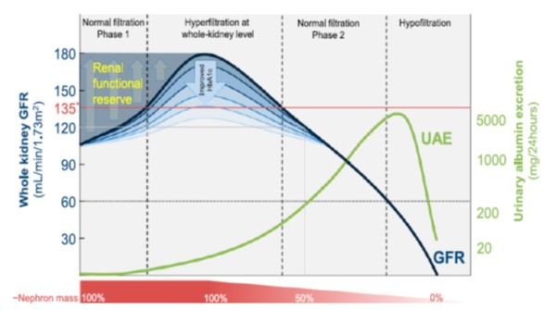
Teaching Tool: Hyperfiltration Early Sign of Hypertension and Diabetes
J Am Soc Nephrol 2017;28:1023-1039
Notes:
Classic course of whole-kidney GFR and UAE according to the natural (proteinuric) pathway of DKD. Peak GFR may be seen in prediabetes or shortly after diabetes diagnosis, and can reach up to 180 ml/min in the case of two fully intact kidneys. Strict control of HbA1c and initiation of other treatments (such as RAS inhibition) mitigate this initial response. Two normal filtration phases can be encountered, in which GFR may be for instance 120 ml/min (indicated with the gray line): one at 100% of nephron mass and one at approximately 50% of nephron mass. Thus, whole-kidney GFR may remain normal even in the presence of considerable loss of nephron mass, as evidenced by a recent autopsy study.121 Assessing renal functional reserve and/or UAE may help identify the extent of subclinically inflicted loss of functional nephron mass. *Whole-kidney hyperfiltration is generally defined as a GFR that exceeds approximately135 ml/min, and is indicated with the red line. Heterogeneity of single-nephron filtration rate and nonproteinuric pathway122 of DKD are not illustrated.

Slide 3
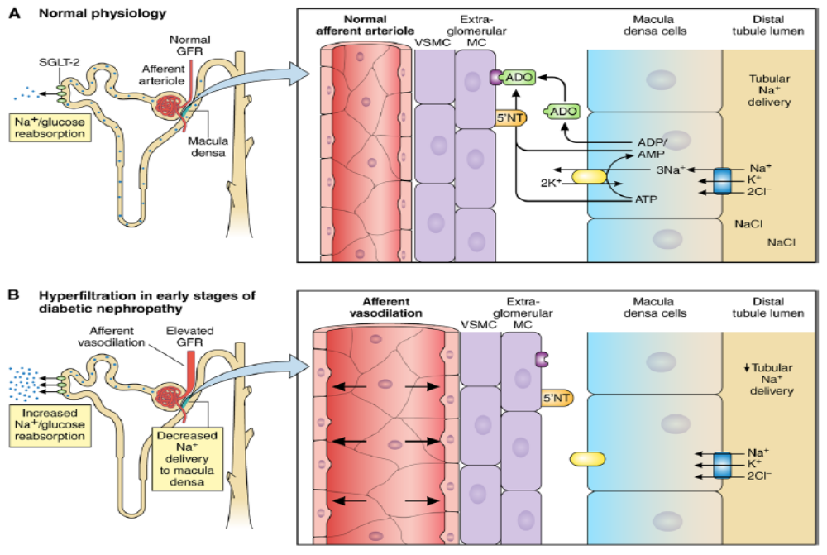
Hyperfiltration Early in
Diabetic Nephropathy
Circulation 2016;134:752-772
Notes:
Putative mechanism for sodium-mediated changes in adenosine bioactivity at the afferent arteriole. During normal conditions (A), sodium-glucose cotransport leads to minimal glycosuria. If, under these nondiabetic conditions, NaCl delivery to the macula densa was reduced in the context of a physiological stress such as hypotension, renal perfusion would decrease, leading to a reduction in NaCl transit across macula densa cells, thereby causing less adenosine triphosphate (ATP) release and breakdown to adenosine, which is a vasoconstrictor. Consequently, less vasoconstrictive adenosine would act via the adenosine type 1 receptor on vascular smooth muscle cells (VSMCs) to cause less afferent arteriolar vasoconstriction. The resulting afferent vasodilation would serve to preserve renal blood flow and glomerular filtration rate (GFR), and thereby avoid acute kidney injury; the inverse relationship between changes in the NaCl transit across macula densa cells and GFR is a process called tubuloglomerular feedback. Adenosine is generated by both intracellular and extracellular sources, and extracellular generation involves ecto-5′-nucleotidase (5′-NT). Under conditions of ambient hyperglycemia (B), sodium-glucose cotransport-2 activity (SGLT2) is increased, thereby reducing macula densa NaCl delivery. This affects the same tubuloglomerular feedback mechanisms, leading to afferent vasodilatation. Because renal blood flow and GFR start off within a normal range, afferent vasodilatation under these circumstances results in renal hyperperfusion and glomerular hyperfiltration. The goal of using an SGLT2 under these conditions (C) would therefore be to restore distal tubular flow and NaCl delivery to the macula densa, thereby increasing local adenosine generation and afferent vasoconstriction to attenuate the hyperfiltration state.

Slide 4
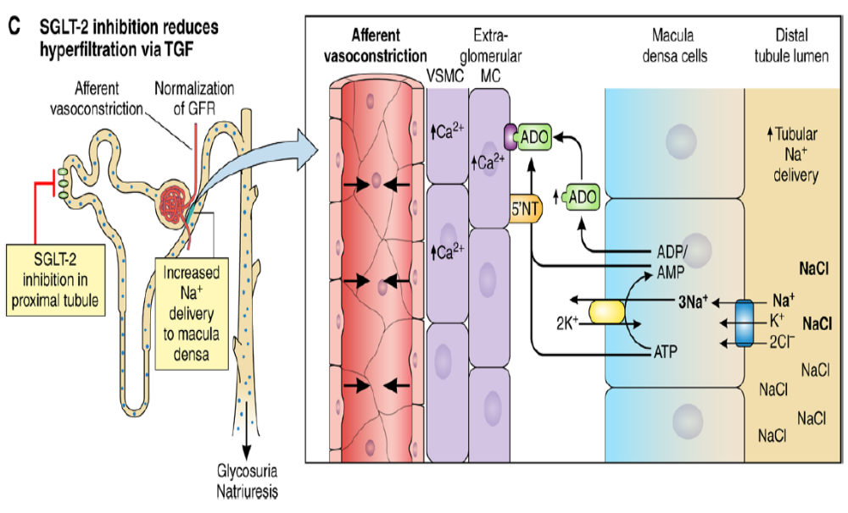
SGLT₂ Inhibition Reduces Hyperfiltration
Circulation 2016;134:752–772
Notes:
Putative mechanism for sodium-mediated changes in adenosine bioactivity at the afferent arteriole. During normal conditions (A), sodium-glucose cotransport leads to minimal glycosuria. If, under these nondiabetic conditions, NaCl
delivery to the macula densa was reduced in the context of a physiological stress such as hypotension, renal perfusion would decrease, leading to a reduction in NaCl transit across macula densa cells, thereby causing less adenosine triphosphate (ATP) release and breakdown to adenosine, which is a vasoconstrictor. Consequently, less vasoconstrictive adenosine would act via the adenosine type 1 receptor on vascular smooth muscle cells (VSMCs) to cause less afferent arteriolar vasoconstriction. The resulting afferent vasodilation would serve to preserve renal blood flow and glomerular filtration rate (GFR), and thereby avoid acute kidney injury; the inverse relationship between changes in the NaCl transit across macula densa cells and GFR is a process called tubuloglomerular feedback. Adenosine is generated by both intracellular and extracellular sources, and extracellular generation involves ecto-5′-nucleotidase (5′-NT). Under conditions of ambient hyperglycemia (B), sodium-glucose cotransport-2 activity (SGLT2) is increased, thereby reducing macula densa NaCl delivery. This affects the same tubuloglomerular feedback mechanisms, leading to afferent vasodilatation. Because renal blood flow and GFR start off within a normal range, afferent vasodilatation under these circumstances results in renal hyperperfusion and glomerular hyperfiltration. The goal of using an SGLT2 under these conditions (C) would therefore be to restore distal tubular flow and NaCl delivery to the macula densa, thereby increasing local adenosine generation and afferent vasoconstriction to attenuate the hyperfiltration state.

Slide 5
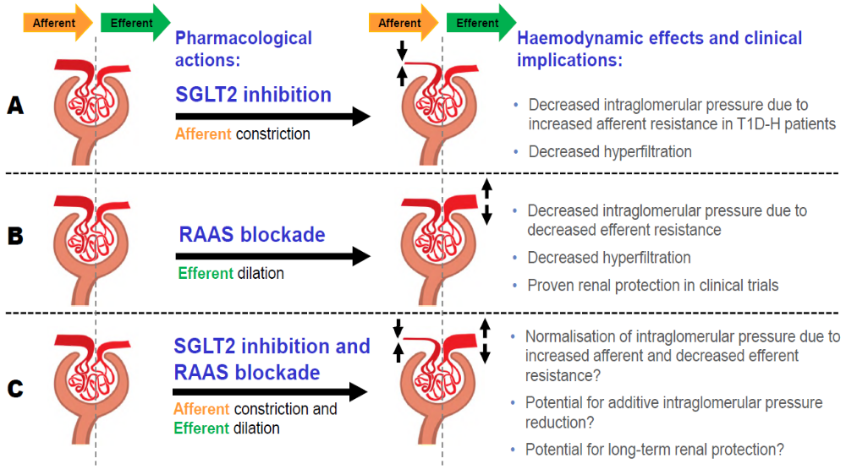
SGLT₂ Inhibition + RAAS Blockade =
Afferent Constriction + Efferent Dilation
Diabetologia 2014;57:2599-2602
GLP-1 agonist also modestly ↓ hyperfiltration

Slide 6
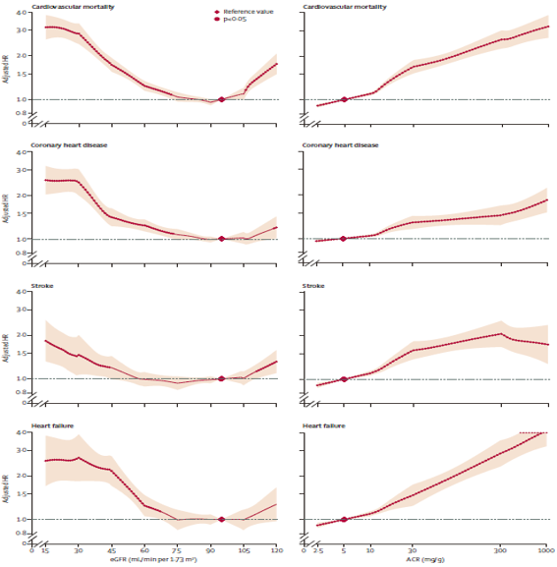
eGFR (<60 >105) and UACR > 5 Associated ↑ CV Mortality, ↑CHD, Stroke, and Heart Failure
eGFR
UACR
↓
↓
Hyperfiltration
HR: 1.0
eGFR
95 mL/min/
1.73 m²
HR: 1.0
UACR
5 mg/g
creatinine
↓
↓
Lancet Diabetes Endocrinol 2015;3:514-525
Notes:
Cardiovascular outcomes according to Egfr and ACR in combined general-population and high-risk cohorts Adjusted HRs and 95% Cis (shaded areas) for cardiovascular mortality, coronary heart disease, stroke, and heart failure according to eGFR and ACR in the combined general-population and high-risk cohorts. The reference value is eGFR 95 mL/min per 1·73 m² and ACR 5 mg/g (diamonds). We made adjustments for age, sex, race or ethnic origin, smoking, systolic blood pressure, antihypertensive drugs, diabetes, total and HDL cholesterol concentrations, and albuminuria (ACR or dipstick) or eGFR, as appropriate. In the analyses of eGFR, there were 629 776 participants for cardiovascular mortality, 144 874 for coronary heart disease, 137 658 for stroke, and 105 127 for heart failure. In the analyses of ACR, there were 120 148 participants for cardiovascular mortality, 91 185 for coronary heart disease, 82 646 for stroke, and 55 855 for heart failure. All axes are log scales except for the eGFR axis. eGFR=estimated glomerular filtration rate. ACR=urine albumin-to-creatinine ratio.

Slide 7
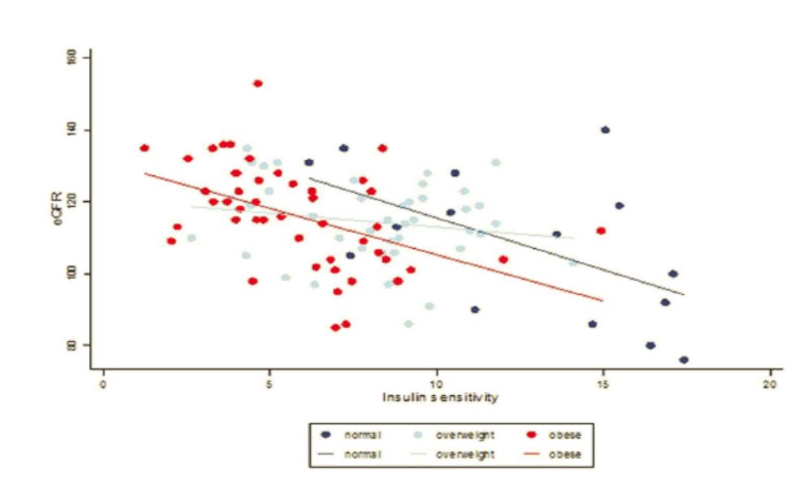
Insulin Resistance Promotes Glomerular Hyperfiltration
Sci Rep 2017;7:45522, 10.1038/srep45522
Notes:
Association of eGFR and insulin sensitivity by BMI.

Slide 8
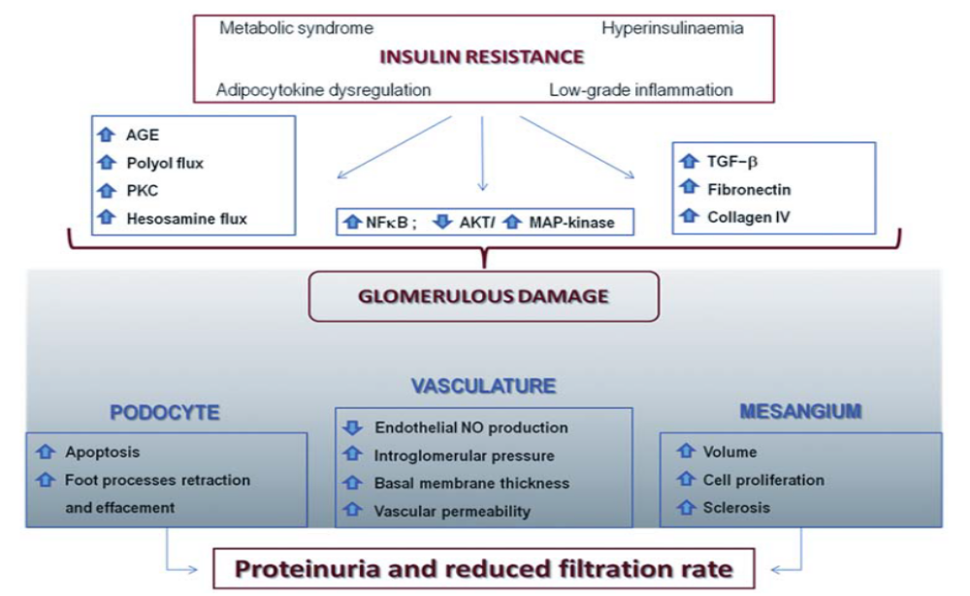
Insulin Resistance Promotes Kidney Dysfunction
Nephrol Dial Transplant 2013;28:29–36
Notes:
Pathogenic mechanisms linking insulin resistance to kidney dysfunction. The constellation of abnormalities related to insulin resistance
including those clustering in the metabolic syndrome, adipocytokine dysregulation, hyperinsulinaemia and low-grade inflammation are all involved in
worsening kidney function. Several biochemical and molecular pathways are involved in mediating the effect of the above described abnormalities on
kidney function. Dysregulation of polyol and hexosamine fluxes, AGE, activation of PKC isoforms are mostly a consequence of hyperglycaemia.
Abnormalities in the insulin-signalling pathway, possibly, but not exclusively, due to adipocytokine-induced activation of JNK, IKK and specific
PKC isoforms and/or to imbalance between the PI3K/Akt (which is impaired) and MAPK (which is exacerbated) axes also play a role by reducing
NO-dependent vasodilation and increasing vasoreactivity and angiogenesis, well-established promoters of kidney dysfunction. Profibrotic elements
and vascular growth factors, among which TGF-β is the most well studied, are also involved in damaging glomerulus function through
overproduction of mesangial cell matrix and thickening of the glomerular basement membrane which eventually end in albumin leakage. Finally, an
emerging role of podocyte-specific insulin resistance is recently proposed with podocyte function, structure and survival being heavily affected by
abnormal insulin signalling, thus further contributing to reduced kidney function. Abbreviations: AGE, advanced glycation end-products; Akt, protein
kinase B; IKK, IκB kinase; JNK, C-jun N-terminal kinase; MAPK, mitogen-activated protein kinase; NO, nitric oxide; PKC, protein kinase C;
TGF-β, transforming growth factor.

