Slide 1
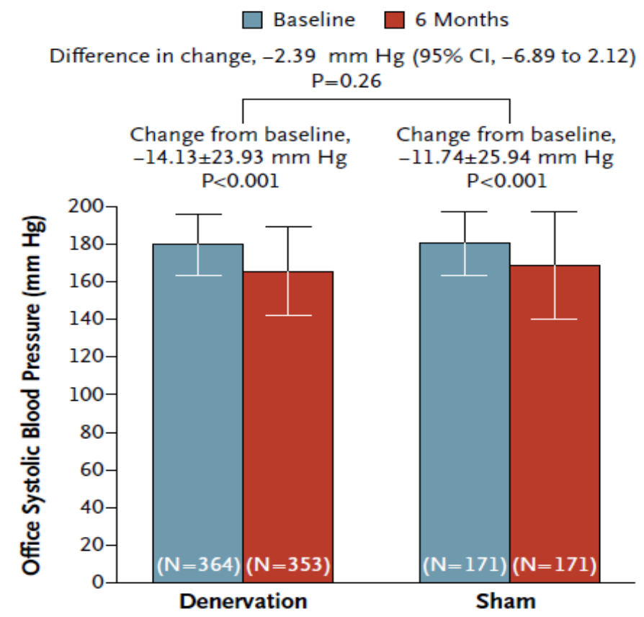
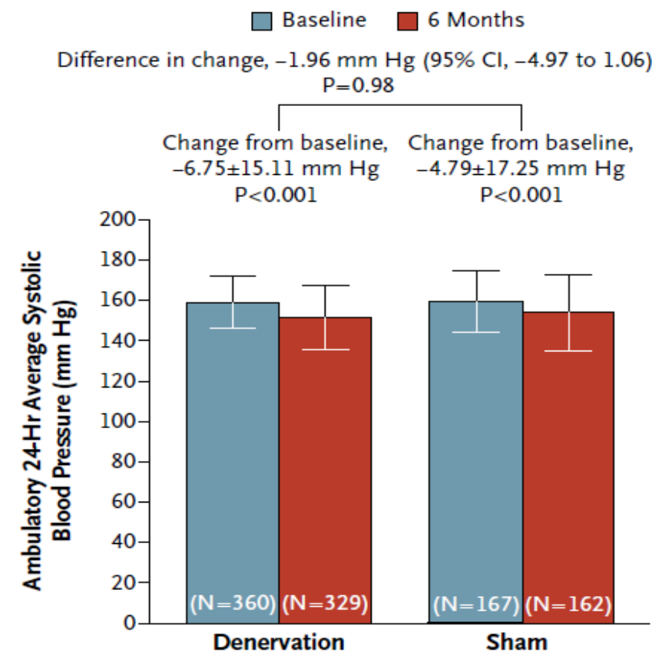
Renal Denervation
Failed to Reduce Blood Pressure in Resistant Hypertension
N Engl J Med 2014;370:1393-1401
Notes:
Primary Efficacy End Point.
A significant change from baseline to 6 months in office systolic blood pressure was observed in both study groups. The between-group difference (the primary efficacy end point) did not meet a test of superiority with a margin of 5 mm Hg. The I bars indicate standard deviations.

Slide 2
Teaching Tool: Targeting Blood Pressure to Goal
Blood pressure >120/80 mmHg *
Work toward lifestyle modifications and search for exogenous factors.
Start thiazide-type diuretic.
If not at goal, add ACEI or ARB if creatinine >1.5, cough, hyperkalemia.
If BP still not at goal, add carvedilol/nebivolol or calcium-channel blocker.
Once at goal consider combination therapy.
BP still not at goal? Assess 24-hour urinary sodium.
Sodium >100 Meq
Sodium <100 Meq
Refer to a nutritionist
for education on reducing
foods high in salt.
Add spironolactone, eplerenone,
aliskiren, clonidine, or alpha-blocker.
CHF add Valsartan + Sacubitril
BP still not at goal? Exclude secondary causes.
JAMA
2014;311:507-520
Refer to a clinical hypertension specialist.
* NO threshold for BP when albuminuria is present; 5 mmHg above syncope!!

Slide 3
Carvedilol
All the GOOD NEWS of β-blockers without the Concerns*
β-Blockers
  worsen lipids
  increase visceral weight
  peripheral
  vasoconstriction → cold extremities
  ↑ insulin resistance
  may increase albuminuria
Carvedilol
  neutral on lipids
  no weight gain
  peripheral
  vasodilation → no cold extremities
  ↓ insulin resistance
  ↓ albuminuria
*Nebivolol (Bystolic) similar properties to Carvedilol

Slide 4
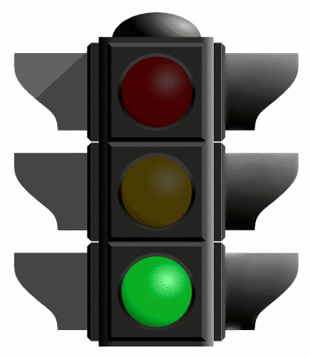

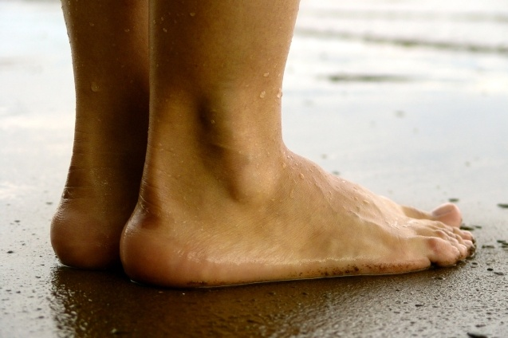
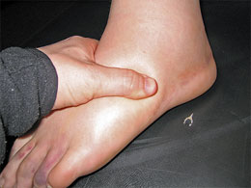
Amlodipine
Besylate
NO to 10 mg!!
5 mg

Slide 5
CCB Combination with ARBs and DRI
AZOR (amlodipine + olmesartan)
5 mg amlodipine/20 mg olmesartan
5 mg amlodipine/40 mg olmesartan
10 mg amlodipine/20 mg olmesartan
10 mg amlodipine/40 mg olmesartan
EXFORGE (amlodipine + valsartan)
5 mg amlodipine/160 mg valsartan
5 mg amlodipine/320 mg valsartan
10 mg amlodipine/160 mg valsartan
10 mg amlodipine/320 mg valsartan
TWYNSTA (amlodipine + telmisartan)
5 mg amlodipine/40 mg telmisartan
5 mg amlodipine/80 mg telmisartan
10 mg amlodipine/40 mg telmisartan
10 mg amlodipine/80 mg telmisartan
Do not offer 10 mg
on your formulary.
TEKAMLO (amlodipine + aliskiren)
5 mg amlodipine/150 mg aliskiren
5 mg amlodipine/300 mg aliskiren
10 mg amlodipine/150 mg aliskiren
10 mg amlodipine/300 mg aliskiren

Slide 6
CCB Combinations + ARB/DRI + HCT
TRIBENZOR (amlodipine + olmesartan + HCT)
5 mg amlodipine/20 mg olmesartan/12.5 mg HCT
5 mg amlodipine/40 mg olmesartan/25 mg HCT
5 mg amlodipine/40 mg olmesartan/25 mg HCT
10 mg amlodipine/40 mg olmesartan/12.5 mg HCT
10 mg amlodipine/40 mg olmesartan//25 mg HCT
EXFORGE HCT (amlodipine + valsartan + HCT)
5 mg amlodipine/160 mg valsartan/12.5 mg HCT
5 mg amlodipine/160 mg valsartan/25 mg HCT
10 mg amlodipine/160 mg valsartan/12.5 mg HCT
10 mg amlodipine/160 mg valsartan/25 mg HCT
10 mg amlodipine/320 mg valsartan/25 mg HCT
Do not offer 10 mg
on your formulary.
AMTURNIDE (amlodipine + aliskiren + HCT)
5 mg amlodipine/150 mg aliskiren/12.5 HCT
5 mg amlodipine/300 mg aliskiren/12.5 HCT
5 mg amlodipine/300 mg aliskiren/25 HCT
10 mg amlodipine/300 mg aliskiren/12.5 HCT
10 mg amlodipine/300 mg aliskiren/25 HCT

Slide 7
Hypertension-Conclusion
Hypertension remains the #1 cause of mortality in the world and must be treated aggressively.
Complications of hypertension include cardiovascular disease, stroke, heart failure and chronic kidney disease (hyperfiltration and albuminuria); new treatment options are emerging to improve patient quality of life and increase survival
New hypertension trials are demonstrating that lowering systolic blood pressure to <120 mmHg is safe and beneficial
Medical Nutrition Therapy remains the cornerstone of treating hypertension; customize nutrition based on ApoE genotype; it is now time that we start restricting fructose in the diet.
Carvedilol (and Nebivolol) provides all the “good” things in a β-blocker; Amlodipine 5mg is an effective antihypertensive; 10mg dosing offers little or no additional benefit and should not be prescribed given the high rate of adverse events.
Notes:
References
1. American Diabetes Association, Workgroup on Hypoglycemia. Defining and reporting hypoglycemia in diabetes. Diabetes Care. 2005;28(5):1245–1249.
2. UK Hypoglycaemia Study Group. Risk of hypoglycaemia in types 1 and 2 diabetes: effects of treatment modalities and their duration. Diabetologia. 2007;50:1140–1147.
3. Matyka K, Evans M, Lomas J, Cranston I, MacDonald I, Amiel SA. Altered hierarchy of protective responses against severe hypoglycemia in normal aging in healthy men. Diabetes Care. 1997;20(2):135–141.
4. Akram K, Pedersen-Bjergaard U, Carstensen B, Borch-Johnsen K, Thorsteinsson B. Frequency and risk factors of severe hypoglycaemia in insulin-treated type 2 diabetes: a cross-sectional survey. Diabetes Med. 2006;23:750–756.
5. Chico A, Vidal-Ríos P, Subirà M, Novials A. The continuous glucose monitoring system is useful for detecting unrecognized hypoglycemias in patients with type 1 and type 2 diabetes but is not better than frequent capillary glucose measurements for improving metabolic control. Diabetes Care. 2003;26:1153–1157.
6. Amiel SA, Dixon T, Mann R, Jameson K. Hypoglycaemia in type 2 diabetes. Diabet Med. 2008;25(3):245–254.

Slide 8

BP TARGET
<120/80 mmHg
5 mmHg above syncope if albuminuria is present!!

Slide 9


Thank you for your attention!
Happy to Answer Any
QUESTIONS?

