Slide 1
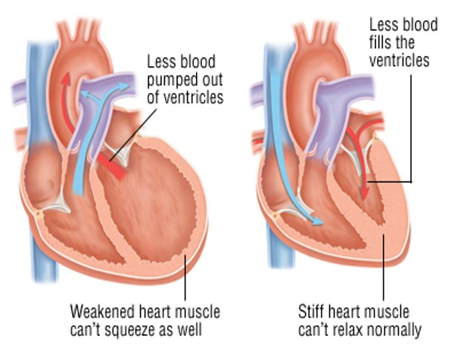
Heart Failure
HFrEF
HFpEF

Slide 2
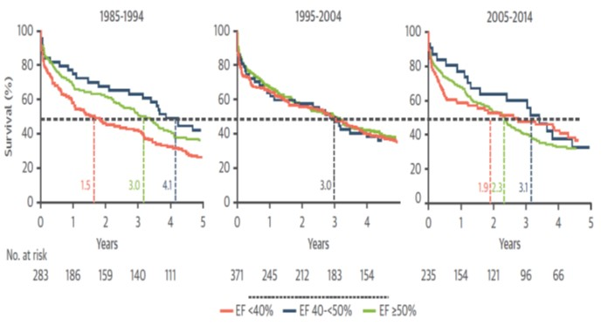
Heart Failure Profiles Have Changed in Recent Decades: HFrEF -> HFpEF
HFmrEF
HFrEF
HFpEF
JACC Cardiovasc Imaging https://doi.org/10.1016/j.jcmg.2017.08.007
Notes:
The horizontal line indicates median survival, and the vertical lines show median survival time for participants with new-onset heart failure (HF) for each subtype of HF. EF = ejection fraction; HFpEF = heart failure with preserved left ventricular ejection fraction; HFmrEF = heart failure with midrange left ventricular ejection fraction; HFrEF = heart failure with reduced left ventricular ejection fraction.
The profile of HF in the community has changed in recent decades, with a lower prevalence of LVSD and an increased frequency of HFpEF, presumably due to concomitant risk factor trends.
Our observations over the last 3 decades suggest that secular trends in CVD risk factors may be altering the profile of HF in the community, marked by a decline in the prevalence of asymptomatic LVSD paralleled by a concomitant increase in the prevalence of HFpEF. The cardiovascular mortality of HFrEF has declined over the last 3 decades, reflecting
the effect of major clinical trials. The unchanged prognosis of asymptomatic LVSD and of HFmrEF and HFpEF indicate unmet needs of patients with these conditions.

Slide 3
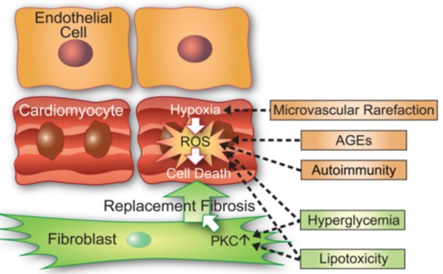
Dilated Heart Failure
HFrEF Phenotype
Heart muscle
can’t squeeze
Euro Heart J 2015;36:1718-1727
Notes:
DM-related pathophysiological mechanisms in diabetes mellitus-related cardiomyopathy with dilated/ heart failure with reduced ejection fraction phenotype. In diabetes mellitus-related cardiomyopathy with dilated/ heart failure with reduced ejection fraction phenotype cardiomyocyte cell death drives left ventricular remodelling and dysfunction. Cardiomyocyte cell death results from oxidative stress within the cardiomyocyte compartment because of tissue hypoxia induced by microvascular rarefaction, presence of autoimmunity-related inflammatory cells, advanced glycation end-products deposition and possibly hyperglycaemia and lipotoxicity. Because of cardiomyocyte cell death there is extensive replacement fibrosis, which is reinforced by high PKC in fibroblasts because of hyperglycaemia and lipotoxicity. DM, diabetes mellitus; DMCMP, diabetic cardiomyopathy; HFREF, heart failure with reduced ejection fraction; ROS, reactive oxygen species; AGEs, advanced glycation end-products; PKC, protein kinase C.

Slide 4
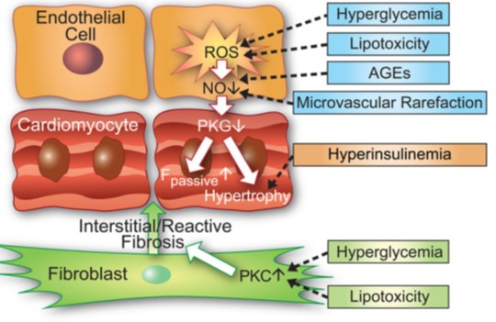
Restrictive Heart Failure
HFpEF Phenotype
Heart muscle
can’t relax
Euro Heart J 2015;36:1718-1727
Notes:
DM-related pathophysiological mechanisms in diabetes mellitus-related cardiomyopathy with restrictive/ heart failure with preserved ejection fraction phenotype. In diabetes mellitus-related cardiomyopathy with restrictive/ heart failure with preserved ejection fraction phenotype coronary microvascular endothelial dysfunction drives left ventricular remodeling and dysfunction through lowering of myocardial NO bioavailability and PKG activity. This releases the brake on myocardial hypertrophy, stiffens cardiomyocytes (i.e. raised passive force (Fpassive)) and causes reactive interstitial fibrosis. Coronary microvascular endothelial dysfunction results from hyperglycemia, lipotoxicity, and advanced glycation end-products deposition. Microvascular rarefaction also contributes to low NO bioavailability and hyperinsulinaemia to cardiomyocyte hypertrophy. Hyperglycaemia and lipotoxicity raise PKC in fibroblasts and augment interstitial collagen deposition. DM, diabetes mellitus; DMCMP: diabetic cardiomyopathy; HFPEF, heart failure with preserved ejection fraction; ROS: reactive oxygen species; NO, nitric oxide; PKG, protein kinaseG;
F-passive: cardiomyocyte resting tension; AGEs, advanced glycation end-products; PKC, protein kinase C

Slide 5
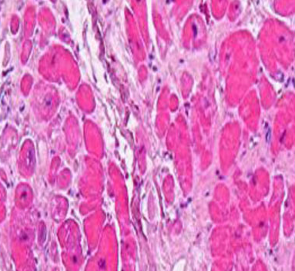
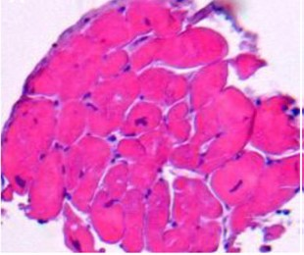
Myocardial Structure in Heart Failure with Dilated HFrEF and Restrictive HFpEF
Restrictive HFrEF phenotype
Dilated HFpEF phenotype
Euro Heart J 2015;36:1718-1727
Notes:
Myocardial structure in restrictive/ heart failure with preserved ejection fraction (HFPEF) and dilated/ heart failure with reduced ejection fraction (HFREF) phenotypes. In the restrictive/ heart failure with preserved ejection fraction phenotype cardiomyocytes are hypertrophied, collagen is laid down in-between cardiomyocytes (reactive fibrosis) (left-hand panel) and sarcomeric structure is preserved (right hand panel). In the dilated/ heart failure with reduced ejection fraction phenotype, cardiomyocytes are small and damaged, collagen is laid down over larger areas (replacement fibrosis) (left-hand panel) and sarcomeres have disappeared (right hand panel). Reproduced with permission from Van Heerebeek et al.

Slide 6
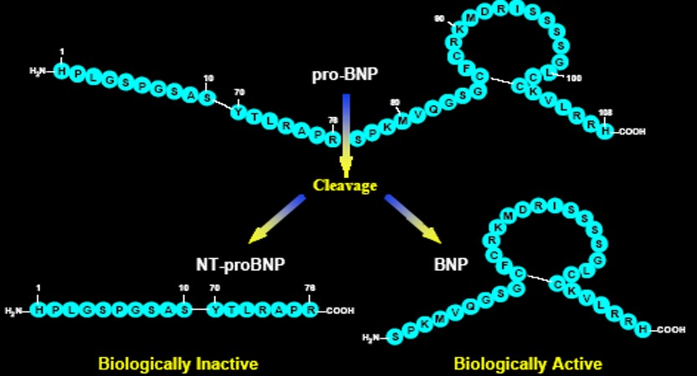
Pro-BNP Derived Peptides: NT-proBNP and BNP
t_{½} = 60-120 minutes
t_{½} = 18 minutes

Slide 7
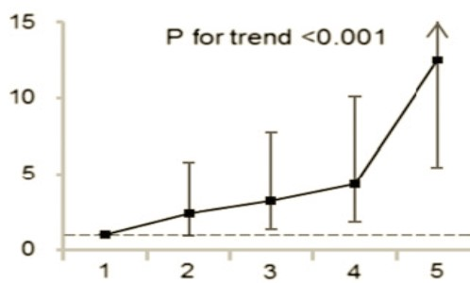
NT-proBNP Strong Predictor of Heart Failure in Patients with Type 2 Diabetes
Hazard Ratio (95% CI)
2.5–24 25–59 60–116 117–255 256.0–35,000
Fifths of NT-proBNP (pg/mL)
Diabetes Care 2017;40:1203–1209 ADVANCE TRIAL
Notes:
The ranges of NT-proBNP were 2.5–24.0, 25.0–59.0, 60.0–116.0, 117.0–255.0, and 256.0–35,000.0 pg/mL.

Slide 8
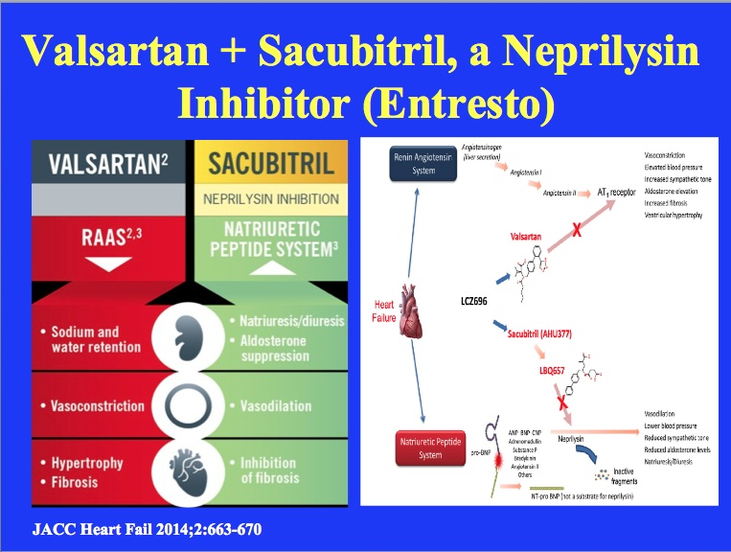
Notes:
Heart failure stimulates both the renin-angiotensin system and the natriuretic peptide system. LCZ696 is composed of 2 molecular moieties, the angiotensin receptor blocker valsartan and the neprilysin inhibitor prodrug sacubitril (AHU377). Valsartan blocks the angiotensin type I (AT1) receptor. Sacubitril is converted enzymatically to the active neprilysin inhibitor LBQ657, which inhibits neprilysin, an enzyme that breaks down the breakdown of atrial natriuretic peptide (ANP), brain (or B-type) natriuretic peptide (BNP), and C-type natriuretic peptide (CNP), as well as other vasoactive substances. N-terminal pro-BNP (NT-proBNP) is not a substrate for neprilysin.

Slide 9
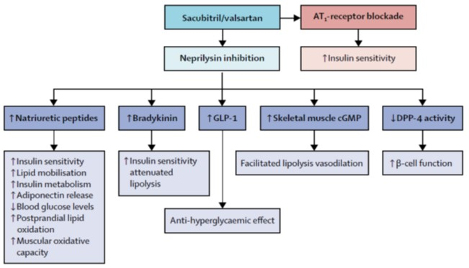
Neprilysin Inhibition Improves Glycemic Control by Multiple Mechanisms
Lancet Diabetes Endocrinol 2017;5:314-315
Notes:
Proposed mechanisms by which dual inhibition of renin-angiotensin system and neprilysin might lead to improved glycaemic control
There is an even stronger association between diabetes and heart failure with preserved ejection fraction. Therefore, the effect of sacubitril/valsartan in this population will be important to assess when the ongoing Efficacy and Safety of LCZ696 Compared to Valsartan, on Morbidity and Mortality in Heart Failure Patients with Preserved Ejection Fraction (PARAGON-HF) trial is
completed (NCT01920711).

Slide 10
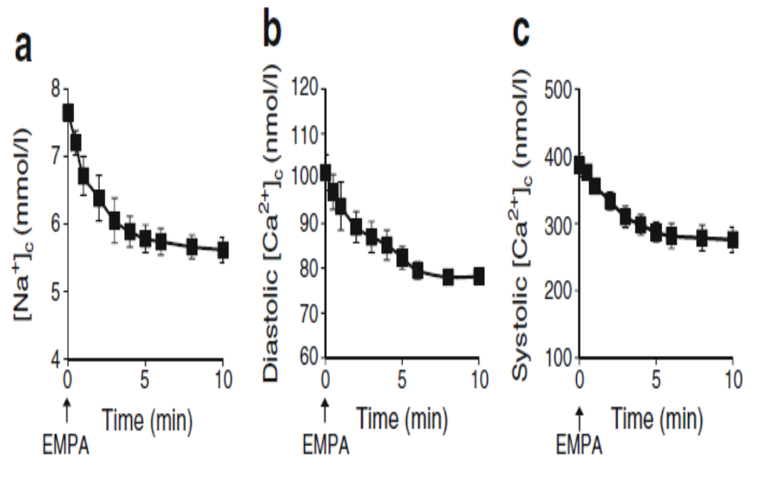
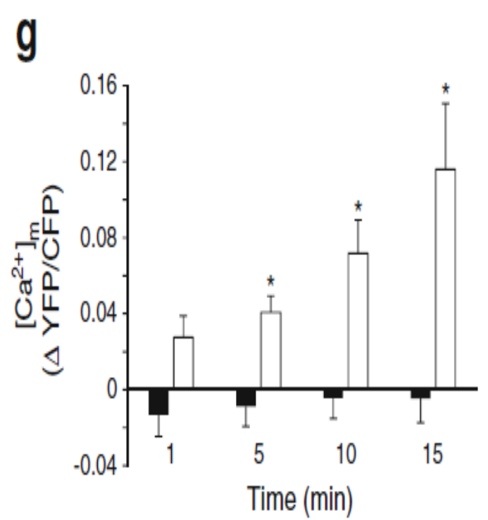
Empagliflozin ↓ Cytoplasmic Na⁺, Diastolic and Systolic Ca⁺⁺ and ↑ Mitochondrial Ca⁺⁺
[Na+]_{c}
[Ca+]_{c}
[Ca+]_{m}
[Ca+]_{c}
EMPA
(white)
Net impact: improved cardiac mitochondrial function
Diabetologia 2017;60:568–573
Notes:
EMPA effects on [Na+]c, [Ca2+]c and [Ca2+]m. (a–c) EMPA (1 μmol/l) acutely lowers (a) [Na+]c, and (b) diastolic [Ca2+]c and (c) systolic [Ca2+]c in rabbit cardiomyocytes. (d,e) Effects of EMPA (3 h incubation) on [Na+]c at (d) 11 mmol/l and (e) 5.5 mmol/l glucose (Gluc), respectively. *p < 0.05 vs 0 μmol/l EMPA, ANOVA with Dunnett’s post hoc tests. (f) Effects of EMPA (3 h pre-incubation; [EMPA] 1) on diastolic (Dias) and systolic (Sys) [Ca2+]c at 11 mmol/l glucose. *p<0.05 vs 0 μmol/l EMPA ([EMPA] 0), unpaired t test.
The present study demonstrates for the first time that the kidney-targeted therapeutic agent, EMPA, directly reduces myocardial intracellular Na2+ through an interaction with the NHE, independent of cardiac SGLT inhibition. The observed decreased [Ca2+]c and increased [Ca2+]m are likely to have occurred secondary to the decrease in [Na+]c via the sarcolemmal and mitochondrial Na+/Ca2+ exchanger (NCX), respectively [6, 7]. Dapagliflozin, another SGLT2 inhibitor with a slightly different chemical composition, was recently shown to reduce cell shortening after 5 min but not after 3 h of treatment. It was also found to reduce systolic but not diastolic Ca2+ in cardiomyocytes from models of type 1 diabetes (but not in control cardiomyocytes) [8]. In comparison with dapagliflozin, the current study indicates a stronger and longer lasting effect of EMPA on cardiomyocytes. It is suggested that further research is required to compare the effects of different classes of SGLT2 inhibitors on cardiomyocytes characteristics.
6. Pogwizd SM, Sipido KR, Verdonck F, Bers DM (2003) Intracellular Na in animal models of hypertrophy and heart failure: contractile function and arrhythmogenesis. Cardiovasc Res 57: 887–896
7. Liu T, O’Rourke B (2008) Enhancing mitochondrial Ca2+ uptake in myocytes from failing hearts restores energy supply and demand matching. Circ Res 103:279–288
8. Hamouda NN, Sydorenko V, Qureshi MA, Alkaabi JM, Oz M, Howarth FC (2015) Dapagliflozin reduces the amplitude of shortening and Ca2+ transient in ventricular myocytes from streptozotocin induced diabetic rats. Mol Cell Biochem 400:57–68

Slide 11

Happy Heart
NT-proBNP <125 pg/mL

