Slide 1
Types of Hypertension
PRIMARY
Also known as essential hypertension
Accounts for 95% of cases
No universally established cause known
SECONDARY
Less common cause of hypertension
Accounts for 5% of cases
Secondary to other potentially rectifiable causes

Slide 2
Causes of
Secondary Hypertension
Common
  Renovascular
  Mineralocorticoid excess
  Obstructive sleep breathing disorder
Less common
  Pheochromocytoma
  Glucocorticoid excess
  Coarctation of Aorta
  Hyperthyroidism
  Hypothyroidism

Slide 3
Renovascular Hypertension
Atherosclerosis 75-90% (more common in older patients)
Fibromuscular dysplasia 10-25% (more common young patients, especially females)
Other-
    Aortic and renal dissection
    Takayasu’s arteritis
    Thrombotic and cholesterol emboli
    Post transplantation stenosis
    Post radiation

Slide 4
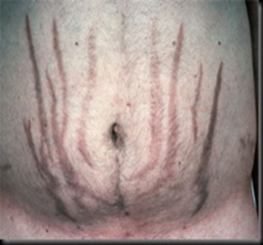
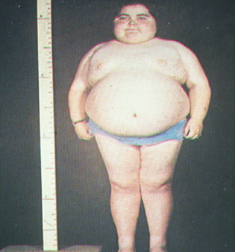
Case #1 BP 160/100
What is the cause of this persons hypertension?
Pheochromocytoma
Primary hyperaldosteronism 2nd to an aldosterone producing adenoma
Cushing’s syndrome
Hyperthyroidism (thyrotoxicosis)
Please select your answer now!

Slide 5
What is Cushing’s Syndrome?
Correct answer is C

Slide 6

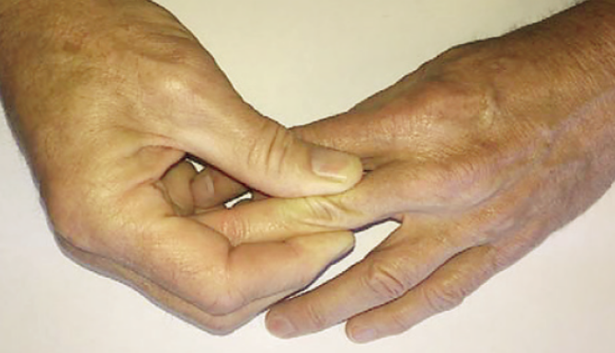
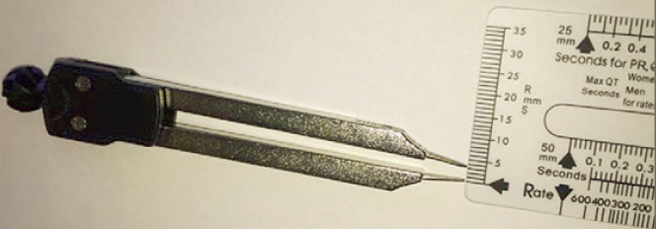
Cushing’s Syndrome
central obesity
skinfold thickness <2 mm
facial rounding
buffalo hump
easy bruising
purple striae
proximal muscle weakness
emotional/cognitive changes
N Engl J Med 2017;376:1451-1459
Notes:
Skinfold thickness is conveniently measured with an electrocardiographic caliper that has the points dulled with a sharpening stone and the screws tightened so that the gap is maintained when the caliper is removed from the skinfold. The skin over the proximal phalanx of the middle finger of the nondominant hand is commonly used for this measurement
(Fig. 1). A thickness of less than 2 mm is considered to be thin skin. Patients who have thin skin are more likely to have Cushing’s syndrome, with a positive likelihood ratio of 116

Slide 7
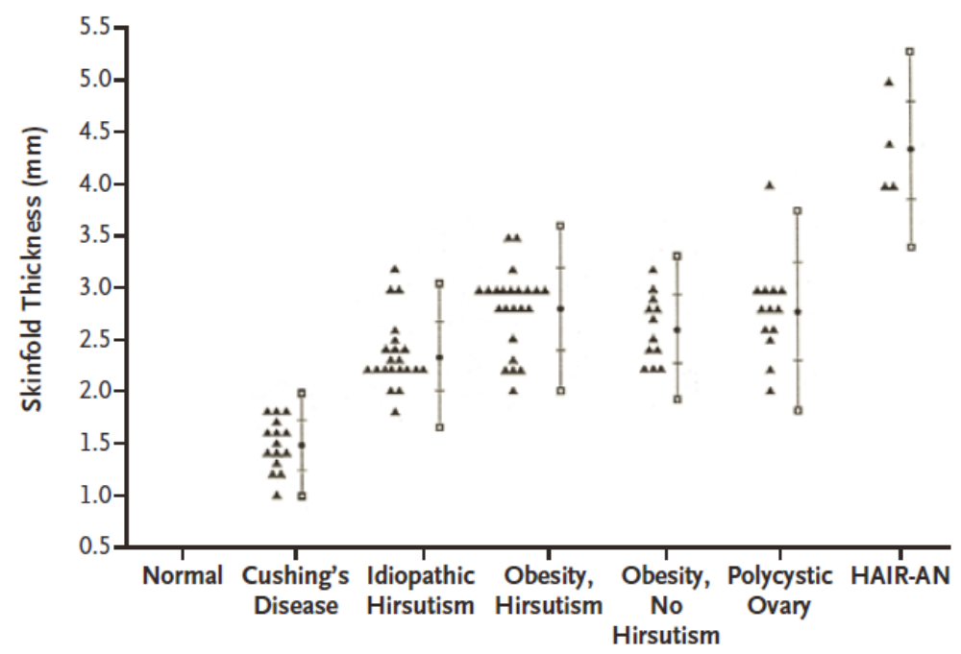
Skinfold Thickness-Cushing’s vs. Other Medical Disorders
N Engl J Med 2017;376:1451-1459
Notes:
Skinfold thickness is conveniently measured with an electrocardiographic caliper that has the points dulled with a sharpening stone and the screws tightened so that the gap is maintained when the caliper is removed from the skinfold. The skin over the proximal phalanx of the middle finger of the nondominant hand is commonly used for this measurement
(Fig. 1). A thickness of less than 2 mm is considered to be thin skin. Patients who have thin skin are more likely to have Cushing’s syndrome, with a positive likelihood ratio of 116
Comparison of Skinfold Thickness in Patients with Cushing’s Syndrome and Those with Other Conditions Related to Insulin Resistance. HAIR-AN denotes hyperandrogenism, insulin resistance, and acanthosis nigricans. Vertical bars indicate means ±2 SD.

