Slide 1


Hypertension Update:
How Low Shall We Go?
Claude K. Lardinois, MD, FACP, MACN, FACE
lardinois@sbcglobal.net
Emeritus Professor
University of Nevada School of Medicine, Reno, Nevada
Board Certified Endocrinologist
Medical Director for American Health Care, Rocklin, CA

Slide 2
Speaker Disclosure
I have received honoraria as a speaker for Boehringer Ingelheim,
Eli Lilly, Janssen Pharmaceuticals, and Merck.
        --Dr. Lardinois

Slide 3
Educational Objectives
Identify the etiologies and prevalence of primary and secondary hypertension.
Identify the manifestations of hypertension complications.
Evaluate observational and clinical trials to determine target blood pressure goals.
Describe life-style changes including dietary and exercise; customize nutrition counseling based on ApoE genotype; is it time to begin restricting fructose in the diet?
Describe pharmacological therapeutic options to target blood pressure to goal.
Notes:
Purpose
To review the learning objectives associated with this lecture.

Slide 4
High Blood Pressure - Leading Cause of Mortality Worldwide, 2002
High Blood Pressure
Tobacco
High cholesterol
Being underweight
Unsafe sex
High BMI
Physical inactivity
High Mortality, Developing Region
Lower Mortality, Developing Region
Developed Region
Alcohol
Indoor smoke from solid fuels
Iron deficiency
0
1
2
3
4
5
6
7
8
Attributable Mortality (in millions – total 55,861,000)
Lancet 2002;360:1347-1360

Slide 5
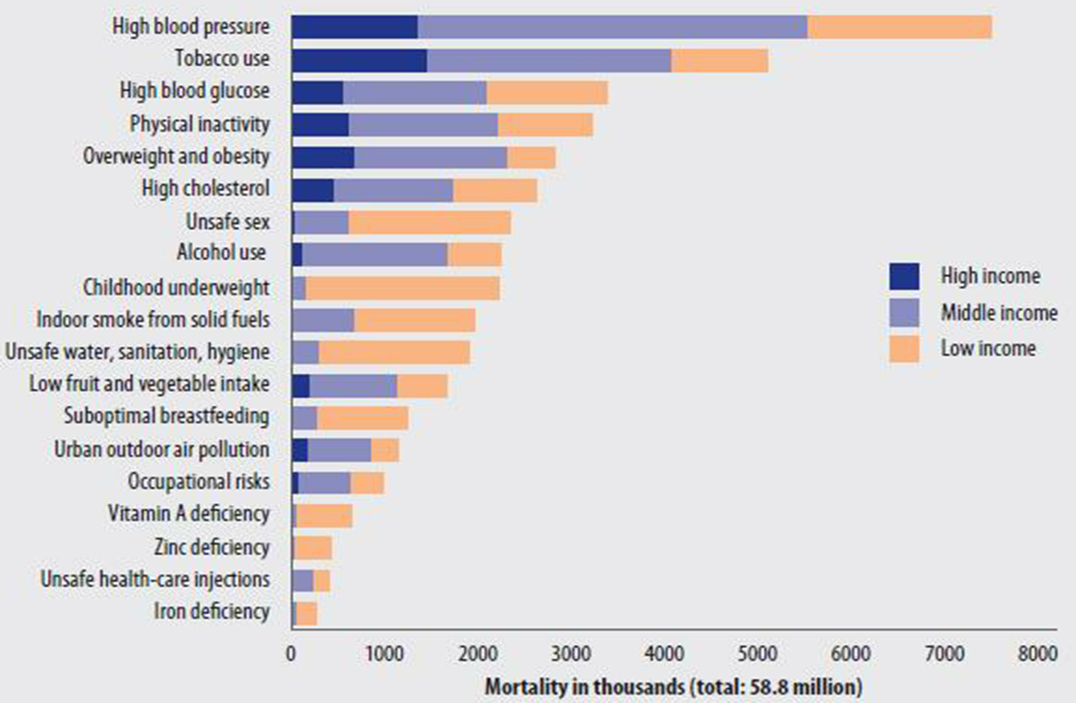
Deaths Attributed to 19 Leading Risk Factors
Again #1 Cause is High Blood Pressure, 2004

Slide 6
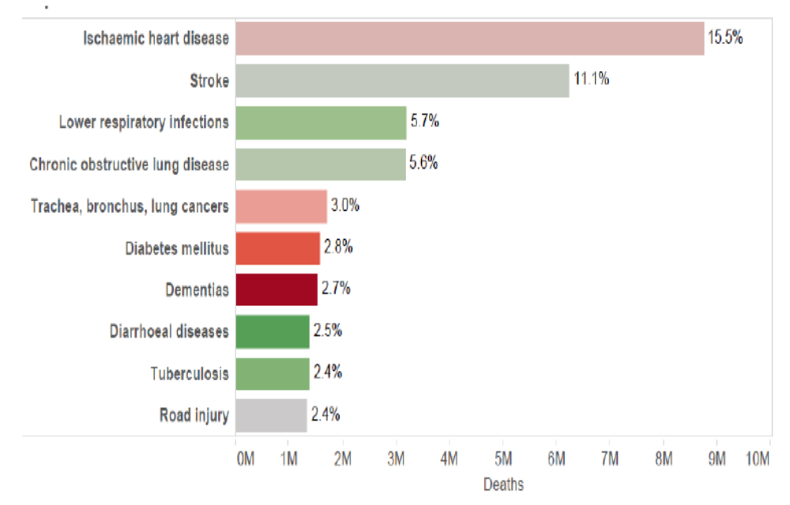
The 10 leading Causes of Death in the World, 2015
Hypertension
http://www.who.int/healthinfo/global_burden_disease/en
Notes:
Leading causes of death in 2015
Of the 56.4 million deaths worldwide in 2015, more than half (54%) were due by the following 10 causes (Figure 11.1). Ischemic heart disease and stroke killed 15 million people in 2015 – these two diseases have remained the biggest killers globally in the last 15 years. World Health Organization. Chronic lung disease claimed 3.2 million lives in 2015, while lung cancer (along with trachea and bronchus cancers) caused 1.7 million deaths. Diabetes killed 1.6 million people in 2015, up from less than 1 million in 2000. Deaths due to dementias more than doubled between 2000 and 2015, making it the 7th leading cause of global deaths in 2015. Lower respiratory infections remained the most deadly communicable disease, causing 3.2 million deaths worldwide in 2015. Diarrhea death rate almost halved between 2000 and 2015, but the disease still caused a large number of deaths (1.4 million) in 2015. Similarly, tuberculosis death rate decreased during the same period, but the disease was still among the top 10 causes of death in 2015 with a death toll of 1.4 million. Road injury killed 1.3 million people in 2015, three-quarter of which were men and boys

Slide 7
Epidemiology of Blood Pressure
  Blood pressure increases with age, especially systolic blood pressure and pulse pressure (difference between systolic and diastolic blood pressure).
  In Americans ≥65 years, the prevalence of hypertension is:
    50% to 70%;
    highest among blacks; and
    higher in women than men.
  The proportion of patients with hypertension whose blood pressure is controlled is disappointingly low even at current blood pressure recommended goals.

