Slide 1
Practical Implementation of the
THE COMMON ORIGINS OF DIABETES AND ITS COMPLICATIONS CONSTRUCT

Slide 2
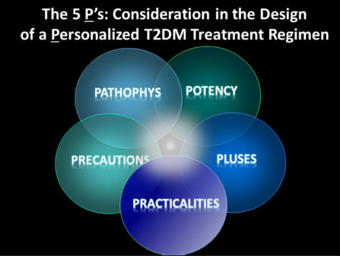
Ins. Def./IR
Inflam/Immune
Environment
Wt. loss
CV benefit
Steatosis
albuminuria
HYPO-
Weight
GI
Edema
GU inf
Volume
Co-morbities
Speed of efficacy, injection,
dosing schedule, lab monitoring
And Economic VALUE
Not just cost of a dose, but cost benefit of CV/Complication reduction

Slide 3
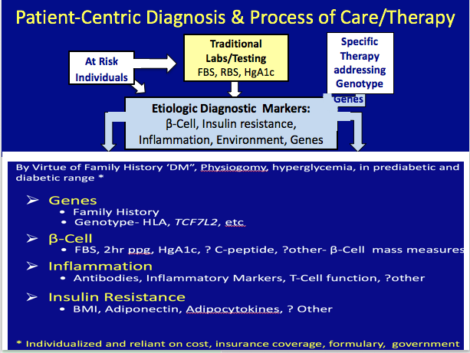

Slide 4
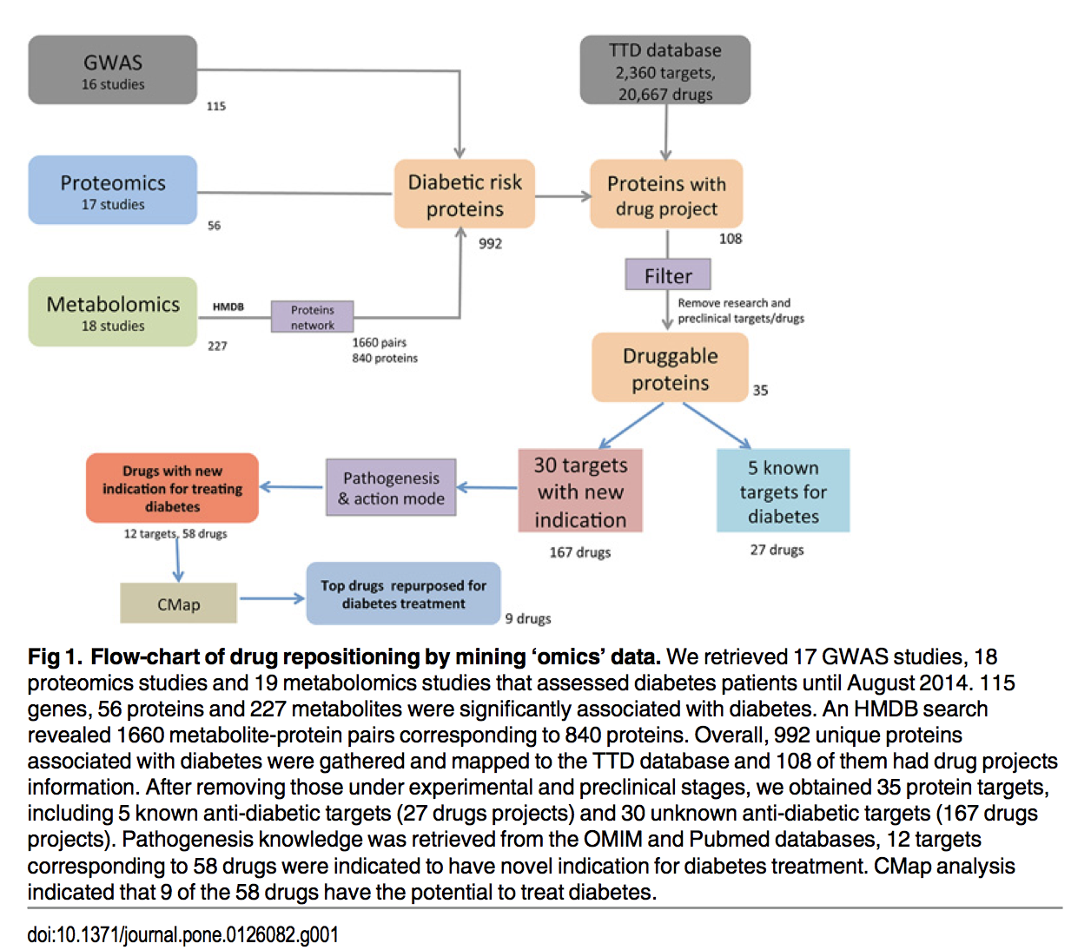
Principles/ Potential of Omics Analysis for Rx DM

Slide 5
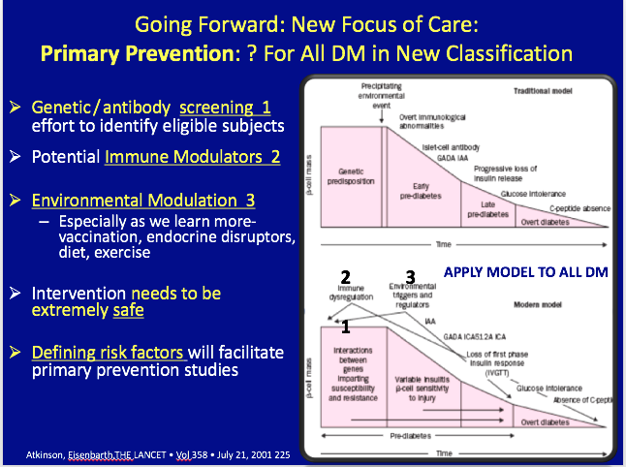

Slide 6
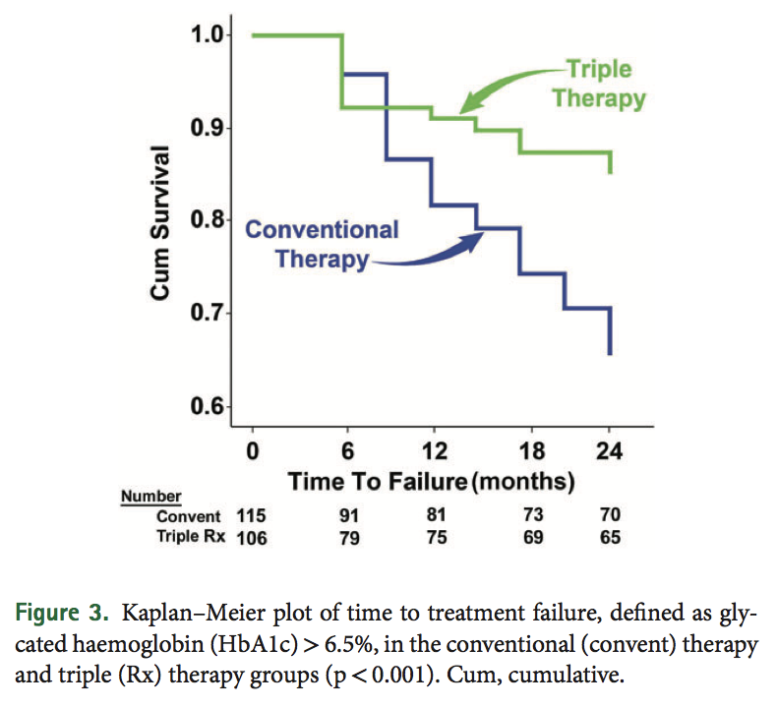
SELECT AGENTS THAT CAN PRESERVE β-Cell function/mass
  Treating Causes of β-Cell dysfunction
  Treating Abnormalities resulting from β-Cell dysfunction
No Logic for Agents that Decrease β-Cell dysfunction
Liraglutide- 80% delay in progression to overt DM
Piog- Act-Now 72%
Metformin 30%
sglt-2- theoretical
Triple rx

