Slide 1
Choice of Therapy
  Allows us to Correct a myth
MYTH: “Most Patients with ‘T2DM’ will eventually
progress to insulin because of inexorable β-Cell loss”
- But data obtained on SU=apoptosis; Hyperinsulinism with weight gain
- Think of bariatric patients –no insulin after 25 years DM/ 20 years insulin
- Most patients dying with DM have > 20% β-Cell mass- Butler
- saw in med school-Need to remove >80% pancreas to get DM;
see in sub-total pancreatectomies- need to remove >80%
to leave patient with DM post-op
J Gastrointest Surg (2008) 12:1548–1553,Distal Pancreatectomy: Incidence of Postoperative Diabetes
Jonathan King & Kevork Kazanjian & J. Matsumoto & Howard A. Reber & Michael W. Yeh & O. Joe Hines & Guido Eibl

Slide 2
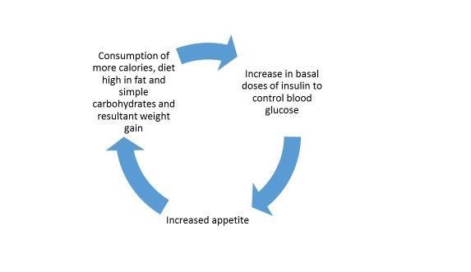
Avoid Early Insulin Therapy and Hyper-Insulinemia
(except in Ketosis-prone)
Vicious Circle(s) of Hyperinsulinemia-
Result in Weight Gain and Hypoglycemia
Re-Examining Insulin Therapy
Blood glucose rises
Over-insulinization with basal or bolus insulin to compensate
Poor diet/food choices
Increased risk of severe hypoglycemia episodes, deleterious chronic asymptomatic hypoglycemia and its sequelae

Slide 3


Re-Examining Insulin Therapy
Iatrogenic hyperinsulinemia
is an unavoidable consequence injecting insulin into the periphery, and causes a host of downstream negative effects
Endogenous Insulin
Exquisitely controlled levels of insulin released into the portal vein
Fine-tuned, physiologically appropriate insulinemia
Exogenous Insulin
‘Obligatory’ excess peripheral insulin to get modicum of reduced hepatic glucose production
Insulin Resistance
β-cell Dysfunction
-------
Potential
β-cell Exhaustion
Hypoglycemia
Obesity
Atherosclerosis
Hyperinsulin-emia
Weight gain
Hypertension
Dyslipidemia
Cancer
Chronic Inflammation
Type II Diabetes
Notes:
All because all insulin results in hyperinsulinemia with risk of negative consequences

Slide 4
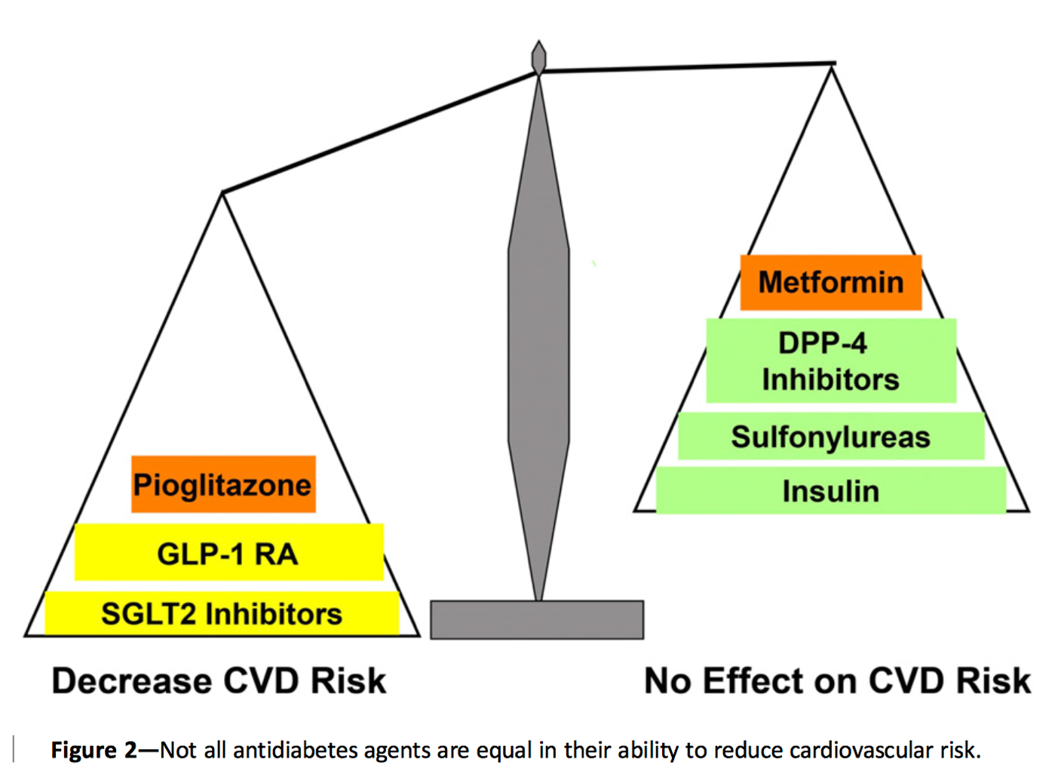
Recognize CV benefits
of some DM MEDS
Bromo-QR
Metformin/DPP-4 inh
Neutral
Adverse
Modified from Abdul-Ghani, Diabetes Care July, 2017

Slide 5
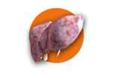





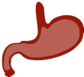
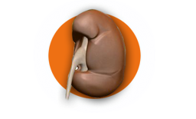
A. β-Cell-Centric Construct: Egregious Eleven
Basis for New Guideline for DM Care
4. Colon/Biome
1. Liver
INSULIN RESISTANCE
3. Muscle
Probiotics
DPP-4 Inh*
GLP-1 RA ***WR
Metformin***
2. Adipose
Metformin TZDs**
5. Immune
Dysregulation/
Inflammation
1. Pancreatic β-cells
↓ β-Cell function
↓ β-Cell mass
6. Brain
Insulin
GLP-1 RA***WR
Bromocriptine-QR**
Appetite Suppressants
FINAL COMMON DENOMINATOR
DPP-4 Inh.*
GLP-1 RA***WR
(anti-inflammatories
Immune Modulators
2. ↓Incretin
effect
3. α-cell
defect
↓Amylin
DPP-4 Inh*
GLP-1 RA***WR
DPP-4 Inh*
GLP-1 RA***WR
Pramlintide
↑ Glucagon
*Logic for CV risk/outcome
reduction exists
**Supporting evidence exists
***Prospective Evidence-Based
Data Exists
WR- weight reduction
4. Stomach/
Small intestine
Hyperglycemia
GLP_1 RA***WR
Pramlintide
Alpha Glucosidase Inhibitors**
5. Kidney
SGLT-2 Inhibitors
***WR

Slide 6
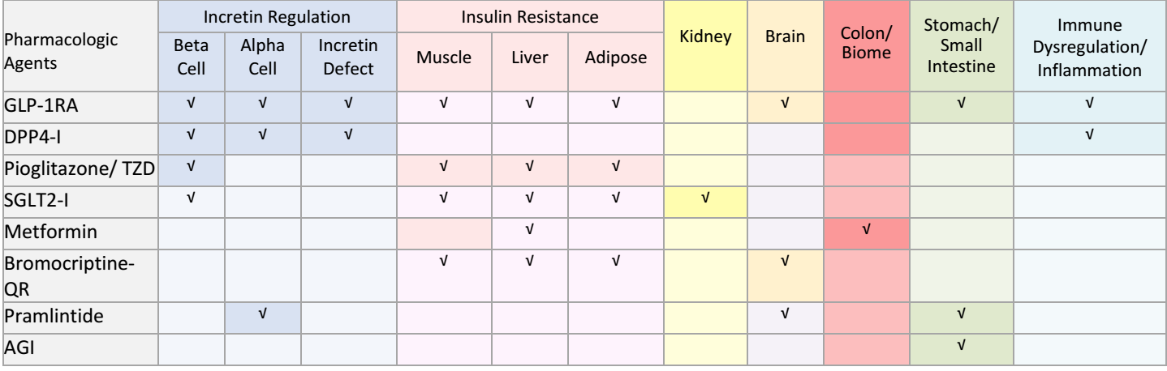
Logic for (early) Combination therapy-
Use least number of Agents that treat most number of mechanisms of hyperglycemia

Slide 7
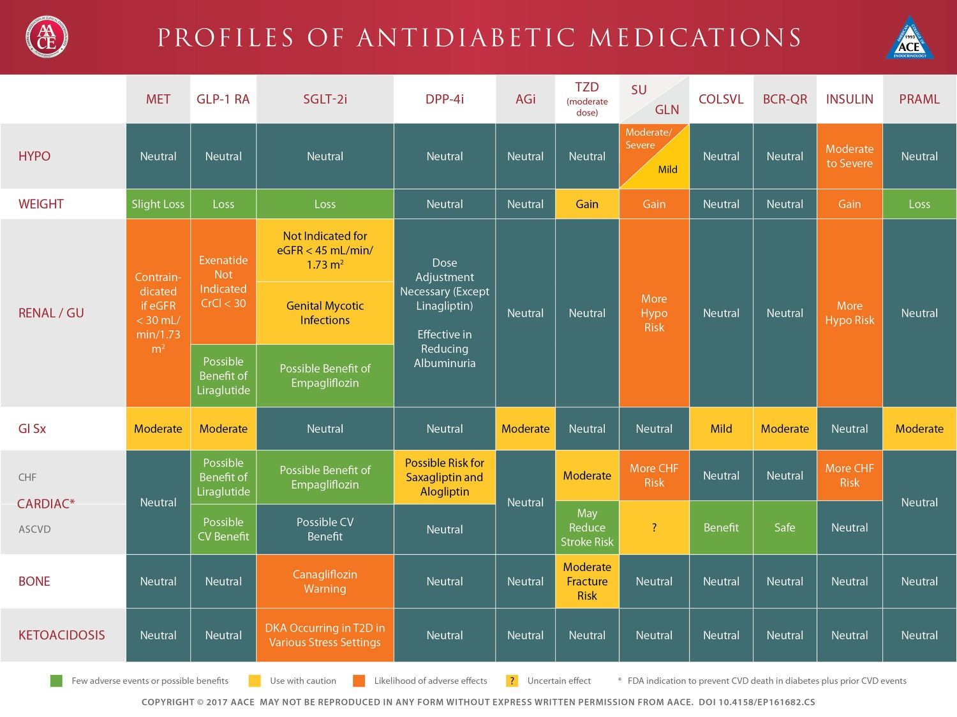
EMR- CDMP can take patient specific data and apply
Therapeutic Principles Across Continuum of Care eg: Right Drug for Right Patient and vice versa

Slide 8
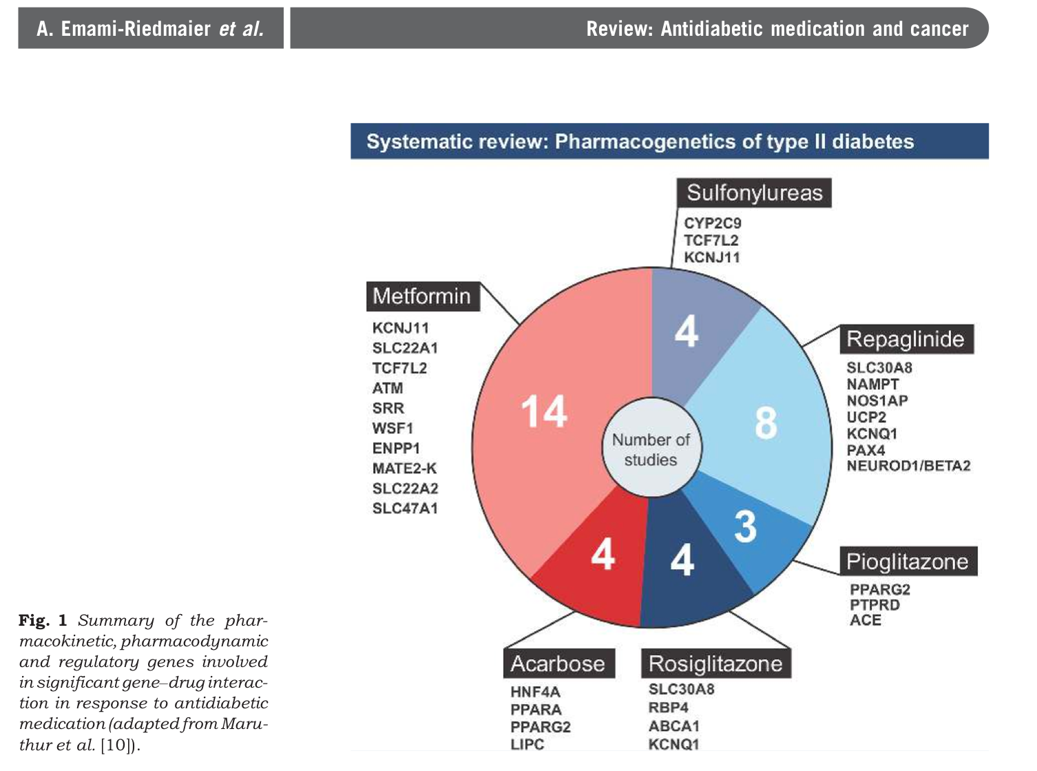
Pharmacogenetics:
Which agents most likely
to be effective
in a given patient
TAK-OEC

