Slide 1
Value of construct
1. Fits with Harry Keen’s construct
  why similar HgA1c in different folk give different risks
2. Helps understand how DM meds reduce CV outcomes, even if glycemic benefit small
3. Helps explain STENO_2 trial CV or mortality benefits, even if glycemic benefit small

Slide 2
CV Benefits of DM Meds Driven By Other Mechanisms!!
study | HgA1c drop | eye | nerve | kidney | MACE | CV Mort | MI | CVA | CHF | All Cause Mort | Inferences on Value of Glycemic Control and Other Mechanisms of DM meds in Reducing Complications of Diabetes
UKPDS | 0.9 | ⬇ | ⬇ | ⬇ |  |  | ⬇ |  |  | ⬇ | Glycemic Hypothesis Proven in Primary
DCCT | ~2.0 | ⬇ | ⬇ | ⬇ | ⬇ |  |  |  |  |  | Prevention despite ‘wrong meds’
VADT | 1.5 |  | − | − | − |  | − | − | − |  | Glycemic Benefit could not be proven in face of
ADV. | 0.8 |  | ⬇ | ⬇ | ⬇ |  | − | − | − |  | Metabolic memory
ACCORD | 1.1 |  | ⬇ | ⬇ | ⬇ | ⬆ | − | − | − | ⬆ | Wrong drugs, wrong process of care
BROMO-QR | (pts <7) |  |  |  | ⬇ |  |  |  |  |  | Benefits primarily driven
Canvas EMPAReg | ~0.5 |  |  | ⬇ | ⬇ ⬇ | ⬇ |  |  | ⬇ ⬇ | ⬇ | By other mechanisms
IRIS | IR /pre-DM |  |  |  |  |  | ⬇ | ⬇ |  |  | Besides glycemia, eg:
LEADER | 0.4 |  |  | ⬇ | ⬇ | ⬇ |  |  |  | ⬇ | ⬇ IR, Arterial Stiffness, Inflam.,Symp. Tone
Primary prevention
Secondary Prevention
Secondary Prevention- Drug trials with CV Benefit
Notes:
Glycemic Hypothesis Proven in Primary Prevention in both ‘T1DM, T2DM’; Success despite ‘wrong meds’
In Older patients with T2DM- longer duration DM, and many with prexisting complications; Achieved modest ‘microvascular benefit, no CV benefit, but increased mortality in ACCORD- likely due to ‘metabolic memory, and use of ‘wrong meds’ to point of excess hypoglycemia and undue weight gain
But 4 agents recently shown to have reduction in complications-- likely due to
benefits primarily driven by other mechanisms besides glycemia, eg: ⬇ IR, ⬇Arterial Stiffness, reduced Inflammation, ⬇ Sympathetic Tone

Slide 3
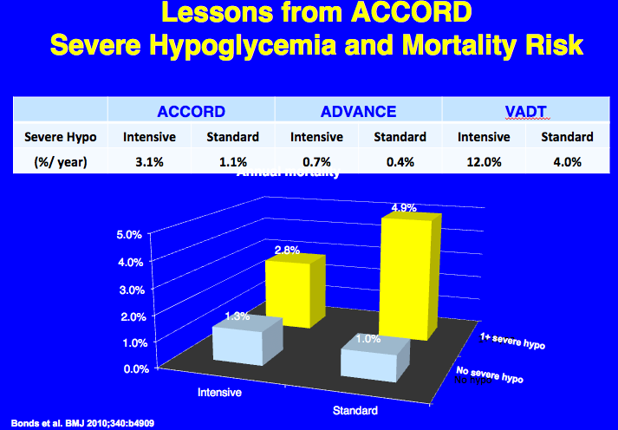
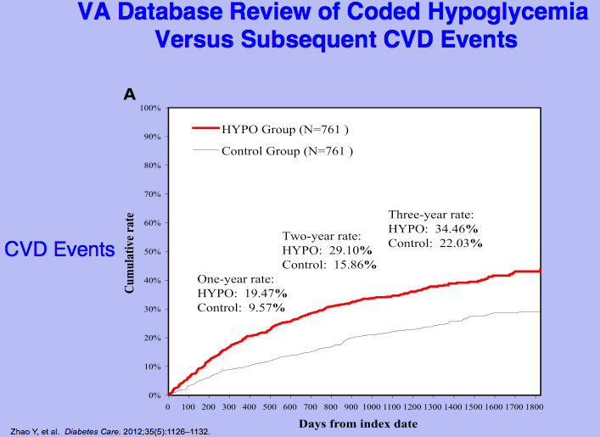
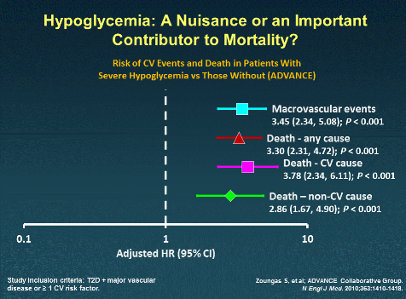
Hypoglycemia Outcomes VADT, ACCORD, ADVANCE

Slide 4
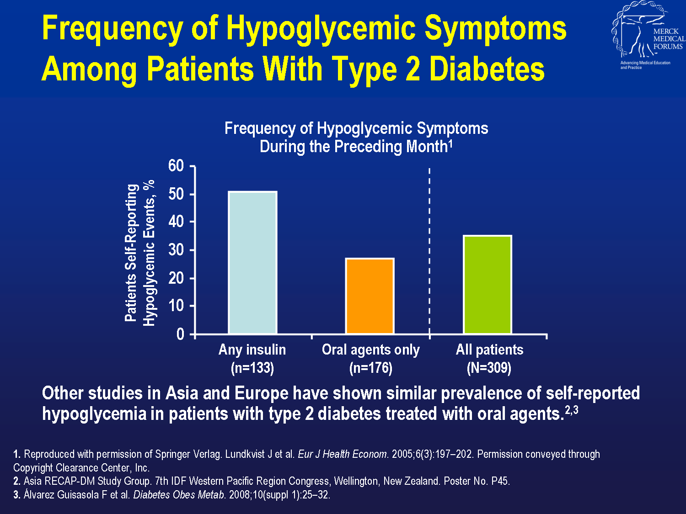
Notes:
Frequency of Hypoglycemic Symptoms Among Patients With Type 2 Diabetes
Lundkvist et al¹ compared the frequency of hypoglycemic symptoms among 309 patients with type 2 diabetes who were receiving oral agents only or insulin.
Symptoms of hypoglycemia were reported by 115 patients during the previous month, representing a 37% incidence of hypoglycemia (24% of patients experienced symptoms once during the month, 11% every week, and 2% every day).¹ The results demonstrated that the frequency of hypoglycemic symptoms in 1 month was lower for patients with type 2 diabetes using only oral agents than in patients taking insulin, as seen on this chart.¹
Other studies in Asia and Europe have shown similar prevalence of self-reported hypoglycemia in patients with type 2 diabetes treated with oral agents.^{2,3}

Slide 5
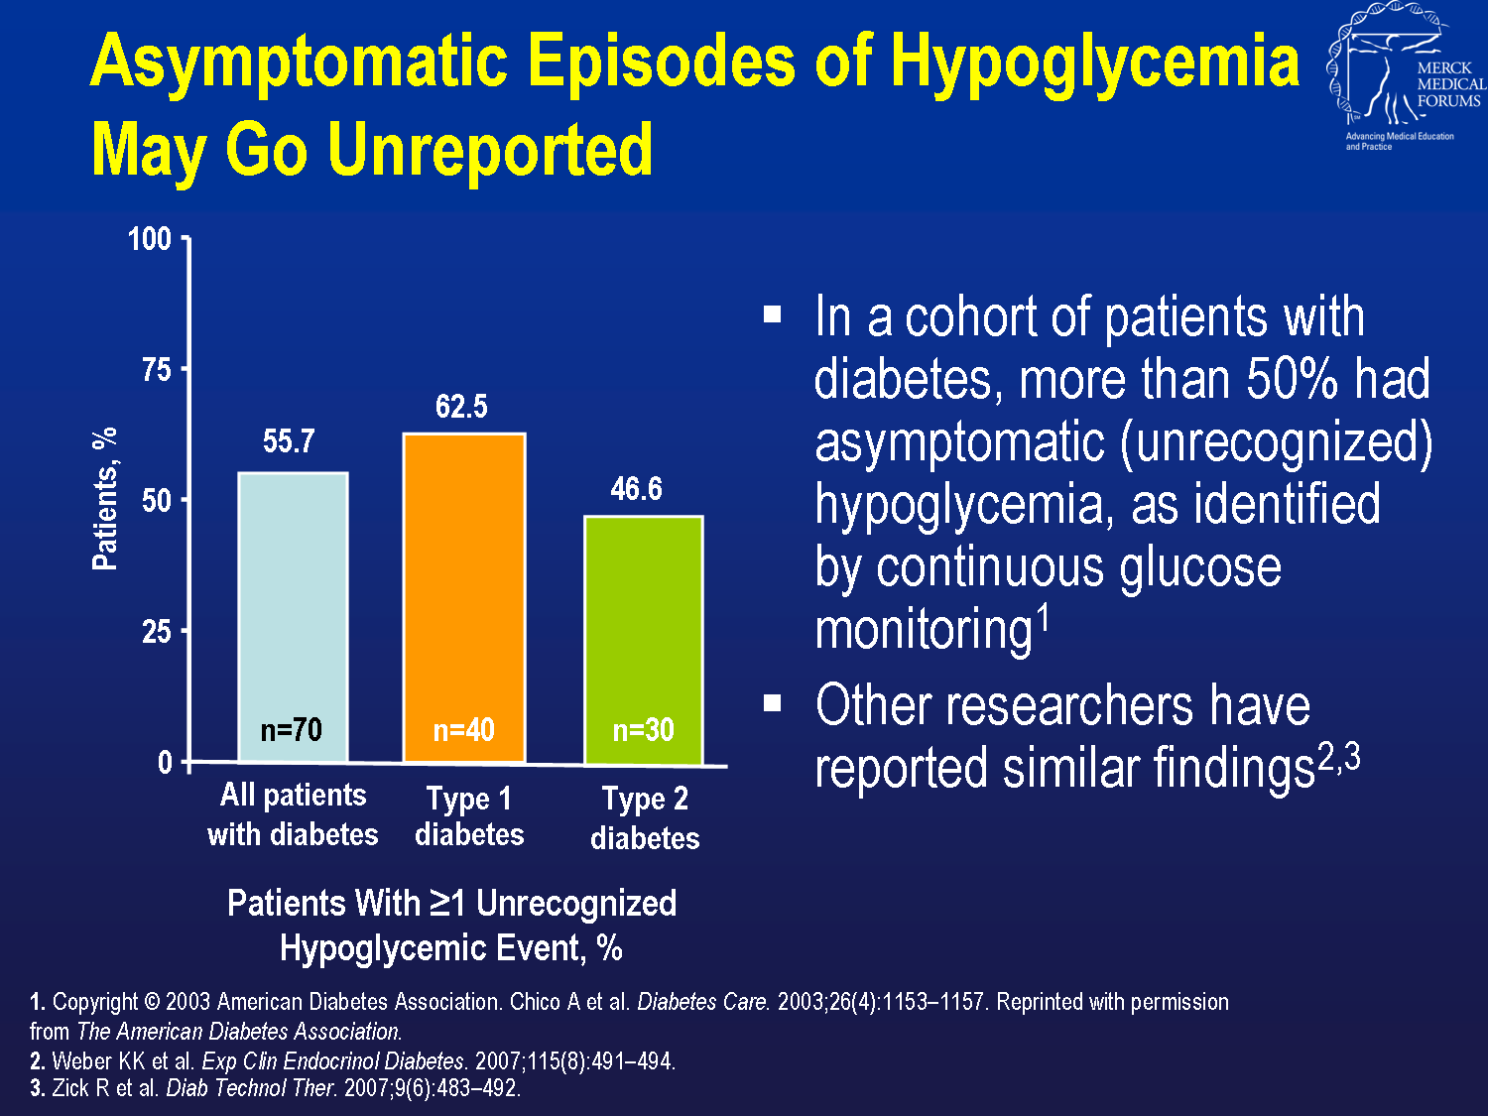
Notes:
Asymptomatic Episodes of Hypoglycemia May Go Unreported
In clinical studies of continuous glucose monitoring (CGM), episodes of hypoglycemia have been found to go unrecognized.^{1–3}
Chico et al¹ used CGM to measure the frequency of unrecognized episodes of hypoglycemia in patients with type 1 (n=40) and type 2 (n=30) diabetes. CGM detected unrecognized hypoglycemic events in 55.7% of all patients. In the subset of patients with type 2 diabetes, CGM detected hypoglycemic events in 46.6% of patients.¹
Other researchers have reported similar findings.^{2,3}

Slide 6
CV Benefits of DM Meds Driven By Other Mechanisms!!
study | HgA1c drop | eye | nerve | kidney | MACE | CV Mort | MI | CVA | CHF | All Cause Mort | Inferences on Value of Glycemic Control and Other Mechanisms of DM meds in Reducing Complications of Diabetes
UKPDS | 0.9 | ⬇ | ⬇ | ⬇ |  |  | ⬇ |  |  | ⬇ | Glycemic Hypothesis Proven in Primary
DCCT | ~2.0 | ⬇ | ⬇ | ⬇ | ⬇ |  |  |  |  |  | Prevention despite ‘wrong meds’
VADT | 1.5 |  | − | − | − |  | − | − | − |  | Glycemic Benefit could not be proven in face of
ADV. | 0.8 |  | ⬇ | ⬇ | ⬇ |  | − | − | − |  | Metabolic memory
ACCORD | 1.1 |  | ⬇ | ⬇ | ⬇ | ⬆ | − | − | − | ⬆ | Wrong drugs, wrong process of care
BROMO-QR | (pts <7) |  |  |  | ⬇ |  |  |  |  |  | Benefits primarily driven
Canvas EMPAReg | ~0.5 |  |  | ⬇ | ⬇ ⬇ | ⬇ |  |  | ⬇ ⬇ | ⬇ | By other mechanisms
IRIS | IR /pre-DM |  |  |  |  |  | ⬇ | ⬇ |  |  | Besides glycemia, eg:
LEADER | 0.4 |  |  | ⬇ | ⬇ | ⬇ |  |  |  | ⬇ | ⬇ IR, Arterial Stiffness, Inflam.,Symp. Tone
Primary prevention
Secondary Prevention
Secondary Prevention- Drug trials with CV Benefit
Notes:
Glycemic Hypothesis Proven in Primary Prevention in both ‘T1DM, T2DM’; Success despite ‘wrong meds’
In Older patients with T2DM- longer duration DM, and many with prexisting complications; Achieved modest ‘microvascular benefit, no CV benefit, but increased mortality in ACCORD- likely due to ‘metabolic memory, and use of ‘wrong meds’ to point of excess hypoglycemia and undue weight gain
But 4 agents recently shown to have reduction in complications-- likely due to
benefits primarily driven by other mechanisms besides glycemia, eg: ⬇ IR, ⬇Arterial Stiffness, reduced Inflammation, ⬇ Sympathetic Tone

Slide 7
Diabetes and Its Complications Arise from
Common Pathophysiologies
Not Micro/
Macro Vascular
Same comp. for
T1DM & T2DM
CELLS of DIABETES-RELATED COMPLICATIONS
Intracellular Fuel Excess
Defines Logic for Varied Risk of Complications
in Individual Patients with similar ,
(poor) HgA1: Likely Genetically based
CELLS of
DIABETES-RELATED COMPLICATIONS
Intracellular Fuel Excess
Susceptibility to abnormal metabolic envir.
1 *
Cell/Tissue
damage and dysfunction
Cell/Tissue
damage and dysfunction
IR /
Dyslipidemia / Hypertension, etc.
*
REDOX regulators
(L/P, β/A, SH/SS, ROS)
miRNA, mechanisms of altered gene expression
Epigenetic Δ
EXTRACELLULAR FUEL EXCESS (glucose/ lipids)
(Brownlee’s Unified Theory of Complications)
Environ-ment
Inflammation /
Immune mech.
Diminished insulin secretion and beta cell mass;
cell damage and dysfunction
Diminished insulin secretion and beta cell mass;
cell damage and dysfunction
Intracellular Fuel Excess
BETA CELLS
Final Common Denominator
Gluco/Lipo
toxicity
2,3 *
Cause or permit susceptibility to damage
Explains why some newer meds for DM
and Rx’ing comorbidities a la Steno -2
decrease adverse outcomes
without major drops in HgA1c
Intracellular Fuel Excess
BETA CELLS
Final Common Denominator

Slide 8
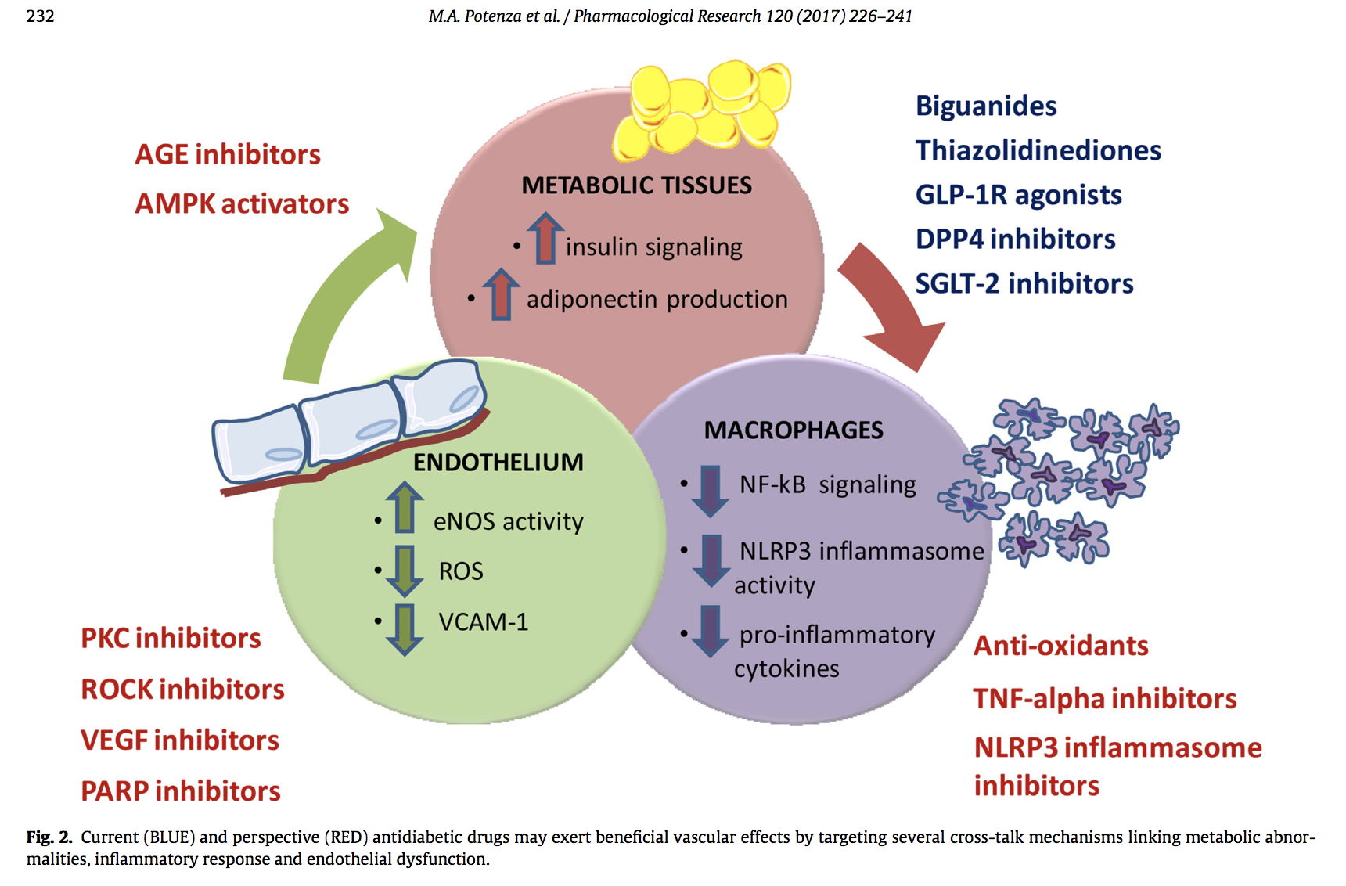

Crosstalk Benefits of Current and Future AntiDiabetic Meds
Current (blue) and future (red) antidiabetic agents may exert beneficial
vascular effects by targeting several crosstalk mechanisms linking
metabolic abnormalities, inflammatory response, and endothelial dysfunction

