Slide 1
ANOTHER INSIGHT:
WHAT ABOUT COMPLICATIONS OF DIABETES?
We noticed 3 ‘old’ general principles:

Slide 2
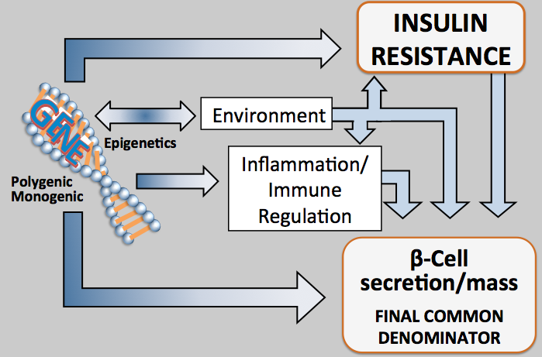
New approach is Commensurate with Natural History of ALL DM
Age 0-15 15-40+ 15-50+ 25-70+
Macrovascular Complications
Disability
IR Phenotype
MI
CVA
Amp
IGT ALL DM
DEATH
Blindness
Amputation
CRF
ETOH
BP
Smoking
Eye
Nerve
Kidney
Disability
Microvascular Complications
Risk of Dev. Complications
Notes:
2

Slide 3
Pathophysiology of Diabetic Complications:
Old Conundrum : why similar HgA1c in different folk give different risks
1
II
Individual Susceptibility
Genetic/ethnic
?Acquired
IV
Early
I
Metabolic Disorder
Glucose, insulin hormones, enzymes, metabolites, etc (i.e., control)
Delayed Complications
Retinal, renal neural, cardiovascular, cutaneous, etc.
Point of metabolic “no return”
III
Modulating Factors
Hypertension, diet, smoking, etc., IR,Inflam
2,3,4
V
Late
Pathophysiology of complications are
THE SAME AS THOSE THAT DAMAGE THE Beta-Cell
harry keen, chronic complications of diabetes mellitus, chapter 16, in monograph, ed. Galloway et al DM, lilly research labs, 1988

Slide 4
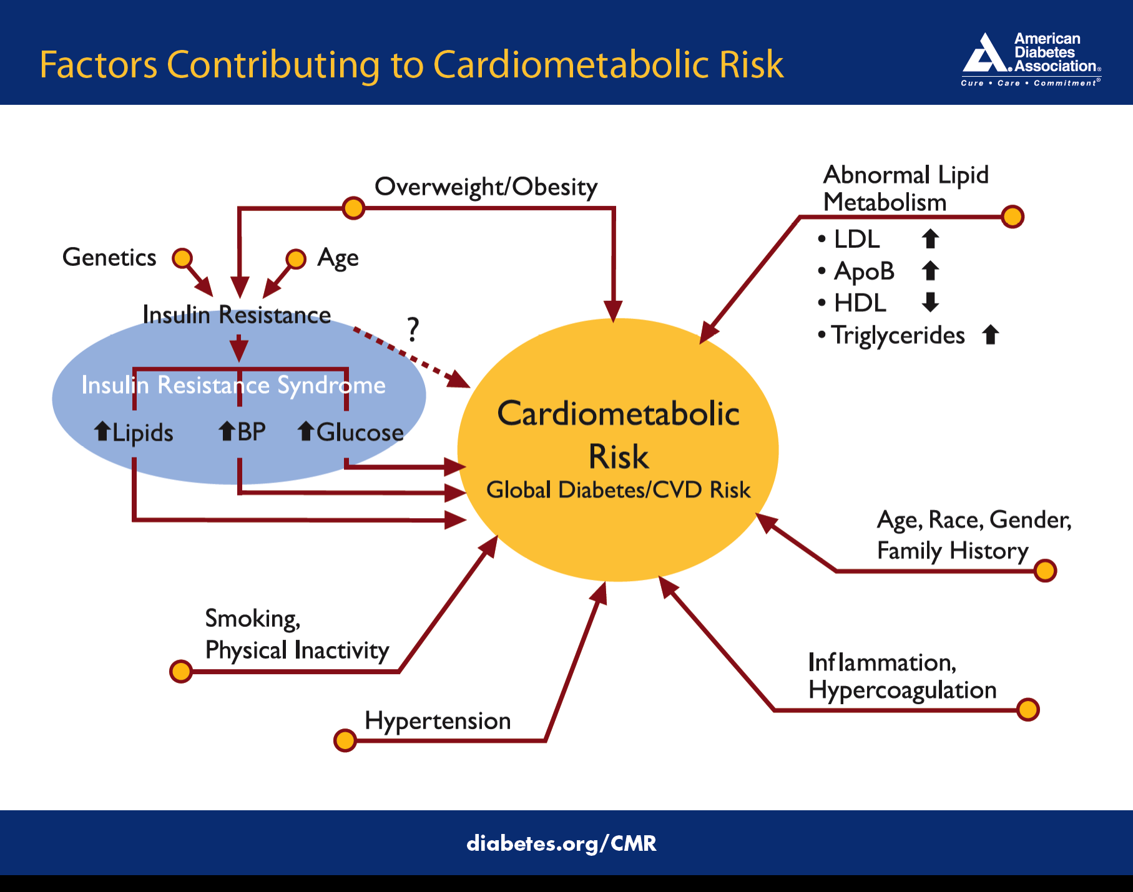
Pathophysiology of complications are
THE SAME AS THOSE THAT DAMAGE THE Beta-Cell
*
*
*
*

Slide 5
Diabetes and Its Complications Arise from
Common Pathophysiologies
MOST MECHANISMS OF B-cell Damage Overlap
with Causes of ALL Complications:
IR /
Dyslipidemia / Hypertension, etc.
*
Epigenetic Δ
EXTRACELLULAR FUEL EXCESS
Environ-ment
Inflammation /
Immune mech.
Diminished insulin secretion and beta cell mass;
cell damage and dysfunction
Gluco/Lipo
toxicity
* Abnormal genes include both unique to the beta cells and genes common to beta cells and each cell type implicated in complications
Intracellular Fuel Excess
BETA CELLS

Slide 6
Diabetes and Its Complications Arise from
Common Pathophysiologies
Not Micro/
Macro Vascular-
It’s CELLS
Same comp. for
T1DM & T2DM
MOST MECHANISMS OF B-cell Damage Overlap
with Causes of ALL Complications:
[ describe in 2 ways]
CELLS of
DIABETES-RELATED COMPLICATIONS
Intracellular Fuel Excess
Cell/Tissue
damage and dysfunction
IR /
Dyslipidemia / Hypertension, etc.
*
Epigenetic Δ
EXTRACELLULAR FUEL EXCESS
Environ-ment
Inflammation /
Immune mech.
Diminished insulin secretion and beta cell mass;
cell damage and dysfunction
Gluco/Lipo
toxicity
* Abnormal genes include both unique to the beta cells and genes common to beta cells and each cell type implicated in complications
Intracellular Fuel Excess
BETA CELLS

Slide 7
Mechanism of Cell Damage in Diabetes
The Beta Cell-Centric Model
=Gluco-LipoToxicity
at beta-cell
Intracellular Fuel Excess
Oxidative stress / ROS
Polyol flux, PKC, Hexosamine flux, AGE pathways
? Circulating
master metabolic REDOX regulators
Exacerbated by
IR/metabolic syndrome
Inflammation / immune system
Environmental interactions
Brownlee’s Hypothesis
Induction of transcription factors Inflammation
Δ Gene
expression
Epigenetic Δ
Histone modifications, miRNAs, LncRNAs DNA methylation
Cell dysfunction hypertrophy, proliferation, remodeling, apoptosis
in Susceptible Cell Types/ Tissues-
Beta-cells; Endothelium, Cardiomyocytes, Renal Cells, Retinal Cells,
Neurons, Vascular Smooth Muscle
All comp.of DM
eye, kidney
nerve,
ASVD
Worsening
Beta- Cell Function

Slide 8
Diabetes and Its Complications Arise from
Common Pathophysiologies
Not Micro/
Macro Vascular
Same comp. for
T1DM & T2DM
CELLS of DIABETES-RELATED COMPLICATIONS
Intracellular Fuel Excess
MOST MECHANISMS OF B-cell Damage Overlap
with Causes of ALL Complications:
[ describe in 2 ways]
CELLS of
DIABETES-RELATED COMPLICATIONS
Intracellular Fuel Excess
Susceptibility to abnormal metabolic envir.
Cell/Tissue
damage and dysfunction
Cell/Tissue
damage and dysfunction
IR /
Dyslipidemia / Hypertension, etc.
*
REDOX regulators
(L/P, β/A, SH/SS, ROS)
miRNA, mechanisms of altered gene expression
Epigenetic Δ
EXTRACELLULAR FUEL EXCESS (glucose/ lipids)
(Brownlee’s Unified Theory of Complications)
Environ-ment
Inflammation /
Immune mech.
Diminished insulin secretion and beta cell mass;
cell damage and dysfunction
Diminished insulin secretion and beta cell mass;
cell damage and dysfunction
Intracellular Fuel Excess
BETA CELLS
Final Common Denominator
Gluco/Lipo
toxicity
Cause or permit susceptibility to damage
* Abnormal genes include both unique to the beta cells and genes common to beta cells and each cell type implicated in complications
Intracellular Fuel Excess
BETA CELLS
Final Common Denominator

Slide 9
Diabetes and Its Complications Arise from
Common Pathophysiologies
Not Micro/
Macro Vascular
Same comp. for
T1DM & T2DM
CELLS of DIABETES-RELATED COMPLICATIONS
Intracellular Fuel Excess
MOST MECHANISMS OF B-cell Damage Overlap
with Causes of ALL Complications:
[ describe in 2 ways]
CELLS of
DIABETES-RELATED COMPLICATIONS
Intracellular Fuel Excess
Susceptibility to abnormal metabolic envir.
MARKERS
Cell/Tissue
damage and dysfunction
Cell/Tissue
damage and dysfunction
IR /
Dyslipidemia / Hypertension, etc.
MARKERS
*
REDOX regulators
(L/P, β/A, SH/SS, ROS)
miRNA, mechanisms of altered gene expression
Epigenetic Δ
MARKERS
EXTRACELLULAR FUEL EXCESS (glucose/ lipids)
(Brownlee’s Unified Theory of Complications)
MARKERS
Environ-ment
Inflammation /
Immune mech.
MARKERS
MARKERS
Diminished insulin secretion and beta cell mass;
cell damage and dysfunction
MARKERS
Diminished insulin secretion and beta cell mass;
cell damage and dysfunction
Intracellular Fuel Excess
BETA CELLS
Final Common Denominator
Gluco/Lipo
toxicity
Cause or permit susceptibility to damage
MARKERS serve to predict, manage, prevent damage to beta cell, and each of the diabetes complications
Intracellular Fuel Excess
BETA CELLS
Final Common Denominator

Slide 10
Phenotypic Presentation of Each Complication is defined by:
Slope = ‘Natural History’ over time,
i.e.= RATE OF Development of Comp. Slope is not linear, and may be intermittently relapsing, remitting, stabilized, and improved, until ‘point of no return’
when presence and damage irreversible
no Comp.
−
−
−
−
−
−
−
--
−
end Stage −
DEPENDENT on
Genes- which, how many
Environmental Factors-
which/how many
Inflamatory/ Immune- which factors/ how many
IR/ Cardiometabolic Syndrome
For All DM
Severity of Complication
Complication
Risk/Presence
Modifiable
Irreversible
I I I I I/ ≈ / I I I I I I I I I I I I I I I I I I I I I I I I I I I I I I I I I I I I I I I I I I I I I I I I I I I I I I I I I I I I
Increasing Age/ Duration
Age/ at presentation = tipping point when the combined pathophysiolocic processes are exposed as phenotypic functional/structural abnormalities

