Slide 1
Insulin Resistance Issues

Slide 2
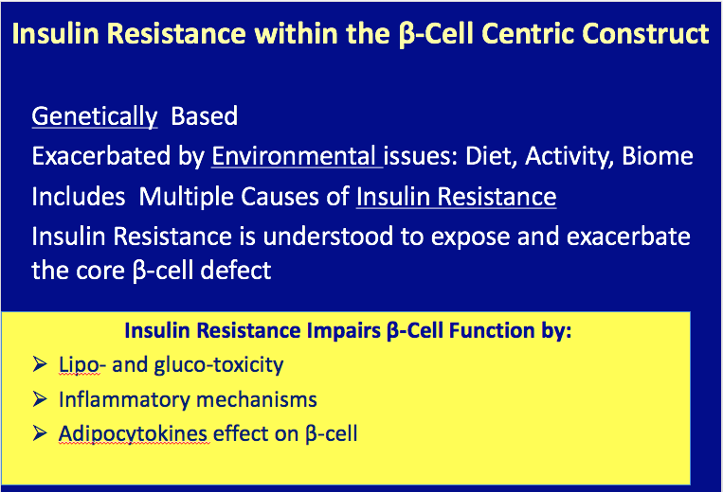

Slide 3
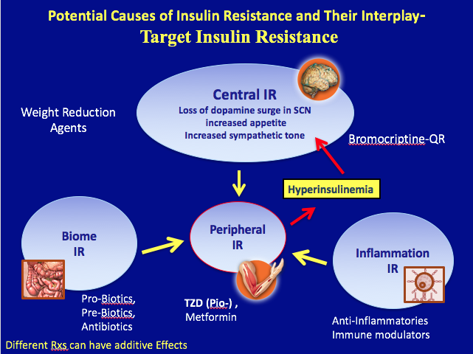

Slide 4
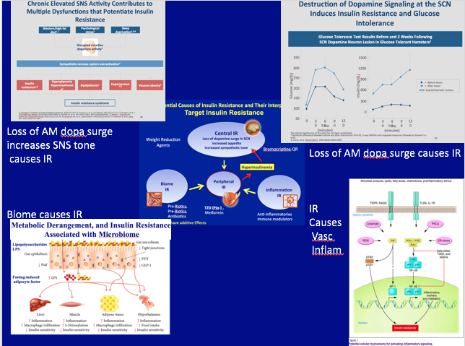

Slide 5
Nomenclature

Slide 6
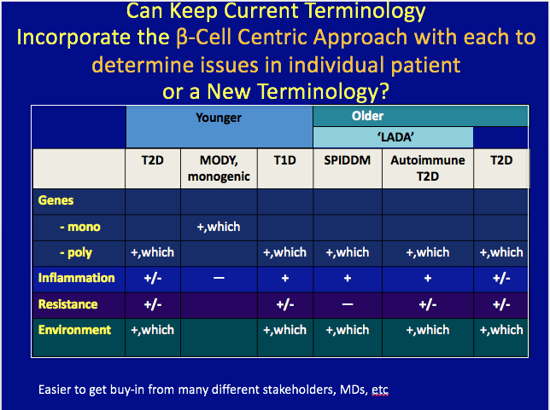

Slide 7
