Slide 1
Inflammation/Immune Issues

Slide 2
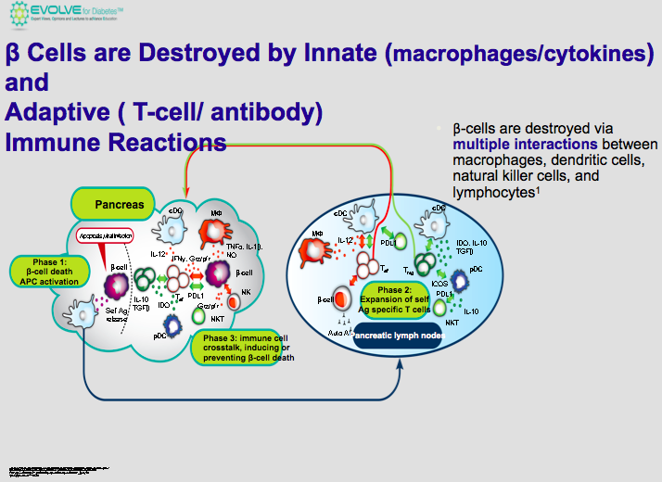
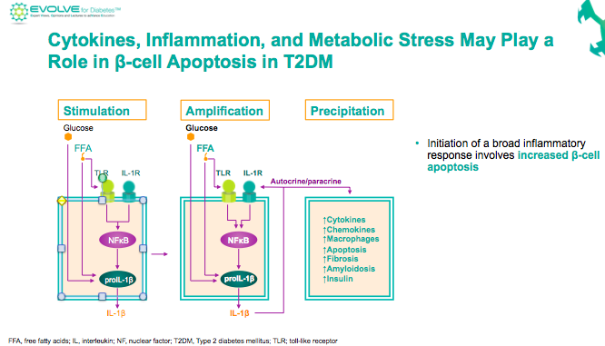
New β-Cell Centric Construct: Implications
Inflammation/ Immune Dysregulation Issues-ALL DM
Same Processes for
T1DM, T2DM
-
Same AND
Different Triggers
T1DM
T2DM
Yumi Imai1, Anca D. Dobrian2, Margaret A. Morris1,3, and Jerry L. Nadler,Islet inflammation: a unifying target for diabetes treatment? Trends in Endocrinology and Metabolism 2013:1-10 ;
Barbara Brooks-Worrell, Radhika Narla, and Jerry P. Palmer Biomarkers and immune-modulating therapies for Type 2 diabetes Trends in Immunology November 2012, Vol. 33, No. 11; James JohnsonUniversity of British Columbia Vancouver, BC, Canada

Slide 3
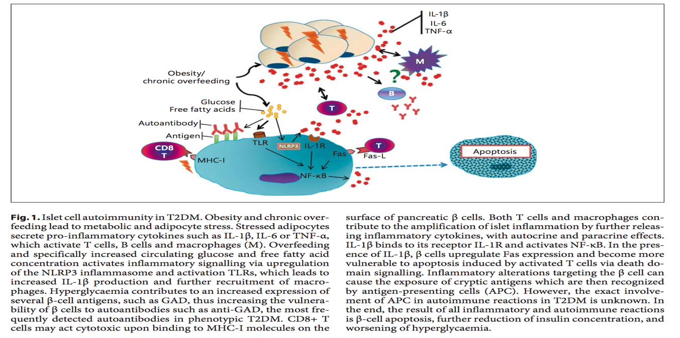
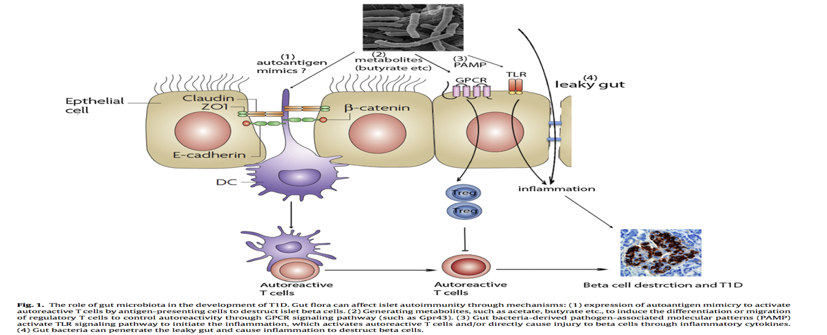


Obesity Increases Anti-Islet Cell Adipo-cytokines/ Inflammation
Beta Cell
apoptosis
Apoptosis
Beta Cell
Haptoglobin
Gene Variant
Associated with
leaky gut
Gut Microbiota Trigger Inflammation/ Immune destruction of B-Cell in ‘T1DM’

Slide 4
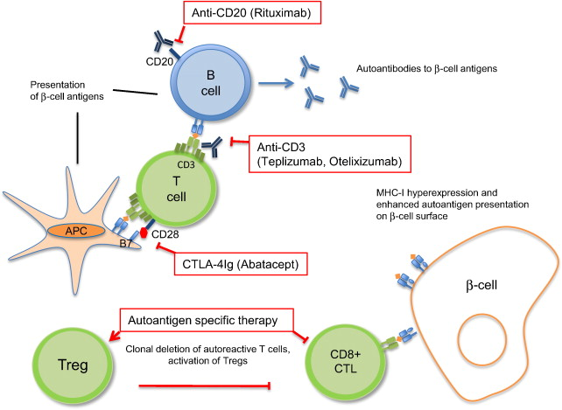
Pathogenesis and biological interventions in
T1DM- LIKE autoimmune diabetes- Insulitis
The class I MHC molecules are hyperexpressed on the β-cell surface in T1D patients making β-cells more susceptible to cytotoxic lymphocyte (CTL)-mediated destruction.
Novel diagnostic and therapeutic approaches for autoimmune diabetes — A prime time to treat insulitis as a disease
http://dx.doi.org/10.1016/j.clim.2014.11.007
Clinical Immunology, 2014
Juha Grönholm , Michael J. Lenardo

Slide 5
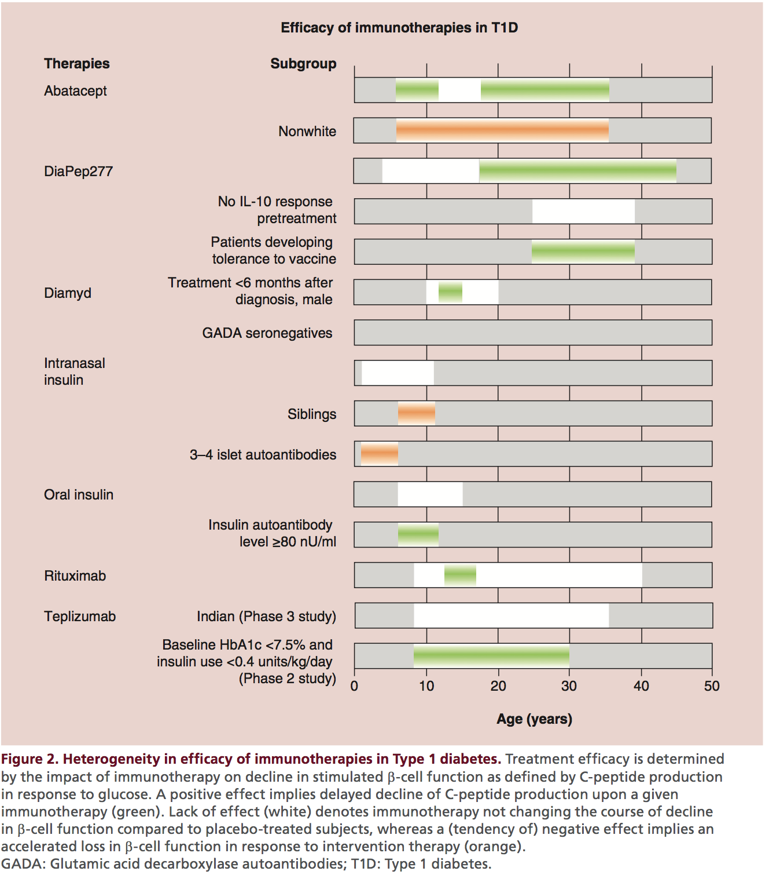
Efficacy of Immunotherapy in T1DM:
Some Can Delay Decline in C-peptide
Woittiez, Roep,
Immunotherapy (2015) 7(2), 163–174

