Slide 1
Phenotypic Presentation is defined by rate and extent of beta cell loss regardless of ‘type of DM- we’re taught it’s an inexorable loss
Slope = ‘Natural History’ over time, i.e.,RATE OF β-cell LOSS. Slope is not linear in either T1DM or T2DM, and may be intermittently relapsing, remitting, stabilized, and improved. Complete loss of β-cell mass may never be reached, especially if newer agents better preserve β-cells.
100%
−
−
−
−
−
−
−
−
−
0% −
Severity =
β-cell loss of mass
Pre-Diabetes = FBS ≥100, PPG ≥140
β−Cell
Mass
All DM = FBS ≥126, PPG ≥200
%
β−Cell
Mass
I I I I I/ ≈ / I I I I I I I I I I I I I I I I I I I I I I I I I I I I I I I I I I I I I I I I I I I I I I I I I I I I I I I I I I I I
Increasing Age
Age at presentation = tipping point when the combined gene effect / environmental trigger is exposed as phenotypic hyperglycemia

Slide 2
But data obtained from folks on SU (and Insulin)
DURABILITY OF GLYCEMIC CONTROL WITH SULFONYLUREAS eg: destroys beta cells
1
Glyburide
Glyburide
Glimepiride
SU
0
Glyburide
GLY
Alvarsson (n=39)
SU
Alvarsson (n=48)
Gliclazide
RECORD (n=272)
Change in HbA1c (%)
Glyburide
Hanefeld (n=250)
Charbonnel (n=313)
-1
Gliclazide
UKPDS (n=1,573)
Chicago (n=230)
ADOPT (n=1,441)
PERISCOPE (n=181)
Tan (n=297)
-2
0
1
2
3
4
5
6
10
TIME (years)
Notes:
2

Slide 3
Disease Modification: B-Cell Function/ Mass
1. Avoid Agents that destroy Beta Cells
2. Use agents that preserve Beta-cells
3. Newer / Future Agents to Increase Beta-Cells
4. Might Avoid Need for Insulin
100%
−
−
−
−
−
−
−
−
−
0% −
Pre-Diabetes = FBS ≥100, PPG ≥140
All DM = FBS ≥126, PPG ≥200
β−Cell
Mass
%
β−Cell
Mass
Disease Modification
I I I I I/ ≈ / I I I I I I I I I I I I I I I I I I I I I I I I I I I I I I I I I I I I I I I I I I I I I I I I I I I I I I I I I I I I
Increasing Age

Slide 4
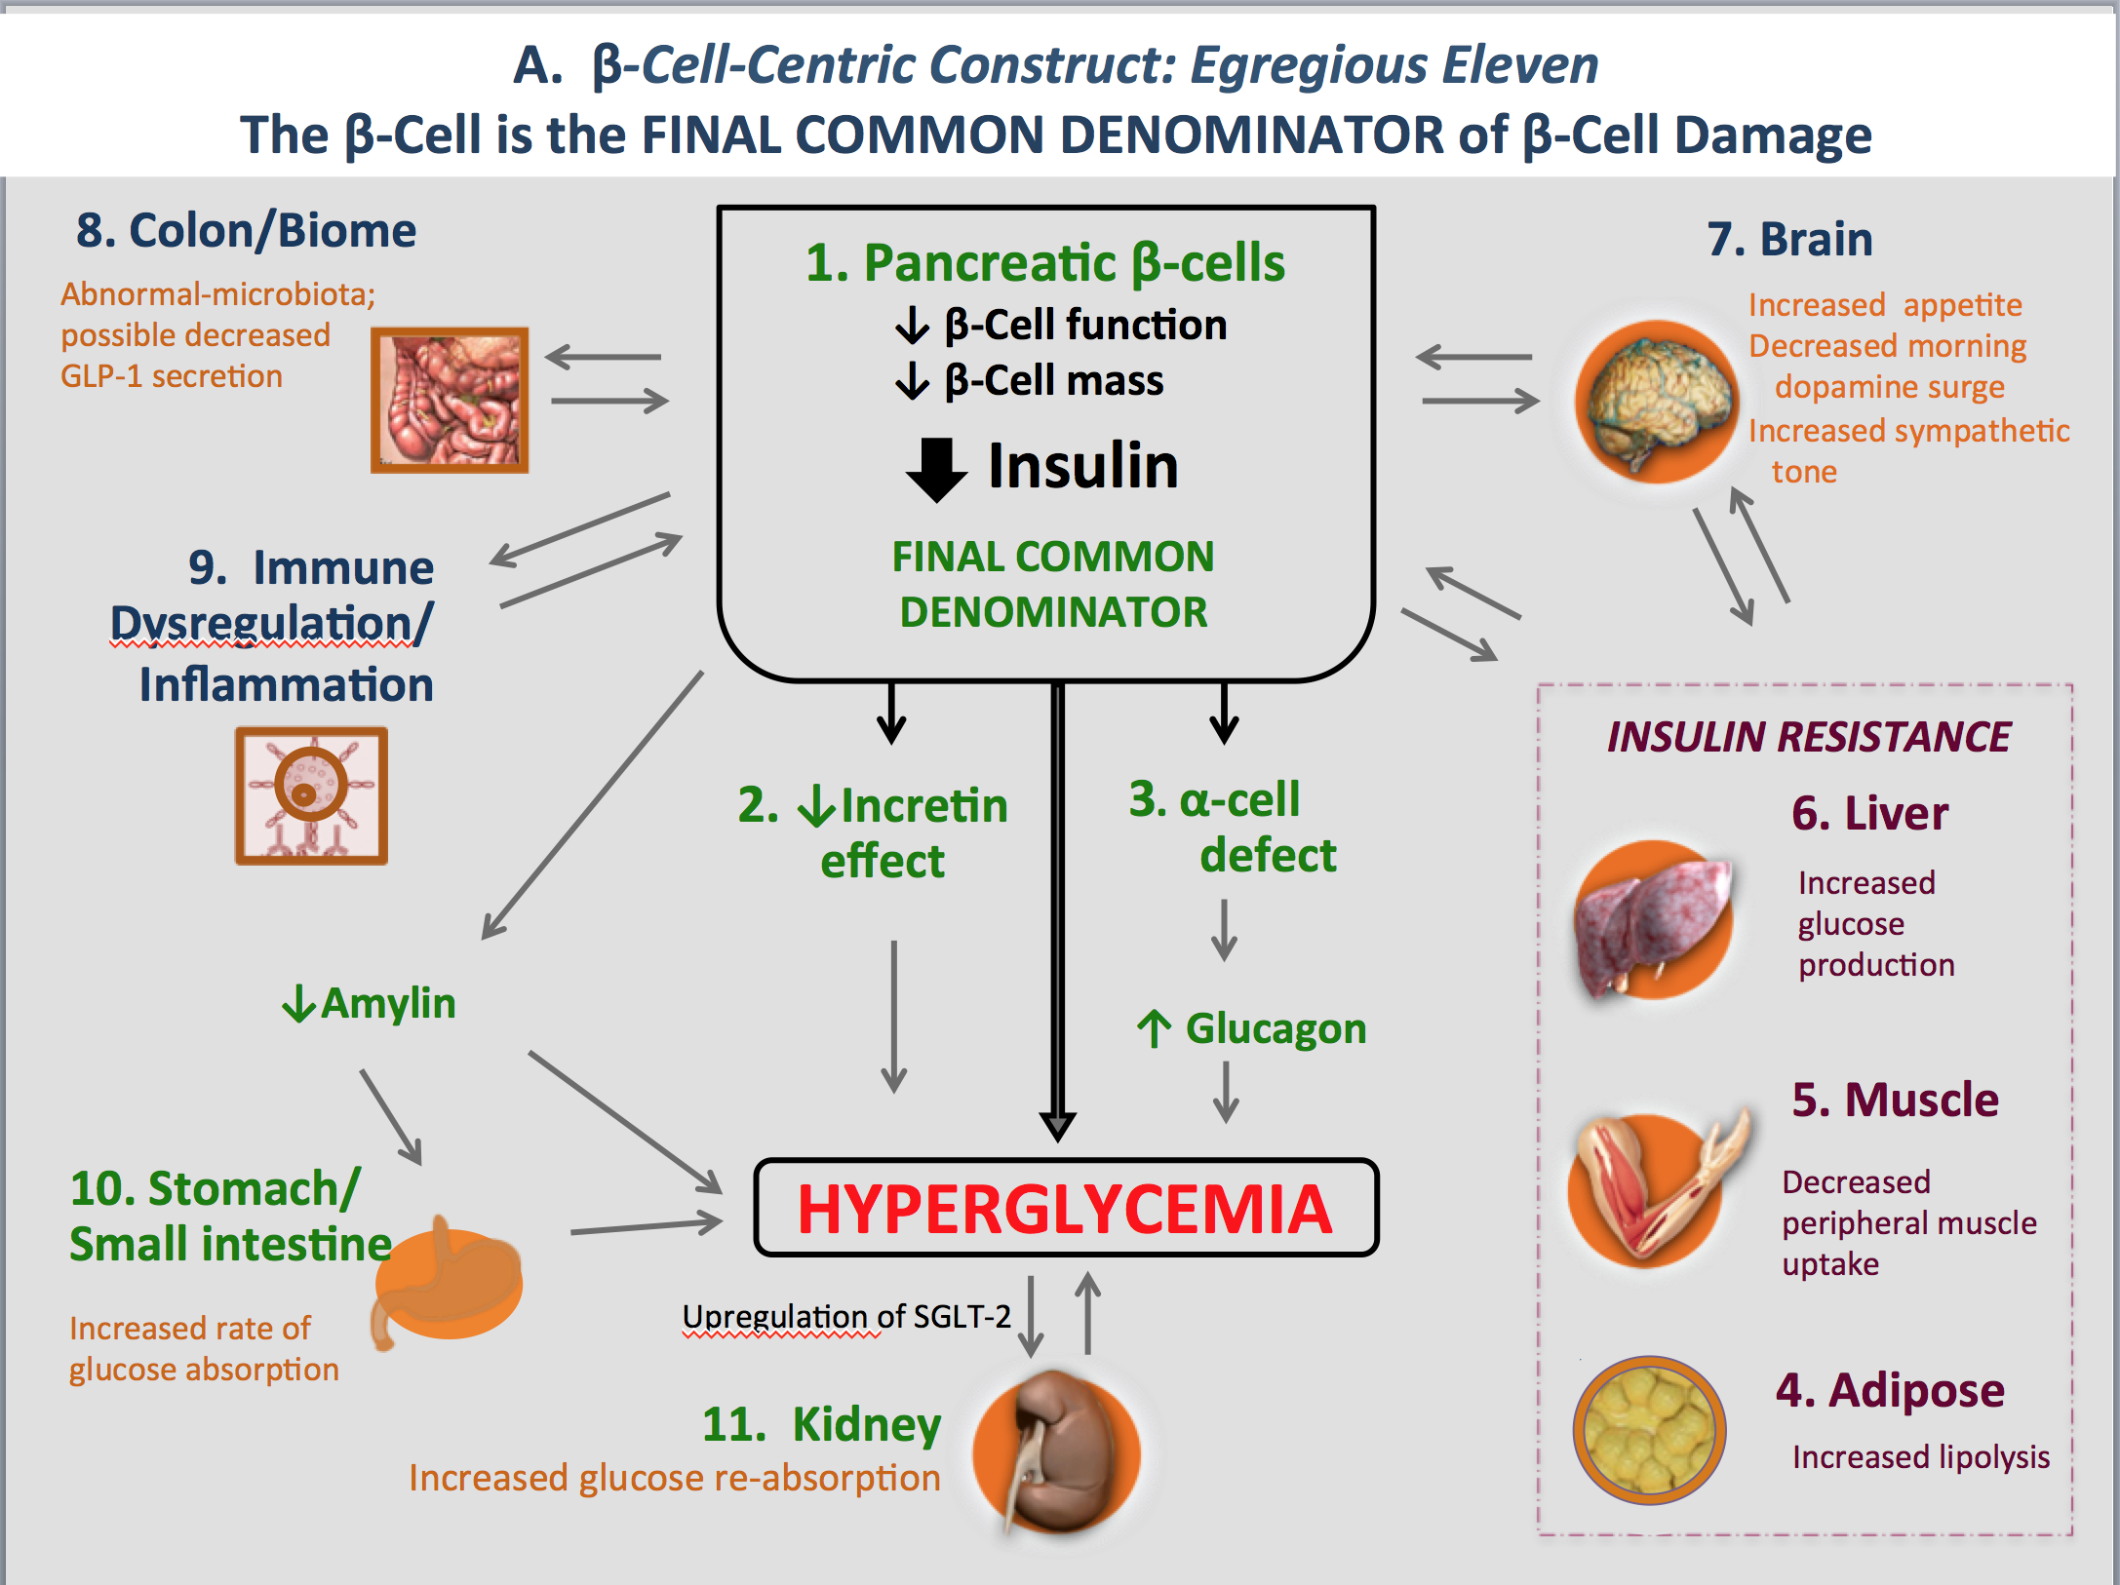
The β-cell centric classification allows for individualized care by identifying and treating patient-specific etiologies and mediating pathways of hyperglycemia
=EGREGIOUS ELEVEN
β-Cell Centric Classification of DM:
Implications for Classification, Diagnosis, Prevention, Therapy, Research
One CORE Defect- the β-Cell
THE FINAL COMMON DENOMINATOR
2. (at least) 6 treatable Causes of
β-Cell Damage
  5 treatable mediators
  of resultant HYPERGLYCEMIA
resulting from β-Cell Damage

Slide 5
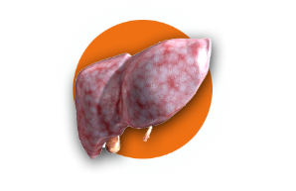

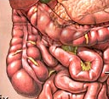


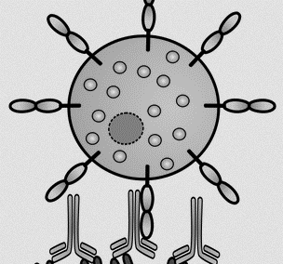
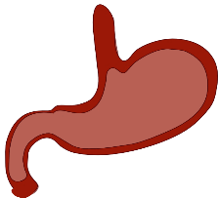
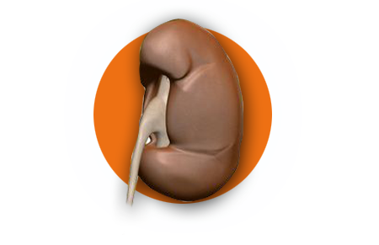
A. β-Cell-Centric Construct: Egregious Eleven
The β-Cell is the FINAL COMMON DENOMINATOR of β-Cell Damage
4. Colon/Biome
1. Liver
INSULIN RESISTANCE
3. Muscle
Increased
glucose
production
2. Adipose
Decreased peripheral muscle uptake
Abnormal-microbiota;
possible decreased
GLP-1 secretion
Increased lipolysis
5. Immune
Dysregulation/
Inflammation
1. Pancreatic β-cells
↓ β-Cell function
↓ β-Cell mass
6. Brain
Insulin
Increased appetite
Decreased morning dopamine surge
Increased sympathetic tone
FINAL COMMON DENOMINATOR
2. ↓Incretin
effect
3. α-cell
defect
↓Amylin
↑ Glucagon
4. Stomach/
Small intestine
6 mechanisms of damage
To β-cells
5 downstream effects of
damage to β-cells
Hyperglycemia
Increased rate of glucose absorption
Upregulation of SGLT-2
5. Kidney
Increased glucose re-absorption

