Slide 1
The β-Cell Centric Classification of DM
Intuitively obvious approach…
The DISEASE is: all DM
=The Phenotype: Hyperglycemia
Continuous variable based on risk of complications
(That’s what we do for BP/ Hyperlipidemia)
Due to: ( not 8 core defects a la Defronzo)
But, ONE CORE DEFECT- the BETA_CELL,
with multiple CAUSES of B-cell dysfunction
‘Disease’ definition : disorder of structure or function in a human, animal, or plant, especially one that produces specific signs or symptoms

Slide 2
The β-Cell Centric Classification of DM
Intuitively obvious approach…
Classify each patient by the specific
CAUSE(s) of the β-cell dysfunction
in each patients
clinical presentation
(specific phenotype)
Prescribe personalized treatment
(PRECISION MEDICINE) via
targeted therapies aimed at
all possible Mediating Pathways of Hyperglycemia

Slide 3
β-Cell Centric Classification of Diabetes:
Common etiological factors that can be found at work across all sub-types of DM:
INSULIN RESISTANCE
G
E
Environment
N
E
Epigenetics
Inflammation/
Immune Regulation
Polygenic
Monogenic
β-Cell
secretion/mass
FINAL COMMON
DENOMINATOR
CLASSIFY PATIENT BY CAUSE(s) of
Beta-Cell Dysfunction In EACH Individual

Slide 4
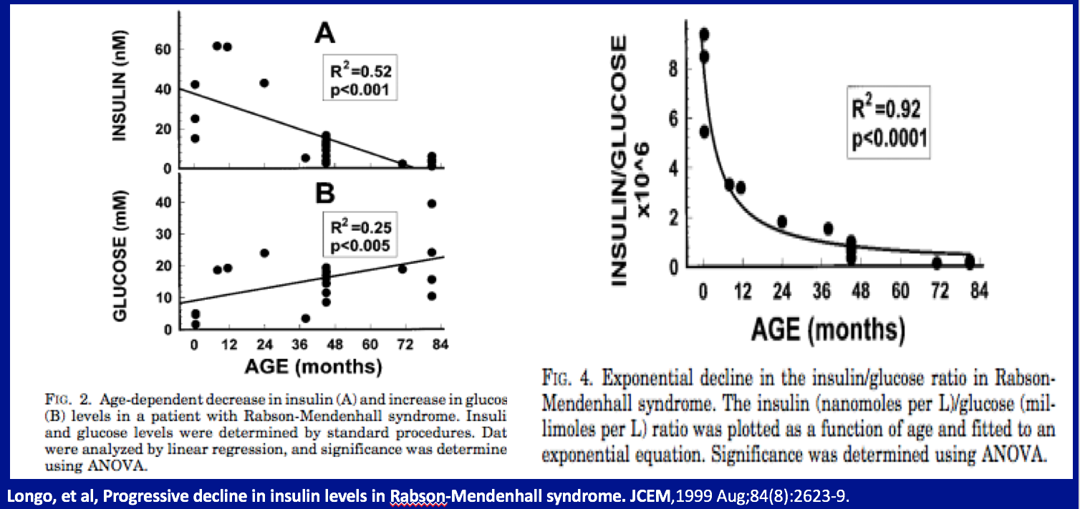
Pushback
What about ‘pure’ Insulin Resistance Syndromes?
  Rare Insulin Resistance Syndromes, e.g. leprechaunism, may not have a specific β-cell genetic defect, but β-cells can be damaged by IR
And remember only 1/3 of obese patients-with insulin resistance- become diabetic

Slide 5

Schwartz, Stanley; Epstein, Solomon; Corkey, Barbara; Grant, Struan; The Time is Right
for New Classification System for Diabetes Mellitus: Rationale and Implications of the
β-Cell Centric Classification Schema;, Diabetes Care. 2016 Feb;39(2):179-86. doi: 10.2337/dc15-1585
β-Cell Centric Classification of Diabetes:
Implications for Classification, Diagnosis, Prevention, Therapy, Research
Polygenic
Monogenic
Epigenetics
INSULIN RESISTANCE
Inflammation/
Immune Regulation
Environment
β-Cell
secretion/mass
FINAL COMMON
DENOMINATOR
CLASSIFY PATIENT BY CAUSE(s) of
Beta-Cell Dysfunction In EACH Individual

Slide 6
Schwartz, Stanley; Epstein, Solomon; Corkey, Barbara; Grant, Struan; The Time is Right
for New Classification System for Diabetes Mellitus: Rationale and Implications of the
β-Cell Centric Classification Schema;, Diabetes Care. 2016 Feb;39(2):179-86.
β-Cell Centric Classification of Diabetes:
Implications for Classification, Diagnosis, Prevention, Therapy, Research
Centrally Induced IR
Peripheral IR
Stress Hormone-induced IR
Gut Biome-induced IR
Polygenic
Monogenic
Epigenetics
INSULIN** RESISTANCE
Inflammation/
Immune Regulation
Environment*
Genetic susceptibility to e.g.
Viruses
Endocrine disruptors
Food AGEs
Gut Biome
β-Cell
secretion/mass
FINAL COMMON
DENOMINATOR
Environment

