Slide 1
Empagliflozin (Jardiance®)
Lowering HbA1c and weight independently of beta cell function
or insulin resistance
HbA1c & body weight reduction with empagliflozin as monotherapy:
  -0.34% & -2.24 kg with 10 mg dose & -0.47% & -2.61 kg with 25 mg dose
HbA1c & body weight reduction when used as an add-on to metformin:
  -0.34% & -3.14 kg with 10 mg dose
  -0.63% & -4.03 kg with 25 mg dose about 9 pounds
Hypoglycemia: 0.9-3.6% (vs. 7.1% on metformin alone & 5.4% on sitagliptin)
  Lower incidence of hypoglycemia
Reduction in SBP: 4-5mmHg from baseline
  Effect more pronounced if SBP >140mmHg

Slide 2
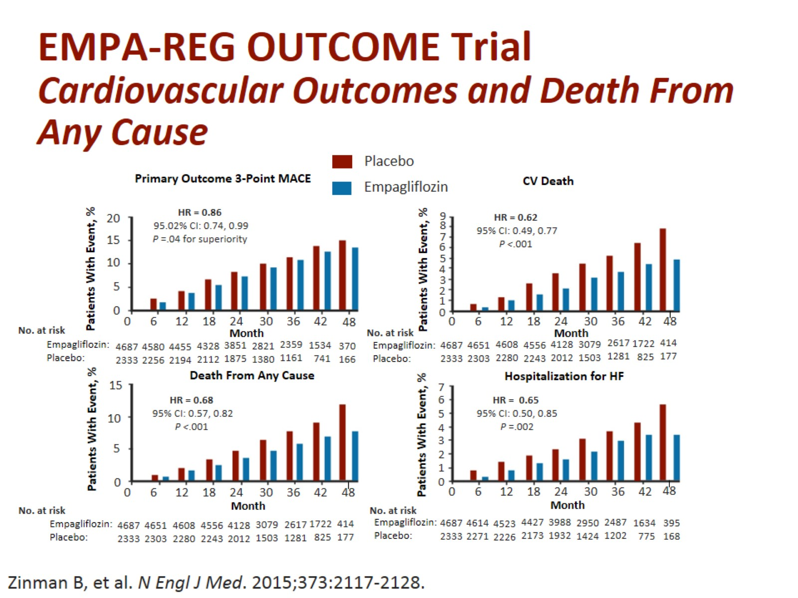
EMPA-REG OUTCOME Trial
Cardiovascular Outcomes and Death From
Any Cause

Slide 3
Type 2 Diabetes
Results in Premature Death
Life Expectancy Stats
Age @ Diagnosis | Disease Duration | Life-Years Lost | QALYs Lost
20 | 44 | 18 | 30
30 | 38 | 15 | 25
40 | 32 | 12 | 20
50 | 25 | 9.3 | 16
60 | 18 | 8 | 12
70 | 12 | 6 | 9

Slide 4
Reduces CV risk by 38%!
Empa-Reg Outcome Study
Empagliflozin (Jaridance®)
FDA Approved the Indication
  Reduction in CV outcomes
  Reduction in mortality
  Reduction in BP
  Reduction by 35% in hospitalization for heart failure
The treatment group experienced a 38% reduction in all-cause mortality.
Reduces risk for Death, lowers blood glucose, BP, weight, and can improve kidney function
    No reduction in stroke
    No reduction in MI
Notes:
Ever since Avandia was found in error to increase risk of CVD, all diabetes drugs need to go thru a CV study to make sure that it does not increase the one thing that most diabetes die from and that is CVD.

Slide 5
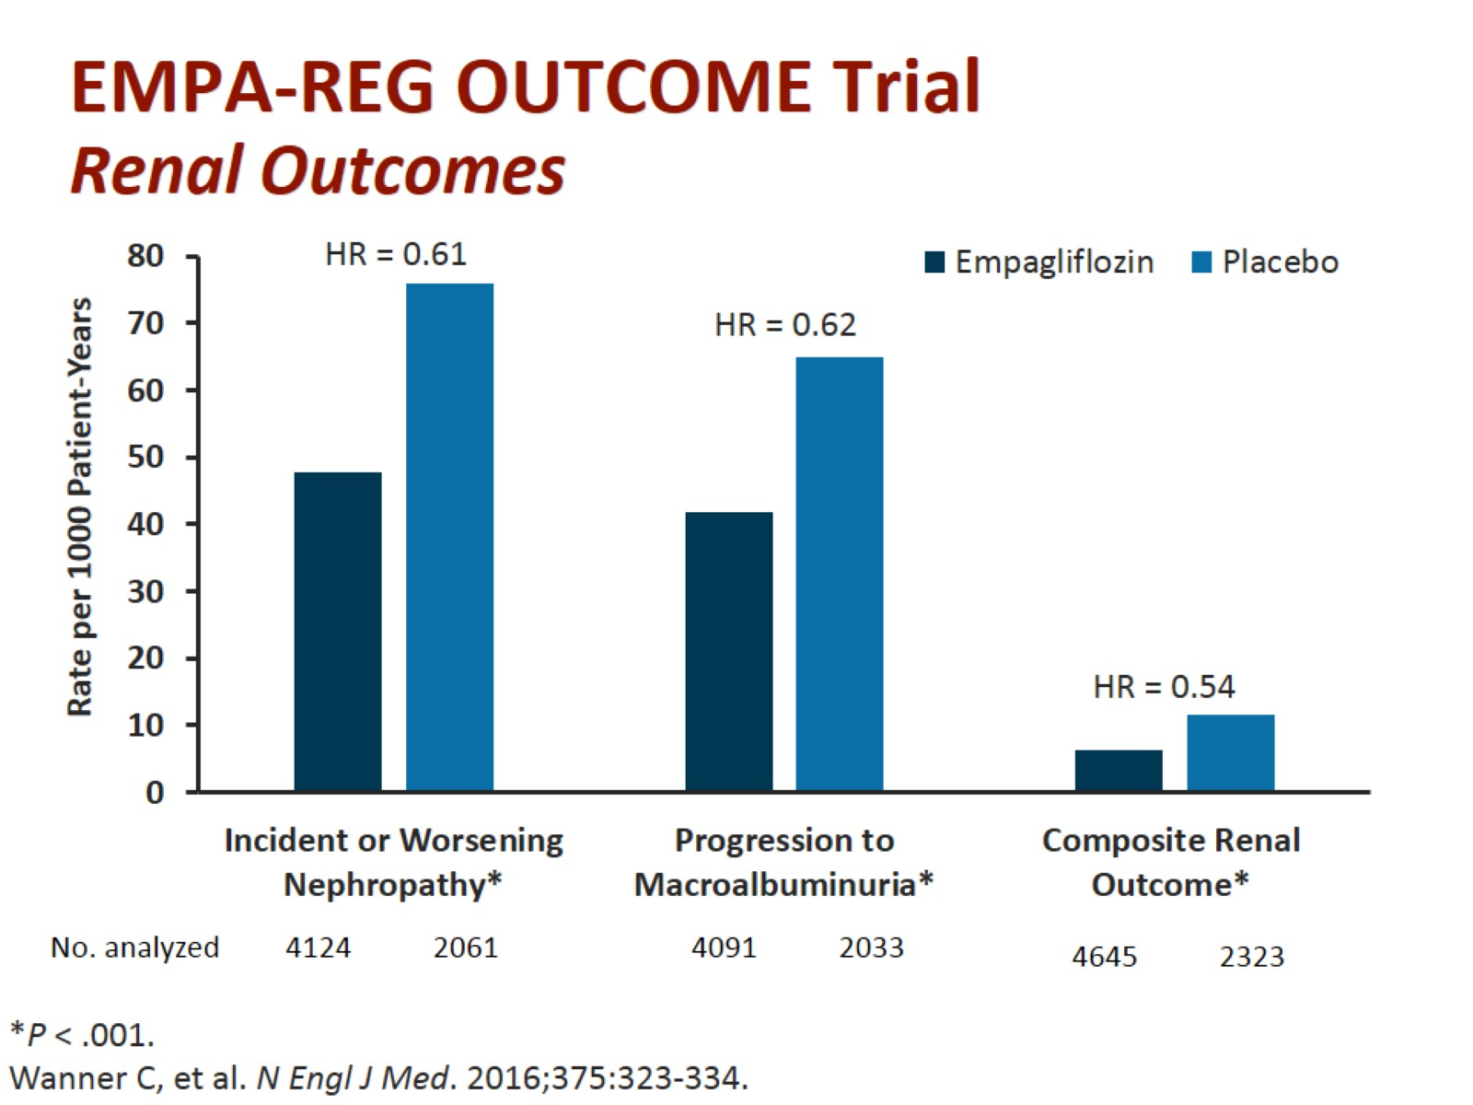
EMPA-REG OUTCOME Trial
Renal Outcomes

Slide 6
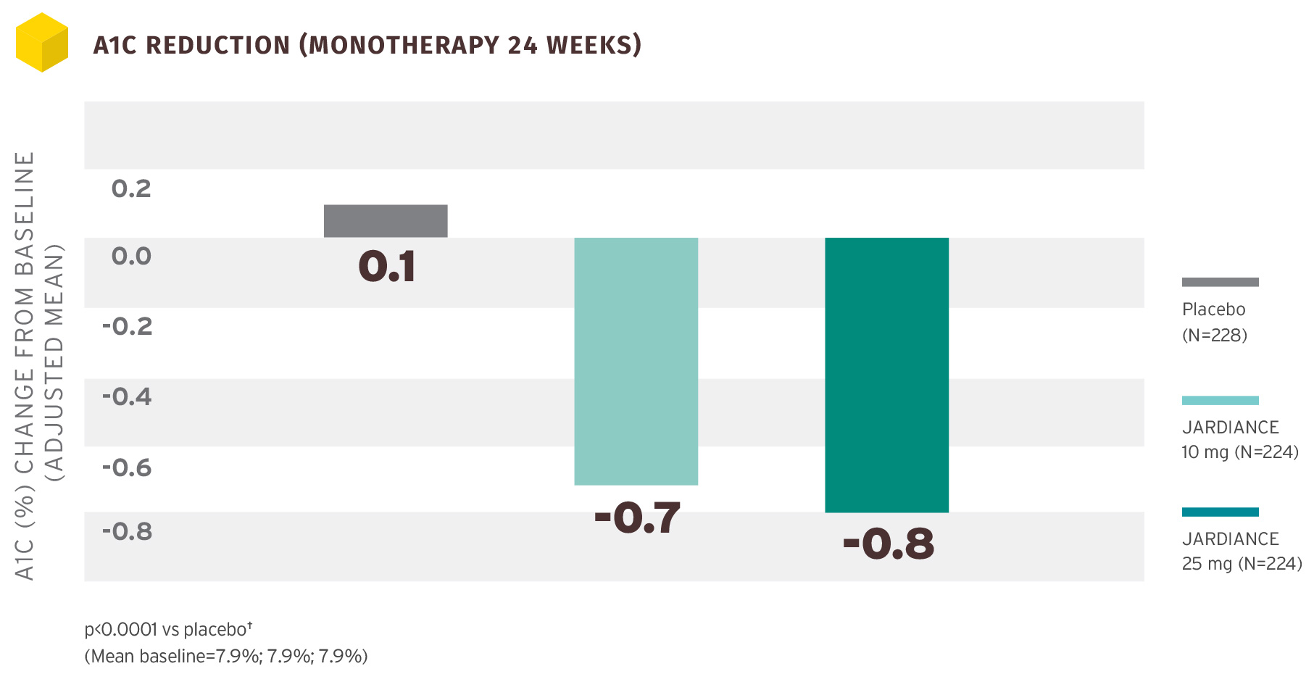
Jardiance
Empaglifozin
Weight Loss‡:
-2.8% (10 mg)
-3.2% (25 mg)
SBP Reduction§:
-2.6 mm Hg (10 mg)||
-3.4 mm Hg (25 mg)¶

Slide 7
Canagliflozin (Invokana®)
Canagliflozin 100mg and 300mg vs. sitagliptan reductions:
  A1c: on average -0.73% and -0.88% vs. -0.73% respectively
  Body weight: -3.8% and -4.2% vs. -1.3 % respectively
  Systolic Blood Pressure: -3.5% and -4.7% vs. -0.7% respectively
Important Side Effects:
  Dehydration - Increased risk of Yeast Infections and UTI
  Hyperkalemia (incidence higher with > 300mg dose)
Key Information:
  Best to take before the first meal of the day
  NOT recommended for use in severe hepatic impairment
  NOT for use in severe renal impairment (<30mL/minute), ESRD, or patients receiving dialysis
The results from the Canvas study showed that canagliflozin reduced the overall risk of cardiovascular disease and death by 14 percent and reduced the risk of heart failure hospitalization by 33 percent. The drug also demonstrated potential renal protective effects.

Slide 8
Canagliflozin/Metformin
(Invokamet®)
Results from 26-week placebo-controlled clinical study comparing canagliflozin/metformin 100/1000 mg and 300/1000 mg vs metformin 1000 mg are as follows.
  A1c change from baseline: -0.79% and -0.94% vs 0.17% respectively.
  Change in fasting plasma glucose: -48 and -57 mg/dL vs 2 mg/dL respectively.
  Change in body weight: -3.7 kg and -4.2 kg vs. -1.2 kg respectively.
Important Side Effects:
  Lactic Acidosis (Black Box Warning)
  Hyperkalemia
  Increased risk of genital tract infections
Key Information:
  Best to take before breakfast and dinner.
  NOT recommended for use in severe hepatic impairment
  NOT for use in severe renal impairment (<30mL/minute), ESRD, or patients receiving dialysis
Notes:
https://www.janssenmd.com/pdf/invokamet/PI-INVOKAMET.pdf

Slide 9
Dapagliflozin (Farxiga®)
Results of a 24-week, double-blind placebo-controlled study of dapagliflozin 10mg and 5 mg compared to placebo.
  A1c: were -0.9% and -0.8% vs. -0.2% respectively.
  Fasting Plasma Glucose: were -28.8 and -24.1 mg/dL vs. -4.1 mg/dL respectively.
Important Side Effects:
  Hypotension
  Genital mycotic infections
  Ketoacidosis
  Increases in LDL-C
Key Information:
  Best when taken before the first meal of the day.
  NOT for use in severe renal impairment (<30mL/minute), ESRD, or patients receiving dialysis.
  Safety has not been established in pediatric patients or pregnant patients.
Notes:
http://www.azpicentral.com/farxiga/pi_farxiga.pdf#page=1

Slide 10
Dapagliflozin/Metformin
(Xigduo XR®) (zig-duo)
Results of 24 week active-controlled study of dapagliflozin/metformin XR 5/500 mg and 10/500 mg compared to metformin XR 500 mg are as follows:
  Change in A1c are -2.1% and -2.0% vs. -1.4% respectively.
  Change in fasting plasma glucose are -61 mg/dL and -60.4 mg/dL vs. -33.6 mg/dL respectively.
  Change in body weight are -3.3 kg and -2.7 kg vs. -1.3 kg respectively.
Important Side Effects:
  Hypotension
  Genital mycotic infections
  Ketoacidosis
  Increases in LDL-C
Key information:
  Best when taken before the first meal of the day.
  NOT for use in severe renal impairment (<30mL/minute), ESRD, or patients receiving dialysis.
  Safety has not been established in pediatric patients or pregnant patients.
Notes:
http://www.azpicentral.com/farxiga/pi_farxiga.pdf#page=1

Slide 11
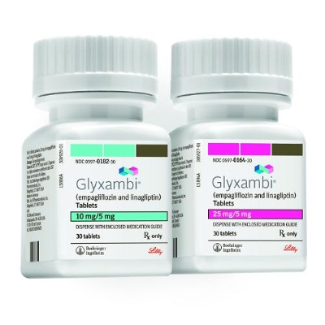
Empagliflozin/Linagliptin (DPP-IV)
(Glyxambi®)
Mixture of SGLT2 and DPP4 inhibitor, Glyxambi is the first medication that combines two different mechanisms of action in the treatment of diabetes.
In phase 3 clinical trials comparing Glyxambi 10/5mg and 25/5 mg vs Empagliflozin 10mg and 25 mg vs Linagliptin 5 mg. Results are as follows:
  A1c: -1.1% and -1.2% vs -0.7% and -0.6% vs -0.7% respectively.
Important Side Effects:
  Urinary tract infections
  Hypotension
  Nasopharyngitis
Key Information:
  Not for the treatment of diabetic ketoacidosis.
  Do not initiate if renal function is <45 mL/min.
  Do not initiate in patients with pancreatitis.

Slide 12
Ertugliflozin – Possible Approval 2017
Currently undergoing a phase 3 clinical trial evaluating the safety and efficacy of a combination of ertugliflozin with sitagliptin compared with ertugliflozin or sitagliptin alone.
Merck and Pfizer are working together to develop ertugliflozin.
Sotagliflozin - Possible Approval 2017
SGLT dual Inhibitor
SGLT-1 and SGLT-2 inhibitors
Works on the intestine and the Kidney to eliminate excess glucose
In phase 3 trials
Notes:
The Tandem 3 trial studied sotagliflozin. This drug has a dual mechanism of action. Its SGLT-1 inhibitor function delays glucose from being absorbed by the intestines, while its SGLT-2 inhibitor function helps further lower blood glucose level by making the kidney excrete excess glucose.

Slide 13
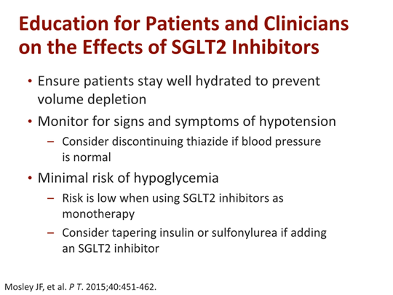

Slide 14
SGLT-2 Inhibitors - Conclusion
SGLT2 inhibitors are a good option in patients that are not meeting their glycemic goals while taking their current regimen
Significantly reduce fasting & postprandial glucose, HbA1C, body weight, & blood pressure while causing no hypoglycemia
Can Have Significant reduction in cardiovascular risk and DEATH!
Reduces risk for nephropathy, and progression to macroalbuminurea
Overall well tolerated & safe

