Slide 1
A Unifying Pathophysiologic Approach to The Complications of Diabetes in the Context of the Beta-cell Classification of Diabetes:
A Framework for Understanding and Managing DM
Stanley Schwartz MD, FACE, FACP
Affiliate, Main Line Health System
Emeritus, Clinical Associate Professor of Medicine
University of Pennsylvania
stschwar@gmail.com

Slide 2
I cannot teach anybody anything,
I can only make them think
Socrates (470-399 B.C.)

Slide 3
Stanley Schwartz MD Disclosures
Research Support: 0
Employee: 0
Board Member/Advisory Panel: Janssen, Merck, AZ-BMS, BI-Lilly, Salix, Novo, Genesis Biotechnology Group
Stock/Shareholder: Saturn EMR Decision Support APP., Flairz, ARKAY
Consultant: NIH RO1 DK085212, Struan Grant PI
Speaker’s Bureaus: Janssen, Merck, Novo, Salix, BI-LILLY, Eisai, AZ-Int’l, Amgen

Slide 4
Value of Appropriate Classification of DM
DM diagnostics need to be pragmatic
Appropriate classifications permits us to:
  PREDICT risk of DM
  PREVENT advancement of DM
  PLAN treatment strategy
  PROMOTE informed research directions
Current diagnostics do none of the above

Slide 5
Current DM Classification Failing
T1DM= Immune destruction of β-cells
T2DM= Insulin Resistance
This distinction has been used as basis of distinction between T1D, and T2D
BUT WE’VE LEARNED SO MUCH MORE
Notes:
The four types of diabetes include:
The typical child with type 1 diabetes;
Early onset of type 2 diabetes, particularly in non-Caucasian groups;
An atypical form of diabetes sometimes with fluctuating insulin dependency, seen in African Americans; and
The very rare “maturity onset diabetes of youth” (MODY), which has been found to be related to identifiable genetic mutations, transmitted in an autosomal dominant pattern, and virtually always in Caucasians.

Slide 6
EG: I was asked how to Diagnose Diabetes Mellitus in Adults: Type 1, Type 2, LADA
WE SAW
That Confusion Abounds,
Definitions Imprecise
Diagnosis is often imprecise/ or overlapping phenotypes
  Flatbush DM- present in DKA- ‘turn out to be T2DM’
  LADA- Adults who look like ‘typical T1DM’
  Antibody positive patients who look like ‘T2DM’
  T1DM with Insulin Resistance (like T2DM)

Slide 7
Comparing Definitions for T1D, ‘LADA’, T2D
IMMUNITY AGE GENES BMI INSULIN THERAPY
child
adult
adult
adult
HLA++
HLA+
HLA
?
T1D
In children
T1D
In adults
LADA
T2D
Strong
+++
++
+
weak
low
normal
normal
high
Immediate
Immediate
Variable
Infrequent
Adapted from Leslie et al. Diabetes Metab Res Rev. 2008 Oct;24(7):511-9

Slide 8
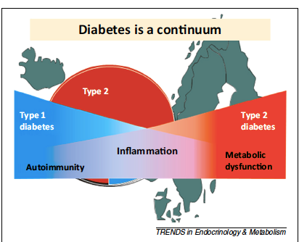
Diabetes is a Continuum OF
β-cell DYSFUNCTION
Issue is not
    ‘What is LADA,T1DM, T2DM?’
    Issue is:
    WHAT ARE MECHANISMS
    And RATE OF DESTRUCTION OF β-cells
    in a given patient
Groop et al. 2014
This ‘vantage point’ also informs best treatment course

Slide 9
Isn’t it
Time for A New Classification Schema for the
Diagnosis and Treatment of Diabetes Mellitus (DM)
CLASSIFICATION/ DIAGNOSIS IS IMPORTANT

