Slide 1

New Devices in Diabetes Care
Have you ridden a bicycle in the last month?
  1) Yes
  2) No

Slide 2
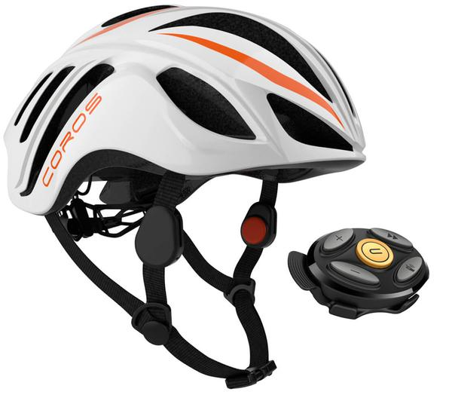
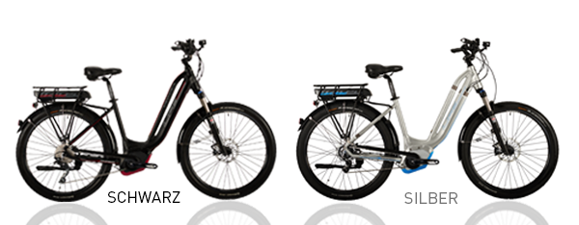
Ebike? - Life-Bike.com
Anchorage features 122 miles of paved bike paths.
Developed by a sports physician, It is a pedal assisted bike, not a scooter.
Made for people who have a fear of falling, can manage a rider up to 400 pounds, balanced for ease of getting on and off, plus absorbs shocks better then most bicycles and controls made for a person with arthritis.
www.life-bike.com
Coros Smart Helmet system with Blue Tooth for your phone, GPS, Microphone, bone conduction audio, and collision sensor.
Notes:
Pedal Assisted
Battery operated
Goes 70 miles on a charge
Automatic Shiffting
You set your cadence
Male bar removed
Shock system prevents body and hand jarring
Holds up to 400 pounds
Special Seat
Makes riding a bike fun again
Now you can keep up with your grandkids
Working to get Insurance companies to provide rebates with the purchase

Slide 3
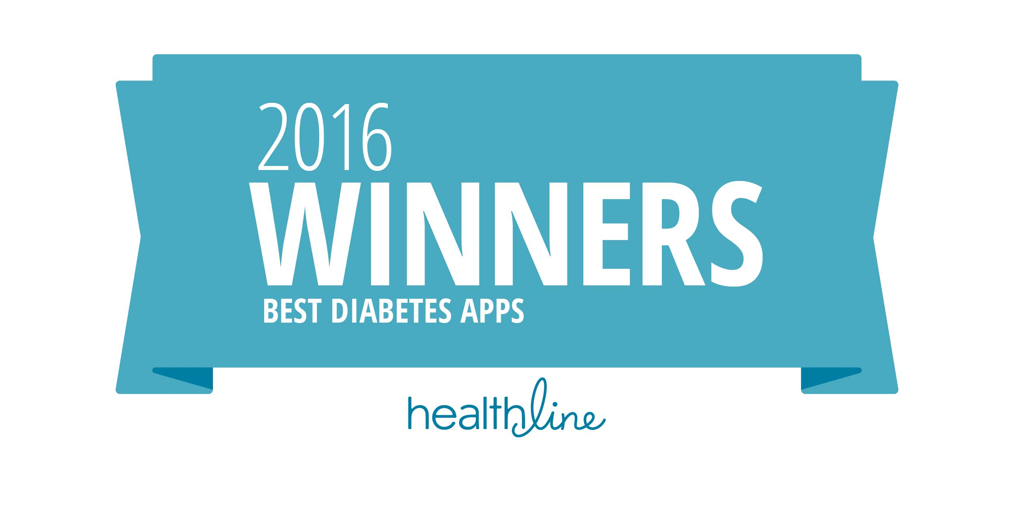
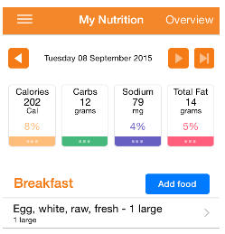
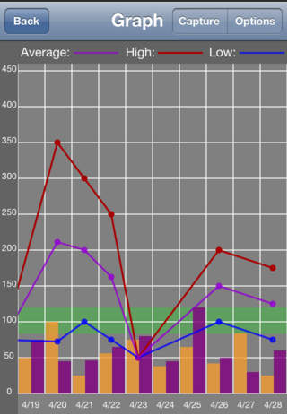
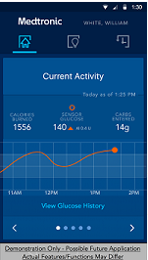
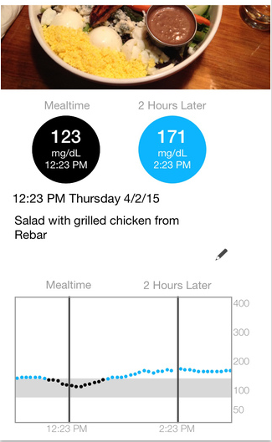
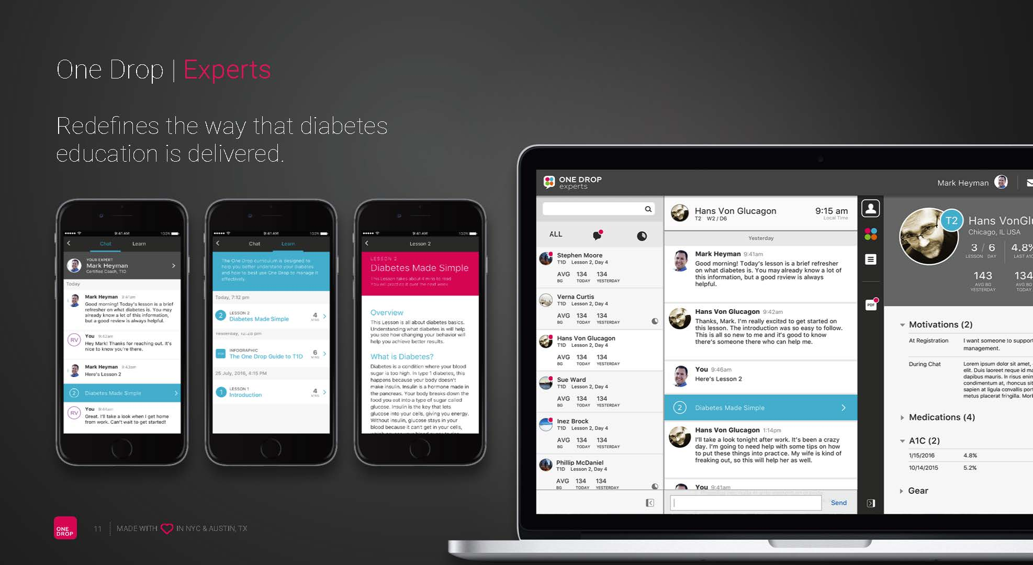
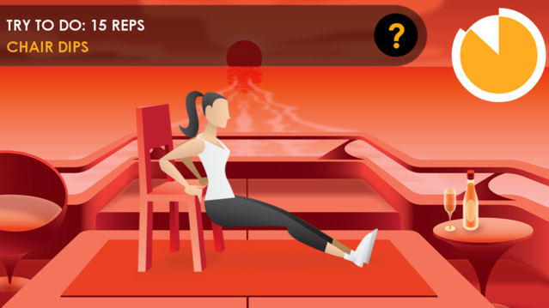
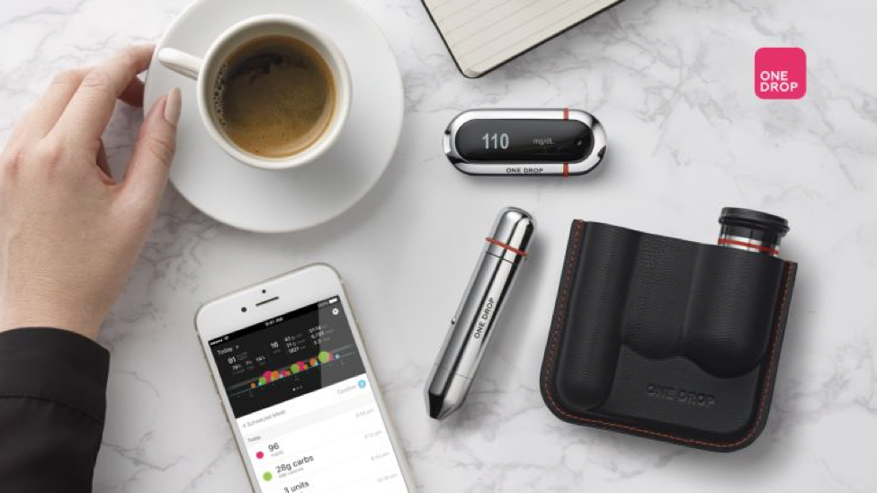
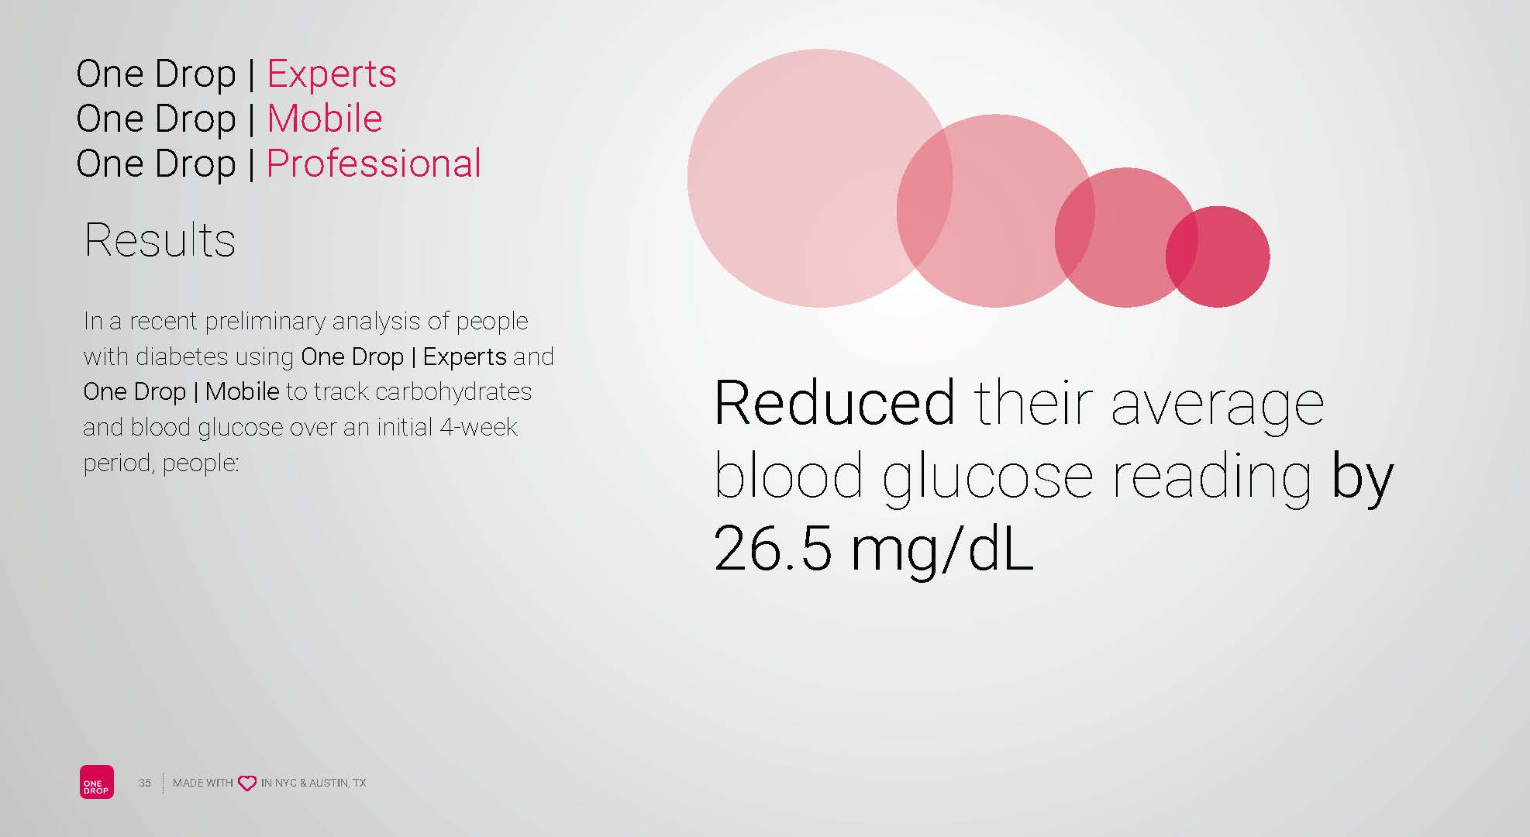
Diabetes Apps
See Handout
Some FDA approved
Notes:
A similar trend is developing in the crowded and very competitive insulin market. Last week Sanofi (NYSE: SNY) joined Lilly and Roche in gaining FDA approval for a smartphone app with a built-in bolus calculator. Now this app is really nothing that special as according to a 2015 study there are almost 50 apps that do the same thing. The main difference between the Sanofi, Lilly and Roche apps is they have received FDA clearance, which is nice but quite frankly not that big of a deal. Yes, we know that people will just hate this but calculating bolus isn’t that complicated provided all the data points are available.
Where apps like these could have, an impact is they COULD help patients achieve better control. We say could because of the data that’s required from the patient. To dose insulin properly the patient must know the following pieces of data;
Current glucose level- target glucose level-insulin on board-time to action-duration of action-carbohydrate intake- insulin to carb factor. If that’s not enough data the patient must also consider will they be exercising, what type of carbs they are eating, when they are eating, etc.
Yes, an app can simplify the dosing decision provided these apps have the proper and accurate data to perform their calculations.
What companies like Sanofi and Lilly are hoping for is that these apps would be combined with their insulin’s. That patients will be bound to their products because of the system they are connected with not the insulin they use. As we have said a million times while there are minor differences between insulin’s for the most part they all do the same thing the same way. It’s not the insulin that matters it’s using this insulin effectively which is what these apps are all about.

Slide 4
The Diabetes Pandemic
30 Million with Diabetes (25% don’t know)
100 Million with Prediabetes
Average A1c is over 9% ((215mg/dL.)
How to Educate 130 million???
THE ANSWER:
Education
  Doctors cant do it
  Not enough educators
  The answer is………………………

Slide 5
How to educate 100 million?
Online Diabetes Educational Programs
Technology can provide effective educational programs
Can provide at a reduced cost from live education
Made available to most patients with access
Patient can participate on their time 24hrs a day
Can communicate with a medical professional via texting or emailing
Programs can collect and report data
Programs will be judged by the outcomes
The future is now!

Slide 6
The Future Is In Technology
GLP-1 agonist in a oral tablet
SGLT-2 Drugs which also lower risk for heart attacks and death
Smart Insulin
The Bandaid CGM
Artificial Pancreas
Newer interactive Apps
On-line interactive websites for education
Smart insulin pens
Artificial Pancreas with Nano technology
ITCA 650 (Exenatide)with once a year dosing
WE NEED TO EMBRACE TECHNOLOGY!

Slide 7
References
Byetta [package insert]. San Diego, CA: Eli Lilly; October 2009. https://www.accessdata.fda.gov/drugsatfda_docs/label/2009/021773s9s11s18s22s25lbl.pdf
Tanzeum [package insert]. Wilmington, DE: GlaxoSmithKline; April 2014. https://www.accessdata.fda.gov/drugsatfda_docs/label/2014/125431s000lbl.pdf
Trulicity [package insert]. Indianapolis, IN: Eli Lilly; January 2017. https://www.accessdata.fda.gov/drugsatfda_docs/label/2017/125469s007s008lbl.pdf
Victoza [package insert]. Princeton, NJ: Novo Nordisk; January 2010. https://www.accessdata.fda.gov/drugsatfda_docs/label/2010/022341lbl.pdf
Farxiga [package insert]. Princeton, NJ: Astrazeneca; August 2014. https://www.accessdata.fda.gov/drugsatfda_docs/label/2014/202293s003lbl.pdf
Jardiance [package insert]. Indianapolis, IN: Boehringer Ingelheim; August 2014. https://www.accessdata.fda.gov/drugsatfda_docs/label/2014/204629s000lbl.pdf
Invokana [package insert]. Titusville, NJ: Janssen Pharmaceuticals; March 2016. https://www.accessdata.fda.gov/drugsatfda_docs/label/2016/204042s011lbl.pdf
Januvia [package insert]. Whitehouse Station, NJ: Merck; August 2017. https://www.merck.com/product/usa/pi_circulars/j/januvia/januvia_pi.pdf
Tradjenta [package insert]. Ridgefield, CT: Boehringer Ingelheim and Eli Lilly; 2012. https://www.accessdata.fda.gov/drugsatfda_docs/label/2012/201280s005lbl.pdf
Onglyza [package insert]. Princeton, NJ: Bristol-Myers Squibb; July 2009. https://www.accessdata.fda.gov/drugsatfda_docs/label/2009/022350lbl.pdf
Nesina [package insert]. Deerfield, IL: Takeda Pharmaceuticals; January 2013. https://www.accessdata.fda.gov/drugsatfda_docs/label/2013/022271s000lbl.pdf
“Semaglutide demonstrated superior HbA1c reduction vs placebo as add-on to basal insulin alone or with metformin in adults with type 2 diabetes.” Press Release , Novo Nordisk, 13 Sept. 2016, www.novonordisk.com/bin/getPDF.2041775.pdf. Accessed 24 Aug. 2017.

Slide 8
References:
Longo VD, Mattson MP. (2014) Fasting: molecular mechanisms and clinical applications. Cell Metab. 19: 181-192.
Mattson MP. (2012) Energy intake and exercise as determinants of brain health and vulnerability to injury and disease. Cell Metab. 16: 706-722.
Marosi K, Mattson MP. (2014) BDNF mediates adaptive brain and body responses to energetic challenges. Trends Endocrinol Metab. 25: 89-98.
Tucker M. ADA’s New Standards of Care Focus on Individualization. Medscape. http://www.medscape.com/viewarticle/856376
Vinik, Andrew. A New Paradigm in the Treatment of Diabetes. Dec. 22, 2015.
Mattison, Mark. Intermittent Fasting. Jan. 8, 2016.
http://www.dlife.com/dlife_media/mobile
https://www.glooko.com/patients
http://diatribe.org/app-predicts-low-blood-sugars-three-hours-advance
http://www.glucosebuddy.com/glucose_buddy_app
www.diabeteseducator.org/patient-resources/diabetes-goal-tracker-app
http://agamatrix.com/products/agamatrix-diabetes-manager/
http://echotx.com/technology/
http://www.dexcom.com/g5-mobile-cgm
http://diatribe.org/abbott-freestyle-libre-transforming-glucose-monitoring-throug-utter-simplicity-fingersticks

Slide 9
References:
http://www.locemia.com/press-release/lilly-acquires-phase-iii-intranasal-glucagon-from-locemia-solutions
http://diatribe.org/xultophy-beats-out-lantus-major-clinical-trial-a1c-weight-and-hypoglycemia-benefits
http://diatribe.org/fda-approves-ultra-long-acting-basal-insulin-tresiba-taken-any-time-day
http://textlab.io/doc/16909/the-glp-1-glp-2-dual-agonist-zp-gg-72
https://clinicaltrials.gov/ct2/show/NCT01982630
https://globenewswire.com/news-release/2015/12/17/796325/0/en/Novo-Nordisk-successfully-completes-fourth-phase-3a-trial-with-semaglutide-in-people-with-type-2-diabetes.html
http://www.intarcia.com/media/press-releases/2015-aug-18-freedom2.html
http://www.fiercepharmamarketing.com/story/sanofis-combo-med-lixilan-ready-go-fda-ongoing-scramble-diabetes-dominance/2015-09-14
Pfeffer MA, et al. Symposium - The Evaluation of Lixisenatide in Acute Coronary Syndrome—The Results of ELIXA. Presented at ADA 75th Scientific Sessions, Boston, U.S., 2015.

