Slide 1
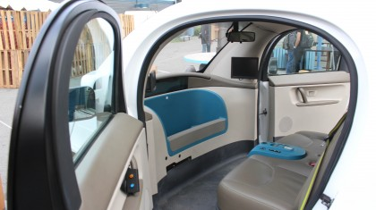
Technology In Drugs
If we can make a driverless car, then we should be able to Normalize blood sugars!
Notes:
More Smart Technology means less need for monitoring and education and less need for diabetes educators

Slide 2
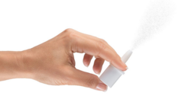
Intranasal Glucagon (Locemia®) (lo-chemia)
Not approved yet in the US, but is approved in the European market.
Lilly submitted to the FDA in 2016
 | Caregivers |  | Acquaintances
 | Locemia | Injection Kit | Locemia | Injection Kit
% Who gave correct dose | 94% | 13% | 93% | 0%
Average time to dose given | 16 seconds | 2 -5 minutes | 26 seconds | 2 minutes, 24 seconds
Notes:
http://www.locemia.com/press-release/lilly-acquires-phase-iii-intranasal-glucagon-from-locemia-solutions

Slide 3
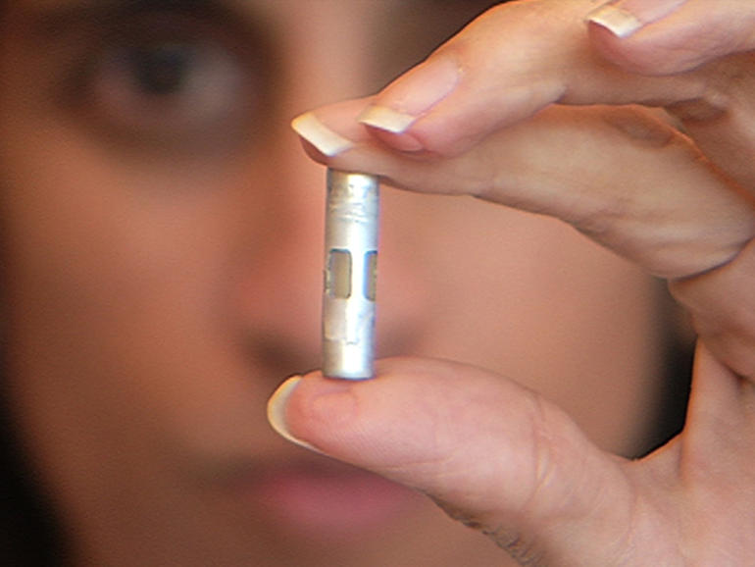
Artificial Implanted Pancreas using NanoTechnology
When blood sugar flows inside the capsule, it stimulates the cells to produce insulin to control sugar levels.
The device has nano pores, pores so small that the body's antibodies cannot get in to attack the cells, but large enough that the insulin can flow out and into the body.
Notes:
Insulin injections may soon be a thing of the past for diabetics thanks to nano-technology. At UCSF Professor of bioengineering, Tejal Desai, implants millions of pancreatic cells that secrete insulin into tiny capsules that can be implanted into the body in an effort to create an artificial pancreas. When blood sugar flows inside the capsule, it stimulates the cells to produce insulin to control sugar levels. The device has nano pores, pores so small that the body's antibodies cannot get in to attack the cells, but large enough that the insulin can flow out and into the body.

Slide 4
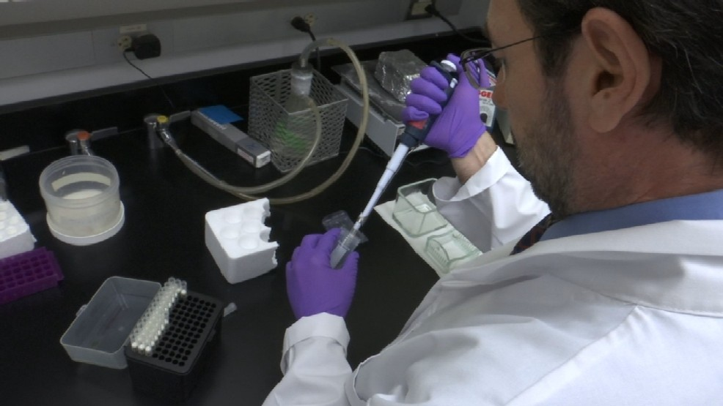
Possible Cure??
Researchers at UT Health San Antonio have discovered a strategy that could mean a
cure.
Gene Transfer has shown that we can alter other cells so they start to secrete insulin but only in response to sugar.
The therapy has cured diabetes in mice for one year without any side effects, which has never been done.
The goal is to conduct large-animal studies and human clinical trials in the next three to five years.

Slide 5
What if there was a drug that could:
Slow glucose absorption from the gut
Increase insulin from the pancreas when glucose is high.
Lower glucagon levels after meals?
Suppress a receptor in the hypothalamus to reduce appetite?
Increase beta-cell mass and 1st phase insulin release so more insulin reaches the liver and blood more quickly?
Reduce the risk of all-cause mortality?
Reduce the risk of MACE (heart attacks and strokes)
Did not cause hypoglycemia
Solves the major problem of Therapy Compliance
AND YOU ONLY HAD TO TAKE ONCE EVERY 365 DAYS?
It’s Coming Soon! 2017
Notes:
because this system solves the biggest problem in diabetes, therapy compliance. We are also watching the oral version of semaglutide from Novo Nordisk (NYSE: NVO) again not because the drug is all that special rather it would be the first GLP-1 to be delivered orally and not injected. In both cases, it’s not the drug that is all that special but how it is delivered.

Slide 6
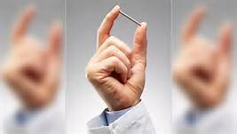
ITCA 650
A GLP-1 Agonist
Results from the FREEDOM-2 trial show that after 52 weeks, ITCA 650 (Exenatide) continued to produce glycemic control and weight loss
A phase 3 study of 5200 patients with type 2 diabetes 61% of the ITCA 650 patients achieved an A1C of < 7%
A drop in A1c of 1.5 points
Patients in the ITCA 650 arm lost an average of 8.8 pounds
Exenatide-treated patients were 19% less likely to have a CVD event than patients treated with other glucose-lowering agents
Exenatide-treated patients were also less likely to experience CVD-related and all-cause hospitalization.
Guarantees Compliance
  25% taken properly and only 20% get refilled

Slide 7
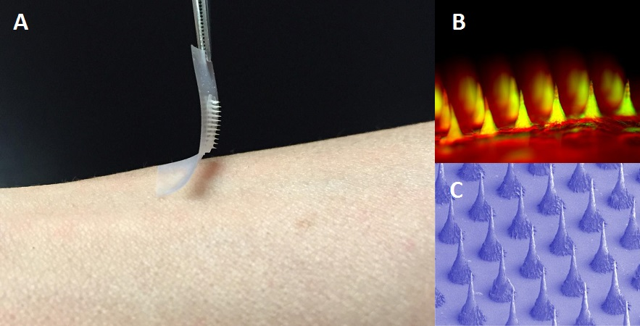
Smart Insulin Patch
The new, painless patch is smaller than a postage stamp and is covered with an array of more than 100 microneedles, each of which are loaded with insulin and glucose-sensing enzymes that rapidly releases the insulin when blood sugar levels get too high.
Notes:
Researchers have invented a “smart insulin patch” that detects increases in blood sugar levels and quickly secretes doses of insulin into the bloodstream whenever needed. If proven effective in humans, the smart insulin patch has the potential to replace bothersome insulin injections

Slide 8
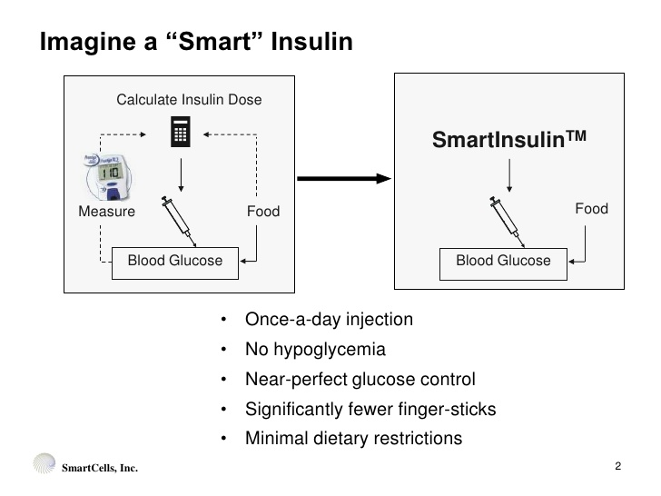
SMART INSULIN – GRI -
Glucose Responsive Insulin – A Game Changer
The Holy Grail
Notes:
Smart Insulin GRI (Glucose Responsive Insulin) – The Holy Grail: There was a special event with academic experts, researchers, industry JDRF and funding organizations to discuss the current information on glucose responsive insulin also known as “smart insulin”. The highly interactive event brought together academic experts, researchers, industry, funding organizations, and patient advocates, including our own Kelly Close, to discuss the current state of the glucose responsive insulin field (also known as “smart insulin”). In theory, this next-generation insulin would work automatically in response to blood glucose: the higher the blood sugar, the more insulin is released or activated, and the lower the blood sugar, the less insulin is released or activated.
The idea of the “perfect” smart insulin is very compelling for people with diabetes on insulin: one injection per day, blood sugar levels that stay in zone without hypoglycemia, no more carb counting, no more guessing what dose is correct, no more feeling frightened, and a much safer and less stressful life. Plus less need for hours with a diabetes educator. The reality, as the leaders emphasized at this meeting, is that glucose responsive insulin (GRI) is still in its infancy, and development will likely proceed in steps: the first generation of these drugs may offer some, but not all, of the anticipated benefits. It was agreed that a perfect glucose-responsive insulin could eventually be an enormous game-changer for people with diabetes. In the discussion they described an ideal GRI as a once-daily therapy that delivers the right amount of insulin at the right time in the right part of the body, leading to in-range blood sugars with little to no risk of hypoglycemia. But, like everything else, the first GRI may not have everything we would like and it probably will have to wait for the second generation GRI.
It was agreed that a first-generation GRI would be a meaningful advance prior to development of the ideal product, there was some debate over exactly what that first product should look like. So they stated that most likely that the characteristics for the first-generation GRI would have the following benefits:
· Helps with meals, but may still require basal insulin.
· Once or twice daily injection.
· Glucose monitoring 2-3 times daily.
· A1c reduction of 0.5%, similar effects to current insulins.
· A target of 80% time in the 90-150 mg/dl range.
· Less than 5 hypoglycemic events per week.
· Weight gain of ~0.5 kg (about one pound), comparable to current insulin therapies.
The next or ideal generation would more like this:
· No other insulin use required.
· Once daily injection
· Glucose monitoring 0-1 times per day.
· A1c reduction of ~0.7%, superior to current insulins.
· ~80% time in range (70-130 mg/dl).
· One or less hypoglycemic events per month
· Minimal weight gain.
· Reduced diabetes-related stress.
· No severe product-related complications with chronic use
Other proposed ideas for first-generation GRI products included (i) a combination of two different insulins, one for low glucose levels and one for high glucose levels; (ii) as many as five products approved for different populations (i.e., athletes vs. pregnant women vs. those with high hypoglycemia unawareness); (iii) a product approved only for type 2 diabetes; (iv) a post-meal GRI added on to existing basal insulin; and (v) a basal GRI added on to existing basal insulin. It is just a matter of time before we see the Smart Insulins
An overview of the companies and academic groups with GRI candidates in development – with over 11 groups currently working on smart insulin projects. All of these projects are at a very early stage: one (Merck’s MK-2640) is in its first study in humans, and the others are all still being tested in animals. The groups all have very different approaches to GRI development, ranging from a smart insulin patch (UNC/NC State) to glucose-sensing nanoparticles (Monash University). All three major insulin companies – Sanofi, Lilly, and Novo Nordisk – are working on smart insulin as well, with Lilly recently acquiring smart insulin technology from the startup company Glycostasis in February 2016.
Smart Insulin™ consists of a layered, biocompatible and biodegradable polymer-therapeutic that is bound to an engineered glucose-binding molecule. Insulin is released from Smart Insulin only when the polymer-therapeutic is unbound from Insulin by the presence of a specific glucose concentration. Imagine: Once-a-day injection,No hypoglycemia,Near-perfect glucose control,Significantly fewer finger pricks,Minimal dietary restrictions. On demand insulin release! Number of patents filed for such insulin's Number of companies are quite active

Slide 9
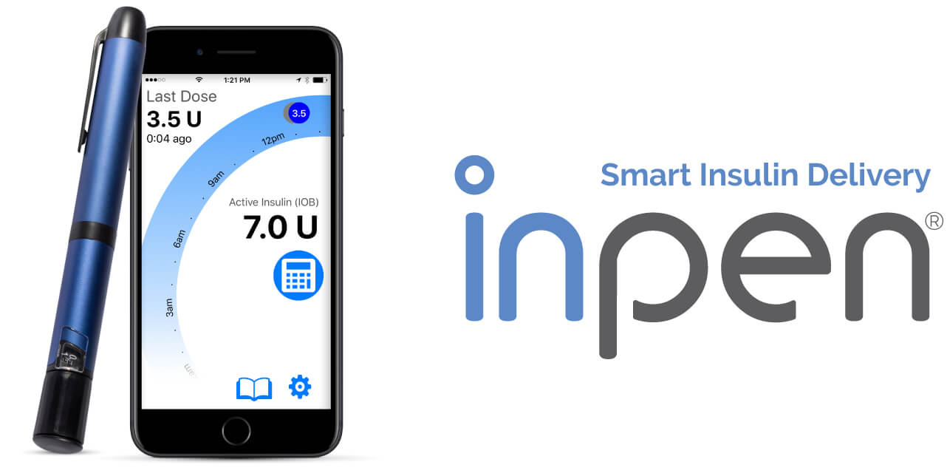
Smart Insulin Pen
A reusable a CGM/” smart” insulin pen/app combination could produce solid patient outcomes at a lower cost than an insulin pump. This could be a real threat to the insulin pump market.
Calculates insulin doses, tracks injection data and shares data when pared with smart phone.
INSULIN IS NOT JUST A LIFE SAVING DRUG BUT ALSO A LETHAL DRUG WHEN DOSED IMPROPERLY. Available Oct 2017 (Companion Medical)
Notes:
A reusable a CGM/” smart” insulin pen/app combination could produce solid patient outcomes at a lower cost than an insulin pump. That such a system would be a real threat to the insulin pump market, that of course assumes the damn thing works and there are no bugs or glitches.
The Pen
The InPen insulin injector pen. An easy-to-use pen that not only helps calculate your doses, but also keeps track of injection data.
When paired via Bluetooth® with the smartphone app, the InPen delivery system keeps tabs on how many units you received at your last injection, when you took them, and other helpful information.
InPen was designed for insulin-dependent individuals 12 and older undergoing multiple daily subcutaneous injections. It can deliver 0.5 to 30 units of insulin, dialed in half-unit increments. Dial too many units? Not a problem. InPen lets you correct the dose without wasting insulin.
The InPen injector pen is compatible with Lilly Humalog® and Novo Nordisk Novolog® U-100 3.0 mL insulin cartridges and single-use detachable and disposable needles (not included).
InPen is as easy to maintain as it is to use. The InPen lasts for one year – no recharging needed. And with options in blue, grey, and pink, you can even add a bit of color to your management plan.
The App
The InPen app is the other half of InPen’s smart diabetes management tool. Using information transmitted from the pen, the app can track insulin therapy, calculate doses, share therapy data with your doctor or family, and much more.
injector pen plus an intuitive smartphone interface equals smart insulin delivery. Simplify your diabetes care plan.
InPen is compatible with Apple iOS 10 devices supporting Apple HealthKit.
An Android version of the app will be coming soon.
Easy to use and install. The tutorial will walk you through it and a handy link to the online user guide makes sure you’re always supported.
How does InPen work?
The InPen Insulin Delivery System works just like a standard insulin pen, but with the support of Bluetooth® technology and an easy-to-use smartphone app.
The InPen injector pen tracks injections and seamlessly delivers the information to your smartphone. From there, the app helps you calculate doses, monitor insulin status, and stores up to a year of data.
How does the InPen dose calculator work?
The calculator computes insulin doses based on previous injections, blood glucose, and carbohydrate intake. Patient-specific target blood glucose, insulin-to-carbohydrate ratio, and insulin sensitivity parameters must be provided by your healthcare professional before use and programmed into the app software.
You simply sync your InPen to the app, load setting information provided by your physician, and you are on your way.
Will I still need to count carbs and check my blood sugar?
Yes. The InPen dose calculator requires the user to input glucose and carbohydrate data.
What insulin is compatible with the InPen System?
The InPen pen injector is compatible with Lilly Humalog® U-100 3.0mL and Novo Nordisk Novolog® U-100 3.0mL insulin cartridges and single-use detachable and disposable pen needles (not included).
Do I need a prescription to use the InPen?
Yes, a prescription is required to use the InPen.
Where can I get the InPen System?
The InPen Insulin Delivery System will be available from our website, mail order pharmacy, and select retail pharmacies. For more information, visit the Get InPen page.
Where can I get the InPen app?
The InPen app will be available in the Apple Store and is compatible with Apple iOS 10 devices supporting Apple HealthKit. Compatibility with Android devices is coming soon.
How long will my InPen injector pen last?
The InPen has a non-rechargeable lithium battery that lasts for one year of pen injector use.
What will my InPen look like?
The InPen injector is the same size and weight as a traditional insulin pen: 6.5”x 0.6” and 35 grams. The pen is available in pink, grey, and blue.
Does InPen track my prime doses?
Yes, it tracks them and automatically differentiates them from therapeutic doses.

Slide 10
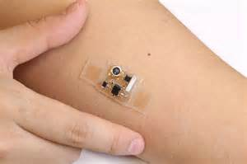
Disposable
Bandaid CGMS
Google/Dexcom developing a disposable bandaid CGM
Will transform diabetes management –Blood Glucose monitors where you need to prick your finger will no longer exist.
This will change the way we monitor & Treat patients with
diabetes, and prediabetes.

Slide 11
Minimed 670G
First Artificial Pancreas?
CGM reading every five minutes, the 670G pump’s software automatically increases or decreases basal insulin delivery to target a blood glucose of 120 mg/dl.
The 670G is considered a “hybrid closed loop,” as a user still needs to bolus for meals and notify the system of exercise. Otherwise, it takes care of insulin dosing in the background, which is particularly valuable at night.
It will only suggest a correction bolus when a fingerstick is taken. Still, the 670G will modulate basal insulin to keep glucose in range.
Future models under testing, will add correction boluses based on CGM readings, further addressing highs automatically.
It provides for better control and less hypoglycemia.
Notes:
In diabetes technology, the closed loop advanced further towards commercialization, led by Medtronic’s MiniMed 670G – more than ever, this year made it clear that closing the loop is now a question of “when” and “how,” not “if.”

Slide 12
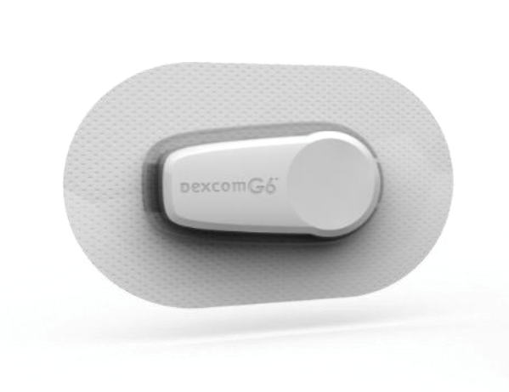
The Dexcom G5 is the first continuous glucose monitoring system to receive FDA approval for insulin dosing decisions, without the need for a fingerstick. (except for calibrating the system)
The Dexcom G5 CGM sensor now paid for by Medicare for those with type 1 or 2 diabetes, on multiple injections and check their blood sugars at least 4 times day.
g5
The G6 sensor expected in 2018 will be smaller and thinner and will not need any calibrations and will last 14 days instead of the current 7 days.
Notes:
A key step for obtaining Medicare coverage (hopefully expected in 2018), for increasing safety, and for encouraging CGM use
On December 20, the US Food & Drug Administration (FDA) finally approved Dexcom’s G5 continuous glucose monitor (CGM) for making diabetes treatment decisions – for example, dosing insulin – without the need for a confirmatory fingerstick. The expanded indication, approved for people with diabetes ages two and older, is the first of its kind for a CGM in the US.
G6 Sensor Shines in Early Accuracy Study
Earlier this month, Dexcom shared compelling new details on its longer-wear, less calibration G6 sensor and its partnership with Verily to develop a bandage-like continuous glucose monitoring (CGM) device. The G6 sensor is expected to launch in 2018, while the first-gen Verily sensor will launch in late 2018, with a second-gen version coming as early as 2020. Read on for the new details!
The New G6 Sensor: Longer Wear (10-14 days) and the Potential for No Fingerstick Calibrations
Dexcom showed new data from a 49-person trial testing use of the new G6 sensor over ten days of wear. The average error compared to lab measurement was just 8.1% with one fingerstick calibration per day (after startup), and an expected 8.8% error with no fingerstick calibration at all. Notably, 96% of G6 readings were within 20% or 20 mg/dl of the true glucose value, the strongest data Dexcom has ever released. Improving accuracy – and especially minimizing the error percentage – is important because a difference of plus or minus 20 mg/dl can have big implications in the hypoglycemia range.
These early accuracy results are exciting, suggesting that the G6 will have better or equal accuracy to G5, with up to double the wear duration (10-14 days – wow!) and fewer fingersticks needed. A larger, 300-person pivotal trial is now underway to investigate. Dexcom said it plans to launch the initial version of G6 in 2018.
And given the strong data seen with G6 use so far, Dexcom ultimately believes it can last for 14 days of wear with no fingerstick calibrations needed.
The Thinnest CGM Ever, from Dexcom and Verily
Another standout in Dexcom’s pipeline is its partnership with Verily (the part of Alphabet Inc. formerly known as Google Life Sciences), which aims to develop two smaller, less expensive CGM devices. Earlier this month, Dexcom showed the latest pictures of the “thinnest CGM ever,” with less volume than an M&M and roughly the size of a penny – check out the picture below of the second-gen device! This would dramatically reduce the size of CGM on the body, hopefully make it less expensive, and bring the technology to far more people than are currently using it (only about 1-in-5 people with type 1 in the US use CGM, and far fewer people with type 2 diabetes).
Medicare announced that it will now reimburse “therapeutic continuous glucose monitoring” (CGM) devices for people with type 1 or type 2 diabetes on intensive insulin therapy (“MDI” – multiple daily injections – or a pump). This milestone is a big deal because it establishes reimbursement for Dexcom’s G5 CGM, the only “therapeutic CGM” – meaning it has FDA approval for making diabetes decisions without a confirmatory fingerstick – currently available in the US.
For those covered by Medicare who want to get CGM, Dexcom can help get the process started for you – learn more here (there’s an option to enter your information for Dexcom to reach out regarding next steps). Coverage applies to claims starting on January 12, 2017 and later.
People with diabetes covered by Medicare are eligible for reimbursement if they meet the following criteria:
Have type 1 or type 2 diabetes;
Currently use a home blood glucose monitor (BGM) and perform at least four fingersticks per day;
Take insulin, either with multiple daily injections or an insulin pump;
And have an insulin plan that requires frequent changes based on CGM readings.
Medicare announced that it will now reimburse “therapeutic continuous glucose monitoring” (CGM) devices for people with type 1 or type 2 diabetes on intensive insulin therapy (“MDI” – multiple daily injections – or a pump). This milestone is a big deal because it establishes reimbursement for Dexcom’s G5 CGM, the only “therapeutic CGM” – meaning it has FDA approval for making diabetes decisions without a confirmatory fingerstick – currently available in the US.
For those covered by Medicare who want to get CGM, Dexcom can help get the process started for you – learn more here (there’s an option to enter your information for Dexcom to reach out regarding next steps). Coverage applies to claims starting on January 12, 2017 and later.
People with diabetes covered by Medicare are eligible for reimbursement if they meet the following criteria:
Have type 1 or type 2 diabetes;
Currently use a home blood glucose monitor (BGM) and perform at least four fingersticks per day;
Take insulin, either with multiple daily injections or an insulin pump;
And have an insulin plan that requires frequent changes based on CGM readings.

Slide 13
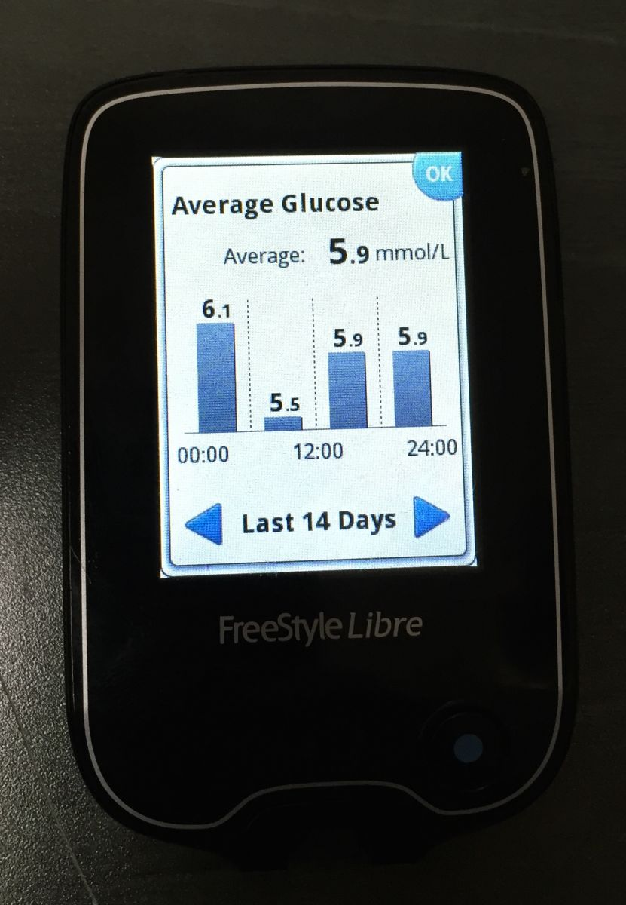
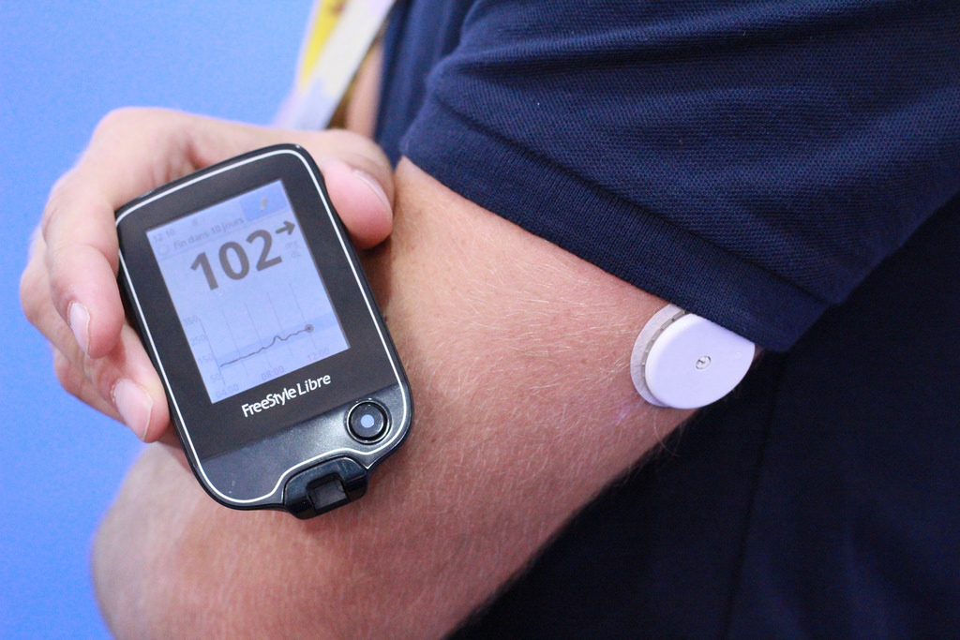
Freestyle Libre Pro
FreeStyle® Libre Flash Glucose (CGMs) Monitoring System, is a revolutionary new glucose sensing technology for people with diabetes that eliminates finger sticks. The system reads glucose levels through a sensor. In addition, no finger prick calibration is needed, a key differentiator from current CGM systems. Another differentiator is that it doesn’t have an alarm for highs or lows like CGMs do. (Navigator software)
Currently only available in Europe.
For now, the data is blinded from patient
14 day sensor COST 60 dollars
Reader cost 60 dollars which you can use for multiple sensors
Reimbursement is about 200 dollars
Google, Dexcom, Abbott, and Apple in a race to replace the BGM!
Notes:
UK researchers conducted a trial of Abbott Diabetes Care's FreeStyle Libre glucose monitoring system involving 89 children with type 1 diabetes, ages 4 to 17, and found that the sensor detected hyperglycemia and hypoglycemia 85% and 70% of the time, respectively, rising to 94% and 84%, respectively, when pending alerts were considered. The findings in the Archives of Disease in Childhood also revealed that five participants had five device-related adverse events, all of which were resolved by the end of the study.
Medscape (free registration) (2/2)
Diabetes Monitoring With a Patch
Nicky Broyd
September 13, 2017
There's a new way for people with diabetes to monitor their blood sugar levels that doesn't rely on finger prick blood tests. What it does use is a sensor on the arm and the kind of technology used in contactless bank cards.
The new-style monitor licensed for use in the European Union is the FreeStyle Libre by Abbott.
It has just been approved for NHS funding by the NHS Business Services Authority.
Is the new sensor system the same as a continuous glucose monitoring system (CGM)?
It's not. The company which makes the sensor says: "The FreeStyle Libre System is not a CGM device." Abbot says it has developed 'a new category' of glucose monitoring.
The sensor is designed to be worn for 14 days and is intended to replace blood glucose meters whilst still giving people with diabetes continuous glucose monitoring-like information.
How does it work?
First you have to fix the sensor to the back of your upper arm in a procedure which is said to be no more painful than a typical finger prick test. The sensor is pressed onto a disposable applicator and then the applicator is pushed down firmly to apply the tiny sterile sensor to your upper arm. The sensor goes just under your skin and is connected to a white, water-resistant plastic patch similar in size to a £2 coin.
The sensor monitors glucose in your interstitial fluid - the fluid between your cells - rather than blood glucose levels. The sensor is also fitted with a transmitter that wirelessly transmits results to a special scanner, or an app on your smart phone, to see what your glucose levels are. You hold the scanner, or your phone, close to the sensor for about 3 seconds. You can scan your arm through your clothes.
With a finger prick blood test you get a snapshot of where your blood glucose levels are. With the new sensor every scan shows your current glucose reading, a trend arrow indicating the direction your glucose is heading and the last 8 hours of your glucose history. This lets you know how food, activity and insulin affect your glucose levels - day and night.
Advantages
The benefits of the FreeStyle Libre monitoring system are:
It's discrete and convenient
It takes readings every minute - but you won't be aware of this
It gives 8 hours of easy to view glucose history which means patients get more information about the effects of different foods and activity on their glucose levels
It's factory-calibrated so it doesn't require finger prick blood glucose measurements for calibration
The sensor remains inserted for 14 days
It stores your readings for up to 90 days
It provides an easy way to share information with your doctor or diabetes nurse
It's approved for children aged 4 to 17 and means parents or carers can manage night-time monitoring with a scan, rather than having to wake children to take a finger prick blood test
It can be used whether you use an insulin pump, multiple daily insulin injections, other diabetes medications or diet and exercise
It's reported to be about as accurate as a CGM.
Disadvantages
It's not the end of all finger prick tests and there will still be times when they are necessary. For example, when blood glucose levels are rapidly changing, since interstitial fluid glucose levels may not accurately reflect the current blood level, or when the system reports hypoglycaemia or impending hypoglycaemia, or when the patient's symptoms don't match the device's readings.
The FreeStyle Libre does not have any alarms alerting you to the fact your glucose levels are too high or too low, nor does it include a 'share' feature to allow for remote monitoring by another person.
Not everyone gets on well wearing the sensor, some find it itches and some have insertion-site reactions.
Has it been trialled?
A 6-month study, published in The Lancet in September 2016, found it significantly reduced hypoglycaemia without raising HbA1c levels in insulin-treated patients with type 1 diabetes, compared with self-monitoring of blood glucose using finger pricks. The research monitored 328 patients with type 1 diabetes from 23 European centres - Sweden, Austria, Germany, Spain and the Netherlands.
The lead researcher, Professor Jan Bolinder, professor of clinical diabetes research at the Karolinska Institute, Stockholm, Sweden, told Medscape: "When the patients started using the Libre device, they instantly tripled their rate of self-monitoring, and this resulted in a marked reduction in time and events spent in hypoglycaemia, time spent in hyperglycaemia, an increase in time spent in optimum range, less glucose variability, and improvements in quality-of-life measurements."
At the European Association for the Study of Diabetes 2016 Annual Meeting, Dr Thomas Haak, of Diabetes Zentrum Mergentheim, Germany, presented data showing similar outcomes with the FreeStyle Libre system in patients with type 2 diabetes on intensive insulin therapy.
A study published online January 31 in the Archives of Disease in Childhood found the FreeStyle Libre system was accurate, safe and suitable for a broad range of children and young people with diabetes. The study involved 89 children aged 4 to 17 years with type 1 diabetes in 9 UK diabetes centres. Participants were asked to perform four capillary blood glucose tests daily, each immediately followed by a sensor reading.
The company behind the FreeStyle Libre funded the trials.
"Life-Changing"
Reacting to the NHS funding announcement in a statement, Diabetes UK chief executive Chris Askew, says: "Today’s announcement is fantastic news: Not since the transition from urine testing to finger-prick testing has there been such potential to transform the lives of people living with type 1 and type 2 diabetes through technology.
"Flash glucose monitoring can free people living with diabetes from the pain and rigour of frequent finger-prick testing, and puts them in greater control of their condition. In doing so, it has the potential to help prevent a host of devastating long-term complications. Today’s decision is testament to the commitment of campaigners, clinicians and policy makers to making this technology available.
"The challenge now will be that everyone who could benefit from this technology is able to access it where they live. Diabetes UK will be looking to local decision makers to ensure people living with diabetes get proper access to this potentially life-changing technology."
SOURCES:
Abbott news release
Diabetes UK
FreeStyle Libre website
Medscape
The Lancet: Novel glucose-sensing technology and hypoglycaemia in type 1 diabetes: a multicentre, non-masked, randomised controlled trial
Flash Glucose-Sensing Technology as a Replacement for Blood Glucose Monitoring for the Management of Insulin-Treated Type 2 Diabetes: a Multicenter, Open-Label Randomized Controlled Trial
BMJ Journals: An alternative sensor-based method for glucose monitoring in children and young people with diabetes
NICE
Diatribe – making sense of diabetes
WebMD Health News © 2017
Cite this article: Diabetes Monitoring With a Patch - Medscape - Sep 13, 2017.

