Slide 1
GLP-1 Agonist and SGLT-2 Inhibitor Monotherapy Trial Results
(handout)
Drug | Class | HbA1c Reduction | Fasting BG Reduction | Weight change | CV Outcomes | FDA Approval
Semaglutide | GLP-1A | 0.5 mg: 1.5% 1.0 mg: 1.8% | 0.5 mg: - 29 mg/dL 1.0 mg: - 43 mg/dL | 0.5 mg: - 10.1 lbs 1.0 mg: - 14.3 lbs | Decreased risk of CV events by 26% | Submitted; Awaiting FDA Approval
Bydureon (exenatide ER) | GLP-1A | 2 mg: 1.6% | 2 mg: 25 mg/dL | 2 mg: - 5 lbs | No statistically significant change | Jan 2012
Victoza (liraglutide) | GLP-1A | 1.2 mg: 0.8% 1.8 mg: 1.1% | 1.2 mg: 15 mg/dL 1.8 mg: 26 mg/dL | 1.2 mg: - 4.6 lbs 1.8 mg: - 5.5 lbs | FDA approved to reduce risk of MI, CVA & death | Jan 2010
Trulicity (dulaglutide) | GLP-1A | .75 mg: 0.8% 1.5 mg: 1.1% | .75 mg: 16 mg/dL 1.5 mg: 27 mg/dL | .75mg: - 2.9 lbs 1.5mg: - 4.1 lbs | Does not increase the chances of a CV event | Sept 2014
Farxiga (dapagliflozin) | SGLT2-I | 5 mg: 1.2% 10 mg: 1.5% | 5 mcg: 42 mg/dL 10 mcg: 46 mg/dL | 5 mcg: - 5.7 lbs 10 mcg: - 6.0 lbs | Does not increase the chances of a CV event | Jan 2014
Invokana (canagliflozin) | SGLT2-I | 100 mg: 0.8% 300 mg: 1.0% | 100 mg: 27 mg/dL 300 mg: 35 mg/dL | 100 mg: - 5.3 lbs 300 mg: - 7.5 lbs | Significantly reduces risk stroke, heart attack and CV death 14% | Mar 2013
Jardiance (empagliflozin) | SGLT2-I | 10 mg: 0.7% 25 mg: 0.8% | 10 mg: 19 mg/dL 25 mg: 25 mg/dL | 10 mg: - 4.9 lbs 25 mg: - 5.5 lbs | FDA approved to reduce risk of CV death 38% | Aug 2014

Slide 2
SGLT-2 & DPP-4 Inhibitors Monotherapy Trial Results (handout)
Drug | HbA1c Reduction | Fasting BG Reduction | Weight change | CV Outcomes | FDA Approval
Farxiga – SGLT2 (dapagliflozin) | 5 mg: 1.2% 10 mg: 1.5% | 5 mcg: 42 mg/dL 10 mcg: 46 mg/dL | 5 mcg: - 5.7 lbs 10 mcg: - 6.0 lbs | Does not increase the chances of a cardiovascular event | January 2014
Jardiance- SGLT2 (empagliflozin) | 10 mg: 0.7% 25 mg: 0.8% | 10 mg: 19 mg/dL 25 mg: 25 mg/dL | 10 mg: - 4.9 lbs 25 mg: - 5.5 lbs | FDA approved to reduce risk of cardiovascular death (Dec 2016) | August 2014
Invokana – SGLT2 (canagliflozin) | 100 mg: 0.8% 300 mg: 1.0% | 100 mg: 27 mg/dL 300 mg: 35 mg/dL | 100 mg: - 5.3 lbs 300 mg: - 7.5 lbs | Significantly reduces risk stroke, heart attack and cardiovascular death | March 2013
Januvia – DPP-4 (sitagliptin) | 100 mg: 0.6% | 100 mg: 12 mg/dL | No significant change | Does not increase the chances of a cardiovascular event | October 2006
Tradjent DPP-4 (linagliptin) | 5 mg: 0.4% | 5 mg: 9 mg/dL | No significant change | Does not increase the chances of a cardiovascular event | May 2011
Onglyza- DPP-4 (saxagliptin) | 2.5 mg: 0.4% 5 mg: 0.5% | 2.5 mg: 15 mg/dL 5 mg: 9 mg/dL | No significant change | Increased risk of heart failure (FDA added new safety warnings in 2016) | July 2009
Nesina – DPP-4 (alogliptin) Generic ONLY | 25 mg: 0.6% | 25 mg: 16 mg/dL | No significant change | Increased risk of heart failure (FDA added new safety warnings in 2016) | January 2013

Slide 3
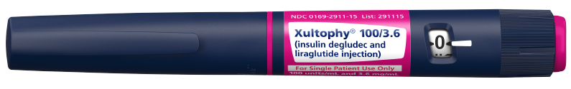
Xultophy 100/3.6 (ZUL-toh-fye)
INSULIN DEGLUDEC + LIRAGLUTIDE (GLP-1)
Starting dosage of XULTOPHY® 100 /3.6 is 16 units (16 units of insulin degludec and 0.58 mg of liraglutide)
Given subcutaneously once daily, with or without food.
Maximum daily dosage of XULTOPHY® 100/3.6 is 50 units (50 units of insulin degludec and 1.8 mg of liraglutide)
100/3.6 pen delivers doses from 10 to 50 units
Use alternative antidiabetic products if patients require a dose less then 16 units or over 50 units
Contraindications and side effects same as degludec and liraglutide
A1c change from baseline when added to metformin (8.7) was -1.94 drop.
Percentage of achieving goal of <7%A1c- 57.3%
A reduction of FPG from baseline of 175mg/dL to 110mg/dL.
Hypoglycemia higher compared with liraglutide alone (32% vs 7%)
Notes:
In people who are insulin-naïve, insulin degludec/liraglutide (Xultophy) was non‑inferior to insulin degludec alone and superior to liraglutide alone for reductions in HbA1c (with a difference of 0.64% compared with liraglutide). In people previously treated with basal insulin, insulin degludec/liraglutide was superior to insulin degludec alone for reducing HbA1c with a difference of 1.1%. The safety profile and long‑term safety concerns of insulin degludec/liraglutide are broadly in line with those of the 2 included components.

Slide 4
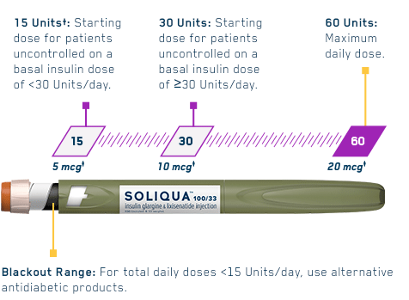
Soliqua 100/33 Dosage and Administration (GLP-1 + Insulin)
Lixisenatide plus glargine
The Soliqua 100/33 Pen delivers doses from 15 to 60 units in a single injection
In patients inadequately controlled on less than 30 units of basal insulin or on lixisenatide, the recommended starting dosage of Soliqua 100/33 is 15 units (15 units insulin glargine/5 mcg lixisenatide) given subcutaneously once daily.
In patients inadequately controlled on 30 to 60 units of basal insulin, the recommended starting dosage of Soliqua 100/33 is 30 units (30 units insulin glargine/10 mcg lixisenatide) given subcutaneously once daily.
Administer Soliqua 100/33 subcutaneously once a day within the hour prior to the first meal of the day. Approx price of $670 - 5 pens (Sanofi)
Not known if safe for children 18 years of age or younger

Slide 5
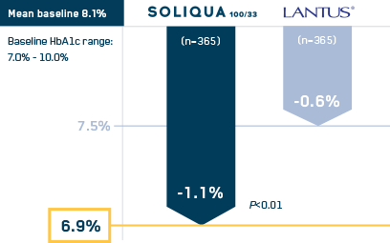
SOLIQUA 100/33
Insulin glargine 100 Units/ml. & Lixisenatide 33mcg/ml

Slide 6
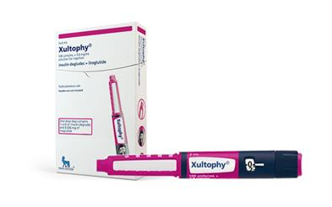
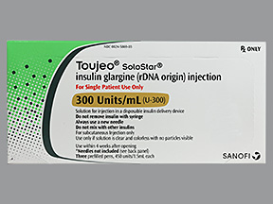
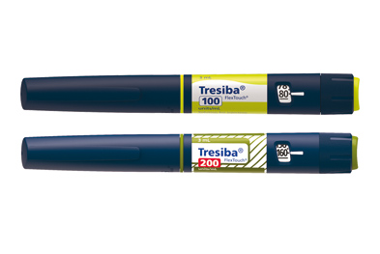

Long-acting Insulins

Slide 7
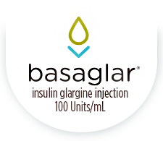

First BioSimilar Insulin (basa-glur)
Insulin glargine (BioSimilar to Lantus)
BASAGLAR is a long-acting insulin used to control high blood sugar in adults and children with type 1 & 2 diabetes.
Lantus (Sanofi) cost Approx $420/ 5 Solostar pens of 3ml/ea
Basaglar (Lilly) cost Approx $385/ 5 pens of 3ml/ea
Most 3rd party payor’s will no longer pay for Lantus

Slide 8
PRE-DIABETES
95 -100 Million
What is it?
Do Patients Even Know What It Is?
Is Prediabetes Diabetes?
Diagnosis was 180 – 140 – 126 - >99mg/dL
How do we diagnose 100 million and why?
Can we define it?
Definition:
  An A1c of 5.7-6.4%
  Fasting blood sugar of 100-124mg/dL. (125mg/dL=Diabetes)
  PostPrandial Blood Sugar or a OGTT of 140-199mg/dL.
Treatments- Lifestyle Change
  Nutrition
  Physical Activity
  No FDA approved medication to treat
  ADA recommends metformin for some
Risks
  CVD
  Kidney disease
  When blood sugars are elevated over time, we are at greater risk for every disease known to man.
Notes:
With 90-100 million or 1/3 of our population with prediabetes we need to take seriously in finding, educating and treating.

Slide 9
EPIC-Norfolk Study: Every 1% Increase in A1C Increased CV Risk
1% Increase in A1C Above 5%
1% Increase in A1C Above 7%
Men
Women
↑ 40%
30
↑ 28%
40
↑ 25%
↑ 24%
25
↑ 21%
↑ 21%
↑ 20%
30
↑ 26%
20
Increase in Relative Risk (%)*
Increase in Relative Risk (%)†
15
20
↑ 16%
10
10
5
0
0
CHD
CVD
Total
Mortality
CHD
CVD
Total
Mortality
CHD
CVD
Total
Mortality
*Multivariate regression – adjusted for age and risk factor; †Multivariate regression – adjusted for age, sex, and risk factor.
EPIC-Norfolk: The European Prospective Investigation into Cancer in Norfolk was a prospective population study of 4,662 men and 5,570 women aged 45-79 years. Average follow-up time was 6.3 years.
Khaw KT et al. Ann Intern Med. 2004;141:413-420.

Slide 10
What About Recommended Treatments for Pre-Diabetes From FDA, ADA and AACE for 2017?
THERE ARE NONE
The American Diabetes Association’s 2017 guidelines suggest consideration of metformin in patients with prediabetes and additional risk factors (BMI, ≥35 kg/m²; age, <60 y; prior gestational diabetes mellitus) or rising HbA1c.
The prevalence of metformin use is below 1% in adults with prediabetes.
Published in Diabetes April 18, 2017
Notes:
There are over 30 studies now using many of our current drugs to show that we need to prevent prediabetes from becoming diabetes. Certainly metformin is effective but it is offlabel use. We should have a number of options within the next 3-5 years.

Slide 11
WHY Metformin: 7 Studies Found :
  Lower mortality in Type 2 patients with comorbidities as chronic kidney disease, congestive heart failure and chronic liver disease.
  Reduces cardiovascular risk factors.
  Enhances cellular insulin sensitivity.
  Inhibits excess intestinal absorption of sugar.
  Reduces excess liver production of glucose.
  Reduces appetite, wt, and body fat content.
  New data on REMOVAL study shows that it reduces the glomerular filtration rate (eGFR) that you normally see in type 1
  Metformin has been found to suppress the growth of some tumors and enhance the activity of anti-cancer drugs.
  Has a mild effect on weight loss.
  increases insulin sensitivity.
  Reduces or lowers the chances of developing atherosclerosis.
  Does not cause hypoglycemia.
  Can help decrease FBG 60-70mg/dL.
  Increases hypothalamo-pituitary sensitivity that declines with age.
  Shown to reduce Cholesterol and triglycerides.
  Reduces risk for polycystic ovarian syndrome.
  Cost 3 dollars or Free
  Side Effects: Abdominal distress
  What can we do? A1ctest
Yet, the FDA does not recommend metformin for those with PreDiabetes?
Notes:
In conclusion, the scientific research points to metformin's multiple uses, with few drawbacks. Accordingly, the drug's numerous side benefits associated with the treatment and prevention of diabetes, as well as other disorders, appear to outweigh its limited side effects.
Researchers found that older men with type 2 diabetes who were on metformin therapy had a reduced risk of developing cancer, cardiovascular disease, dementia, depression and frailty-related diseases. The findings in the Journal of Diabetes and Its Complications, based on 41,204 men ages at least 65, also revealed an association between metformin use and a reduced mortality rate.

Slide 12
Who Should Be Tested? EVERYONE
You have a family history of pre-diabetes or type 2 diabetes
Have Polycystic Ovarian Syndrome (women) or metabolic syndrome (men and women);
Have Hashimoto’s Thyroiditis, Are pregnant; Are age 45 or older; Are overweight, especially around the abdomen; If you have any skin changes or discoloration especially on the neck or underarms, have skin tags; or have unexplained weight gain, an increase in acne, scalp hair loss, increase in facial hair (women), or changes in your periods (women) at the same time.
Solution: Make A1c result required on Drivers License and a requirement yearly for school record.

