Slide 1
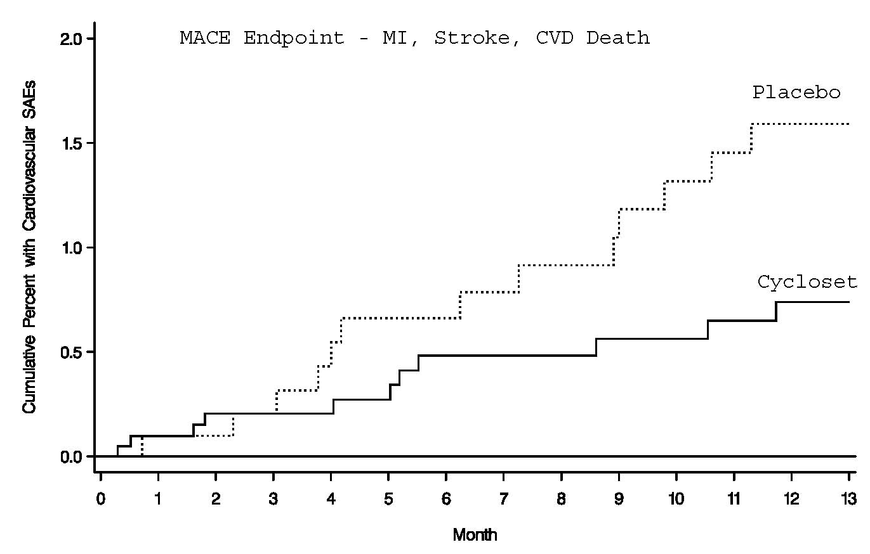
Cycloset®A Dopamine Receptor Agonist
Cycloset® -Bromocriptine: Safety Trial: Post Hoc Analysis of Cumulative Percent MACE Endpoint
Bromocriptine (Parlodel) is used to treat symptoms of hyperprolactinemia (high levels of a natural substance called prolactin in the body) also pituitary tumors, Parkinson's disease
HR 0.45; 95% CI 0.2-0.99
RRR= 52%
MACE
Most people with diabetes will not die from diabetes but from CVD.
Among patients in the study, CYCLOSET significantly reduced the relative risk for the composite cardiovascular endpoint of myocardial infarction, stroke and cardiovascular death by 52%.”
Notes:
1

Slide 2
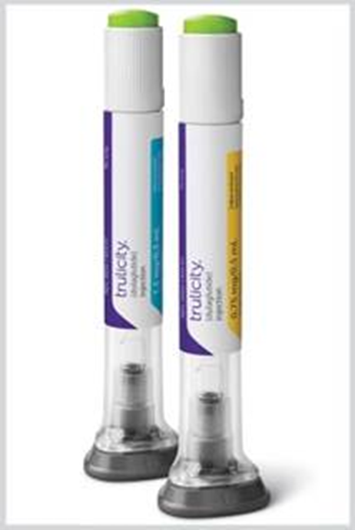
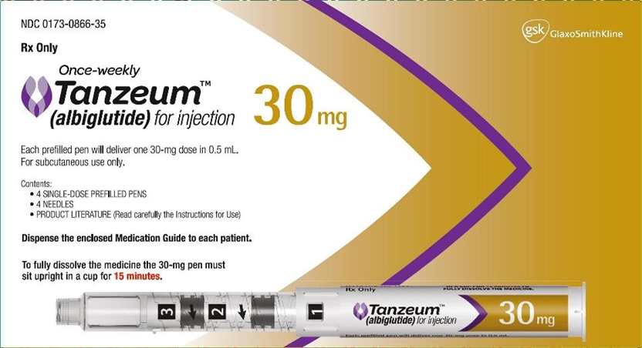
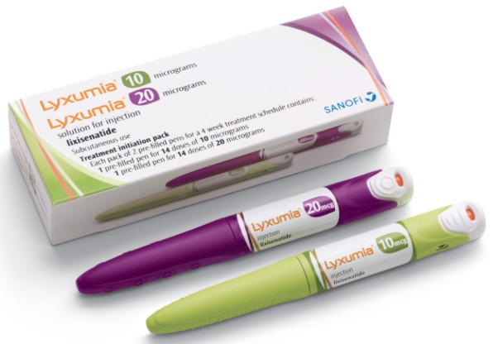
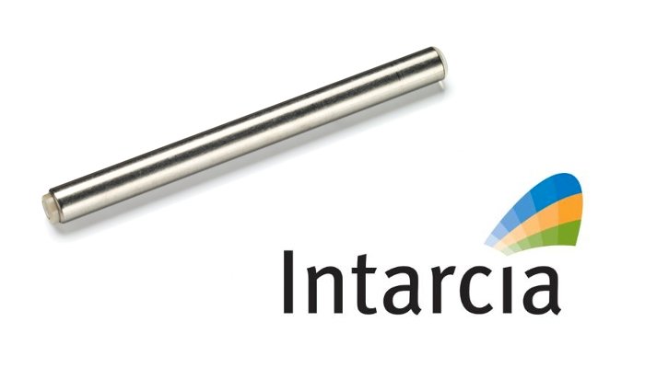
GLP-1 Agonists - Glucagon-like peptide-1 receptor agonist

Slide 3
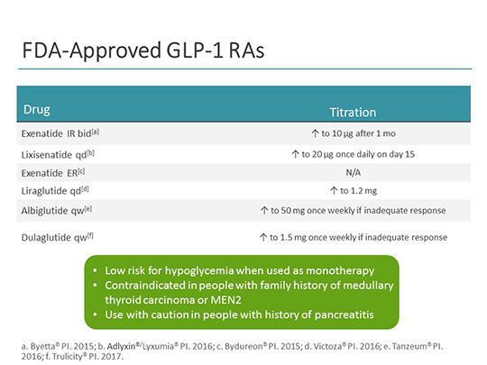

Slide 4
Lixisenatide Study Results
  Lyxumia (Lex-umia)(Lixisenatide) – GLP-1
Randomized population had mean diabetes duration of 9.2 years, BMI 31.8 kg/m2, and daily glargine dosage of 44 units
HbA1c had decreased during run-in from 8.6 to 7.6%
More participants attained HbA1c <7% with lixisenatide
Lixisenatide reduced plasma glucose 2 h after a standardized breakfast and had a favorable effect on body weight
Once daily injection
Nausea, vomiting, and symptomatic hypoglycemia <3.3 mmol/L were more common with lixisenatide

Slide 5
Dulaglutide (Trulicity®)
Dulaglutide offers adults with type 2 diabetes once-weekly dosing in the dulaglutide pen, which has a pre-attached, hidden needle and requires no reconstitution
Long acting GLP-1 agonist
  Significantly reduced both fasting and 2-hour postprandial glucose
Most common side effects: nausea and dyspepsia
Significant weight loss (2-2.5kg) seen with the highest administered dose of 5 and 8 mg
Reduction of HbA1c ~1.52% compared to placebo

Slide 6
Albiglutide (Tanzeum®)
Long-acting GLP-1 agonist
Once-weekly dosing in type 2 diabetes
Study treated type 2 diabetic patients with varying doses of albiglutide over 16 weeks
Main outcome measure:
  Dose-dependent reduction in A1c in all albiglutide schedules
  Mean A1c reduced from baseline of 8% or about 0.9%
  Weight loss: -1.1 to -1.7 kg
  24 mg/dL, Fasting glucose reductions
Conclusion :Shows improved glycemic control, and elicited weight loss

Slide 7
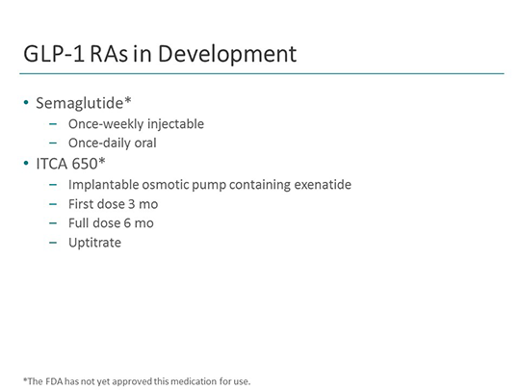
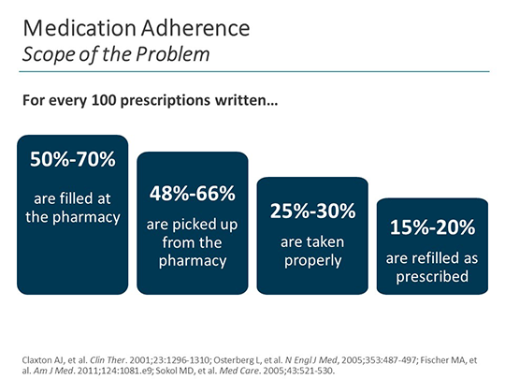

Slide 8
Semaglutide – Not Yet FDA Approved
Semaglutide is a new GLP-1 analogue that is administered once weekly.
Currently undergoing phase 3a trials. Novo Nordisk recently published results from the 4th phase 3a trial (SUSTAIN2). SUSTAIN2 investigated the efficacy and safety of 0.5 mg and 1 mg
Results of SUSTAIN2 were promising showing a statistically significant improvement in A1c of 1.3% with 0.5 mg and 1.6% with 1 mg
Statistically significant weight loss with semaglutide 0.5 mg and 1 mg (4.3 kg and 6.1 kg= 13.5Lbs)
Notes:
https://globenewswire.com/news-release/2015/12/17/796325/0/en/Novo-Nordisk-successfully-completes-fourth-phase-3a-trial-with-semaglutide-in-people-with-type-2-diabetes.html

Slide 9
GLP-1 Agonist Drug Shows Cardiovascular Benefit (Semaglutide) NovoNordisk
Sustain 6 Drug Trail showed that once weekly semaglutide reduced CVD risk
Reduced A1c by 1.5 to 1.8%
74% in trial achieved target of 7 to 6.5A1c levels
Weight loss of up to 4.6kg
39% decrease in nonfatal stroke
26% decrease in nonfatal myocardial infarctions
A lower risk of new or worsening nephropathy
Less hypoglycemia
Safety profile similar to that of other GLP-1–receptor agonists
Submitted to FDA Dec 2016
Oral tablet is coming soon- No training needed
  Higher dose required for oral administration daily not weekly
Notes:
We are also watching the oral version of semaglutide from Novo Nordisk (NYSE: NVO) again not because the drug is all that special rather it would be the first GLP-1 to be delivered orally and not injected. it’s not the drug that is all that special but how it is delivered.

Slide 10
