Slide 1
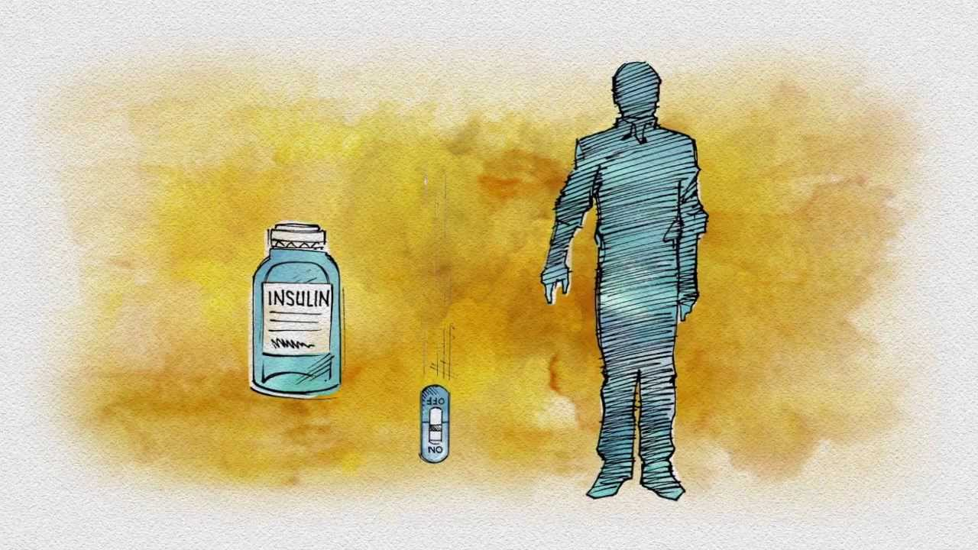


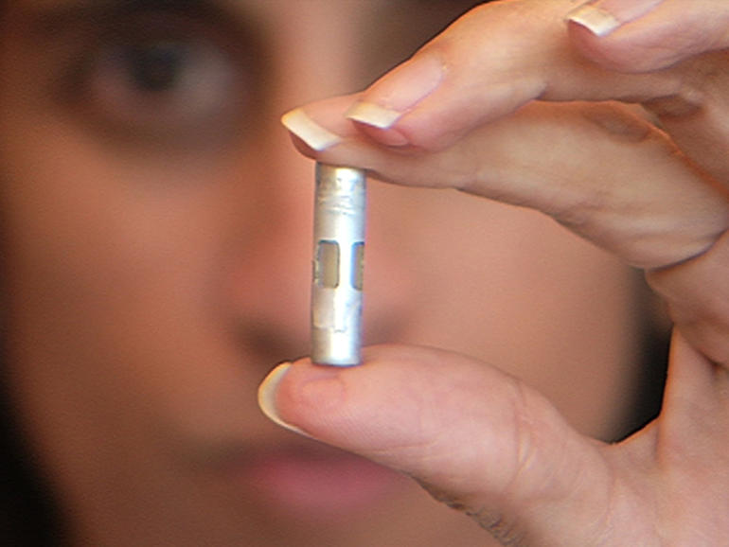

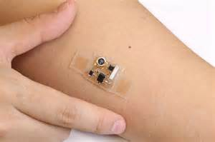

Diabetes 2017 & Into The Future
The goal of this program is to gain better insight into an understanding of the new advances in technology and medications that will change our profession in diabetes management now and into the future.
Notes:
Note: Animas is closing it insulin pump doors. Which leaves Medtronic, Omnipod, and Tandem which could be next

Slide 2
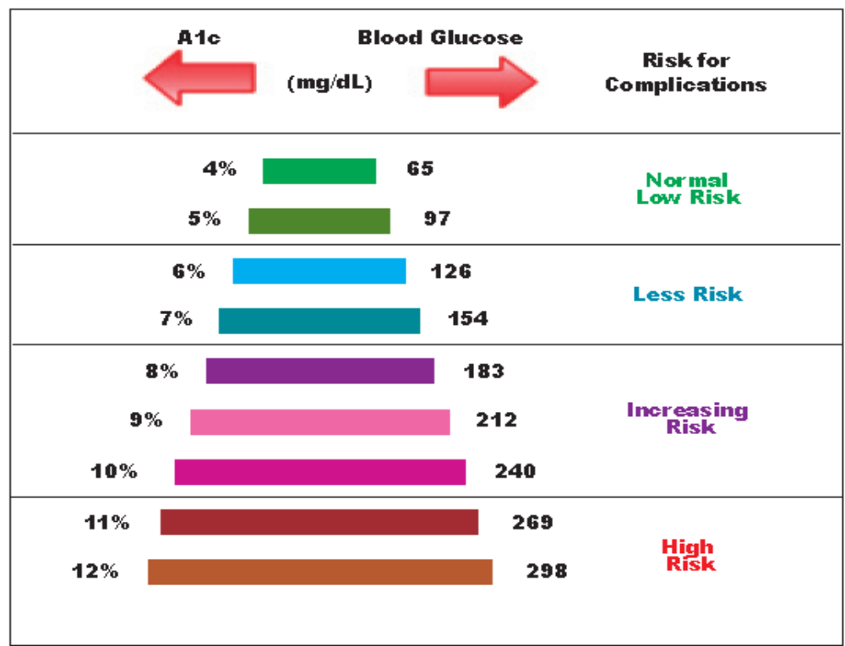
What Is Your Quality of Life (A1c)Number???
Knowing your A1c can motivate life-style change
Average A1c In the US is 9.3%
Normal
4.3-4.5%
Normal
82-85mg/dL
Study published in Diabetes Care showed that those with an avg Fasting BG over 85 have an increase in cardiovascular death
A study in Diabetes Care showed that by doing an A1c test in the office and the results explained, that you can lower A1c a full point
handout

Slide 3
Possible Diabetes Drug Combinations
From 1950 to 1995 only 1 oral medication available (sulfonylurea)
Expect to see other combinations with:
SGLT-2 inhibitors
GLP-1 agonists
Metformin
TZD’s
DPP-4’s
Dopamine Receptor Agonist
Long acting insulin
3,628,800
Possible combinations?? :

Slide 4
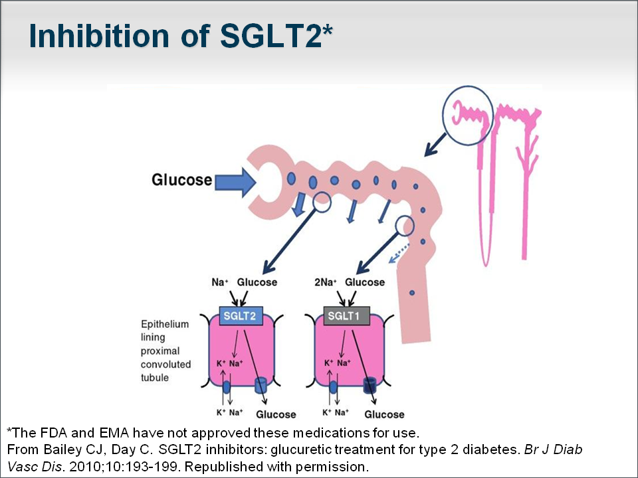
SGLT-2 Inhibitors
Oral sodium glucose cotransporter-2 (SGLT2) inhibitors for the treatment of type 2 diabetes in adult patients adjunct to diet and exercise
Inhibits the SGLT2 from
reabsorbing filtered glucose
across the membranes of the
epithelial cells of the proximal
tubule, resulting in urine
glucose excretion
Need good kidney function
Jardiance, Invokana, Farxiga
From Bailey CJ, Day C. SGLT2 Inhibitors: Glucuretic Treatment for Type 2 Diabetes. Br J Diab Vasc Dis. 2010;10:193-199
Notes:
It lowers the renal threshold for glucose reabsorption in patients with type 2 diabetes mellitus.

Slide 5
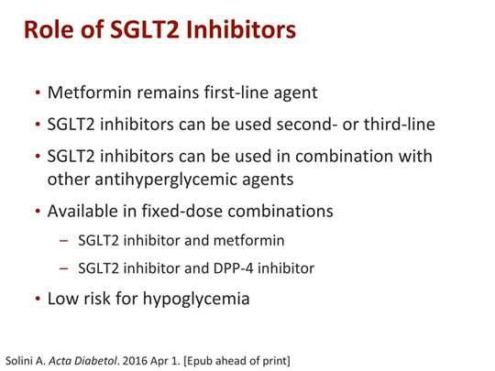

Slide 6
SGLT2 Inhibitors - Oral Tablet
HbA1C reduction of 0.5-0.9%
  Comparable to other PO anti-diabetic agents currently on the market
Amount of glucose excretion in urine dependent on blood glucose concentration
  Greatest amount of glucose excretion when blood glucose levels are highest
  (post-prandial)
Excretion of 80-90g of glucose/day – Significant Weight Loss
  Reduction in 300-400 calories/day in T2DM
Reduces hepatic glucose production
Enhanced insulin sensitivity in muscle & liver
Preserved pancreatic β-cell function
Increased glucose excretion leads to increased urinary flow
(osmotic diuretic effect)
  Decreased blood pressure
Reduced risk of hypoglycemia
Reduce impact of post-prandial glucose spikes
Reduced efficacy in kidney impaired patients
Development and potential role of type-2 sodium-glucose transporter inhibitors for management of type 2 diabetes. Timothy CH, Simon WD. Diabetes Ther. 2011 September; 2(3): 133–145.

Slide 7
Is there a down side to SGLT2 inhibitors?
Do not use in stage IV nephropathy
Amputations with canaglifozin for toes 3/1000 for placebo and 5/1000
Urinary tract infections occur more frequently because of the increased glucose content of the urine, but usually manageable
  With this being said, if a patient is extremely prone to urinary tract infections, it may not be a good option.
  Warning patients about the increased risk of urinary tract infection is important.
  Possible Ketoacidosis
    Ketoacidosis has happened in people who have type 1 or type 2 diabetes, even with normal blood sugars. (Increase risk of dehydration when increasing urination)
Hypotension is also a common side effect of SGLT2 inhibitors.
  Patients that are predisposed to falls, or experience dizziness would not be good candidates for this medication.

Slide 8
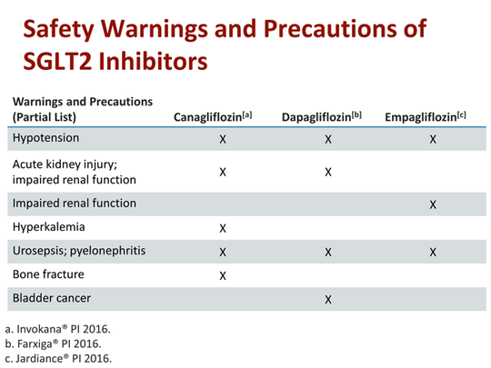
Notes:
but only dapagliflozin 10 mg could lead to higher risk of UTIs than placebo and other active treatments,” wrote lead author Huilin Tang, MSc, of Indiana University (Indianapolis, IN), along with colleagues in China.
“[D]apagliflozin appeared to have [a] dose-response relationship for risk of UTIs and genital infections. On the contrary, incidence of UTIs and genital infections remained similar or even decreased for empagliflozin and canagliflozin,” they added.
SGLT2 inhibitors have been linked to increased risk for UTIs and genital infections, most likely due to glucosuria induced by these drugs. In December 2015, the US Food and Drug Administration (USFDA) revised the labeling of SGLT2 inhibitors to include risk for serous UTIs, due to reports of urosepsis and pyelonephritis in 19 patients on SGLT2 inhibitors.²

Slide 9
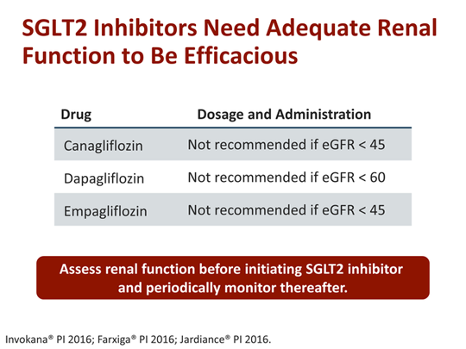
Notes:
Estimated glomerular filtration rate which tells you how well your kidneys are working

