Slide 1
Pharmacologic Approaches to Treating CKD in Type 2 DM (1)
Metformin must be considered the cornerstone of treatment when not contraindicated (eGFR <30)
In patients not at goal on metformin monotherapy, adding an SGLT₂ inhibitor like empagliflozin is warranted when not contraindicated (eGFR <45). (+) CVD benefit ?Class effect?
Patients not at goal with metformin + SGLT₂ inhibitor, adding liraglutide is warranted when not contraindicated (eGFR <30). (+) CVD benefit NOT a class effect
Approaches 2 and 3 are interchangeable based on personal preference; SGLT₂ inhibition ↑glucagon
Notes:
The pathophysiology of albuminuria in these patients (that is, endothelial activation and loss of glycocalyx barrier function) was not the specific target of therapy in these trials and/or patients enrolled in the trials did not have albuminuria to start with and yet the primary end point results were used to argue that albuminuria should not be a therapeutic target.93,94 However, a trial cannot prove or disprove a relationship between a risk factor and outcome unless it is designed specifically to study that relationship. A post hoc analysis of the results across these trials for the subset of patients with albuminuria shows that a reduction in albuminuria is clearly associated with better renal or cardiovascular outcomes.95,96 Nevertheless, this post hoc analysis has not changed the policies of the FDA and European Medicines Agency, and so albuminuria remains an invalid surrogate for renal protective treatment.97 Consequently, pharmaceutical companies are reluctant to invest in approaches that primarily target albuminuria, even though studies of such approaches could prospectively prove the validity of albuminuria as a drug target.
The only solution to this vicious cycle is to conduct a prospective trial that aims to reduce albuminuria with a drug that is proven to reduce albuminuria. The ongoing SONAR study98 stratifies patients according to their antialbuminuric response to the study drug and subsequently randomizes them to receive the active drug or a placebo. This approach enables the relationship between a reduction in albuminuria and clinical outcome to be accurately evaluated. The initial patient stratification also enriches the study population to include those with the greatest antialbuminuric response, which will not only help to achieve optimal use of all trial resources, but will help to determine the true potential of albuminuria as a therapeutic target.

Slide 2
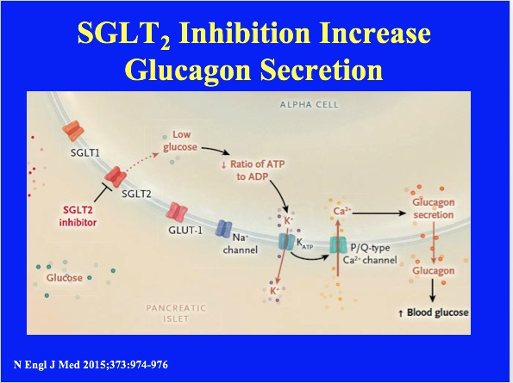

Slide 3
Pharmacologic Approaches to Treating CKD in Type 2 DM (2)
The goal for blood pressure in a patient with type 2 DM with or without CKD should be <120/80 mmHg; the blood pressure goal should be 5 mmHg above syncope if albuminuria is present!!
Renin-Angiotensin System (RAS) inhibition is the cornerstone of treatment
The UACR goal is less than 7.5 for women and less than 4.0 for men (based on muscle mass)
In patients who are not at UACR goal despite acceptable blood pressure (or at risk of syncope), off-label higher dosing of an ACE inhibitor or ARB is warranted; “Duel” ACE inhibitor + ARB is also another option
Notes:
The pathophysiology of albuminuria in these patients (that is, endothelial activation and loss of glycocalyx barrier function) was not the specific target of therapy in these trials and/or patients enrolled in the trials did not have albuminuria to start with and yet the primary end point results were used to argue that albuminuria should not be a therapeutic target.93,94 However, a trial cannot prove or disprove a relationship between a risk factor and outcome unless it is designed specifically to study that relationship. A post hoc analysis of the results across these trials for the subset of patients with albuminuria shows that a reduction in albuminuria is clearly associated with better renal or cardiovascular outcomes.95,96 Nevertheless, this post hoc analysis has not changed the policies of the FDA and European Medicines Agency, and so albuminuria remains an invalid surrogate for renal protective treatment.97 Consequently, pharmaceutical companies are reluctant to invest in approaches that primarily target albuminuria, even though studies of such approaches could prospectively prove the validity of albuminuria as a drug target.
The only solution to this vicious cycle is to conduct a prospective trial that aims to reduce albuminuria with a drug that is proven to reduce albuminuria. The ongoing SONAR study98 stratifies patients according to their antialbuminuric response to the study drug and subsequently randomizes them to receive the active drug or a placebo. This approach enables the relationship between a reduction in albuminuria and clinical outcome to be accurately evaluated. The initial patient stratification also enriches the study population to include those with the greatest antialbuminuric response, which will not only help to achieve optimal use of all trial resources, but will help to determine the true potential of albuminuria as a therapeutic target.

Slide 4
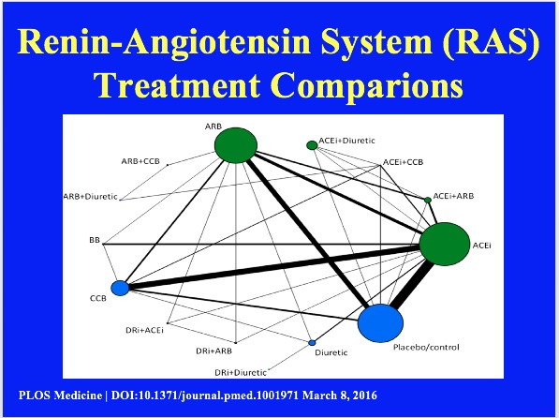
Notes:
Evidence network of all treatment comparisons for all studies. Lines represent direct comparisons within randomized controlled trials. The size of nodes is proportional to the number of randomized participants (sample size), and the width of the lines is proportional to the number of trials comparing each pair of treatments. Nodes in green represent RAS blockers (in monotherapy and/or combination therapies). Nodes in blue represent other control arms included in the evidence networks to preserve randomization. ACEi, ACE inhibitor; DRi, DR inhibitor.

Slide 5
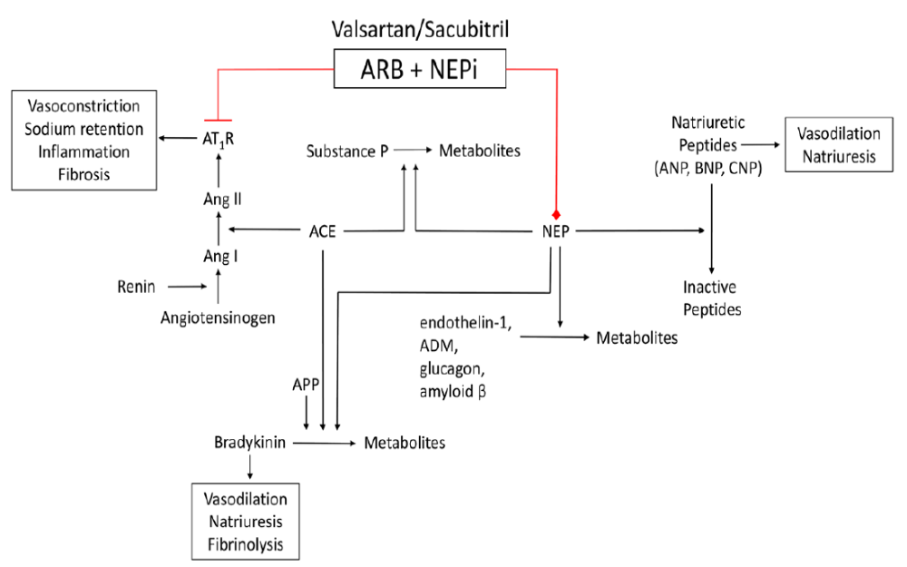
Valsartan/Sacubitril (Entresto) Inhibition of Neprilysin and Blockade of RAS
Circulation 2016;133:1115-1124
Notes:
Effects of valsartan/sacubitril through inhibition of neprilysin (NEP) and blockade of the renin-angiotensin-aldosterone system. Red represents antagonism/inhibition. ACE indicates angiotensin-converting enzyme; ADM, adrenomedullin; Ang I, angiotensin I; Ang II, angiotensin II; ANP, atrial natriuretic peptide; APP, aminopeptidase P; ARB, angiotensin receptor blocker; AT1R, angiotensin type 1 receptor; BNP, brain natriuretic peptide; CNP, C-type natriuretic peptide; and NEPi, neprilysin inhibitor.

Slide 6
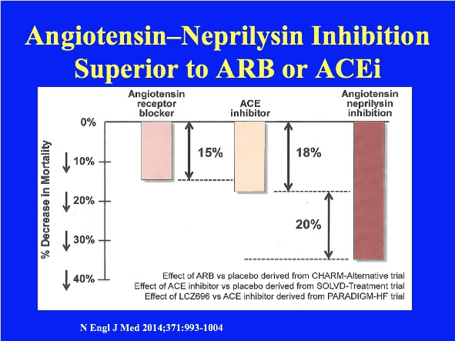
Notes:
Neprilysin, a neutral endopeptidase, degrades several endogenous vasoactive peptides, including natriuretic peptides, bradykinin, and adrenomedullin. 10-12 Inhibition of neprilysin increases the levels of these substances, countering the neurohormonal overactivation that contributes to vasoconstriction, sodium retention, and maladaptive remodeling.13,14 Combined inhibition of the renin–angiotensin system and neprilysin had effects that were superior to those of either approach alone in experimental studies,15,16 but in clinical trials, the combined inhibition of ACE and neprilysin was associated with serious angioedema. 17,18

Slide 7
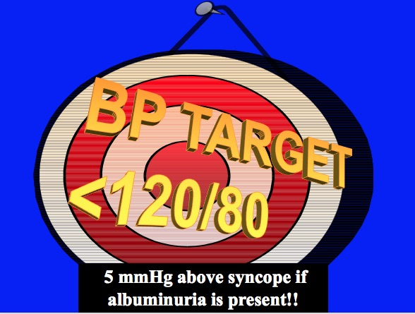
Notes:
Treatment Targets for Diabetic Renal Disease With Hypertension
The results of clinical trials in diabetic patients at increased risk for cardiovascular and renal events suggest that aggressive control of hypertension may be the most cost-effective in reducing these risks, followed, in rank order, by aggressive management of dyslipidemia, and then by tight blood glucose control.
References:
Agarwal R. Treatment of hypertension in patients with diabetes: lessons from recent trials. Cardiol Rev. 2001;9(1):36-44.
UK Prospective Diabetes Study Group: Tight blood pressure control and risk of macrovascular and microvascular complications in type 2 diabetes: UKPDS 38. BMJ. 1998;317:703-713.

Slide 8
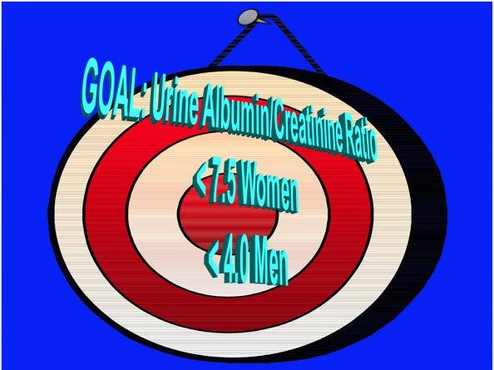
Notes:
Treatment Targets for Diabetic Renal Disease With Hypertension
The results of clinical trials in diabetic patients at increased risk for cardiovascular and renal events suggest that aggressive control of hypertension may be the most cost-effective in reducing these risks, followed, in rank order, by aggressive management of dyslipidemia, and then by tight blood glucose control.
References:
Agarwal R. Treatment of hypertension in patients with diabetes: lessons from recent trials. Cardiol Rev. 2001;9(1):36-44.
UK Prospective Diabetes Study Group: Tight blood pressure control and risk of macrovascular and microvascular complications in type 2 diabetes: UKPDS 38. BMJ. 1998;317:703-713.

Slide 9
Pharmacologic Approaches to Treating CKD in Type 2 DM (3)
Mineralocorticoid receptor antagonists (MRA) reduce albuminuria and total mortality when combined with RAS inhibition
However, MRA increases the risk of hyperkalemia in patients with stage 3b (eGFR 30-44) or higher stage CKD
When contraindications such as co-medication with potassium-sparing diuretics are respected and renal function and potassium levels are closely, patients with mild to moderate renal insufficiency appear to gain similar reductions in mortality and hospitalization by MRA as CHF patients with normal renal function
Whether Patiromer (Veltassa) and Sodium Zirconium Cyclosilicate that treat hyperkalemia allow increased use of MRA (and RAS inhibition) remains to be determined.
Circulation 2012;125:271-279
Notes:
The pathophysiology of albuminuria in these patients (that is, endothelial activation and loss of glycocalyx barrier function) was not the specific target of therapy in these trials and/or patients enrolled in the trials did not have albuminuria to start with and yet the primary end point results were used to argue that albuminuria should not be a therapeutic target.93,94 However, a trial cannot prove or disprove a relationship between a risk factor and outcome unless it is designed specifically to study that relationship. A post hoc analysis of the results across these trials for the subset of patients with albuminuria shows that a reduction in albuminuria is clearly associated with better renal or cardiovascular outcomes.95,96 Nevertheless, this post hoc analysis has not changed the policies of the FDA and European Medicines Agency, and so albuminuria remains an invalid surrogate for renal protective treatment.97 Consequently, pharmaceutical companies are reluctant to invest in approaches that primarily target albuminuria, even though studies of such approaches could prospectively prove the validity of albuminuria as a drug target.
The only solution to this vicious cycle is to conduct a prospective trial that aims to reduce albuminuria with a drug that is proven to reduce albuminuria. The ongoing SONAR study98 stratifies patients according to their antialbuminuric response to the study drug and subsequently randomizes them to receive the active drug or a placebo. This approach enables the relationship between a reduction in albuminuria and clinical outcome to be accurately evaluated. The initial patient stratification also enriches the study population to include those with the greatest antialbuminuric response, which will not only help to achieve optimal use of all trial resources, but will help to determine the true potential of albuminuria as a therapeutic target.

Slide 10
Closing Remarks
Treating CKD in Type 2 DM
Hypertension and albuminuria are both independent variables that predict long-term decline in renal function;
- goal for blood pressure should be <120/80
- UACR goal <7.5 in women and <4.0 in men
RAS is the cornerstone of treatment CKD
Critical that future studies focus on albuminuria as a primarily end-point; need to prove the validity of albuminuria as a goal in reducing CKD and CVD
Total cholesterol/HDL-C should be <4; Statin therapy should NOT be started in patients receiving dialysis
Metformin, Empagliflozin, and Liraglutide are drugs that benefit patients with type 2 DM and CKD
Whether other drugs in the pipeline prove beneficial for patients with CKD remain to be seen
Notes:
References
1. American Diabetes Association, Workgroup on Hypoglycemia. Defining and reporting hypoglycemia in diabetes. Diabetes Care. 2005;28(5):1245–1249.
2. UK Hypoglycaemia Study Group. Risk of hypoglycaemia in types 1 and 2 diabetes: effects of treatment modalities and their duration. Diabetologia. 2007;50:1140–1147.
3. Matyka K, Evans M, Lomas J, Cranston I, MacDonald I, Amiel SA. Altered hierarchy of protective responses against severe hypoglycemia in normal aging in healthy men. Diabetes Care. 1997;20(2):135–141.
4. Akram K, Pedersen-Bjergaard U, Carstensen B, Borch-Johnsen K, Thorsteinsson B. Frequency and risk factors of severe hypoglycaemia in insulin-treated type 2 diabetes: a cross-sectional survey. Diabetes Med. 2006;23:750–756.
5. Chico A, Vidal-Ríos P, Subirà M, Novials A. The continuous glucose monitoring system is useful for detecting unrecognized hypoglycemias in patients with type 1 and type 2 diabetes but is not better than frequent capillary glucose measurements for improving metabolic control. Diabetes Care. 2003;26:1153–1157.
6. Amiel SA, Dixon T, Mann R, Jameson K. Hypoglycaemia in type 2 diabetes. Diabet Med. 2008;25(3):245–254.

