Slide 1
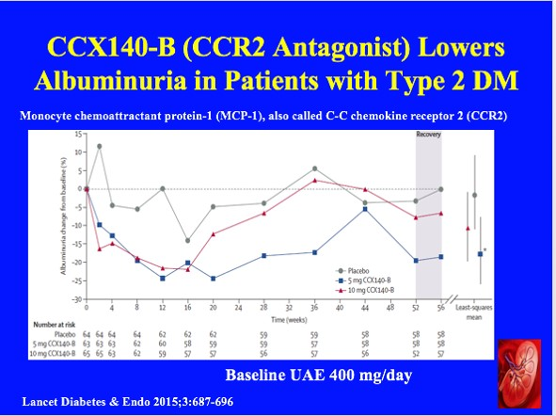
Notes:
Urinary albumin to creatinine ratio change in percent geo metric mean from baseline to 56 weeks for patients receiving placebo, CCX140-B 5 mg, or CCX140-B 10 mg. Least-squares means change (±95% CIs) in urinary albumin to creatinine ratio (integral response) are plotted on the right hand side of the figure and represent the primary endpoint. *p=0·01 for CCX140-B compared with placebo.
Novel treatment options that target other pathways involved in the pathophysiology of diabetic nephropathy are needed. Monocyte chemoattractant protein-1 (MCP-1), also called C-C chemokine ligand 2 (CCL2), one of the ligands for C-C chemokine receptor type 2 (CCR2), has been implicated, not only in insulin resistance 9,10 but also in progressive renal injury and has been suggested to be a potential marker of renal disease.11 MCP-1 promotes monocyte and macrophage migration and activation.12 CCX140-B is a small molecule CCR2 antagonist that inhibits CCR2 and blocks MCP-1-dependent monocyte activation and chemotaxis. Data from preclinical studies suggested that oral CCX140-B improved glycemia and albuminuria in a mouse model of diabetes.13 Our aim in this study was to test the efficacy and safety of two doses of CCX140-B on albuminuria in patients with type 2 diabetes and proteinuria.
9 Monocyte chemoattractant protein 1 in obesity and insulin resistance. Proc Natl Acad Sci USA 2003; 100: 7265–70.
10 MCP-1 contributes to macrophage infiltration into adipose tissue, insulin resistance, and hepatic steatosis in obesity. J Clin Invest 2006; 116: 1494–505.
11 MCP-1/CCL2: a new diagnostic marker and therapeutic target for progressive renal injury in diabetic nephropathy. Am J Physiol Renal Physiol 2008; 294: F697–701.
12 Molecular cloning and functional expression of two monocyte chemoattractant protein 1 receptors reveals alternative splicing of the carboxyl-terminal tails. Proc Natl Acad Sci USA 1994; 91: 2752–56.
13 CCR2 antagonist CCX140-B provides renal and glycemic benefits in diabetic transgenic human CCR2 knockin mice. Am J Physiol Renal Physiol 2013; 305: F1288–97.
In our chronic kidney disease program, our lead drug candidate, CCX140, is an inhibitor of the chemokine receptor known as CCR2 and is being developed as an orally administered therapy for the treatment of diabetic nephropathy, a form of chronic kidney disease. We have successfully completed a Phase II, placebo-controlled, clinical trial in patients with this disease.

Slide 2
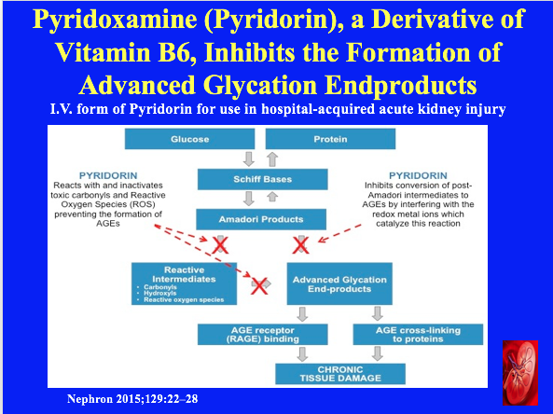
Notes:
Pyridoxamine dihydrochloride (Pyridorin TM , Nephro- Genex, Inc.) is a small molecule derivative of pyridoxal phosphate (vitamin B 6 ) with a distinct chemical structure that inhibits the formation of advanced glycation endproducts (AGE). Pyridoxamine inhibits a broad range of pathogenic oxidative chemistries that lead to AGE formation, including activity against toxic carbonyls, reactive oxygen species, and the conversion of glycosylated proteins to AGEs [6–18] . AGEs play a significant role in the pathogenesis of DN [19–30].
Our Phase 3 trial PYR-311, the first of two identical trials in our PIONEER program, is evaluating the safety and efficacy of Pyridorin to reduce disease progression in this patient population (see Clinical Trials). The design of the trial has been agreed with the FDA under a Special Protocol Assessment and Pyridorin has been granted a Fast Track designation by the FDA. For more information about our pivotal Phase 3 Pyridorin trial, see clinicaltrials.gov.
Treating Acute Kidney Injury
NephroGenex to develop I.V. form of Pyridorin for use in hospital-acquired acute kidney injury.
PYRIDORIN® has been shown to scavenge both ROS and RCS in vitro and in preclinical studies. In the proof of principle preclinical studies, Pyridorin treatment ameliorated renal oxidative stress and injury, enhanced functional recovery and reduced post-injury fibrosis in the ischemia-reperfusion mouse model of AKI.

Slide 3
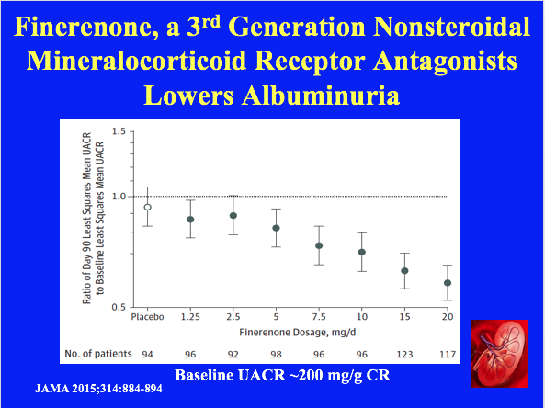
Notes:
Change in Least Squares Mean UACR at Day 90 Relative to Baseline in Patients Treated With Finerenone, 1.25-20mg/d, or Placebo
Steroidal mineralocorticoid receptor antagonists, when added to a renin-angiotensin system blocker, further reduce proteinuria in patients with chronic kidney disease but may be underused because of a high risk of adverse events.
Reviews of randomized studies demonstrate that mineralocorticoid receptor antagonists (MRAs), when added to a renin-angiotensin system(RAS) blocker, further reduce proteinuria in patients with chronic kidney disease (CKD) From either diabetes or nondiabetic causes.1-5 However, eplerenone and spironolactone increase the risk of hyperkalemia in patients with stage 3 or higher CKD by as much as 3- to 8-fold.5,6
Finerenone(BAY94-8862) is a novel nonsteroidal MRA that has greater receptor selectivity than spironolactone and better receptor affinity than eplerenone in vitro.7 In preclinical studies, equinatriuretic doses of finerenone provided a greater reduction in proteinuria and end organ damage than eplerenone.8 In the Mineralocorticoid Receptor Antagonist Tolerability Study (ARTS), finerenone doses of 2.5 to 10 mg/d reduced albuminuria from baseline in patients with CKD and heart failure, with a lower incidence of hyperkalemia than spironolactone.9 Thus, finerenone may be able to address the
unmet medical need of safely managing albuminuria without adversely affecting serum potassium in patients with type 2 diabetes mellitus who have clinical diagnosis of diabetic kidney disease.
5. Aldosterone antagonists for preventing the progression of chronic kidney disease. Cochrane Database Syst Rev. 2014;4: CD007004.
6. Prediction and management of hyperkalemia across the spectrum of chronic kidney disease. Semin Nephrol. 2014;34(3):333-339.
7. Discovery of BAY 94-8862: a nonsteroidal antagonist of the mineralocorticoid receptor for the treatment of cardiorenal diseases. ChemMedChem. 2012;7(8):1385-1403.
8. Finerenone, a novel selective nonsteroidal mineralocorticoid receptor antagonist protects from rat cardiorenal injury. J Cardiovasc Pharmacol. 2014;64(1):69-78.
9. Safety and tolerability of the novel nonsteroidal mineralocorticoid receptor antagonist BAY 94-8862 in patients with chronic heart failure and mild or moderate chronic kidney disease. Eur Heart J. 2013;34(31):2453-2463.

Slide 4
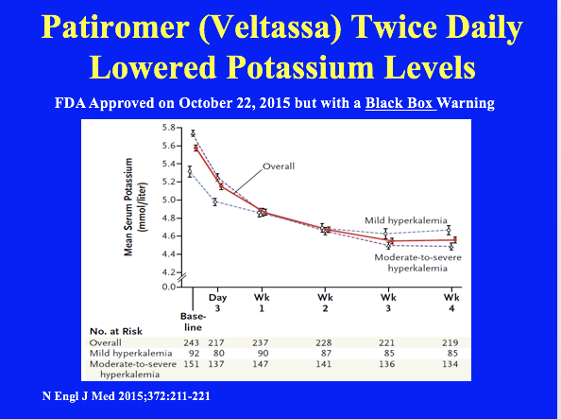
Notes:
Serum Potassium Levels over Time during the Initial Treatment Phase. Values are the observed mean values as measured in a central laboratory. During the 4-week initial treatment phase, all patients received treatment with patiromer; patients with a potassium level of 5.1 to less than 5.5 mmol per liter (mild hyperkalemia) received 4.2 g of patiromer twice daily, and those with a potassium level of 5.5 to less than 6.5 mmol per liter (moderate to-severe hyperkalemia) received 8.4 g of patiromer twice daily. I bars indicate standard errors. Data points are staggered to make them more legible.
WARNING: BINDING TO OTHER ORAL MEDICATIONS Veltassa binds to many orally administered medications, which could decrease their absorption and reduce their effectiveness. Administer other oral medications at least 6 hours before or 6 hours after Veltassa. Choose Veltassa or the other oral medication if adequate dosing separation is not possible. (2.1, 5.1, 7)
Hyperkalemia is associated with life-threatening cardiac arrhythmias and increased mortality.1 Patients at the highest risk for hyperkalemia are those with stage 3 or higher chronic kidney disease, with or without diabetes or heart failure, who are being treated with drugs that inhibit renal potassium excretion, particularly inhibitors of the renin– angiotensin–aldosterone system (RAAS).1-4
Outpatient treatment of hyperkalemia is limited by the lack of effective agents.4 Sodium polystyrene sulfonate and calcium polystyrene sulfonate may cause serious gastrointestinal adverse events5-8 as well as less serious gastrointestinal side effects that may be difficult for patients to tolerate, which together typically limit their extended use.4,9,10
The active moiety of patiromer for oral suspension is a nonabsorbed polymer that binds potassium in exchange for calcium (see the Supplementary Appendix, available with the full text of this article at NEJM.org), predominantly in the distal colon, where the concentration of free potassium is highest, thus increasing fecal potassium excretion and lowering serum potassium levels.11 Here we present the results of a multinational, single-blind, two-phase study evaluating the safety and efficacy of patiromer in patients with chronic kidney disease who were receiving at least one RAAS inhibitor and who had hyperkalemia.

Slide 5
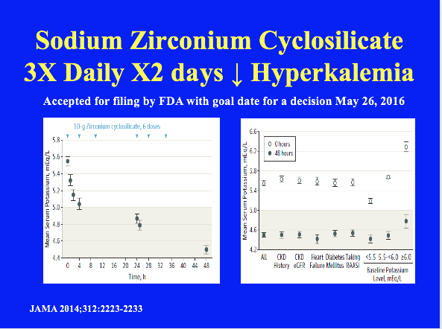
Notes:
A, Mean serum potassium levels over time in patients treated during the open-label phase with zirconium cyclosilicate, 10 g, 3 times daily for 48 hours.
B, Mean serum potassium levels at 0 and 48 hours across pre-specified subgroups of chronic kidney disease (CKD) (by patient history and by estimated glomerular filtration rate [eGFR] <60 mL/min/1.73m2), heart failure, diabetes mellitus, concomitant renin-angiotensin-aldosterone system inhibitor (RAASi) use, and baseline potassium levels. Error bars indicate 95%confidence
intervals; shaded region, normal potassium range.

Slide 6
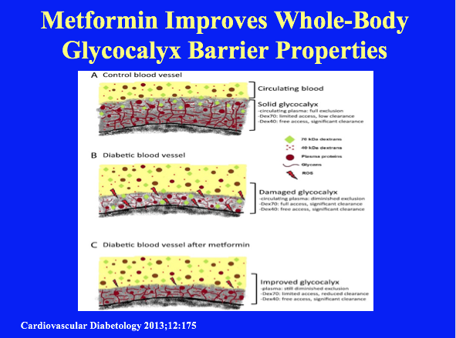
Notes:
Schematic illustration of the hypothesized effect of metformin on the glycocalyx barrier. The endothelial glycocalyx is considered to form a highly hydrated mesh of polysaccharide structures and adsorbed plasma proteins on the luminal side of all blood vessels. A. Under normal physiological conditions, the structure of the glycocalyx layer is stable and its molecular composition represents a dynamic balance between continued biosynthesis versus shedding of glycans in combination with the absorption and release of plasma proteins. A healthy glycocalyx has been shown to constitute a significant barrier for the circulating blood. While its sieving properties hinder the access of 70 kDa dextrans (Dex70), 40 kDa dextrans (Dex40) appear to have unlimited access to the entire glycocalyx domain. B. The balance between glycocalyx synthesis and breakdown is, however, disrupted in diabetes. This results in an impairment of the barrier properties of the glycocalyx, causing a diminished exclusion of the circulating blood and permeation of Dex70. Reactive oxygen species (ROS) are indicated to be involved in the glycocalyx breakdown. C. Two weeks of metformin treatment is associated with a partial recovery of the diabetes-associated disrupted glycocalyx barrier. While exclusion of circulating plasma is still impaired, the exclusion of Dex70 is significantly increased. As a result, the access of Dex70 into the glycocalyx is hindered and Dex70 stays mainly confined to the circulation. While the mechanisms underlying the glycocalyx improvement by metformin remain to be elucidated, alleviation of oxidative stress is suggested to play a role. Diagrams are not drawn to scale.
Effects of two weeks of metformin treatment on whole-body glycocalyx barrier properties in db/db mice.
Two weeks of metformin in the drinking water is associated with an improvement in glycocalyx barrier properties in db/db mice, as evidence by an enhanced exclusion and retention of 70 kDa dextrans in the vasculature. In addition, metformin improved hydration of heart and kidney. Previous reported cardiovascular benefits of metformin may well involve an improvement of the endothelial glycocalyx.
Metformin has in the past been associated with less cardiovascular morbidity and mortality in patients with NIDDM; this effect was shown to be in part independent of an improvement in glycemic control. In the current study it was found that two weeks of metformin treatment in db/db mice was associated with significant recovery of the endothelial glycocalyx barrier without a change in blood glucose levels. Given the indicated important role of the glycocalyx as orchestrator of vascular homeostasis and its close association with a firm endothelial function, our results imply that an improvement of endothelial glycocalyx function may contribute to the suggested cardiovascular benefits of metformin. Alleviation of glycocalyx damage is proposed a useful therapeutic target in NIDDM.
13. The endothelial glycocalyx: a potential barrier between health and vascular disease. Curr Opin Lipidol 2005, 16:507–511.
14. Endothelial glycocalyx: sweet shield of blood vessels. Trends Cardiovasc Med 2007, 17:101–105.
15. The endothelial glycocalyx as a barrier to leukocyte adhesion and its mediation by extracellular proteases. Ann Biomed Eng 2012, 40:840–848.
16. Role of hyaluronic acid glycosaminoglycans in shear-induced endothelium-derived nitric oxide release. Am J Physiol Heart Circ Physiol 2003, 285:H722–726.
17. Endothelial cell glycocalyx modulates immobilization of leukocytes at the endothelial surface. Arterioscler Thromb Vasc Biol 2003, 23:1541–1547.
18. Role of glycocalyx in leukocyte-endothelial cell adhesion. Am J Physiol 2002, 283:H1282–1291.
19. The endothelial glycocalyx protects against myocardial edema. Circ Res 2003, 92:592–594.
20. Endothelial glycocalyx and coronary vascular permeability: the fringe benefit. Basic Res Cardiol 2010, 105:687–701.
21. Loss of endothelial glycocalyx during acute hyperglycemia coincides with endothelial dysfunction and coagulation activation in vivo. Diabetes 2006, 55:480–486.
22. Endothelial glycocalyx damage coincides with microalbuminuria in type 1 diabetes. Diabetes 2006, 55:1127–1132.

Slide 7
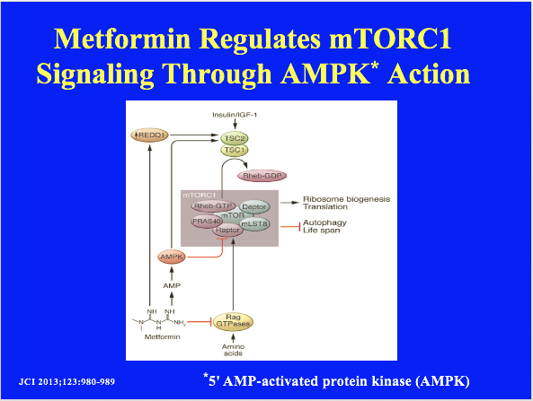
Notes:
Metformin regulates mTORC1 signaling. Metformin activates AMPK by inhibiting oxidative phosphorylation, which in turn negatively regulates
mTORC1 signaling via activation of TSC2 and inhibitory phosphorylation of raptor. In parallel, metformin inhibits mTORC1 signaling by suppressing the activity of the Rag GTPases and upregulating REDD1.
Rapamycin shows significant promise in animal models as a pharmaceutical agent for the treatment of age-related disease. However, the significant side effects limit its long-term utility in humans.
Similar problems are likely to emerge for rapalogs and mTOR kinase inhibitors. Moving forward, mTORC1-specific inhibitors that avoid disruption of mTORC2 signaling or that only reduce, rather than abolish, the activity of the mTORC1 pathway, may offer a safer method for the treatment of age-related diseases. The exploration of different dosing regimens for rapamycin and further testing of metformin have significant promise in this regard, but further research will be required to determine whether any of the available strategies for targeting mTOR will ultimately prove beneficial to human longevity and protect against age-related diseases.

Slide 8
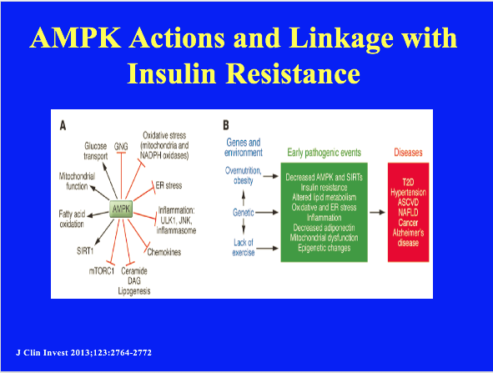
Notes:
AMPK actions and putative linkage between decreased AMPK activity and metabolic syndrome–associated diseases.
(A) Effects of AMPK activation. In addition to activating processes that produce ATP and diminish its consumption, AMPK inhibits inflammation, ER and oxidative stress, and activates autophagy, all of which appear to be involved in the pathogenesis of IR. Where studied, SIRT1 can produce many of the same effects as AMPK (see also text and Figure 3). The above-listed actions of AMPK and others have been extensively reviewed (5, 6, 67). GNG, gluconeogenesis; ULK1, UNC-51–like kinase 1; JNK, JUN-activated kinase.
(B) Proposed link between AMPK and IR in the setting of the metabolic syndrome. It has long been held that the combination of over nutrition (obesity), inactivity, and indeterminate genetic factors predispose humans to the metabolic syndrome and associated disorders. Based on studies of the offspring of patients with metabolic syndrome–associated disorders, hyperinsulinemia and IR may antedate such diseases as hypertension, type 2 diabetes, and ASCVD by many years (reviewed in ref. 28). Likewise, studies in both experimental animals and humans have implicated oxidative and ER stress and low-grade inflammation and decreased adiponectin in the pathogenesis of these disorders. An emerging body of evidence, predominantly but not exclusively from animal models, suggests that dysregulation of AMPK, and probably sirtuins, could both contribute to these abnormalities and be a target for their prevention and therapy (13). One possibility is that such dysregulation of AMPK and sirtuins causes epigenetic changes (methylation, acetylation, etc.) that could contribute to the diseases (151). NAFLD, nonalcoholic fatty liver disease; T2D, type 2 diabetes.

