Slide 1
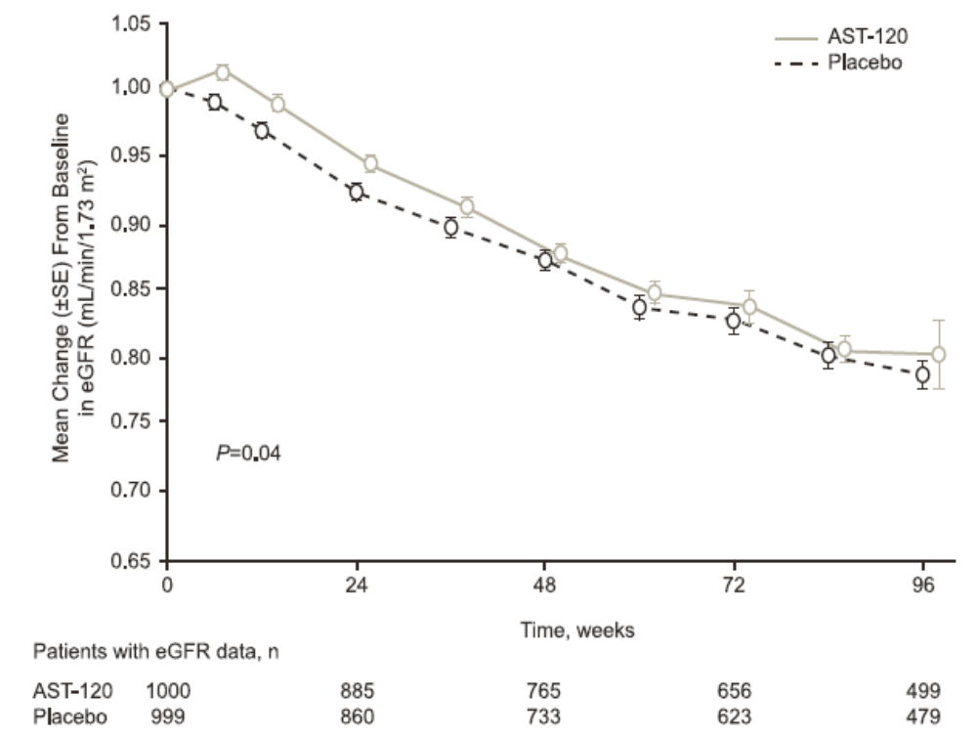

EPPIC Trials of AST-120: NO Additional Benefit to Standard Care in CKD
J Am Soc Nephrol 2015;26:1732–1746
Notes:
Randomized Placebo-Controlled EPPIC Trials of AST-120 in CKD
Reduced GFR in patients with CKD causes systemic accumulation of uremic toxins, which has been correlated with disease progression and increased morbidity. The orally administered spherical carbon
adsorbent AST-120 reduces systemic toxin absorption through gastrointestinal sequestration, which may slow disease progression in these patients. The multinational, randomized, double-blind, placebo controlled Evaluating Prevention of Progression in CKD (EPPIC)-1 and EPPIC-2 trials evaluated the effects of AST-120 on the progression of CKD when added to standard therapy. We randomly assigned 2035 adults with moderate to severe disease (serum creatinine at screening, 2.0–5.0 mg/dl for men and 1.5– 5.0mg/dl for women) to receive either placebo or AST-120 (9 g/d). The primary end point was a composite of dialysis initiation, kidney transplantation, and serum creatinine doubling. Each trial continued until accrual of 291 primary end points. The time to primary end point was similar between the AST-120 and the placebo groups in both trials (EPPIC-1: hazard ratio, 1.03; 95% confidence interval, 0.84 to 1.27; P=0.78) (EPPIC-2: hazard ratio, 0.91; 95% confidence interval, 0.74 to 1.12; P=0.37); a pooled analysis of both trials showed similar results. The estimated median time to primary end points for the placebo groups was 124 weeks for power calculations, but actual times were 189.0 and 170.3 weeks for EPPIC-1 and EPPIC-2, respectively. Thus, disease progression was more gradual than expected in the trial populations. In conclusion, the benefit of adding AST-120 to standard therapy in patients with moderate to severe CKD is not supported by these data.

Slide 2
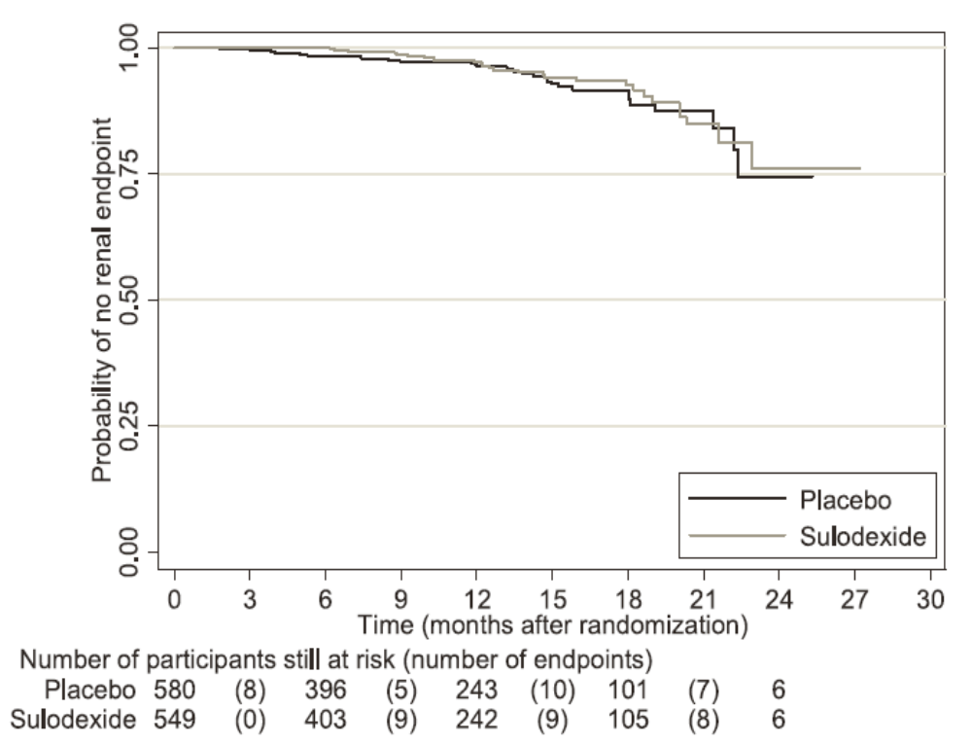
SUN Trial: Sulodexide Failed to Demonstrate Renoprotection in Overt
Type 2 Diabetic Nephropathy
Baseline UACR ~1000 mg/g CR
J Am Soc Nephrol 2012;23:123–130
Notes:
ABSTRACT
Sulodexide, a mixture of naturally occurring glycosaminoglycan polysaccharide components, has been reported to reduce albuminuria in patients with diabetes, but it is unknown whether it is renoprotective. This study reports the results from the randomized, double-blind, placebo-controlled, sulodexide macroalbuminuria, which evaluated the renoprotective effects of sulodexide in patients with type 2 diabetes, renal impairment, and significant proteinuria (.900 mg/d) already receiving maximal therapy with angiotensin II receptor blockers. The primary end point was a composite of a doubling of baseline serum creatinine, development of ESRD, or serum creatinine $6.0 mg/dl. We planned to enroll 2240 patients over approximately 24 months but terminated the study after enrolling 1248 patients. After 1029 person-years of follow-up, we did not detect any significant differences between sulodexide and placebo; the primary composite end point occurred in 26 and 30 patients in the sulodexide and placebo groups, respectively. Side effect profiles were similar for both groups. In conclusion, these data do not suggest a renoprotective benefit of sulodexide in patients with type 2 diabetes, renal impairment, and macroalbuminuria.
Sulodexide is a commercially available compound consisting of heparan sulphate (80%) and dermatan sulphate (20%). Sulodexide is degraded in the digestive tract into GlcNAc building blocks, leading to an increase in the precursors available for GAG synthesis [14, 15]. In vitro studies have shown that sulodexide attenuates hyperglycaemia-associated endothelial permeability in vitro through enhanced Glycosaminoglycan (GAG) synthesis [16], but the effect of sulodexide treatment on diabetes-associated microalbuminuria in vivo is less clear. In the present study, we thus hypothesized that increasing the precursors available for GAG synthesis could improve endothelial glycocalyx properties in type 2 diabetes mellitus patients. To this end, we evaluated the glycocalyx dimension in two different vascular beds before and after oral administration of sulodexide for 8 weeks.
14. Buse MG (2006) Hexosamines, insulin resistance, and the complications of diabetes: current status. Am J Physiol Endocrinol Metab 290:E1–E8
15. Weiss R, Niecestro R, Raz I (2007) The role of sulodexide in the treatment of diabetic nephropathy. Drugs 67:2681–2696
16. Ciszewicz M, Polubinska A, Antoniewicz A, Suminska-Jasinska K, Breborowicz A (2009) Sulodexide suppresses inflammation in human endothelial

Slide 3
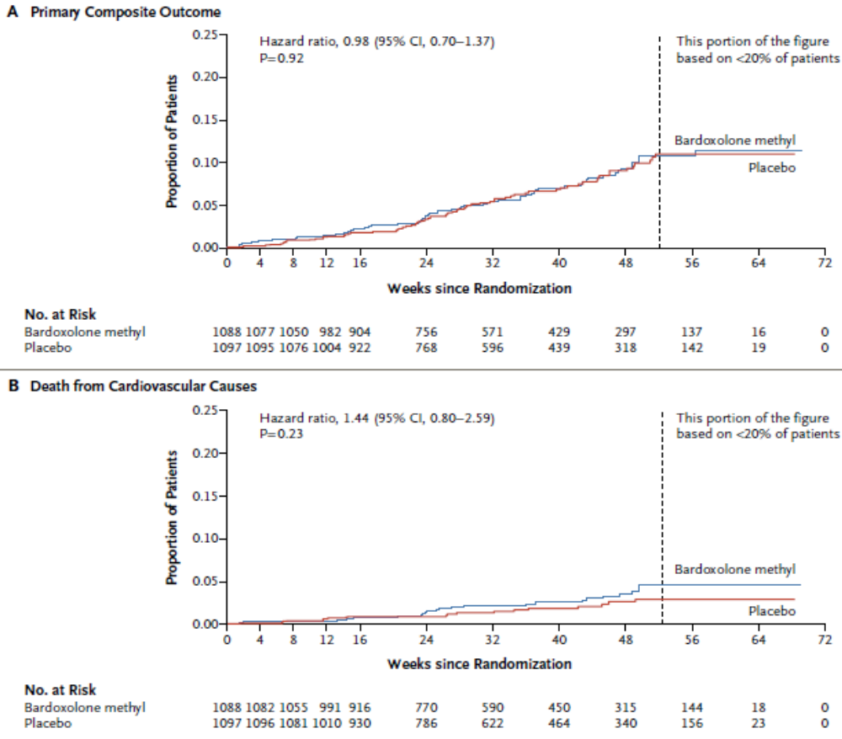
BEACON Study: Bardoxolone Methyl Increased CV Deaths in Type 2 Diabetes and Stage 4 CKD
N Engl J Med 2013;369:2492-2503
Notes:
Kaplan–Meier Plots of the Time to the First Event of the Primary Outcome and Its Components. Panel A shows the time to the first occurrence of the primary composite outcome (end-stage renal disease [ESRD] or death from cardiovascular causes) among patients in the bardoxolone methyl group and those in the placebo group. Panel B shows the time to death from cardiovascular causes in the two study groups, and Panel C the time to the development of ESRD in the two groups.
Oxidative stress and impaired antioxidant capacity intensify with the progression of chronic kidney disease.13 In animals with chronic kidney disease, oxidative stress and inflammation are associated with impaired activity of the nuclear 1 factor (erythroid-derived 2)–related factor 2 (Nrf2) transcription factor. The synthetic triterpenoid bardoxolone methyl and its analogues are the most potent known activators of the Nrf2 pathway. Studies involving humans,14 including persons with type 2 diabetes mellitus and stage 3b or 4 chronic kidney disease, have shown that bardoxolone methyl can reduce the serum creatinine concentration for up to 52 weeks.15
CONCLUSIONS
Among patients with type 2 diabetes mellitus and stage 4 chronic kidney disease, bardoxolone methyl did not reduce the risk of ESRD or death from cardiovascular causes. A higher rate of cardiovascular events with bardoxolone methyl than with placebo prompted termination of the trial.
8. A trial of darbepoetin alfa in type 2 diabetes and chronic kidney disease. N Engl J Med 2009;361:2019-32.
9. Cardiorenal end points in a trial of aliskiren for type 2 diabetes. N Engl J Med 2012;367:2204-13.
10. Sulodexide fails to demonstrate renoprotection in overt type 2 diabetic nephropathy. J Am Soc Nephrol 2012;23:123-30.
11. Avosentan for overt diabetic nephropathy. J Am Soc Nephrol 2010;21:527-35.
12. Combined angiotensin inhibition for the treatment of diabetic nephropathy. N Engl J Med 2013;369:1892-903.
13. Targeting the transcription factor Nrf2 to ameliorate oxidative stress and inflammation in chronic kidney disease. Kidney Int 2013;83:1029-41.
14. Effect of bardoxolone methyl on kidney function in patients with T2D and stage

Slide 4
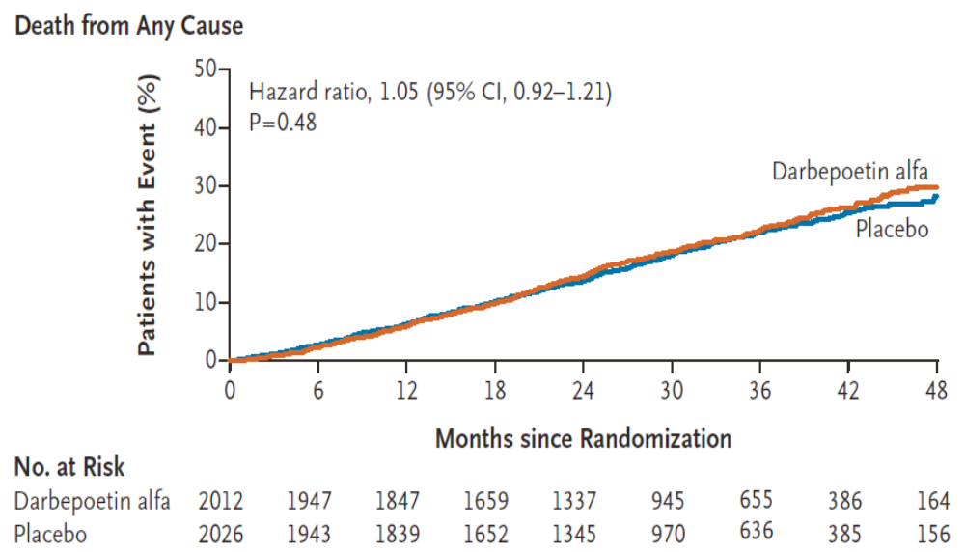
TREAT Trial: Darbepoetin Alfa Failed to Demonstrate Renoprotection in Overt
Type 2 Diabetic Nephropathy
N Engl J Med 2009;361:2019-2032
Notes:
CONCLUSIONS The use of darbepoetin alfa in patients with diabetes, chronic kidney disease, and moderate anemia who were not undergoing dialysis did not reduce the risk of either of the two primary composite outcomes (either death or a cardiovascular event or death or a renal event) and was associated with an increased risk of stroke. For many persons involved in clinical decision making, this risk will outweigh the potential benefits.

Slide 5
Protein Kinase C-β (PKC-β) Inhibition: A Promise Not Yet Fulfilled
Ruboxistaurin, an oral PKC-β was withdrawn on March 15, 2007 by Eli Lilly
Notes:
Protein Kinase C-b Inhibition: A Promise Not Yet Fulfilled
Ruboxistaurin, an orally active protein kinase C beta (PKC beta) inhibitor, is a macrocyclic bisindolylmaleimide compound under development by Eli Lilly with potential as a therapy for diabetic macular oedema and other diabetic angiopathies, including diabetic retinopathy, diabetic peripheral neuropathy and diabetic nephropathy. Ruboxistaurin is awaiting approvals in the US and Europe for the treatment of diabetic retinopathy. Eli Lilly and Alcon entered into a long-term agreement to co-promote ruboxistaurin in the US and Puerto Rico for diabetic retinopathy. The agreement is subject to the US FDA's approval of the agent for this indication. Under the terms of the agreement, Alcon will assume primary responsibility for promotion to eye specialists including retinal specialists and general ophthalmologists, while Eli Lilly will be targeting endocrinologists and physicians. Subject to approval in the US, Eli Lilly will receive milestone and marketing payments from Alcon. Alcon in turn will receive compensation based on product sales. In December 2003, Eli Lilly signed a joint development and co-marketing agreement with Takeda Chemical Industries for ruboxistaurin in the Japanese market. Under the terms of the agreement, Eli Lilly Japan and Takeda will jointly develop ruboxistaurin in Japan, will file an NDA for diabetic peripheral neuropathy and diabetic retinopathy, and subsequently will market the drug in Japan. Ruboxistaurin was submitted for approval in Europe in the second quarter of 2006. The agent is also in phase II studies for the treatment of diabetic maculopathy (macular retinopathy) in Japan. Data from a phase III, 3-year study of ruboxistaurin in patients with moderate to severe diabetic retinopathy showed that ruboxistaurin markedly reduced the risk of sustained vision loss compared with placebo. This multicentre, randomised study, named PKC-DRS2 (Protein Kinase C-Diabetic Retinopathy Study 2), was conducted at 70 clinical sites and involved 685 patients with diabetic retinopathy. The agent is also in a phase II study in the US, Canada and Europe in patients with clinically significant macular oedema. The trial (B7A-MC-MBCU), which will evaluate oral administration of the drug using optical coherence tomography over a period of 18 months, is expected to enrol approximately 220 patients. This randomised, double-blind, placebo-controlled study was initiated in August 2005 and is expected to be completed in March 2008. Previously, results of the PKC-Diabetic Retinopathy Study (PKC-DRS) showed that ruboxistaurin at a dose of 32 mg/day has potential to reduce the risk of moderate vision loss especially in patients with diabetic macular oedema. This phase III, randomised, double-blind, multidose study in 252 patients with type 1 and type 2 diabetes receiving ruboxistaurin or placebo for 3-4 years evaluated the safety of the agent and its effect on progression of diabetic retinopathy, moderate vision loss and sustained moderate vision loss. The study was conducted at Joslin Diabetes Center and at centres in the US, Canada, Denmark, The Netherlands and the UK. In 2004, Eli Lilly presented new analysis of previously reported data for ruboxistaurin in diabetic macular oedema indicating that ruboxistaurin has the potential to decrease the progression of diabetic macular oedema involving the center of the macula. Positive results from the PKC Beta Inhibitor Diabetic Macular Edema (PKC-DMES) trial were reported in 2003. Eli Lilly expected to file for approval of ruboxistaurin for the treatment of diabetic peripheral neuropathy in the US and Europe in 2005. However, no development was reported for this indication. On 15 March 2007, Eli Lilly withdrew its marketing authorization application for ruboxistaurin for diabetic retinopathy filed with EMEA in May 2006. Its current development status in the EU is unclear at this stage.
12. Tuttle KR, McGill JB, Haney DJ, Lin TE, Anderson PW; for the PKC-DRS, PKC-DMES, and PKC-DRS 2 Study Groups: Kidney outcomes in long-term studies of roboxistaurin for diabetic eye disease. Clin J Am Soc Nephrol 2: 631–636, 2007

Slide 6
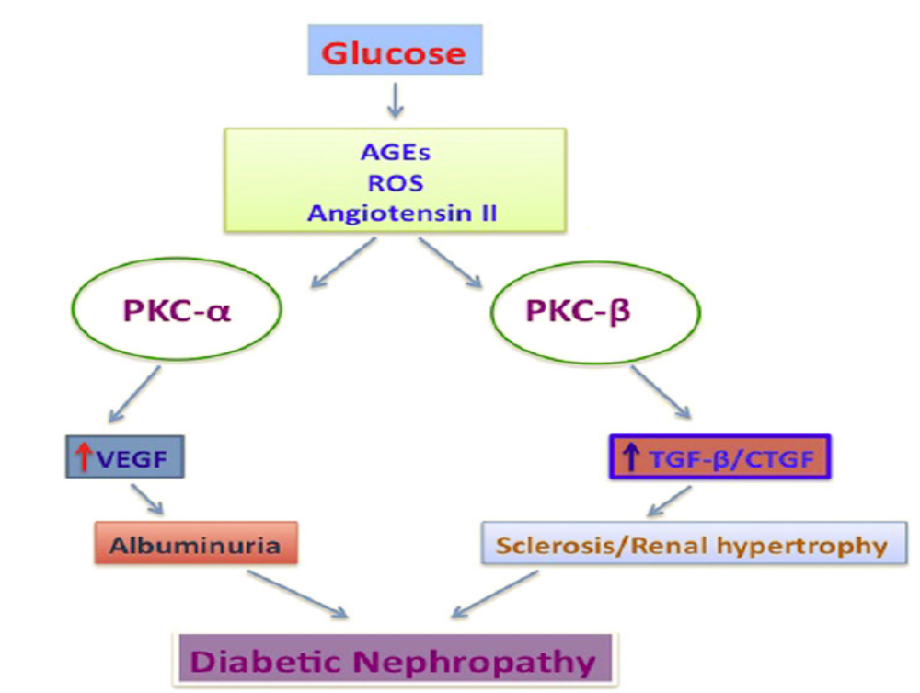
Dual Inhibition of Classical Protein Kinase C-α and Protein Kinase C-β Isoforms Protects Against Diabetic Nephropathy
Diabetes 2013;62:1010-1011
Notes:
In diabetic nephropathy, hyperglycemia initiates various intracellular signaling pathways resulting in further downstream activation of different PKC isoforms. ROS, reactive oxygen species; CTGF, connective tissue growth factor.
As diabetic nephropathy continues to be a major complication of type 1 and type 2 diabetes and represents the major cause of end-stage renal disease in the Western world, new therapies are urgently needed. Improved control of hyperglycemia and blood pressure are critical for preserving renal function in diabetes, and interruption of the renin-angiotensin system remains the gold standard for the treatment of diabetic nephropathy. However, this new study highlights the need for further development of isoform-specific PKC inhibitors with dual PKC-a/b action, which could potentially be used in diabetic nephropathy.

Slide 7
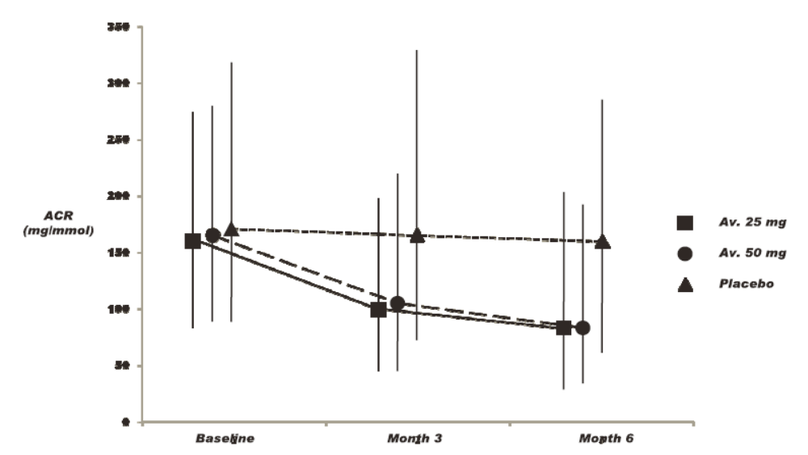
ASCEND Trial: Endothelin
Antagonist Avosentan Significantly Decreased Albuminuria
Study terminated due to CHF and deaths
J Am Soc Nephrol 2010;21:527–535
Notes:
Urine ACR changed significantly (P < 0.0001; see Table 3) in the avosentan (av)-treated groups during the first 6 months of the trial. Medians and interquartile ranges are given. Similar differences were found for fractional excretion of urine albumin (see Supplemental Appendix 2).
Adverse events led to discontinuation of trial medication significantly more often for avosentan than for placebo (19.6 and 18.2 versus 11.5% for placebo), dominated by fluid overload and congestive heart failure; death occurred in 21 (4.6%; P = 0.225), 17 (3.6%; P = 0.194), and 12 (2.6%), respectively. In conclusion, avosentan reduces albuminuria when added to standard treatment in people with type 2 diabetes and overt nephropathy but induces significant fluid overload and congestive heart failure.
Urine ACR changed significantly (P < 0.0001; see Table 3) in the avosentan (av)-treated groups during the first 6 months of the trial. Medians and interquartile ranges are given. Similar differences were found for fractional excretion of urine albumin (see Supplemental Appendix 2).
ABSTRACT
In the short term, the endothelin antagonist avosentan reduces proteinuria, but whether this translates to protection from progressive loss of renal function is unknown. We examined the effects of avosentan on progression of overt diabetic nephropathy in a multicenter, multinational, double-blind, placebo controlled trial. We randomly assigned 1392 participants with type 2 diabetes to oral avosentan (25 or 50 mg) or placebo in addition to continued angiotensin-converting enzyme inhibition and/or angiotensin receptor blockade. The composite primary outcome was the time to doubling of serum creatinine, ESRD, or death. Secondary outcomes included changes in albumin-to-creatinine ratio (ACR) and cardiovascular outcomes. We terminated the trial prematurely after a median follow-up of 4 months (maximum 16 months) because of an excess of cardiovascular events with avosentan. We did not detect a difference in the frequency of the primary outcome between groups. Avosentan significantly reduced ACR: In patients who were treated with avosentan 25 mg/d, 50 mg/d, and placebo, the median reduction in ACR was 44.3, 49.3, and 9.7%, respectively. Adverse events led to discontinuation of trial medication significantly more often for avosentan than for placebo (19.6 and 18.2 versus 11.5% for placebo), dominated by fluid overload and congestive heart failure; death occurred in 21 (4.6%; P = 0.225), 17 (3.6%; P = 0.194), and 12 (2.6%), respectively. In conclusion, avosentan reduces albuminuria when added to standard treatment in people with type 2 diabetes and overt nephropathy but induces significant fluid overload and congestive heart failure.

Slide 8
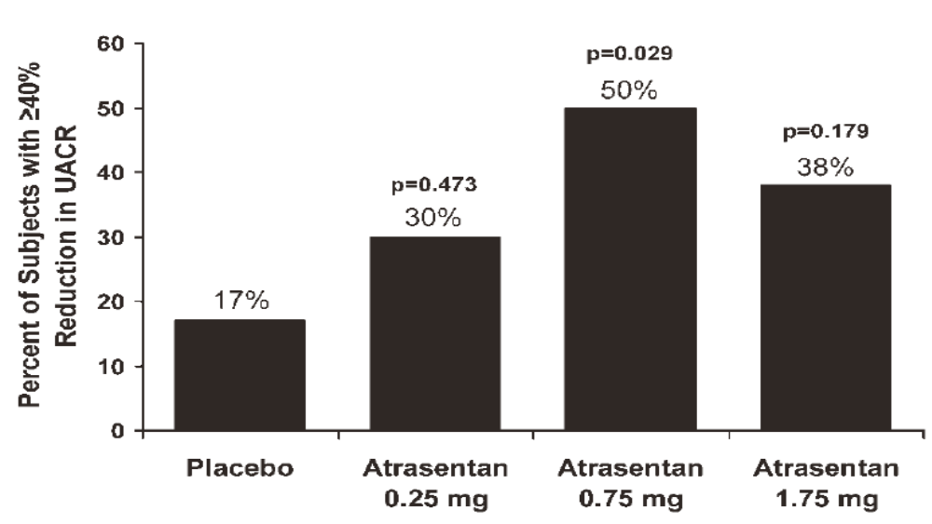
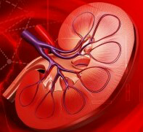
Addition of Atrasentan, an Endothelin
Antagonist, to RAS Blockade Reduces Albuminuria in Diabetic Nephropathy
Baseline UACR ~400 mg/g CR
J Am Soc Nephrol 2011;22:763-772
Notes:
Atrasentan treatment significantly increases the percentage of subjects achieving > 40% reduction in UACR compared to placebo.
Peripheral edema occurred in 9% of subjects receiving placebo and in 14, 18, and 46% of those receiving 0.25, 0.5, and 1.75 mg atrasentan, respectively (P < 0.007 for 1.75 mg versus placebo). In summary, atrasentan, at the doses tested, is generally safe and effective in reducing residual albuminuria and may ultimately improve renal outcomes in patients with type 2 diabetic nephropathy. In conclusion, atrasentan may offer an additional therapeutic benefit to the current standard of care using RAS inhibition for albuminuria reduction in patients with type 2 DN. Outcome-driven clinical trials will ultimately be required to establish its long-term safety and efficacy in slowing or preventing the progression to ESRD.
89. Addition of atrasentan to renin-angiotensin system blockade reduces albuminuria in diabetic nephropathy. J Am Soc Nephrol 2011;22:763–772
Our present findings indicate that BP independent monotherapy of ETA receptor antagonist attenuated the progression of CKD and significantly mitigated CVD. This evidence proposes that proteinuria is strongly correlated with cardiovascular abnormalities in salt-loaded hypertensive rats, and that attenuation of proteinuria was indicative of reno- and cardioprotective effects. In BP independent combined therapy, main therapeutic index was exerted by ETA receptor antagonist and was independent of RAS inhibition. All these findings suggest that, in patient with CKD and CVD, BP independent monotherapy of ETA receptor antagonism may be considered a novel strategy.
PLOS ONE | DOI:10.1371/journal.pone.0121664 March 16, 2015

Slide 9
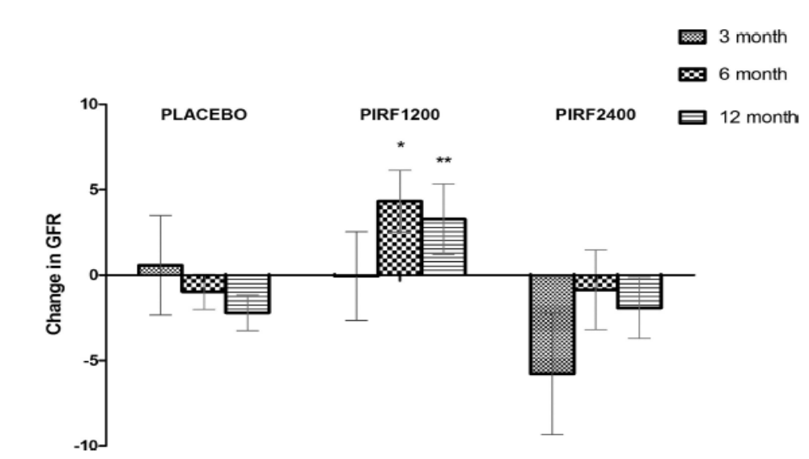
Pirfenidone, an Inhibitor of TGF-β at 1200 mg/d, but NOT 2400 mg/d, Improves eGFR from Baseline
Pirfenidone (Esbriet) approved to treat idiopathic pulmonary fibrosis
J Am Soc Nephrol 2011;22:1144–1151
Notes:
Pirfenidone at 1200 mg/d, but not 2400 mg/d, improves eGFR from baseline. The change in eGFR from baseline of the completers in the three groups: PLACEBO (placebo group; n = 21), PIRF1200 (pirfenidone 1200-mg group; n = 17), and PIRF2400 (pirfenidone 2400-mg group; n = 14) at 3, 6, and 12 months. Data are expressed as mean +/- SEM, *P = 0.02 when compared with placebo at 6 months, and **P = 0.026 when compared with placebo at 12 months.
Pirfenidone is an orally bioavailable compound that has been found to inhibit transforming growth factor- b (TGF- b ) production and consequent matrix deposition in experimental animal models of lung and kidney disease [6] . In a recent randomized double-blind placebo-controlled trial [7] , 77 subjects with diabetes, reduced estimated glomerular filtration rate (eGFR), and proteinuria were enrolled and randomized to one of the three study arms (placebo, pirfenidone 1,200 mg daily, and pirfenidone 2,400 mg daily). The primary end point was the change in eGFR in individual subjects from baseline to the end of the study. After 54 weeks, there was an improvement in eGFR in the pirfenidone 1,200 mg group, with a net increase of 3.3 ml/min/1.73 m 2 . The pirfenidone 2,400 mg group had an intermediate change in eGFR (–1.9 ml/min/1.73 m 2 ) that was not significantly different compared with the placebo arm. Interestingly, there were no significant differences among the study groups in the change in urinary ACR from baseline to the end of the study.
6 Pirfenidone is renoprotective in diabetic kidney disease. J Am Soc Nephrol 2009; 20: 1765–1775.
7 Pirfenidone for diabetic nephropathy. J Am Soc Nephrol 2011; 22: 1144–1151.
Several growth factors or cytokines that are locally produced in the kidney appear to contribute to the extracellular matrix accumulation, inflammation, and scarring in progressive diabetic nephropathy. The TGF-b system is activated and plays a pathogenetic role in diabetic kidney disease in animal models of type 19 and type 2 diabetes.10 In addition, several studies in patients with type 1 and type 2 diabetes indicate increased renal production of TGF-b.11,12 The TNF-a system has also been recently linked with human diabetic nephropathy on the basis of circulating blood levels13 and gene expression in kidneys from patients with diabetic nephropathy.14 An orally bioavailable compound, pirfenidone, has been found to inhibit TGF-b production and consequent matrix deposition
in experimental animal models of lung and kidney disease.15,16 In animal models and cell culture studies, pirfenidone also reduces TNF-bproduction.17,18 We have found that oral pirfenidone administered to db/db mice after the onset of established diabetic kidney disease was effective in reducing glomerulosclerosis. 19 In addition, in an open-label clinical study in patients with advanced and treatment-refractory focal segmental glomerulosclerosis (FSGS), there was a 25% reduction in the rate of estimated GFR (eGFR) decline in patients on pirfenidone as compared with the rate of decline before pirfenidone.20

Slide 10
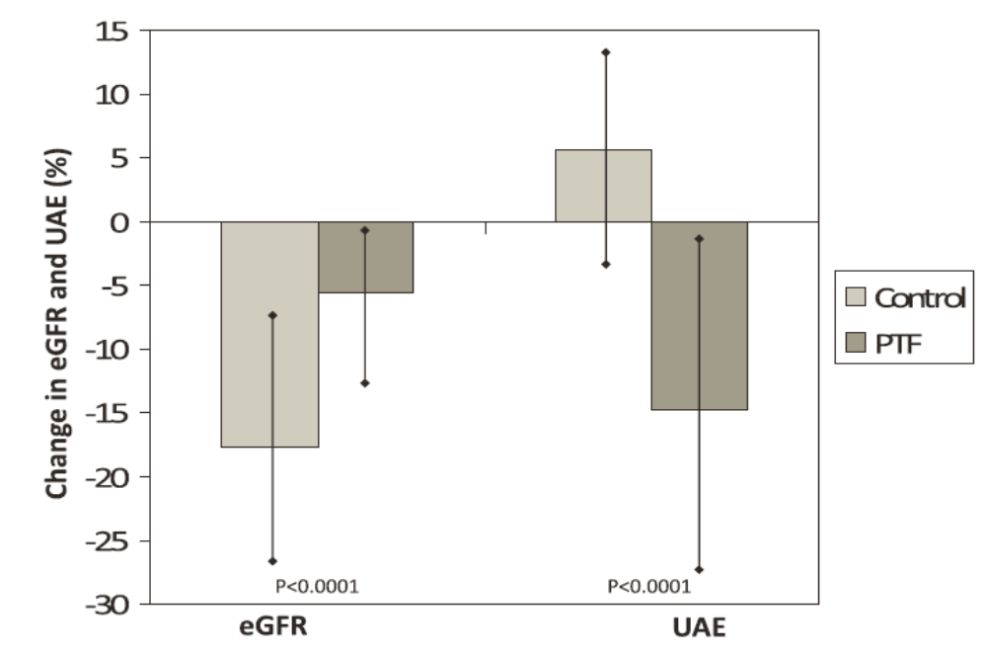

Pentoxifylline-Lower Decline in eGFR and Greater UAE Reduction
Baseline UAE ~1000 mg/day
J Am Soc Nephrol 2015;26:220–229
Notes:
Change in eGFR and UACR from baseline to the end of the study. Patients in the control group presented a significantly higher reduction of UACR and a lower decrease in the eGFR. Vertical bars represent 95% CIs. P values are for the comparison of the PTF group versus the control group.
Pentoxifylline (PTF) is a methylxanthine derivate and nonspecific phosphodiesterase inhibitor clinically used to treat patients with occlusive peripheral vascular disorders for more than 30 years. In addition to its rheologic properties, PTF has anti-inflammatory, antiproliferative, and antifibrotic actions13–17 that have been associated with beneficial effects in experimental models of renal disease progression. 18,19 We previously reported that PTF administration to diabetic patients resulted in the reduction of clinical markers of glomerular and tubulointerstitial injury.20,21 In addition, recent meta-analyses indicate that PTF may reduce proteinuria and that this drug could offer some beneficial effects on renal function in patients with DKD.22,23 Therefore, we conducted the present randomized trial to prospectively test the hypothesis that add-on PTF to maximized ACEI or ARB treatment provides additional benefits against renal disease progression in patients with type 2 diabetes who have stages 3–4 CKD.
18. Pentoxifylline attenuated the renal disease progression in rats with remnant kidney. J Am Soc Nephrol 13: 2916–2929, 2002
19. Preventive effect of pentoxifylline on renal scarring in rat model of pyelonephritis. Urology 61: 1037–1041, 2003
20. Effects of pentoxifylline administration on urinary N-acetyl-beta-glucosaminidase excretion in type 2 diabetic patients: A short-term, prospective, randomized study. Am J Kidney Dis 42: 264–270, 2003
21. Additive antiproteinuric effect of pentoxifylline in patients with type 2 diabetes under angiotensin II receptor blockade: A short-term, randomized, controlled trial. J Am Soc Nephrol 16: 2119–2126, 2005
22. The effect of pentoxifylline on proteinuria in diabetic kidney disease: A meta-analysis. AmJ Kidney Dis 52: 454–463, 2008
23. Pentoxifylline for diabetic kidney disease. Cochrane Database Syst Rev 2: CD006800, 2012

