Slide 1
Therapeutic Approaches to Chronic Kidney Disease-Beyond the RAS
Despite improvements in glycemia and BP control, and the efficacy of RAS blockade, a substantial number of patients will progress to ESRD
This finding is consistent that key pathogenetic mechanisms leading to progression of renal disease are not modified or inactivated by current therapeutic approaches
Understanding the key mechanisms leading to progressive CKD and developing nephroprotective agents is critical to slowing the progression of this deadly process
Nat Rev Nephrol 2014;10:325-346
Notes:
Despite improvements in glycaemic and blood pressure control, and the efficacy of renin– angiotensin system (RAS) blockade for proteinuria reduction, diabetic nephropathy is the most frequent
cause of end-stage renal disease in developed countries. This finding is consistent with the hypothesis that key pathogenetic mechanisms leading to progression of renal disease are not modified or inactivated by current therapeutic approaches. Although extensive research has elucidated molecular signaling mechanisms that are involved in progression of diabetic kidney disease, a number of high-profile clinical trials of potentially nephroprotective agents have failed, highlighting an insufficient understanding of pathogenic pathways. These include trials of paricalcitol in early diabetic kidney disease and bardoxolone methyl in advanced-stage disease. Various strategies based on encouraging data from preclinical studies that showed renoprotective effects of receptor antagonists, neutralizing antibodies, kinase inhibitors, small compounds and peptide-based technologies are currently been tested in randomized controlled trials. Phase II clinical trials are investigating approaches targeting inflammation, fibrosis and signalling pathways. However, only one trial that aims to provide evidence for marketing approval of a potentially renoprotective drug (atrasentan) is underway—further research into the potential nephroprotective effects of novel glucose‑lowering agents is required.
12. Commentary
Despite the tremendous advancement in delineating the pathways that contribute to DKD, clinicians are still a long way away from having a new drug in their prescribing arsenal. Many of the above therapeutics have been successful in experimental models, yet few have proven sufficiently efficacious to be brought into the mainstream management of DKD. Perhaps one of the reasons that finding a new drug for DKD has proven difficult is that there still is not a perfect marker for DKD. While albuminuria is considered the gold standard for diagnosing DKD and remains the strongest predictor of mortality in diabetes, it does not detect almost half of patients with diabetes that progress to DKD whilst remaining normoalbuminuric [23, 188]. Perhaps the prolific research in tubular biomarkers will reveal one that is more specific for DKD than albuminuria. It would be more useful yet to find a marker of DKD that precedes the histopathologic damage that has already occurred once albuminuria is noted.
A study by Lurbe et al. demonstrated that an increase in systolic blood pressure during sleep preceded the development of microalbuminuria in patients with type 1 diabetes [189]. It would be remarkable to find that an inexpensive and noninvasive maneuver such as measuring blood pressure during sleep could identify future cases of DKD before they develop. It would certainly be less expensive and noninvasive than performing more kidney biopsies in patients with diabetes. However, performing kidney biopsy in this setting may also be beneficial to patients and clinicians alike. In a retrospective study of 620 patients with type 1 and type 2 diabetes that had undergone biopsy, only 37% had isolated DKD. Thirty-six percent of patients had nondiabetic renal disease, which included glomerulonephritides, acute tubular necrosis, and hypertensive nephrosclerosis; the remaining 27% had nondiabetic renal disease superimposed on DKD [18, 190]. Until clinicians are better at discerning the cause of kidney disease in their patients, obtaining a histopathologic diagnosis may prove fruitful as it would allow them to identify those patients with or without DKD and guide their care accordingly. Ultimately, the treatment of DKD will likely require a multifaceted approach given the numerous pathways involved in the diabetic kidney. Perhaps one day, “triple therapy” will also refer to the multipronged approach necessary to tackle DKD.
[23] “Renal insufficiency in the absence of albuminuria and retinopathy among adults with type 2 diabetes mellitus,” JAMA, vol. 289, no. 24, pp. 3273–3277,
2003.
In summary, urine creatinine concentrations differ between men and women and between different racial/ethnic groups. Therefore, standardizing urine albumin concentrations to creatinine
(i.e., ACR) may underestimate microalbuminuria in subjects with higher muscle mass (men) and possibly in certain racial/ethnic groups, such as NHB, or overestimate it in subjects with lower muscle mass (women). Future research studies that use the ACR to define microalbuminuria should use sex specific ACR cut points to help avoid the potential problems of underestimating microalbuminuria in subjects with high urine creatinine excretion (e.g., men) and overestimating microalbuminuria in subjects with low urine creatinine excretion (e.g., women). Results from prospective studies should be used to define risk of abnormal urine albumin excretion at different levels of ACR. Studies are also needed to determine appropriate ACR thresholds for different race/ethnicity groups.

Slide 2
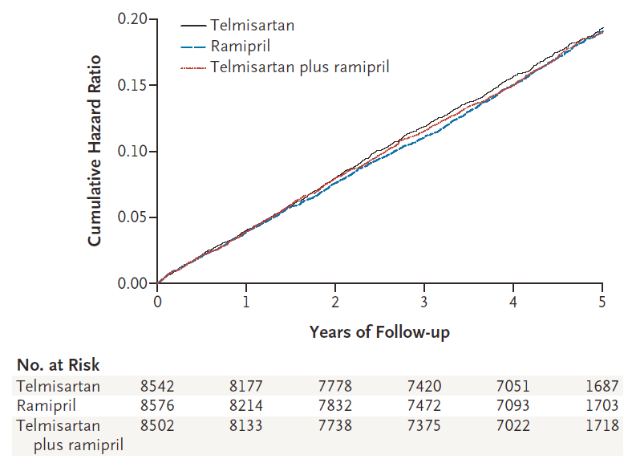

ON‑TARGET Trial: Dual RAAS Therapy with Ramipril and Telmisartan Failed to Decrease Vascular Events
Baseline UACR 929 mg/g CR
N Engl J Med 2008;358:1547-1559
Notes:
Albuminuria in clinical trials
Progressive diabetic kidney disease is associated with a poor prognosis, and the condition and its comorbidities reduce quality of life. 88 Current recommended interventions can marginally attenuate but not stop disease progression; morbidity persists even with treatment, and mortality surpasses that of some types of cancer.89 Albuminuria is an important prognostic factor in this residual risk. 90 In the past decade, trials in diabetic renal and cardiovascular disease have all failed. These trials included ON‑TARGET (dual RAAS); SUN (sulodexide); TREAT (darbepoetin); SHARP for kidney protection (simvastatin plus ezetimibe); ALTITUDE (dual RAAS blockade); VA‑NEPHRON‑D (dual RAAS blockade); BEACON (bardoxolone); ASCEND (avosentan) and EPICC (absorbent, AST‑120).75,76,79,91,92 These trials either aimed to reduce albuminuria or reported the effect of the drug on albuminuria, and concluded that a reduction in albuminuria was not associated with a better renal or cardiovascular outcome, and that a better outcome was not associated with a reduction in albuminuria. These conclusions triggered a debate over whether the reduction of albuminuria itself can still serve as a treatment goal or whether albuminuria is just a consequence of vascular disease with no pathophysiological meaning. However, the conclusions of these studies themselves are questionable. The pathophysiology of albuminuria in these patients (that is, endothelial activation and loss of glycocalyx barrier function) was not the specific target of therapy in these trials and/or patients enrolled in the trials did not have albuminuria to start with and yet the primary end point results were used to argue that albuminuria should not be a therapeutic target.93,94 However, a trial cannot prove or disprove a relationship between a risk factor and outcome unless it is designed specifically to study that relationship. A post hoc analysis of the results across these trials for the subset of patients with albuminuria shows that a reduction in albuminuria is clearly associated with better renal or cardiovascular outcomes.95,96 Nevertheless, this post hoc analysis has not changed the policies of the FDA and European Medicines Agency, and so albuminuria remains an invalid surrogate for renal protective treatment.97 Consequently, pharmaceutical companies are reluctant to invest in approaches that primarily target albuminuria, even though studies of such approaches could prospectively prove the validity of albuminuria as a drug target.
The only solution to this vicious cycle is to conduct a prospective trial that aims to reduce albuminuria with a drug that is proven to reduce albuminuria. The ongoing SONAR study98 stratifies patients according to their antialbuminuric response to the study drug and subsequently randomizes them to receive the active drug or a placebo. This approach enables the relationship between a reduction in albuminuria and clinical outcome to be accurately evaluated. The initial patient stratification also enriches the study population to include those with the greatest antialbuminuric response, which will not only help to achieve optimal use of all trial resources, but will help to determine the true potential of albuminuria as a therapeutic target.
79. Randomized placebo-controlled EPPIC trials of AST‑120 in CKD. J. Am. Soc. Nephrol. 26, 1732–1746 (2015).
95. Mortality and morbidity in relation to changes in albuminuria, glucose status and systolic blood pressure: an analysis of the ONTARGET and TRANSCEND studies. Diabetologia 57, 2019–2029 (2014).
96. Stroke outcomes and renal function in diabetes: a meta-analysis of randomized controlled trials [Poster FR‑PO751]. J. Am. Soc. Nephrol. 25 (Suppl.), 541A (2014).

Slide 3
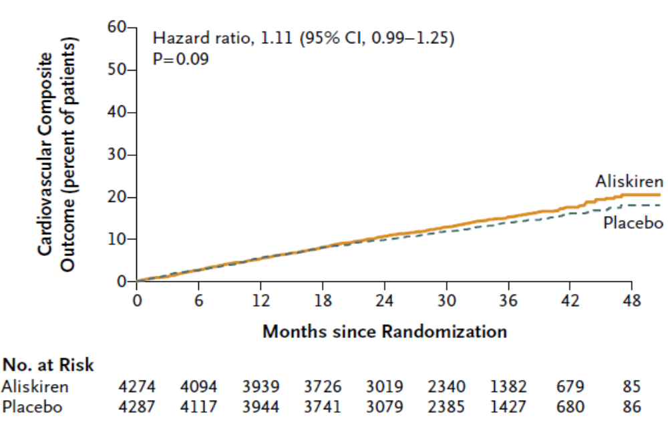

ALTITUDE Trial: Dual RAAS Therapy with Aliskiren and ACEi/ARB Failed to Decrease Vascular Events
Baseline UACR 206 mg/g CR
N Engl J Med 2012;367:2204-2213
Notes:
Albuminuria in clinical trials
Progressive diabetic kidney disease is associated with a poor prognosis, and the condition and its comorbidities reduce quality of life. 88 Current recommended interventions can marginally attenuate but not stop disease progression; morbidity persists even with treatment, and mortality surpasses that of some types of cancer.89 Albuminuria is an important prognostic factor in this residual risk. 90 In the past decade, trials in diabetic renal and cardiovascular disease have all failed. These trials included ON‑TARGET (dual RAAS); SUN (sulodexide); TREAT (darbepoetin); SHARP for kidney protection (simvastatin plus ezetimibe); ALTITUDE (dual RAAS blockade); VA‑NEPHRON‑D (dual RAAS blockade); BEACON (bardoxolone); ASCEND (avosentan) and EPICC (absorbent, AST‑120).75,76,79,91,92 These trials either aimed to reduce albuminuria or reported the effect of the drug on albuminuria, and concluded that a reduction in albuminuria was not associated with a better renal or cardiovascular outcome, and that a better outcome was not associated with a reduction in albuminuria. These conclusions triggered a debate over whether the reduction of albuminuria itself can still serve as a treatment goal or whether albuminuria is just a consequence of vascular disease with no pathophysiological meaning. However, the conclusions of these studies themselves are questionable. The pathophysiology of albuminuria in these patients (that is, endothelial activation and loss of glycocalyx barrier function) was not the specific target of therapy in these trials and/or patients enrolled in the trials did not have albuminuria to start with and yet the primary end point results were used to argue that albuminuria should not be a therapeutic target.93,94 However, a trial cannot prove or disprove a relationship between a risk factor and outcome unless it is designed specifically to study that relationship. A post hoc analysis of the results across these trials for the subset of patients with albuminuria shows that a reduction in albuminuria is clearly associated with better renal or cardiovascular outcomes.95,96 Nevertheless, this post hoc analysis has not changed the policies of the FDA and European Medicines Agency, and so albuminuria remains an invalid surrogate for renal protective treatment.97 Consequently, pharmaceutical companies are reluctant to invest in approaches that primarily target albuminuria, even though studies of such approaches could prospectively prove the validity of albuminuria as a drug target.
The only solution to this vicious cycle is to conduct a prospective trial that aims to reduce albuminuria with a drug that is proven to reduce albuminuria. The ongoing SONAR study98 stratifies patients according to their antialbuminuric response to the study drug and subsequently randomizes them to receive the active drug or a placebo. This approach enables the relationship between a reduction in albuminuria and clinical outcome to be accurately evaluated. The initial patient stratification also enriches the study population to include those with the greatest antialbuminuric response, which will not only help to achieve optimal use of all trial resources, but will help to determine the true potential of albuminuria as a therapeutic target.
79. Randomized placebo-controlled EPPIC trials of AST‑120 in CKD. J. Am. Soc. Nephrol. 26, 1732–1746 (2015).
95. Mortality and morbidity in relation to changes in albuminuria, glucose status and systolic blood pressure: an analysis of the ONTARGET and TRANSCEND studies. Diabetologia 57, 2019–2029 (2014).
96. Stroke outcomes and renal function in diabetes: a meta-analysis of randomized controlled trials [Poster FR‑PO751]. J. Am. Soc. Nephrol. 25 (Suppl.), 541A (2014).

Slide 4
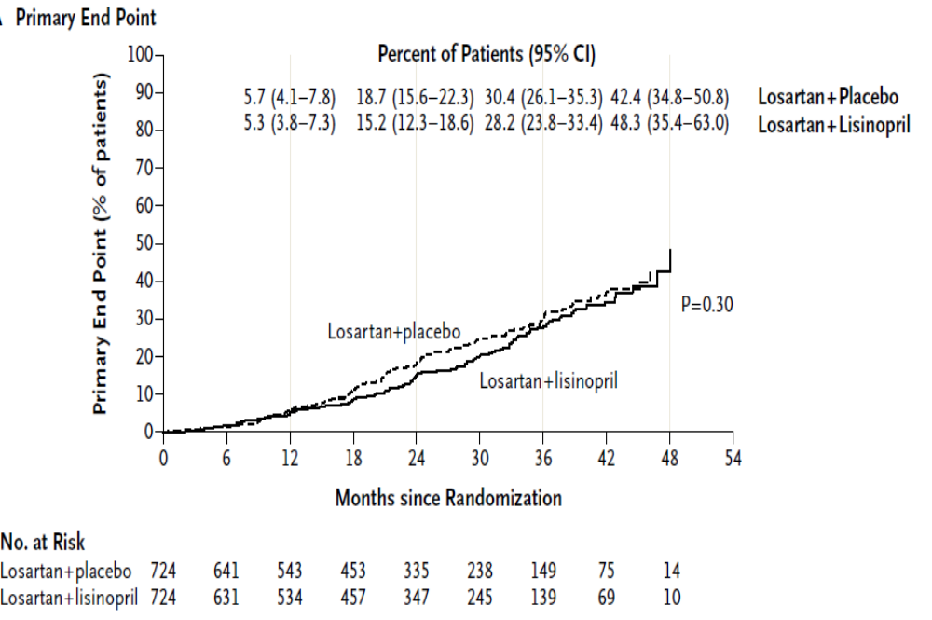

VA‑NEPHRON‑D Trial: Dual RAAS Therapy with Losartan and Lisinopril Did Not Provide an Overall Clinical Benefit
Baseline UACR 862 mg/g CR
N Engl J Med 2013;369:1892-1903
Notes:
Albuminuria in clinical trials
Progressive diabetic kidney disease is associated with a poor prognosis, and the condition and its comorbidities reduce quality of life. 88 Current recommended interventions can marginally attenuate but not stop disease progression; morbidity persists even with treatment, and mortality surpasses that of some types of cancer.89 Albuminuria is an important prognostic factor in this residual risk. 90 In the past decade, trials in diabetic renal and cardiovascular disease have all failed. These trials included ON‑TARGET (dual RAAS); SUN (sulodexide); TREAT (darbepoetin); SHARP for kidney protection (simvastatin plus ezetimibe); ALTITUDE (dual RAAS blockade); VA‑NEPHRON‑D (dual RAAS blockade); BEACON (bardoxolone); ASCEND (avosentan) and EPICC (absorbent, AST‑120).75,76,79,91,92 These trials either aimed to reduce albuminuria or reported the effect of the drug on albuminuria, and concluded that a reduction in albuminuria was not associated with a better renal or cardiovascular outcome, and that a better outcome was not associated with a reduction in albuminuria. These conclusions triggered a debate over whether the reduction of albuminuria itself can still serve as a treatment goal or whether albuminuria is just a consequence of vascular disease with no pathophysiological meaning. However, the conclusions of these studies themselves are questionable. The pathophysiology of albuminuria in these patients (that is, endothelial activation and loss of glycocalyx barrier function) was not the specific target of therapy in these trials and/or patients enrolled in the trials did not have albuminuria to start with and yet the primary end point results were used to argue that albuminuria should not be a therapeutic target.93,94 However, a trial cannot prove or disprove a relationship between a risk factor and outcome unless it is designed specifically to study that relationship. A post hoc analysis of the results across these trials for the subset of patients with albuminuria shows that a reduction in albuminuria is clearly associated with better renal or cardiovascular outcomes.95,96 Nevertheless, this post hoc analysis has not changed the policies of the FDA and European Medicines Agency, and so albuminuria remains an invalid surrogate for renal protective treatment.97 Consequently, pharmaceutical companies are reluctant to invest in approaches that primarily target albuminuria, even though studies of such approaches could prospectively prove the validity of albuminuria as a drug target.
The only solution to this vicious cycle is to conduct a prospective trial that aims to reduce albuminuria with a drug that is proven to reduce albuminuria. The ongoing SONAR study98 stratifies patients according to their antialbuminuric response to the study drug and subsequently randomizes them to receive the active drug or a placebo. This approach enables the relationship between a reduction in albuminuria and clinical outcome to be accurately evaluated. The initial patient stratification also enriches the study population to include those with the greatest antialbuminuric response, which will not only help to achieve optimal use of all trial resources, but will help to determine the true potential of albuminuria as a therapeutic target.
79. Randomized placebo-controlled EPPIC trials of AST‑120 in CKD. J. Am. Soc. Nephrol. 26, 1732–1746 (2015).
95. Mortality and morbidity in relation to changes in albuminuria, glucose status and systolic blood pressure: an analysis of the ONTARGET and TRANSCEND studies. Diabetologia 57, 2019–2029 (2014).
96. Stroke outcomes and renal function in diabetes: a meta-analysis of randomized controlled trials [Poster FR‑PO751]. J. Am. Soc. Nephrol. 25 (Suppl.), 541A (2014).

Slide 5
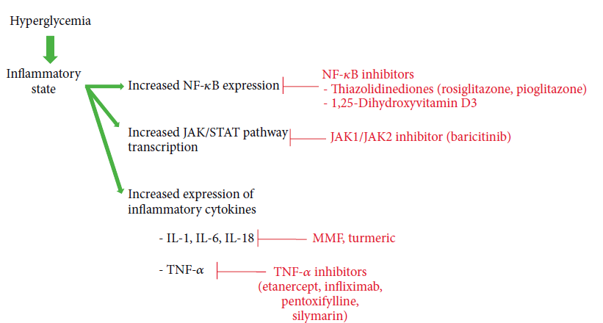
Therapeutics Identified in the Inflammatory Pathway
Journal of Diabetes Research Volume 2015, Article ID 697010, 16 pages
Notes:
A schematic summary of the therapeutics that have been identified in the inflammatory pathway. The inflammatory state occurs as a result of hyperglycemia and is seen in patients with both type 1 and 2 diabetes.

Slide 6
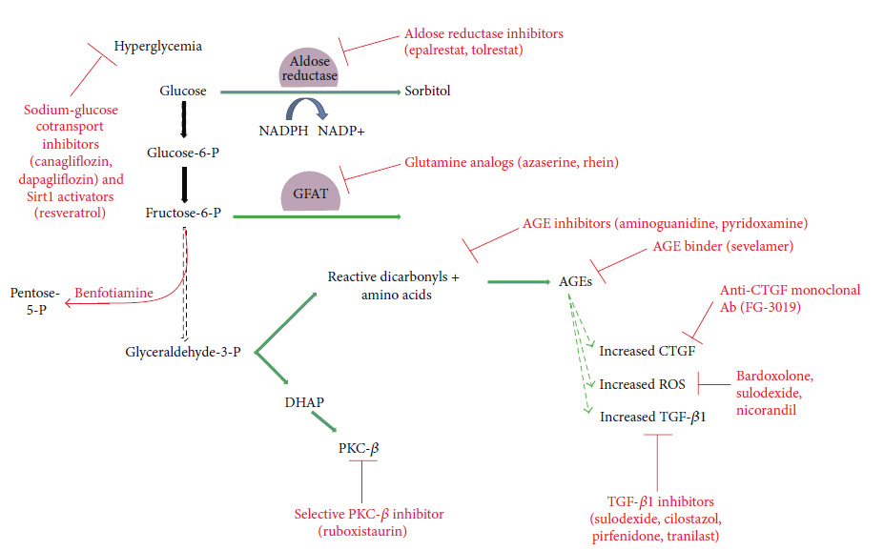
Therapeutic Agents Identified in the Metabolic and Alternative Pathways
Journal of Diabetes Research Volume 2015, Article ID 697010, 16 pages
Notes:
A schematic summary of the various therapeutic agents that have been identified in the metabolic and alternative pathways is shown below. As noted in Figure 2(b), a hyperglycemic milieu shunts glucose metabolism away from the classic glycolysis pathway as is typically seen in patients with type 1 and type 2 diabetes. Sodium-glucose cotransport (SLGT2) inhibitors and Sirt1 activators play a role in alternative pathway and are noted in the upper left. SLGT2 inhibitors combat hyperglycemia by inducing glucosuria, whereas Sirt1 activators are thought to upregulate the highly conserved mechanism, autophagy.

Slide 7
Indoxyl Sulfate
Dietary protein metabolite, and also metabolite of the amino acid tryptophan
A circulating uremic toxin which stimulates glomerular sclerosis and interstitial fibrosis
Increases reactive oxygen species production in tubular cells and increases NAD(P)H oxidase activity in endothelial cells
Impairs osteoblast function and induces abnormalities of bone turnover
The orally administered spherical carbon adsorbent AST-120 reduces “uremic toxins” like indoxyl sulfate and is used in patients with CRF
Nagoya J Med Sci 2010;72.:1 -11
Notes:
Indoxyl sulfate
Description
Indoxyl sulfate is a dietary protein metabolite, and also the metabolite of the common amino acid tryptophan. Indoxyl sulfate is a circulating uremic toxin stimulating glomerular sclerosis and interstitial fibrosis. Indoxyl sulfate is one of the well known substances of a group of protein-bound uremic retention solutes. Indoxyl sulfate increases the rate of progression of renal failure. In plasma, indoxyl sulfate is a protein-bound uremic solute that induces endothelial dysfunction by inhibiting endothelial proliferation and migration in vitro. Some studies suggest that indoxyl sulfate is also involved in oxidative stress. In hemodialyzed patients, serum levels of indoxyl sulfate are associated with levels of pentosidine, a marker of carbonyl and oxidative stress; in vitro, indoxyl sulfate increases reactive oxygen species (ROS) production in tubular cells, and increases NAD(P)H oxidase activity in endothelial cells. Indoxyl sulfate impairs osteoblast function and induces abnormalities of bone turnover. Indoxyl sulfate strongly decreases the levels of glutathione, one of the most active antioxidant systems of the cell.
The so-called ‘uremic toxins’, such as indoxyl sulphate, are biologically active substances involved in the progression of renal failure and many previous reports have shown that they may play an important role in the progressive loss of intact nephrons.3,4 The oral adsorbent, AST- 120, has been developed to inhibit progression of renal failure by lowering uremic toxin levels5 and is used in many
Japanese patients with chronic renal failure. Although the efficacy of AST-120 has been reported in both basic and clinical studies,6,7 data on its long-term use are inadequate. The objective of this study was, therefore, to evaluate the long-term effects of AST-120 in patients with chronic renal failure who had not previously undergone dialysis.

Slide 8
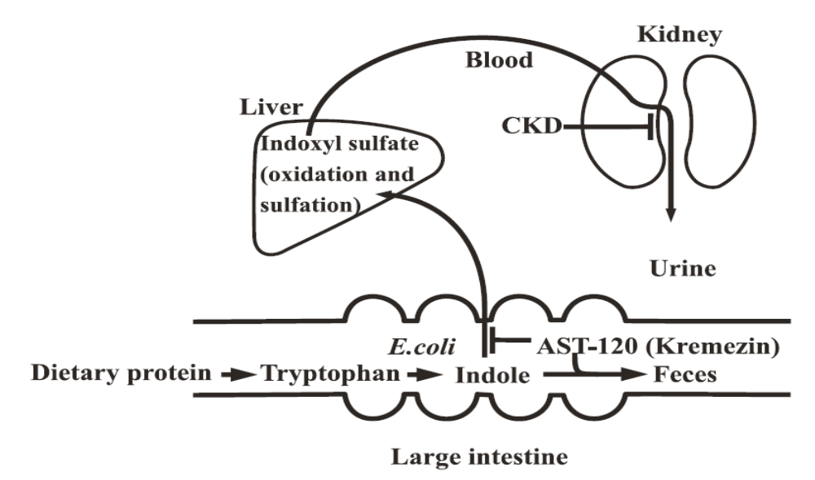
Metabolism of Indoxyl Sulfate and Effect of AST-120
Nagoya J Med Sci 2010;72.:1 -11
Notes:
Metabolism of indoxyl sulfate and effect of AST-120 (Kremezin). Indoxyl sulfate is derived from dietary protein. A part of protein-derived tryptophan is metabolized into indole by tryptophanase in intestinal bacteria such as Escherichia coli. Indole is absorbed into the blood from the intestine, and is metabolized to indoxyl sulfate in the liver, it is normally excreted in urine. In uremia, however, reduced renal clearance of indoxyl sulfate leads to elevated serum levels of indoxyl sulfate. AST-120 reduces the serum and urine levels of indoxyl sulfate in chronic kidney disease (CKD) patients by adsorbing indole in the intestines, and consequently stimulating its excretion in feces.

