Slide 1
Liraglutide Effect and Action in Diabetes: Evaluation of Cardiovascular Outcome Results (LEADER) Trial
Randomized, double-blind, placebo-controlled cardiovascular outcomes trial for up to 5 years
The primary end point is the time from randomization to a composite outcome consisting of the first occurrence of cardiovascular death, nonfatal myocardial infarction, or nonfatal stroke (3 point Major Adverse Cardiovascular Events or 3-MACE)

Slide 2
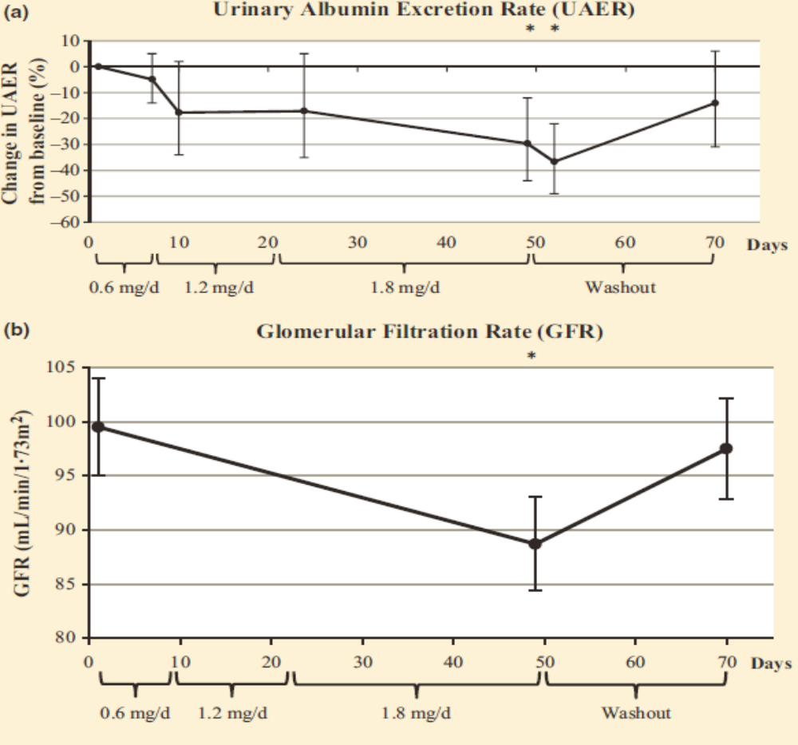
Liraglutide Treatment ↓ Albuminuria and ↓ GFR in Type 2 DM
Baseline
UACR mg/g CR
32.7 (10.4-61.4)
Baseline
GFR (ml/min/1.73 m2)
99.5 (95-106)
Diabet Med 2015;32:343-352
Notes:
Effect of liraglutide treatment on kidney measurements. (a) UAER (95% CI, ratio of geometric means relative to baseline) in 31 participants with Type 2 diabetes treated with liraglutide for 49 days followed by 21 days washout. (b) GFR (SEM) in 31 participants with Type 2 diabetes treated with liraglutide for 49 days followed by 21 days washout. (c) Estimated GFR (SEM) in 31 participants with Type 2 diabetes treated with liraglutide for 49 days followed by 21 days washout. *Represents a significant change (P < 0.05) from baseline.
24–h UAER (mg/day) baseline 32.7 (10.4–61.4) end of treatment 23.0 (8.5–43.4) –30% (–44% to –12%) 0.002 washout 28.1 (10.2–65.8) –14% (–31% to 6%) 0.11
GFR (ml/min/ 1.73 m2) baseline 99.5 (24.8) end of treatment 88.7 (23.6) –10.8 (–14.4 to –7.2) < 0.001 washout 97.5 (25.7) –2.0 (–5.6 to 1.6) 0.26

Slide 3
Liraglutide Effect and Action in Diabetes: Evaluation of Cardiovascular Outcome Results (LEADER) Trial
The primary end point was defined as the composite outcome of the first occurrence of cardiovascular death, nonfatal myocardial infarction, or nonfatal stroke (3-MACE).
The trial met criteria for both non-inferiority and superiority for all three of the end-point components
BREAKING NEWS: March 4, 2016. Results will be presented at the American Diabetes Association annual meeting on June 14, 2016.

Slide 4




Drugs to Treat Type 2 DM Demonstrate Reductions in Major Adverse Cardiovascular Events
How does all this play out when it comes to treating patients with type 2 DM who have chronic kidney disease?

Slide 5
Therapeutic Approaches to Treating CKD in Type 2 DM (1)
The management of diabetic kidney disease must focuses on the treatment of hyperglycemia and hypertension with a foundation of inhibition of the Renin-Angiotensin System (RAS)
Intensifying the management of glycemia produces small reductions in albuminuria but have not decreased the risk of death, cardiovascular disease, or ESRD. Risk of hypoglycemia outweighs benefit.
Hypertension is the #1 cause of death in the world. JNC8 defines normal BP less than 120/80 mm/Hg so anything higher than that is unacceptable especially in patients with type 2 DM and CKD

Slide 6
Cardiovascular Mortality Doubles with each 20/10mmHg Blood Pressure Increment Starting at 115/75mmHg
8.0
8
7
JNC
Goal
6
Cardiovascular
Mortality Risk
4.0
5
4
3
2.0
2
1.0
1
0
115/75
135/85
155/95
175/105
Systolic/Diastolic Blood Pressure (mmHg)
Individuals aged 40-70 years, starting at blood pressure 115/75 mmHg
Lancet 2002;360:1903-1913; JAMA 2003;289:2560-2572
Notes:
Slide Summary
According to a meta-analysis of over 60 prospective studies, the risk of cardiovascular mortality doubles with each rise of 20 mm Hg in systolic blood pressure (BP) and 10 mm Hg in diastolic BP.
Background
In a meta-analysis of 61 prospective, observational studies conducted by Lewington et al involving one million adults with no previous vascular disease at baseline, the researchers found that between the ages of 40-69 years, each incremental rise of 20 mm Hg systolic BP and 10 mm Hg diastolic BP was associated with a twofold increase in death rates from ischemic heart disease and other vascular disease.
The researchers also noted that when attempting to predict vascular mortality risk from a single BP measurement, the average of systolic and diastolic BP was “slightly more informative” than either alone, and that pulse pressure was “much less informative.”
The seventh report Joint National Committee on Prevention, Detection, Evaluation, and Treatment of High Blood Pressure (JNC 7) notes this study result as yet more information linking hypertension to high risk for cardiovascular events.
Lewington S, Clarke R, Qizilbash H, et al. Age-specific relevance of usual blood pressure to vascular mortality: a meta-analysis of individual data for one million adults in 61 prospective studies. Lancet. 2003;361:1903-1913.
JNC 7. JAMA. 2003;289:2560-2572.

Slide 7
Increased Cardiovascular Mortality in Type 2 Diabetes Even at Systolic BP <120 mmHg
250
Non-diabetes patients
200
Type 2 diabetes patients
150
JNC
Goal
Cardiovascular
Mortality
Rate/10,000
person-yrs
100
**
50
0
<120
120–139
140–159
160–179
180–199
≥200
Systolic Blood Pressure (mmHg)
Why should we accept anything less than NORMAL in patients with type 2 DM?
Diabetes Care 1993;16:434-444

Slide 8
Therapeutic Approaches to Treating CKD in Type 2 DM (2)
Dyslipidemia is frequently associated with CKD but LDL-C does not reliable discriminate because many of the patients have lower HDL-C and higher triglycerides. The lipid goal should be a total cholesterol/HDL-C ratio < 4. In patients on dialysis statins should NOT be initiated.
Albuminuria is a powerful independent risk factor for progression of CKD and CVD. While many trials look at reductions in albuminuria, the primary outcomes were not designed to study that relationship. Studies primarily targeting albuminuria are critically needed to prove the validity of albuminuria as a goal in reducing CKD and CVD.
Notes:
The pathophysiology of albuminuria in these patients (that is, endothelial activation and loss of glycocalyx barrier function) was not the specific target of therapy in these trials and/or patients enrolled in the trials did not have albuminuria to start with and yet the primary end point results were used to argue that albuminuria should not be a therapeutic target.93,94 However, a trial cannot prove or disprove a relationship between a risk factor and outcome unless it is designed specifically to study that relationship. A post hoc analysis of the results across these trials for the subset of patients with albuminuria shows that a reduction in albuminuria is clearly associated with better renal or cardiovascular outcomes.95,96 Nevertheless, this post hoc analysis has not changed the policies of the FDA and European Medicines Agency, and so albuminuria remains an invalid surrogate for renal protective treatment.97 Consequently, pharmaceutical companies are reluctant to invest in approaches that primarily target albuminuria, even though studies of such approaches could prospectively prove the validity of albuminuria as a drug target.
The only solution to this vicious cycle is to conduct a prospective trial that aims to reduce albuminuria with a drug that is proven to reduce albuminuria. The ongoing SONAR study98 stratifies patients according to their antialbuminuric response to the study drug and subsequently randomizes them to receive the active drug or a placebo. This approach enables the relationship between a reduction in albuminuria and clinical outcome to be accurately evaluated. The initial patient stratification also enriches the study population to include those with the greatest antialbuminuric response, which will not only help to achieve optimal use of all trial resources, but will help to determine the true potential of albuminuria as a therapeutic target.
Time to Doubling of Serum Creatinine, End Stage Renal Disease or Death in Patients With Type 2 Diabetes Mellitus and Diabetic Nephropathy

Slide 9
Total Cholesterol/HDL-C Ratio
High Cardiovascular Disease Risk when Ratio > 5
Risk Attenuates Once Ratio ≤ 5
Greater Incidence
>6.5
5.3-5.8
5-5.7
5.7-6.5
14
4.4-5.2
12
>5.0
5.3-6.5
10
3.9-5.2
4.7-5.0
<4.3
8
14-year Incidence
Rates (%) for CVD
3.4-4.6
3.8-4.3
6
4.1-5.0
3.3-4
<3.3
3.3-3.8
≥ 260
4
Lower Incidence
230–259
2
200–229
0
< 200
Total Cholesterol
(mg/dL)
<40
40-49
50-59
≥60
HDL-C (mg/dL)
NOTE the curvilinear risk of CVD when TC/HDL-C ratio is > 5 vs. ≤ 5.
JAMA 1986;256:2835-38
Notes:
Low HDL-C Levels Increase CHD Risk Even When Total-C Is Normal (Framingham)
Low high-density lipoprotein cholesterol (HDL-C) levels (< 40 mg/dL) are associated with an increased risk of coronary heart disease (CHD) even if the total cholesterol (Total-C) level is < 200 mg/dL. This slide shows the CHD incidence over 14 years among Framingham Study subjects who were aged 48–83 years at baseline. Among those with HDL-C levels < 40 mg/dL and Total-C < 200 mg/dL, 11.24% experienced a CHD event. This incidence was virtually the same as that (11.91%) for subjects with HDL-C levels between 40–49 mg/dL and Total-C ≥ 260 mg/dL.
References:
Castelli WP, Garrison RJ, Wilson PW, et al. Incidence of coronary heart disease and lipoprotein cholesterol levels: the Framingham Study. JAMA. 1986;256:2835–2838.

Slide 10
Lancet 2012;380:581-590
21 Statin vs. Control Studies
Study | n = | TC/HDL | Ratio-Pre | Ratio-Post | LDL-Pre | LDL-Post | Drug (s) | ↓Mortality
1. WOSCOPS | 6595 | 272/44 | 6.18 | 4.71 | 192 | 142 | Pravastatin | 31%
2. AFCAPS | 6605 | 221/36 | 6.14 | 4.71 | 150 | 115 | Lovastatin | 37%
3. LIPID | 9014 | 218/36 | 6.06 | 4.74 | 150 | 113 | Pravastatin | 24%
4. 4D | 1255 | 218/36 | 6.05 | 4.24 | 125 | 72 | Atorvastatin | None
5. 4S | 4444 | 261/46 | 5.67 | 3.97 | 188 | 122 | Simvastatin | 42%
6. ALLIANCE | 2442 | 226/40 | 5.65 | 4.04 | 147 | 95 | Atorvastatin | 9%
7. HPS | 20536 | 228/41 | 5.57 | 4.67 | 131 | 104 | Simvastatin | 18%
8. CARE | 4159 | 209/39 | 5.36 | 4.08 | 139 | 100 | Pravastatin | 24%
9. LIPS | 1677 | 200/38 | 5.26 | 3.48 | 131 | 96 | Fluvastatin | 31%
----------------BASELINE PRE TC/HDL-C RATIO > FIVE------------------------------------
----------------BASELINE PRE TC/HDL-C < FIVE------------------------------------------------
10. GISSI-P | 4271 | 230/46 | 5.00 | 4.28 | 152 | 123 | Pravastatin | None
11. ALERT | 2102 | 251/51 | 4.90 | 3.90 | 160 | 109 | Fluvastatin | None
12. ALLHAT | 10355 | 224/48 | 4.67 | 3.69 | 146 | 104 | Pravastatin | None
13. PROSPER | 5804 | 220/50 | 4.40 | 3.15 | 147 | 100 | Pravastatin | 24%
14. CORONA | 5011 | 210/48 | 4.40 | 3.08 | 138 | 76 | Rosuvastatin | None
15. ASCOT | 10305 | 212/50 | 4.26 | 3.26 | 133 | 90 | Atorvastatin | 10%
16. MEGA | 8214 | 248/58 | 4.22 | 3.55 | 158 | 129 | Pravastatin | None
17. ASPEN | 2410 | 194/47 | 4.12 | 3.25 | 113 | 80 | Atorvastatin | None
18.GISSI-HF | 4574 | 192/48 | 4.00 | 3.45 | 123 | 90 | Rosuvastatin | None
19. AURORA | 2773 | 176/45 | 3.91 | 2.80 | 100 | 57 | Rosuvastatin | None
20. CARDS | 2838 | 207/54 | 3.83 | 3.31 | 118 | 82 | Atorvastatin | None
21. JUPITER | 17802 | 185/49 | 3.80 | 2.60 | 108 | 55 | Rosuvastatin | 20%

