Slide 1
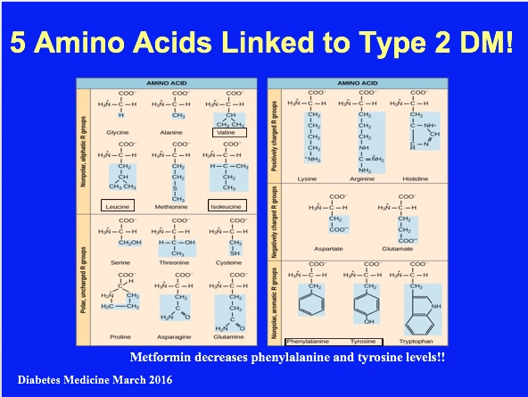
Notes:
Elevated levels of various circulating amino acids (AAs) predict the development of Type 2 diabetes. In one prospective study, three branched-chain AAs (BCAAs), namely, isoleucine, leucine and valine, and two aromatic Aas (AAAs), namely, tyrosine and phenylalanine, showed strong positive associations with Type 2 diabetes risk up to 12 years before disease onset [1]. Subsequent studies have confirmed these associations [2,3]. Increased AA concentrations have also been linked to risk of cardiovascular disease. An analysis of three observational studies showed a positive association between phenylalanine and cardiovascular events [4], while BCAAs and AAAs were associated with increased cardiovascular risk in two further case–control studies [5,6].
1 Metabolite profiles and the risk of developing diabetes. Nat Med 2011;17:448–453.
2 Diabetes risk and amino acid profiles: cross-sectional and prospective analyses of ethnicity, amino acids and diabetes in a South Asian and European cohort from the SABRE (Southall And Brent REvisited) Study. Diabetologia 2015;58:968–979.
3 Identification of serum metabolites associated with risk of type 2 diabetes using a targeted metabolomic approach. Diabetes 2013;62:639–648.
4 Metabolite Profiling and Cardiovascular Event Risk: A Prospective Study of Three Population- Based Cohorts. Circulation 2015; 131: 774–785.
5 Association of a peripheral blood metabolic profile with coronary artery disease and risk of subsequent cardiovascular events. Circ Cardiovasc Genet 2010;3:207–214.
6 A diabetes-predictive amino acid score and future cardiovascular disease. Eur Heart J 2013;34:1982–1989.
AMINO ACIDS: Linked to higher risk of insulin resistance and type 2 DM
Branched-chain: isoleucine, leucine, and valine
Aromatic: tyrosine and phenylalanine
In summary, our findings show that a score of fasting plasma levels of isoleucine, tyrosine, and phenylalanine, recently shown to predict diabetes development, predicts CVD events during long-term follow-up most likely through increased propensity of atherosclerosis. This score also predicts inducible myocardial ischemia in an at-risk clinical cohort undergoing diagnostic exercise testing.

Slide 2
EMPA-REG Trial
Randomised, double-blind, placebo-controlled cardiovascular outcomes trial
The primary end point is the time from randomization to a composite outcome consisting of the first occurrence of cardiovascular death, nonfatal myocardial infarction, or nonfatal stroke (3 point Major Adverse Cardiovascular Events or 3-MACE)

Slide 3
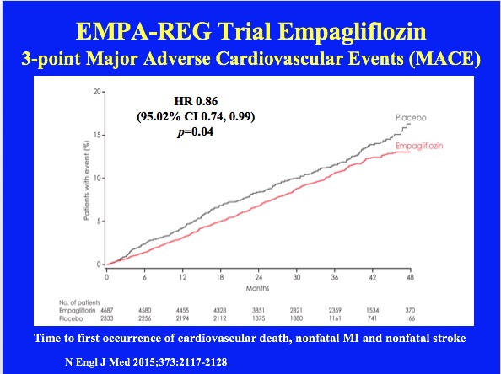

Slide 4
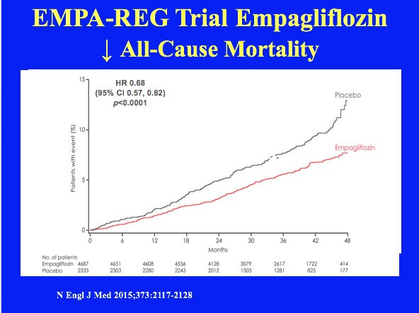

Slide 5
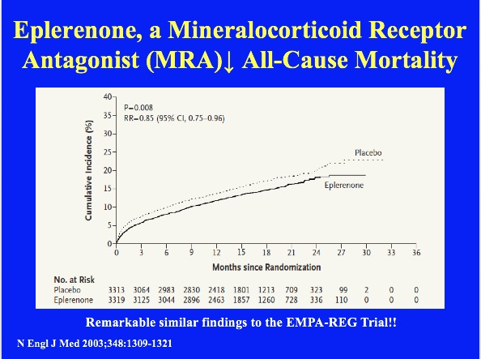
Notes:
Kaplan–Meier Estimates of the Rate of Death from Any Cause (Panel A), the Rate of Death from Cardiovascular Causes or Hospitalization for Cardiovascular Events (Panel B), and the Rate of Sudden Death from Cardiac Causes (Panel C).\ RR denotes relative risk, and CI confidence interval.

Slide 6
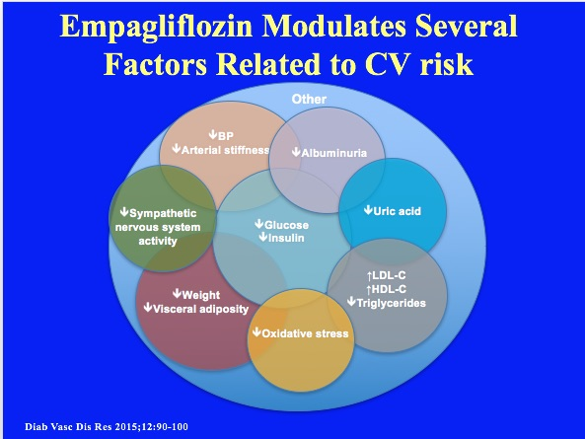

Slide 7
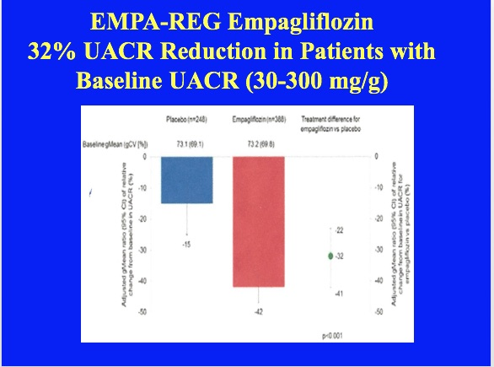

Slide 8
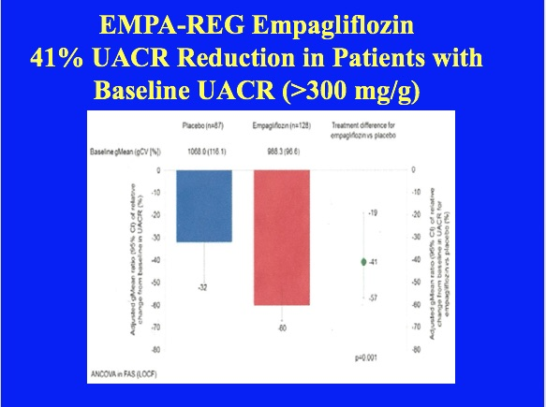

Slide 9
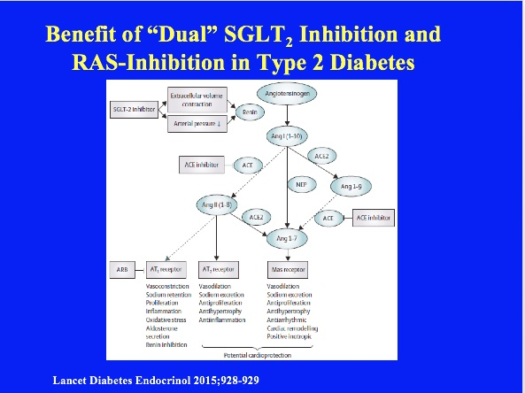
Notes:
Rationale for potential benefit of combined SGLT2 and RAAS-inhibition in type 2 diabetes. SGLT2 inhibitors in addition to ACE inhibition or angiotensin-receptor blockade might favor
improved cardiovascular outcomes by increasing AT2-receptor and Mas-receptor activation. SGLT2=sodium-glucose cotransporter-2. ACE=angiotensin-converting enzyme. ACE2=angiotensin-converting
enzyme 2. Ang I=angiotensin-I. Ang II=angiotensin-II. ARB=angiotensin-receptor blocker. AT1=type-1 angiotensin II receptor. AT2=type-2 angiotensin-II receptor. NEP=neutral endopeptidase.
RAAS=renin-angiotensin-aldosterone-system.
Accumulating data show that many pathways beyond hypertension underlie the pathophysiology of diabetic kidney disease; these have been the basis for several new therapeutic approaches. Endothelin receptor antagonists (such as atrasentan) and inhibitors of the inflammatory response (eg, JAK–STAT inhibitors, or chemokine receptor blockers such as that reported by Dick de Zeeuw and colleagues in this issue) are most advanced in clinical trials. Mineralocorticoid receptor antagonists, which have shown promise in heart failure, are also being tested as a treatment for diabetic kidney disease, and preliminary results from the ARTS-DN trial suggest that oral finerenone reduces urinary albumin-to-creatinine ratio, a surrogate outcome of renal impairment. Additionally, trials assessing renal outcomes of SGLT2 inhibitors (such as canagliflozin and empagliflozin) will hopefully show these hypoglycemic drugs to prevent progression of diabetic kidney disease. Several novel drugs designed to inhibit oxidative stress in diabetic kidney disease are at earlier stages of development.
13. Albuminuria, a therapeutic target for cardiovascular protection in type 2 diabetic patients with nephropathy. Circulation. 2004;110(8):921-927.
14. Albuminuria and blood pressure, independent targets for cardio protective therapy in patients with diabetes and nephropathy. Eur Heart J. 2011;32(12):1493-1499.
15. Albuminuria and kidney function independently predict cardiovascular and renal outcomes in diabetes. J Am Soc Nephrol. 2009;20(8):1813-1821.
16. Mortality and morbidity in relation to changes in albuminuria, glucose status and systolic blood pressure. Diabetologia. 2014;57(10):2019-2029.
17. Recognition, pathogenesis, and treatment of different stages of nephropathy in Patients with type 2 diabetes mellitus. Mayo Clin Proc. 2011;86(5):444-456.
18. Blood pressure, hypertension, RAAS blockade, and drug therapy in diabetic kidney disease. Adv Chronic Kidney Dis. 2014;21(3):281-286.

