Slide 1
HOPE Trial
Urine Albumin/Creatinine Ratio (UACR)
Strong Predictor of All-Cause Mortality *
Quartiles 1ST 2ND 3RD 4Th
UACR (mg/g Creatinine) <1.90 1.9-5.11 5.12-14.2 >14.3
All Patients N = 9043 1 1.08 (0.89-1.32) 1.46 (1.21-1.75) 2.34 (1.99-2.77)
Diabetes N = 3498 1 0.86 (0.58-1.28) 1.41 (1.01-1.95) 2.38 (1.80-3.20)
No Diabetes N = 5545 1 1.17 (0.93-1.47) 1.49 (1.19-1.87) 2.27 (1.82-2.82)
* There was an INCREASED mortality despite “normoalbuminuria”
in ALL patients, including those without diabetes.
Ann Intern Med 2001;134:629-636

Slide 2
HOPE Trial
UACR Best Predictor for Combined Endpoints of Cardiovascular Death, Myocardial Infarction, and Stroke
Variable | Hazard Ratio
Urine Albumin/Creatinine Ratio | 1.59
CAD | 1.51
PVD | 1.49
Diabetes Mellitus | 1.42
Creatinine > 1.4mg/dL | 1.40
Male | 1.20
Waist-Hip Ratio | 1.13
Age | 1.03
N Engl J Med 2000;342:145-153
Notes:
HOPE TRIAL: Independent Predictive Variables for Combined Endpoints of CV Death, MI, and Stroke
A post hoc analysis was performed on data from the Heart Outcomes and Prevention Evaluation (HOPE) Study, a randomized, double-blind, multinational trial involving 267 study centers. Prior to the HOPE Study, cardiovascular risk associated with early renal insufficiency was unknown. Furthermore, clinicians have often been reluctant to use ACE inhibitors in patients with renal insufficiency. To determine whether mild renal insufficiency in­creases cardiovascular risk, and whether ramipril decreases that risk, 980 patients with mild renal insufficiency (serum creatinine ≥1.4 mg/dL) were compared to 8,307 patients with normal renal function (serum creatinine <1.4 mg/dL). Patients with a baseline serum creatinine >2.3 mg/dL were excluded. The primary outcome measure was incidence of cardiovascular death, myocardial infarction, or stroke. Cumulative incidence of the primary outcome was higher in patients with renal insufficiency than in those without (22.2% vs 15.1%; P< 0.001), and increased with serum creatinine. Patients with renal insufficiency had a substantially increased risk for cardiovascular death (11.4% vs 6.6%, P< 0.001) and total mortality (17.8% vs. 10.6%, P< 0.001). Ramipril reduced the incidence of the primary outcome in patients with, and those without, renal insufficiency (hazard ratio, 0.80 vs 0.79; P > 0.2 for the difference). Using multivariate analysis, an elevated serum creatinine concentration and microalbuminuria were highly significant, independent renal risk factors for the aggregate primary outcome of cardio­vascular death, myocardial infarction, or stroke (HR, 1.40 (P< 0.001) and 1.59 (P< 0.001), respectively). In patients who had preexisting vascular disease or diabetes combined with an additional cardiovascular risk factor, mild renal insufficiency significantly increased the risk for subsequent cardiovascular events. Ramipril reduced cardiovascular risk without increasing adverse effects, including worsening renal function.
Reference:
Mann JF, Gerstein HC, Pogue J, Bosch J, Yusuf S. Renal insufficiency as a predictor of cardiovascular outcomes and the impact of ramipril: the HOPE randomized trial. Ann Intern Med. 2001; 134(8):629-636.

Slide 3
Albuminuria Predicts Cardiovascular Risk at Levels BELOW Current Definition
Albuminuria Assessment in Patients with Hypertension and Diabetes Improves Cardiovascular Risk Stratification
2.5
LIFE Study: Composite Endpoint
2
1.5
Adjusted Hazard Ratio
1
0.5
0
<6.9
≥ 6.9 –
<17.2
≥ 17.2 –
<45.0
≥ 45.0 –
<149.4
≥149.4
Quintile of Urine A/C Ratio (mg/g CR) among 1,063 Hypertension Patients with Diabetes
Lancet 2002;359:995-1003
Normoalbuminuria
Microalbuminuria
Notes:
Points of Emphasis / Key Messages
This figure, drawn from the composite endpoint of the LIFE study, depicts the positive correlation between increasing urinary A/C ratio in type 2 diabetic patients with comorbid HTN, and increasing CV hazard.
Among diabetic hypertensive patients in this study, every 10-fold increase in urinary A/C ratio raised the risk of any event by 39%.
These data were obtained from 1063 HTN patients with comorbid diabetes.
The composite endpoint of CV risk referred to in the figure included CV mortality, all-cause mortality, stroke, and MI. Hazard ratio was adjusted for left ventricular mass by electrocardiography, age, sex, smoking, serum creatinine level, race, and study treatment allocation.
Reference
Wachtell K et al. Albuminuria and cardiovascular risk in hypertensive patients with left
ventricular hypertrophy: The LIFE study. Ann Intern Med. 2003;139:901-906.

Slide 4
THE LIFE STUDY
Urine Albumin/Creatinine Ratio (UACR)
and Composite Endpoints in 1,063 Diabetes Patients
Quintiles 1ST 2ND 3RD 4TH 5TH
UACR (mg/g Creatinine) <6.9 6.9-17.1 17.2-45 45.1-149.4 >149.4
All-Cause Mortality 1.0 2.0 1.8 1.8 2.5
Cardiovascular Mortality 1.0 1.8 1.7 2.4 2.7
Myocardial Infarction 1.0 0.8 1.0 1.4 1.1
Stroke 1.0 3.2 3.1 3.4 3.8
Except for myocardial infarction, all endpoints were increased despite “normoalbuminuria”. Hazard ratios were adjusted for LVH, age, sex, smoking, race, and serum creatinine.
Lancet 2002;359:1004-1010

Slide 5
Urine Albumin Creatinine
Ratio (UACR)* and CVD Risk
Risk when UACR > 7.5 mg/g creatinine in women
and > 4.0 mg/g creatinine in men
End Point
CV event
Hazard ratio
2.92
“p”
<0.001
*simple, inexpensive, independent predictor of CVD;
also addresses sex difference as men have higher muscle mass
J Am Soc Nephrol 2002;13:1034-1039; Circulation 2005;112:969-975
Notes:
The recommended albumin (ug)/creatinine (mg) ratio (ACR) (30 ug/mg) to detect microalbuminuria does not account for sex or racial differences in creatinine excretion. In a nationally representative sample of subjects, the distribution of urine albumin and creatinine concentrations was examined by using one ACR value (30 ug/mg) and sex-specific cutpoints (17 ug/mg in men and 25 ug/mg in women) measured in spot urine specimens. Mean urine albumin concentrations were not significantly different between men and women, but urine creatinine concentrations were significantly higher (P < 0.0001). Compared with non-Hispanic whites, urine creatinine concentrations were significantly higher in non-Hispanic blacks (NHB) and Mexican Americans, whereas urine albumin concentrations were significantly higher in NHB (P < 0.0001) but not Mexican Americans. When a single ACR is used, the prevalence of microalbuminuria was significantly lower among the men compared with women (6.0 versus 9.2%; P < 0.0001) and among non-Hispanic whites compared with NHB (7.2 versus 10.2%; P < 0.0001). No significant difference in the prevalence of microalbuminuria between men and women was noted when sex-specific ACR cutpoints were used. In the multivariate adjusted model, female sex (odds ratio, 1.62; 95% confidence interval, 1.29 to 2.05) and NHB race/ethnicity (odds ratio, 1.34; 95% confidence interval, 1.12 to 1.61) were independently associated with microalbuminuria when a single ACR threshold was used. When a sex-specific ACR was used, NHB race/ethnicity remained significantly associated with microalbuminuria but sex did not. The use of one ACR value to define microalbuminuria may underestimate microalbuminuria in subjects with higher muscle mass (men) and possibly members of certain racial/ethnic groups.
In summary, urine creatinine concentrations differ between men and women and between different racial/ethnic groups. Therefore, standardizing urine albumin concentrations to creatinine
(i.e., ACR) may underestimate microalbuminuria in subjects with higher muscle mass (men) and possibly in certain racial/ethnic groups, such as NHB, or overestimate it in subjects with lower muscle mass (women). Future research studies that use the ACR to define microalbuminuria should use sex specific ACR cut points to help avoid the potential problems of underestimating microalbuminuria in subjects with high urine creatinine excretion (e.g., men) and overestimating microalbuminuria in subjects with low urine creatinine excretion (e.g., women). Results from prospective studies should be used to define risk of abnormal urine albumin excretion at different levels of ACR. Studies are also needed to determine appropriate ACR thresholds for different race/ethnicity groups.

Slide 6
Three Principal Mediators Contribute to Chronic Kidney Disease (CKD)
First is loss of nephron mass with resultant glomerular hyperfiltration and increased single nephron glomerular filtration rate
The second is hypertension, #1 cause of death in the world
The third is albuminuria, that represents a common final pathway of CKD irrespective of the underlying specific glomerular pathology and heralds the onset of glomerular damage
Pediatr Nephrol 2014; 29:771–784
Notes:
Irrespective of the underlying cause of the kidney disease in any given population, three principal mediators contribute to CKD progression. The first is loss of nephron mass with resultant glomerular hyperfiltration and increased single nephron glomerular filtration rate (GFR), as first recognized by the seminal work of Brenner et al. (Brenner hypothesis) [4–6]. The second is hypertension, and the Multiple Risk Factor Intervention Trial was one of the first studies to confirm that blood pressure (BP) was a strong independent predictor of CKD progression in adults [7]. The third is proteinuria, as
suggested originally by a number of major international clinical trials, most of which were designed to study protein restriction as a therapeutic renoprotective strategy [8–10]. There has been a paradigm shift from the old opinion, viewing proteinuria as a mere marker of renal injury rather than what is now generally accepted, that it represents a common final pathway of CKD irrespective of the underlying specific glomerular pathology [11]. As such, once proteinuria develops, it not only serves as a marker for disease progression, but also heralds the onset of glomerular damage caused by the proteinuria itself that leads to chronic proteinuric kidney disease.
4. 1978 Molecular basis of proteinuria of glomerular origin. N Engl J Med 298:826–833
5. (1982) Dietary protein intake and the progressive nature of kidney disease: the role of hemodynamically mediated glomerular injury in the pathogenesis of progressive glomerular sclerosis in aging, renal ablation, and intrinsic renal disease. N Engl J Med 307:652–659
6. (1981) Hyperfiltration in remnant nephrons: a potentially adverse response to renal ablation. Am J Physiol 241: F85–F93
7. (1996) Blood pressure and endstage renal disease in men. N Engl J Med 334:13–18
8. (1989) The effect of protein restriction on the progression of renal insufficiency. N Engl J Med 321:1773–1777
9. (1991) Prospective, randomised, multicentre trial of effect of protein restriction on progression of chronic renal insufficiency. Northern Italian Cooperative Study Group. Lancet 337:1299–1304
10. (1994) The effects of dietary protein restriction and blood-pressure control on the progression of chronic renal disease. Modification of diet in Renal Disease Study Group. N Engl J Med 330:877–884
11. (2012) Mechanisms and treatment of CKD. J Am Soc Nephrol 23:1917–1928

Slide 7
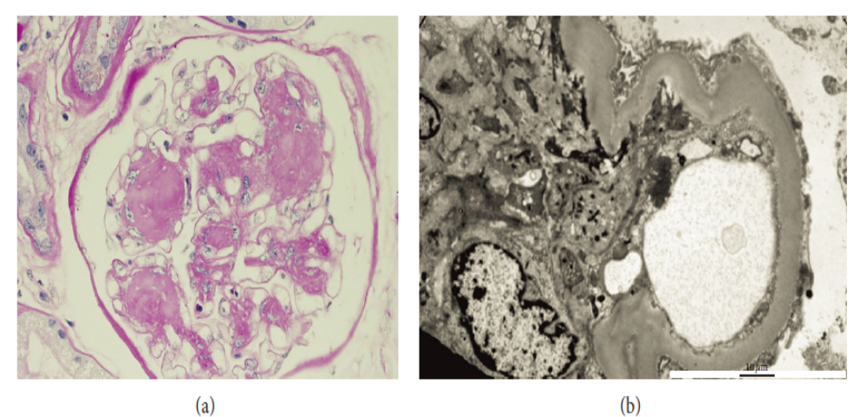
Kimmelstiel-Wilson Lesion, Thickened Basement Membrane, and Podocyte Foot Process Effacement
Notes:
(a) Light microscopy with hematoxylin-eosin staining reveals extensivemesangial expansion without marked increase in cellularity. A Kimmelstiel-Wilson (KW) lesion is shown here and refers to the nodular glomerulosclerosis that can be seen in late disease but is not as common as diffuse diabetic glomerulosclerosis. KW Lesions are usually spherical and eosinophilic and have a central hypocellular or acellular area. Mesangial expansion and KW lesions are both due to increased extracellular matrix production. (b) Electron microscopy reveals a thickened basement membrane and podocyte foot process effacement.

Slide 8
ACE inhibitor Fosinopril
Significantly Decreased Albuminuria
Change from baseline
With Fosinopril
0
- 10
- 20
- 30
Change in
albuminuria
(%)
- 29.5 *
- 31.43 *
* p < 0.001
3 Months
4 Years
Albuminuria, mg/24h
Pre ACE 23.7 (16.9- 44.5)
Post ACE 16.25 (11.6-30.5)
Circulation 2004;110:2809-2816

Slide 9
ACE inhibitor Fosinopril
Reduced Cardiovascular Events in
Subjects with Albuminuria
10
7.5
Risk
reduction
40%
Number
needed to treat
29
Placebo
5
Combined CV endpoint (%)
2.5
ACEi (Fosinopril)
0
0
10
20
30
40
Months
Albuminuria, mg/24h
Pre ACE 23.7 (16.9- 44.5)
Post ACE 16.25 (11.6-30.5)
Circulation 2004;110:2809-2816
Notes:
In the PREVEND IT study treatment with fosinopril resulted in a better event-free survival, although the difference was not statistically significant.
Circulation 2004;110:2809-2816.
Effects of Fosinopril and Pravastatin on Cardiovascular Events in Subjects With Microalbuminuria.
In microalbuminuric subjects, treatment with fosinopril had a significant effect on urinary albumin excretion. In addition, fosinopril treatment was associated with a trend in reducing cardiovascular events.

