Slide 1
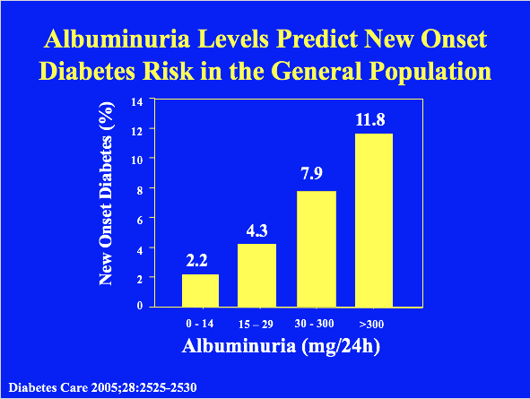

Slide 2
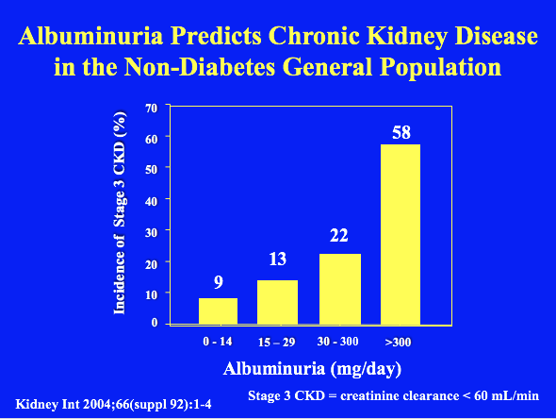
Notes:
The percentage of subjects with de novo development of renal function impairment (GFR<60 ml/min) after 4.2 years of follow up. Subjects with a higher UAE in the 97/98 screening had more frequently renal function impairment at the follow up screening in 2001/03. From Verhave JC et al. Kidney Int 2004;66(suppl 92):1-4

Slide 3
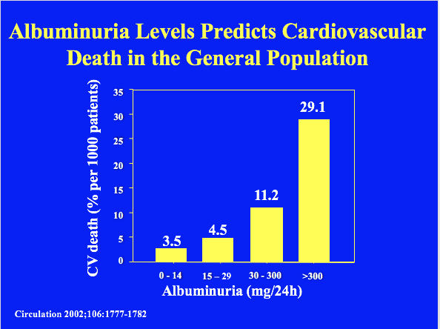

Slide 4
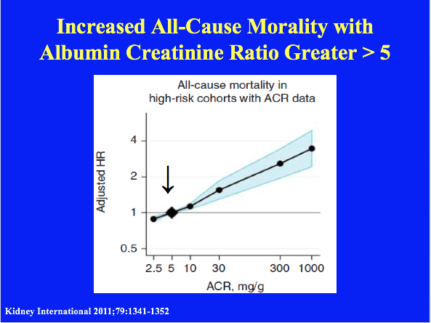

Slide 5
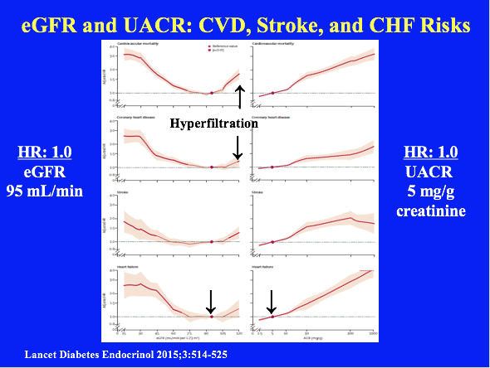
Notes:
Cardiovascular outcomes according to Egfr and ACR in combined general-population and high-risk cohorts Adjusted HRs and 95% Cis (shaded areas) for cardiovascular mortality, coronary heart disease, stroke, and heart failure according to eGFR and ACR in the combined general-population and high-risk cohorts. The reference value is eGFR 95 mL/min per 1·73 m² and ACR 5 mg/g (diamonds). We made adjustments for age, sex, race or ethnic origin, smoking, systolic blood pressure, antihypertensive drugs, diabetes, total and HDL cholesterol concentrations, and albuminuria (ACR or dipstick) or eGFR, as appropriate. In the analyses of eGFR, there were 629 776 participants for cardiovascular mortality, 144 874 for coronary heart disease, 137 658 for stroke, and 105 127 for heart failure. In the analyses of ACR, there were 120 148 participants for cardiovascular mortality, 91 185 for coronary heart disease, 82 646 for stroke, and 55 855 for heart failure. All axes are log scales except for the eGFR axis. eGFR=estimated glomerular filtration rate. ACR=urine albumin-to-creatinine ratio.

Slide 6
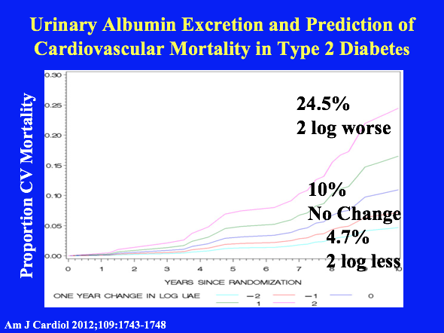

Slide 7
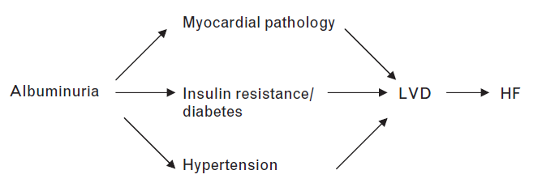
Pathophysiological Mechanisms of Heart Failure in Patients with Albuminuria
Curr Opin Cardiol 2009;24:148-154
Notes:
Albuminuria is highly prevalent in patients with heart failure. Although more frequent in diastolic than systolic dysfunction, it appears to indicate a worse prognosis in the latter class. Albuminuria is frequently associated with diabetes, and indicates a worse prognosis in patients with heart failure and diabetes than in those with heart failure alone. This is probably due to the bidirectional relationship between diabetes and heart failure.
In the SOLVD trial population, which included a large number of patients with LVEF 0.35 or less with symptomatic or asymptomatic heart failure, Capes et al. [42] studied the impact of clinical proteinuria on clinical outcomes. At baseline, patients with clinical proteinuria had a significantly higher prevalence of diabetes, higher systolic and diastolic BP, a lower LVEF and more severe (NYHA III, IV) heart failure. After adjustment for these predictors, clinical proteinuria remained an independent predictor of heart failure hospitalizations and mortality.
Kistorp et al. [43] have prospectively studied during a median of 2.5 years whether albuminuria and other biomarkers of endothelial dysfunction at baseline are related to prognosis in patients with heart failure with and without diabetes. The authors found that among the diabetic heart failure patients albuminuria, plasma E-selectin and fasting blood glucose predicted the risk of ischemic events, but this association was not observed in nondiabetic heart failure patients.

