Slide 1


Slide 2
The Significance of Albuminuria
Albuminuria results from injury to glomerular circulation
Albuminuria is also an indicator of injury to the systemic circulation
Increased albuminuria is associated with progressive kidney disease
Increased albuminuria is associated with increased cardiovascular and cerebrovascular risk
N Engl J Med 2000;342:145-153; Am J Kidney Dis.2000;36:646-661;
Am J Kidney Dis 2000;35(4suppl1):S97-S105
Notes:
The Dual Significance of Proteinuria
In patients with proteinuric renal diseases the rate of progression of renal insufficiency is determined by the level of blood pressure and proteinuria. The reduction of blood pressure and proteinuria has a beneficial impact on renal risk. Observational studies have also demonstrated that proteinuria is a marker for systemic vascular injury. It is hoped that efforts to reduce proteinuria and control blood pressure will improve cardiovascular risk and reduce mortality. In this belief, the National Kidney Foundation and the American Diabetes Association have revised their recommendations for management of high-risk patients for tighter blood pressure control to <130/80.
References:
1.Treatment of hypertension in patients with diabetes: lessons from recent trials. Cardiol Rev. 2001;9(1):36-44.
2.Preserving renal function in adults with hypertension and diabetes: a consensus approach. National Kidney Foundation Hypertension and Diabetes Executive Committees Working Group. Am J Kidney Dis. 2000;36(3):646-661.
3.Microalbuminuria in essential hypertension: significance, pathophysiology, and therapeutic implications. Am J Kidney Dis. 1999;34(6):973-995.
4.Proteinuria: its clinical importance and role in progressive renal disease.. Am J Kidney Dis. 2000;35(4suppl1):S97-S105
5.Effects of an angiotensin-converting-enzyme inhibitor, ramipril, on cardiovascular events in high-risk patients. The Heart Outcomes Prevention Evaluation Study Investigators. N Engl J Med. 2000;342(3):145-153.

Slide 3
Renal Disease and Hypertension-
Core Concepts of Treatment
Hypertension and albuminuria are both independent variables that predict long-term decline in renal function
  Renal disease is both a cause and consequence of hypertension
  Reduction of blood pressure reduces cardiovascular risk and renal risk
  Reduction of albuminuria lowers both cardiovascular risk and renal risk
Cardiol Rev 2001;9:36-44; Am J Kidney Dis. 1999;34:973-995
Notes:
Renal Disease and Hypertension Core Concepts of Treatment
Blood pressure levels are reliable predictors of renal outcome. Both absolute systolic and diastolic blood pressures correlate with the risk of renal damage. African Americans may be at greater risk compared to other racial/ethnic groups. In patients with renal disease, blood pressure reduction clearly effects renal outcome. In both diabetic and non-diabetic patients blood pressure reduction provides greater protection of renal function. The absolute level of blood pressure reduction is important. The initial stages of effective blood pressure control can produce a relative hypoperfusion of the kidneys and a transient increase in serum creatinine. But, clinicians can become alarmed by this rise in serum creatinine and inappropriately withdraw anti-hypertensive therapy rather than waiting several weeks for the serum creatinine to stabilize and/or decline.
References:
Agarwal R. Treatment of hypertension in patients with diabetes: lessons from recent trials. Cardiol Rev. 2001;9(1):36-44.
Bakris GL, Williams M, Dworkin L, Elliott WJ, Epstein M, Toto R, Tuttle K, Douglas J, Hsueh W, Sowers J. Preserving renal function in adults with hypertension and diabetes: a consensus approach. National Kidney Foundation Hypertension and Diabetes Executive Committees Working Group. Am J Kidney Dis. 2000;36(3):646-661.
Bianchi S, Bigazzi R, Campese VM. Microalbuminuria in essential hypertension: significance, pathophysiology, and therapeutic implications. Am J Kidney Dis. 1999;34(6):973-995.
Keane WF. Proteinuria: its clinical importance and role in progressive renal disease. Am J Kidney Dis. 2000;35(4suppl1):S97-S105.
Yusuf S, Sleight P, Pogue J, Bosch J, Davies R, Dagenais G. Effects of an angiotensin-converting-enzyme inhibitor, ramipril, on cardiovascular events in high-risk patients. The Heart Outcomes Prevention Evaluation Study Investigators. N Engl J Med. 2000;342(3):145-153.

Slide 4
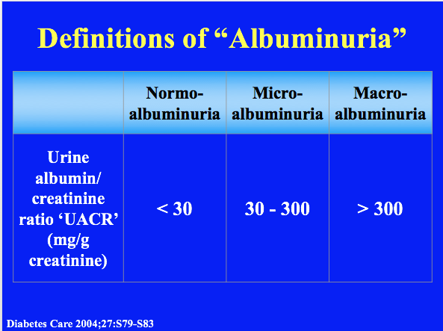
Notes:
Definitions of Microalbuminuria and Macroalbuminuria
Measurements of urinary albumin are made from either a timed (4 or 24 hours) urine collection or from a randomly voided “spot” urine. In the former case the urinary albumin concentration is divided by the time of the collection (in minutes) calculate the first parameter. In the latter case, both albumin and creatinine concentrations are measured in the same specimen and a ratio of albumin to creatinine calculated. Numerous studies have demonstrated that the values obtained from both timed and randomly collected specimens correlate well and have the same prognostic significance. Measurements of urine protein concentrations by “dipstick” chemistry are not sufficiently sensitive to identify urine albumin concentrations that meet the criteria for microalbuminuria. Protein in the urine is usually a combination of albumin, globulins, and Tamm-Horsfall protein derived from tubular secretion.
References:
Bianchi S, Bigazzi R, Campese VM. Microalbuminuria in essential hypertension: significance, pathophysiology, and therapeutic implications. Am J Kidney Dis. 1999;34(6):973-995.
Keane WF. Proteinuria: its clinical importance and role in progressive renal disease. Am J Kidney Dis. 2000;35(4suppl1):S97-S105.

Slide 5
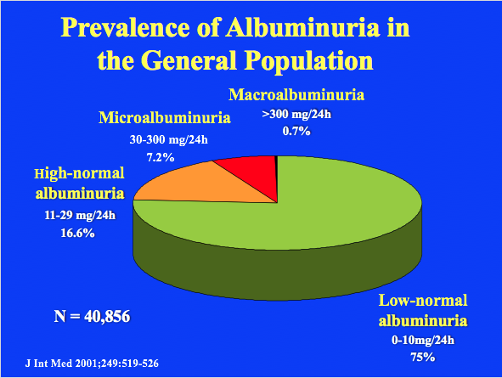
Notes:
The prevalence of microalbuminuria in an aselect sample (n=40,856) of the mostly Caucasian population of 28-75 years in the city of Groningen is 7.2%. Micro-albuminuria was defined as a morning urinary albumin concentration of 20-200 mg/l. Another 16.6% of the population had a borderline albuminuria, or high-normal albuminuria, defined as a urinary albumin concentration of 10-20 mg/L, while 282 subjects had macroalbuminuria.
J Int Med 2001;J Int Med 2001;249:519-526.

Slide 6
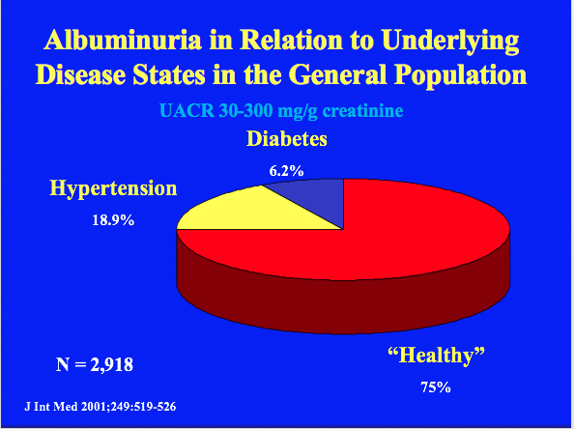
Notes:
Of the 2,918 subjects, that were found to be microalbuminuric (defined as a morning urinary albumin concentration of 20-200 mg/L) only 6.2% was known to be diabetic and 18.9% was known to be hypertensive. Although we should realize that insulin using diabetics were not included, this emphasizes that many subjects having microalbuminuria were not known with disorders, traditionally associated with microalbuminuria.
J Int Med 2001;249:519-526

