Slide 1
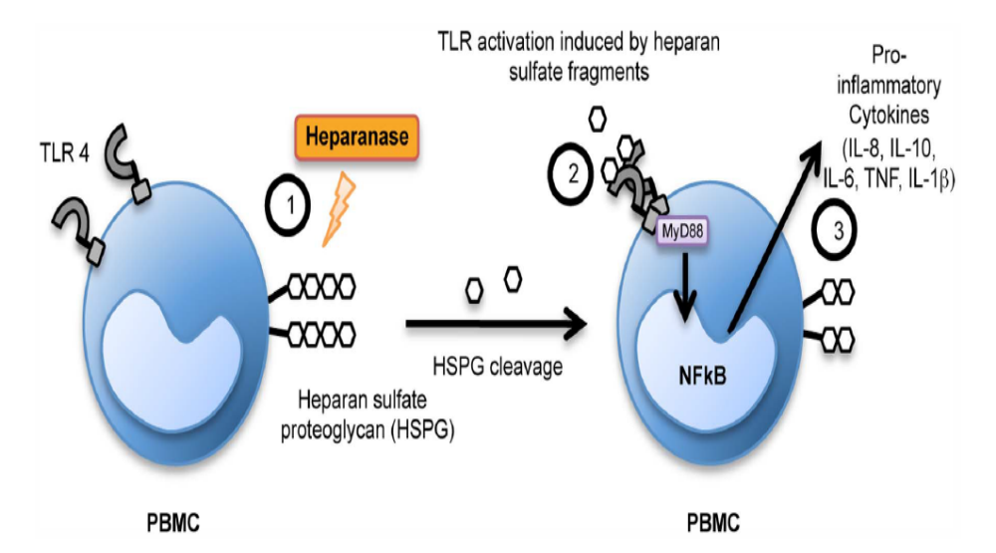
Heparanase Trigger the Release of Pro-Inflammatory Cytokines Through TLR‑4
PBMC = peripheral blood mononuclear cell
PLoS ONE 2014;9:e109596
Notes:
Model of cytokine upregulation in response to HPSE. Schematic model of the proposed function of HPSE in releasing proinflammatory cytokines. (1) HPSE cleaves and solubilizes HS fragments from the cell surface of immune cells. (2) HS fragments then signal through MyD88-dependent receptors, of which TLR4 is one, and this leads to NF-kB cleavage and activation. (3) NF-kB-dependent upregulation of cytokine production and release, including IL-8, IL-10, IL-6, TNF and IL-1b.( 4) Cytokines are involved in inflammatory events including chemoattraction and increased antibody production. (5) These events contribute to the induction of an inflammatory response. doi:10.1371/journal.pone.0109596.g009
Mechanism of glycocalyx degradation. Proheparanase is released by activated endothelial cells and activated platelets and by secretion from leucocytes. Proheparanase is cleaved into active heparanase by cathepsin L. Proteoglycans such as syndecan‑1, but also LDL receptor-related proteins and mannose 6‑phosphate receptors, facilitate recapture of proheparanase by the leucocytes.99 Proteolysis occurs either in the plasma as a result of cathepsin secretion from monocytes, or in the late endosomes and lysosomes of macrophages following internalization of proheparanase. After internal proteolysis, activated heparanase is secreted alongside exosomes, which also contain enzymes involved in extracellular matrix remodelling.100 Heparanase consequently cleaves heparan sulfate in the glycocalyx. Released hyaluron and heparan sulfate fragments promote inflammation.101 Remodelling of the glycocalyx facilitates endothelium–leucocyte interaction. Altogether, this process enables serum proteins, such as albumin and lipoproteins, to enter the subendothelial space.
99. Cellular uptake of mammalian heparanase precursor involves low density lipoprotein receptor-related proteins, mannose 6‑phosphate receptors, and heparan sulfate proteoglycans. J. Biol. Chem. 280, 33141–33148 (2005).
100. Heparanase activates the syndecan–syntenin–ALIX exosome pathway. Cell Res. 25, 412–428 (2015).
101. Soluble heparan sulfate fragments generated by heparanase trigger the release of pro-inflammatory cytokines through TLR‑4. PLoS ONE 9, e109596 (2014).

Slide 2
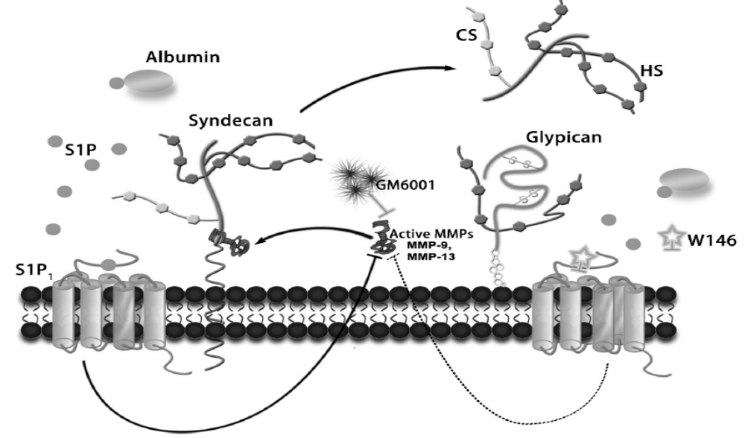
Sphingosine-1-Phosphate (S1P₁) Protects Endothelial Glycocalyx by Inhibiting Syndecan-1 Shedding
Am J Physiol Heart Circ Physiol 2014;306: H363-H372
Notes:
Summary of the role of plasma protein (S1P) in glycocalyx protection. Starting from the left: serum albumin carries S1P, which can activate the S1P1 receptor. The activation of S1P1 inhibits the activity of MMPs and abolishes MMP activity-dependent syndecan-1 ectodomain shedding. Starting from the right: the S1P- S1P1 receptor agonist activity can be blocked by W146. After the bound S1P on the cell surface is cleared by removal of plasma protein (or S1P), the inhibition of MMP activity (MMP-9and-13) is attenuated (broken line), and this induces the shedding of syndecan-1 by cleaving its ectodomain.
In summary, we have described a new mechanism by which plasma proteins and associated S1P protect the endothelial glycocalyx via S1P-mediated inhibition of protease activity dependent shedding of the syndecan-1 ectodomain. The new mechanism is presented in schematic form in Fig. 9. In brief, starting from the left, serum albumin carries S1P, which can activate the S1P1 receptor. The activation of S1P1 inhibits the activity of MMPs and abolishes MMP-dependent syndecan-1 ectodomain shedding. Startingfromtheright,whentheS1P-S1P1 activity on the cell surface is blocked, the inhibition of MMP (MMP-9 and -13) activity is attenuated (broken line), and this induces the shedding of the syndecan-1 ectodomain. The losses of CS and HS are due to shedding of the syndecan-1 ectodomain. Glypican-1 does not change after removal of plasma protein (S1P).
Finally, our observations may have therapeutic implications. It is possible that several of the clinical examples noted in the introduction that result in shedding of the glycocalyx are the result, at least in part, of mechanisms resulting in reduced synthesis of S1P by red cells and platelets or reduced delivery of S1P to the endothelium. Possible conditions include transfusions with aged vs. fresh red cells (8), anemia [red cell are a major source of S1P (6)], and reduced capacity of albumin or HDL to carry the S1P signal to the endothelium. We speculate that glycation of albumin in diabetes could contribute to such a mechanism (26). The idea that there may be parallel limitations of S1P availability due to reduced binding capacity of HDL for S1P also remains to be investigated. Means to maintain the glycocalyx in the face of these insults could be of signiﬁcant therapeutic value.
6. Erythrocyte-derived sphingosine1-phosphate stabilizes basal hydraulic conductivity and solute permeability in rat microvessels. Am J Physiol Heart Circ Physiol 303: H825–H834, 2012.
8. Synergistic effect of anemia and red blood cells transfusion on inﬂammation and lung injury. Adv Hematol 2012: Article ID 924042, 8 pages
26. The glycation of albumin: structural and functional impacts. Biochimie 93: 645–658, 2011.

Slide 3
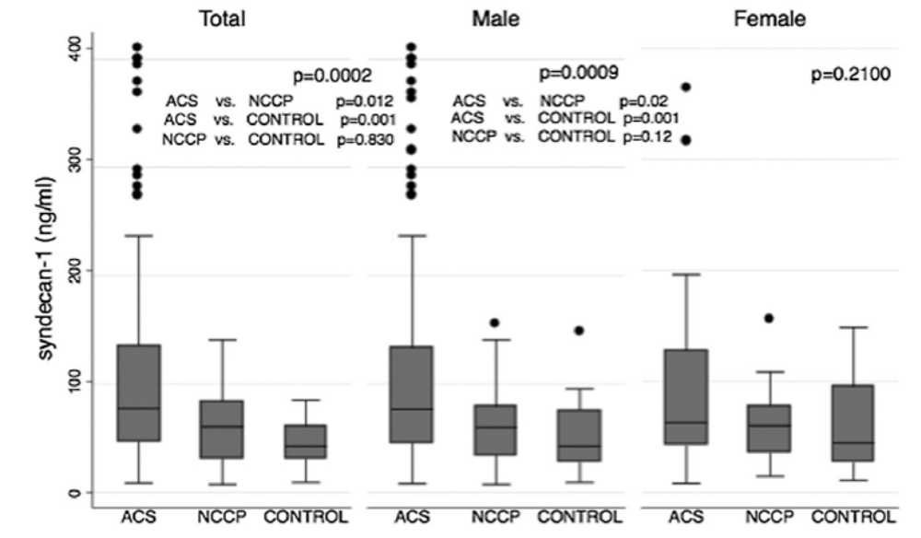
Syndecan-1 Levels are Higher in Men with Acute Coronary Syndrome
Atherosclerosis 2016;247:184-188
Notes:
Syndecan-1 levels observed in the three groups: acute coronary syndrome (ACS), non-coronary chest pain (NCCP) and CONTROL are shown in all individuals (total) and according to each gender category (male and female). Data are presented as box-and-whisker plots, in which the top and bottom of the rectangles indicate the 75th and 25th percentiles, respectively; the horizontal line within the rectangles indicate the 50th percentile; the lines above and below the rectangles indicate the 90th and 10th percentiles, respectively.
The endothelial glycocalyx (EG) is a sugar-based cell-bound surface molecules linked to transmembrane proteins observed on the endothelial surface of the blood vessels [1e3]. Damage to this structure is associated with an increase in platelet and leucocyte adhesion and in shear stress inside the vessel due to decreasing nitric oxide production [4e7]. The syndecan-1 is the most common transmembrane protein constituting of the EG, however is not an endothelial-cell specific protein. A soluble form is produced by the shedding of the EG, and its circulating levels are used as a biomarker of injury to this structure. Many cardiovascular risk factors can contribute to the EG shedding such as inflammation, diabetes, oxidized LDL, etc [8].

Slide 4
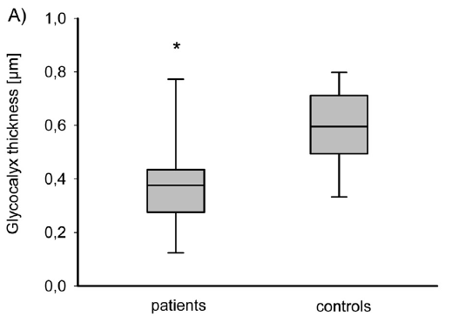
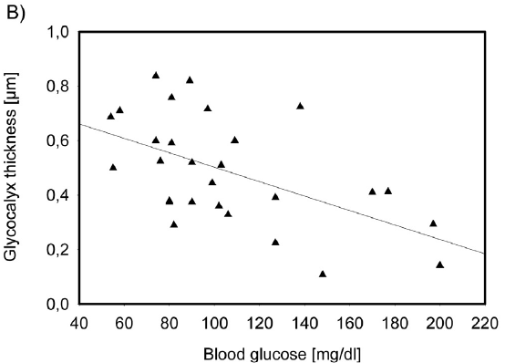
Glycocalyx Thickness is Lower in Children with Type 1 Diabetes
J Pediatr 2014;164:584-589
Notes:
The dimension of the sublingual endothelial glycocalyx in children with T1DM (patients, n = 14) and control patients (n = 14) was indirectly calculated according to the formula: glycocalyx thickness = ½ * D vessel diameter, with D being the difference in vessel diameter before and after spontaneous leukocyte passage. A, Microvascular glycocalyx thickness: *Patients with T1DM vs control patients, P = .013, rank sum test. Data are depicted as median, lower/upper quartile, and min/max. B, Inverse correlation of glycocalyx thickness with acute blood glucose levels (r = -0.55, P = .003,
Pearson correlation).
Microvascular alterations, including changes in microvessel distribution and loss of the glycocalyx, can be detected in children with type 1 diabetes mellitus before clinically apparent vascular complications. Our results disclose the glycocalyx as a possible monitoring measurement for earlier detection of diabetic microangiopathy and may provide a basis for new therapeutic strategies aiming at protection or restoration of the glycocalyx.
Effect of sulodexide on endothelial glycocalyx and vascular permeability in patients with type 2 diabetes mellitus. Diabetologia 2010;53:2646-55.
2. Oral sulodexide reduces albuminuria in microalbuminuric and macroalbuminuric type 1 and type 2 diabetic patients: the Di.N.A.S. randomized trial. J Am Soc Nephrol 2002;13:1615-25.

Slide 5
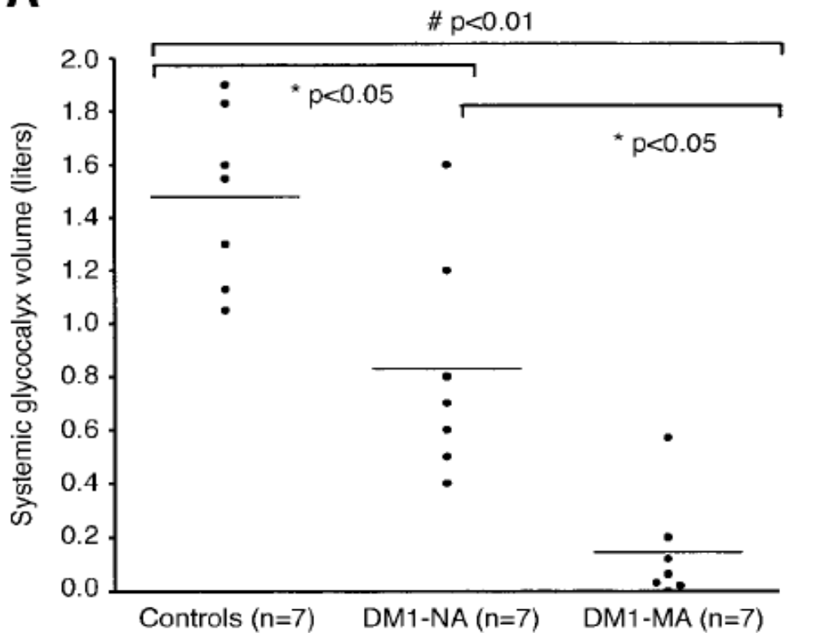
Glycocalyx Volumes are Decreased in Type 1 Diabetes With and Without Albuminuria
Diabetes 2006;55:1127-1132
Notes:
Systemic glycocalyx volumes are decreased in type 1 diabetic patients (DM1-NA and DM1-MA; groups 2 and 3) compared with matched control subjects (Controls; group 1). Between type 1 diabetic
patients, reduction was highest in DM1-MA compared with DM1-NA. *P < 0.05 and #P < 0.01.
The finding of a gradual reduction in glycocalyx volume in association with the presence of microalbuminuria in type 1 diabetic subjects emphasizes the generalized nature of glycocalyx perturbation in the development of diabetes-related microvascular disease. Further studies are needed to address whether glycocalyx perturbation indicates a poor vascular outcome and whether restoration of the glycocalyx is a valuable target to prevent vascular disease progression.
Abstract
The vascular glycocalyx is a gel layer between endothelium and the blood, 0.5 µm thick. Evidence is presented from published studies to indicate that hyperglycaemia causes damage to the vascular glycocalyx. This damage results in microalbuminuria, excess fluid transfer to the interstitium, reduction in nitric oxide (NO) production by arterial endothelium, and leukocyte and platelet adhesion to endothelium leading to atherothrombosis. The lack of NO production proceeds from the fact that glycocalyx is the mechanotransducer transmitting the signal for increased shear stress between blood and arterial wall, and this function is inhibited by hyperglycaemia. When hyperinsulinemia is also present, the problem is compounded by general arterial dilatation leading to low shear rates throughout the arterial tree. These findings explain the predisposition to atherothrombosis in the pre-diabetic condition of insulin resistance/metabolic syndrome/obesity and diabetes mellitus. It is proposed that greater efforts than ever are required to detect occult insulin resistance, to treat such patients and diabetics with ever more strict blood glucose control while minimizing insulin levels, and to carry out further research into how glycocalyx structure and function can be preserved.

