Slide 1
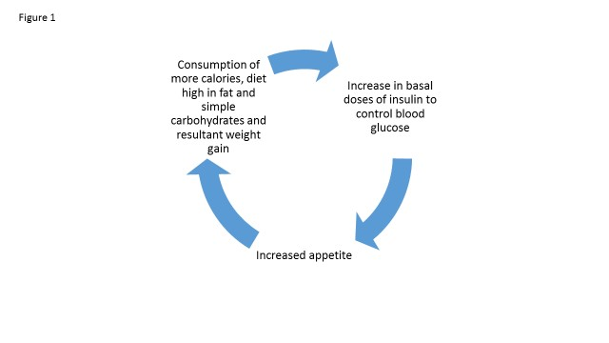
Avoid Early Insulin Therapy
(except in Ketosis-prone)
Vicious Circle(s) of Hyperinsulinemia-
Result in Weight Gain and Hypoglycemia
Blood glucose rises
Undue Basal
Or bolus Insulin
=Overinsulinized
Patient eats too much
Or simple sugars
Hypoglycemia
Symptomatic or not!
INCREASED APPETITE

Slide 2


NOTE:
There is NO perfect Exogenous Insulin:
All result in HyperInsulinemia and Potential Hypoglycemia
Endogenous Insulin
Exquisitely controlled levels of insulin released into the portal vein
Fine-tuned, physiologically appropriate insulinemia
Exogenous Insulin
‘Obligatory’ excess peripheral insulin to get modicum of reduced hepatic glucose production
Insulin Resistance
β-cell Dysfunction
-------
Potential
β-cell Exhaustion
Hypoglycemia
Obesity
Atherosclerosis
Hyperinsulin-emia
Weight gain
Hypertension
Dyslipidemia
Cancer
Chronic Inflammation
Type II Diabetes
Notes:
All because all insulin results in hyperinsulinemia with risk of negative consequences

Slide 3
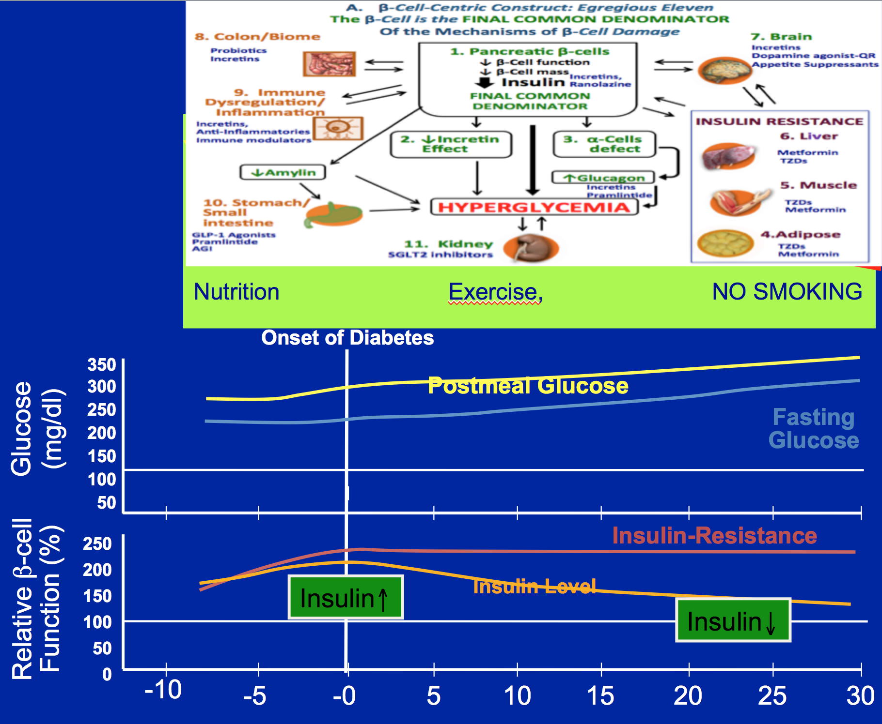
Therapeutic Principles Across Continuum of Care eg:
Right Drug for Right Patient and vice versa
Delay Need for Insulin
2. No need for Early Insulin
3. If need Insulin, Continue
Non-Insulin RX
(Avoids need for Meal-Time Insulin-
(Decrease Risk Hypoglycemia 85%- Garber)
4. Get Patients off insulin who had been given early Insulin

Slide 4
Hedge your Bets: Incretins for all patients
DPP4 inhibitors, GLP-1 RAs, [other agents that increase GLP-1 eg: metformin, colsevalam, (TGR-5)]
T1DM: minimize brittle, dawn, unpredictablity, variability, ? CV benefits, Treat those ‘Type 2’ Genes’, ANTI-INFLAMMATORY
LADA = SPIDDM/ Autoimmune T2DM. Same as above - Slow , stabilize disease process, ANTI-INFLAMMATORY
T2DM: Same as above, treats 7 MOA’s of DeFronzo’s Octet, decreases oxidative stress, β-cell inflammation decreases lipo- and gluco-toxicity, ?preserve mass, decreases appetite, treats IR via wt. loss
MODY 3- recent report
FOR ALL DM – potential CV benefit (ANTI-INFLAMMATORY)

Slide 5

A Unifying Pathophysiologic Approach to The Complications of Diabetes in the Context of the Beta-cell Classification of Diabetes
ALL COMPLICATIONS
(Micro/MacroVascular
Damage)
Susceptibility to abnormal metab. envir.
Genes
(Some in common/
Some
Different)
Endogenous
Fuel Excess
(glucose/ lipids)
(Brownlee’s Unified Theory of Complications
Insulin Resistance
Metab. Syn, BP, Lipid
Circulating master metabolic REDOX regulators
(L/P, β/A, SH/SS, ROS)
miRNA
Inflam./
Immune Mech.
Epigenetics
Environ
ment
Glucotoxicity /
lipotoxicity
Cause or permit susceptibility to damage
Defines Logic for treating Individual components of the pathophysiologic mechanisms contributing to beta cell damage and the complications of diabetes
Notes:
Legend: The Primary Cause of the Complications of Diabetes is the damage wrought by Hyperglycemia and other excess fuels engendered by reduced insulin or insulin effect due to abnormal beta-cell function, primarily in tissues not dependent on insulin for glucose transport into the cell.
We note that the same pathophysiologic mechanisms that damage the beta-cell are also involved with (help define) the risk of developing the complications of diabetes.
The specific risk of developing complications even with similar degrees of hyperglycemia depend on genetic susceptibility to damage by the abnormal metabolic environment, , exogenous environmental factors, immune/ inflammatory factors and insulin resistance and the metabolic syndrome genetically susceptible beta cells are damaged by environmental, inflammatory/immune mechanisms and IR /dysmetabolic syndrome factors. The resultant abnormal metabolic environment resulting from abnormal fuel excess (glucose, FFAs) can iteratively exacerbate beta cell dysfunction and damage genetically susceptible peripheral cells and tissues resulting in diabetic chronic complications. The presence or absence, or degree of damage is defined by the presence or absence of the same processes (environmental, inflammatory/immune mechanisms and IR /dysmetabolic syndrome factors) that are involved in beta cell dysfunction.
The The Fuel Excess resultant from abnormal b-cell function iteratively further exacerbate b-cell dysfunction. The pathways organized by Brownlee, acting through miRNAs, oxidative stress, Barabra Corkey’s metaboloic REDOX regulators as well as epigenetics further exacerbate IR, inflammation and immune dysfunction and ,potentially, susceptibility to environmental factors

Slide 6
Treating the ABCs Reduces
Diabetic Complications
Strategy | Complication | Reduction of Complication
Blood glucose control | Heart attack | ↓ 37%¹
Blood pressure control | Cardiovascular disease Heart failure Stroke Diabetes-related deaths | ↓ 51%² ↓ 56%³ ↓ 44%³ ↓ 32%³
Lipid control | Coronary heart disease mortality Major coronary heart disease event Any atherosclerotic event Cerebrovascular disease event | ↓35%⁴ ↓55%⁵ ↓37%⁵ ↓53%⁴
¹ UKPDS Study Group (UKPDS 33). Lancet. 1998;352:837-853.
² Hansson L, et al. Lancet. 1998;351:1755-1762.
³ UKPDS Study Group (UKPDS 38). BMJ. 1998;317:703-713.
⁴ Grover SA, et al. Circulation. 2000;102:722-727.
⁵ Pyŏrälä K, et al. Diabetes Care. 1997;20:614-620.

Slide 7
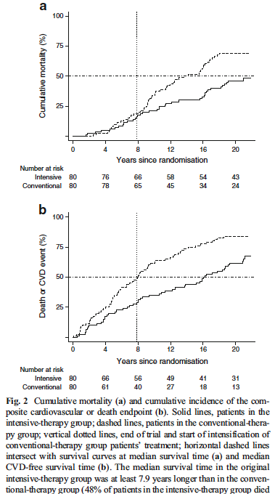
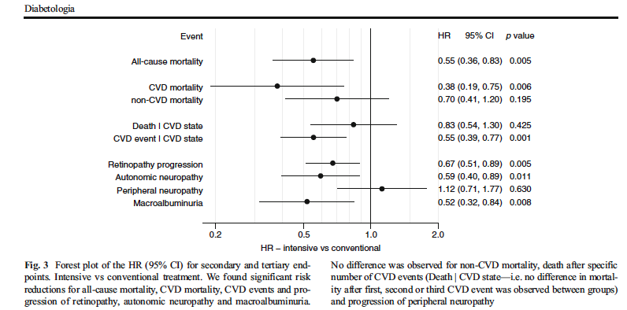
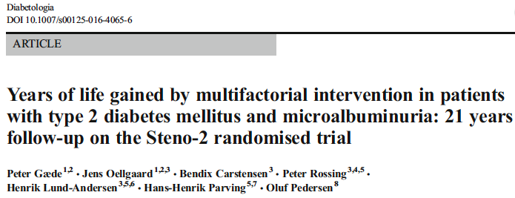
Increased Survival , Decreased
Micro-and Macro Vascular Disease in Steno-2 Rx’ing glucose , BP, Lipids

Slide 8
Aggressive medical therapy in diabetes- SUMMARY
SGLT-2 Inh.
Liraglutide
Bromocriptine QR
Pioglitazone
Metformin
Ranolazine
(Incretins)
Hyperglycemia/
Insulin resistance
Atherosclerosis,
CV Outcomes,
CV Risk Factors,
Mortality
ACE inhibitors
ARBs
β-blockers
CCBs
Diuretics
Hypertension
Statins
Fibric acid derivatives
Colsevalam
PCSK-9 Inh
Dyslipidemia
DM MEDS MAY BE A
CARDIOLOGIST’S BEST FRIEND
Platelet activation
and aggregation
ASA
Clopidogrel
Ticlopidine
Adapted from Beckman JA et al. JAMA. 2002;287:2570-81.
Notes:
Medical therapy for each metabolic abnormality is required to reduce atherogenesis
in patients with diabetes.
This slide depicts the possible therapeutic options for treating hyperglycemia and insulin resistance, dyslipidemia, hypertension, and hypercoagulability (platelet activation and aggregation).
TZDs = thiazolidinediones
Aggressive medical therapy in diabetes

Slide 9
Conclusion
Current classifications of DM are inadequate:
new classification schema -the β-cell as THE CORE DEFECT in ALL DM,
The various mediators of β-cell dysfunction offer key opportunities for Prevention, Therapy, Research and Education
Note, Same Mechanisms of β-cell dysfunction are responsible for DM complications (explains why some DM meds can decrease CV outcomes)

Slide 10
Conclusion-2
Patient care should shift from current classifications that limit therapeutic choices to:
one that views a given patient’s disease and treatment course based on their individual cause(s) of metabolic dysregulation, e.g. genes, inflammation, insulin resistance- ( including gut biome, central (brain) mechanisms), environmental factors, etc.
Defining markers, and Processes of Care permits patient-centric, Precision Medicine Care

Slide 11
Conclusion-3
Convene Organizations eg:ADA/EASD/WHO/IDF/AACE / JDF to Revise Classification of DM
More research always needed, but,
in an evidence-based PRACTICE approach to care, we can START NOW

Slide 12
Presenter Disclosure Information
In compliance with the accrediting board policies, the
American Diabetes Association requires the following
disclosure to the participants:
Stanley Schwartz
Research Support: 0
Employee: 0
Board Member/Advisory Panel: Janssen, Merck, AZ-BMS, BI-Lilly, Salix, Novo, Genesis Biotechnology Group
Stock/Shareholder: Saturn EMR Decision Support APP.
Consultant: NIH RO1 DK085212, Struan Grant PI
Other: Speaker’s Bureaus: Janssen, Merck, Novo, Salix, BI-LILLY, Eisai, AZ-Int’l, Amgen

