Slide 1
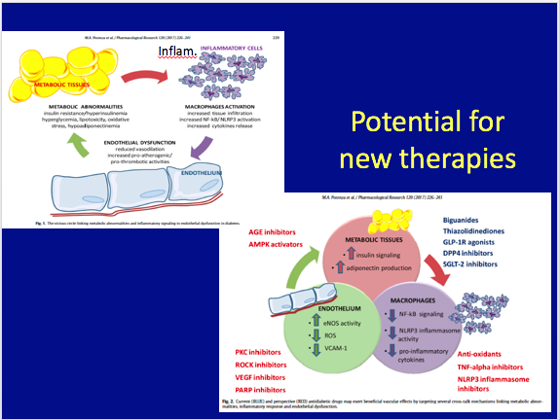

Slide 2
β-Cell (Islet Cell) Classification Model-
Implications for Therapy:
Targets for Therapies/ New Guidelines
Medication Choice Based on
Glycemic Efficacy
BUT ALSO
2. Number of Targets of Therapy each drug addresses
( combo therapy efficacy likely depends on number of
overlapping mechanisms- treat with least # of agents
that treat most # mechanisms of Hyperglycemia)
3.Weight loss
4. Proven Reduction in Risk Factors/ CV outcomes-Synergies–
eg: SGLT-2, pioglitazone, brompcriptine-QR, metformin, GLP-1 RA)

Slide 3
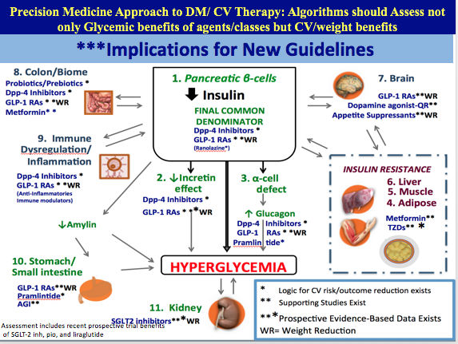

Slide 4
Practical Implementation of the
THE COMMON ORIGINS OF DIABETES AND ITS COMPLICATIONS CONSTRUCT

Slide 5
New β-Cell Centric Construct: Implications
Diagnosis Markers
By Virtue of Family History ‘DM”, Physiogomy, hyperglycemia, in prediabetic and diabetic range *
Genes
  • Family History
  • Genotype- HLA, TCF7L2, etc
β-Cell
  • FBS, 2hr ppg, HgA1c, ? C-peptide, ?other- β-Cell mass measures
Inflammation
• Antibodies, Inflammatory Markers, T-Cell function, ?other
Insulin Resistance
• BMI, Adiponectin, Adipocytokines, ? Other
* Individualized and reliant on cost, insurance coverage, formulary, government

Slide 6
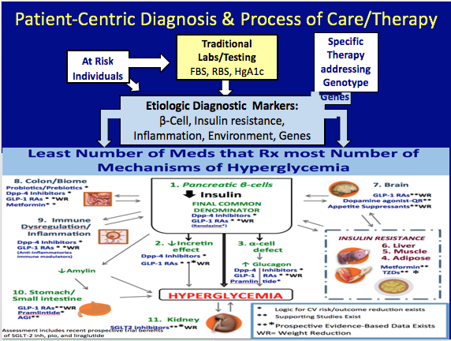

Slide 7
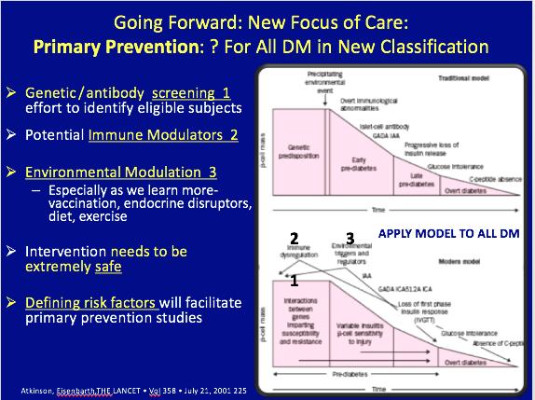

Slide 8
Choice of Therapy
Based on
  Treating Causes of β-Cell dysfunction
  Treating Abnormalities resulting from β-Cell dysfunction
No Logic for Agents that Decrease β-Cell dysfunction
THUS: SELECT AGENTS THAT CAN PRESERVE
β-Cell function/mass
  Allows us to Correct a myth
MYTH: “Most Patients with ‘T2DM’ will eventually progress to insulin
because of inexorable β-Cell loss”
- But data obtained on SU=apoptosis; Hyperinsulinism with weight gain
- Think of bariatric patients –no insulin after 25 years DM/ 20 years
insulin
- Most patients dying with DM have > 20% β-Cell mass- Butler
- Need to remove >80% pancreas in sub-total pancreatectomies to
leave patient with DM post-op

Slide 9
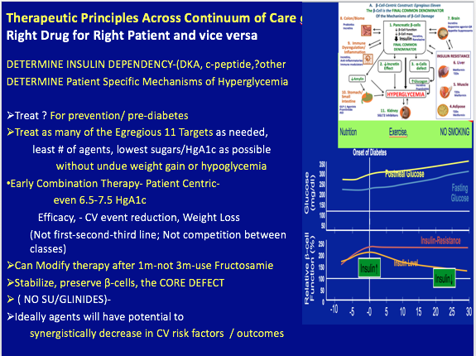

Slide 10
