Slide 1

Albuminuria-A Lot More Than Just a Little Protein in the Urine
Addressing Chronic Kidney Disease Type 2 DM
Claude K. Lardinois, MD, FACP, MACN, FACE
lardinois@sbcglobal.net
Emeritus Professor
University of Nevada School of Medicine
Graduate Faculty, Nevada Studies in Nutrition
University of Nevada, Reno
Medical Director for American Health Care
Rocklin, California

Slide 2
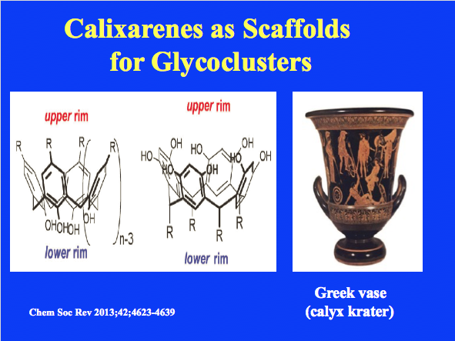
Notes:
(a) CH2-bridged calix[n]arenes or simply calix[n]arenes with notation of the number n of repeating –ArCH2– units and (b) resorcarenes, also belonging to the family of the calixarenes; (c) a picture of a Greek vase (calyx krater), whose shape inspired the name of the molecule.

Slide 3
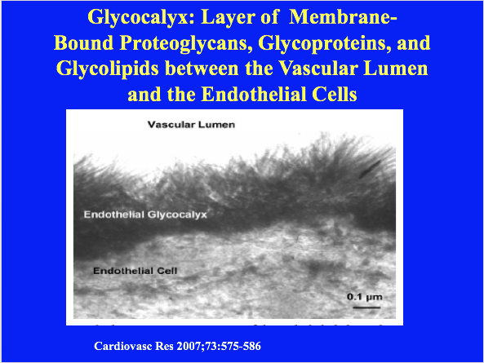
Notes:
Disruption of the glycocalyx and disease
Because the glycocalyx is so prominent throughout the cardiovascular system, disruption to this structure has detrimental effects that can cause disease. Certain stimuli that cause atheroma may lead to enhanced sensitivity of vasculature. Initial dysfunction of the glycocalyx can be caused by hyperglycemia or oxidized LDL which then causes atherothrombosis. In microvasculature, dysfunction of the glycocalyx leads to internal fluid imbalance, and potentially edema. In arterial vascular tissue, glycocalyx disruption causes inflammation and atherothrombosis.[8]
Experiments have been performed in order to test precisely how the glycocalyx can be altered or damaged. One particular study used an isolated perfused heart model designed to facilitate detection of the state of the vascular barrier portion, and sought to cause insult-induced shedding of the glycocalyx to ascertain the cause and effect relationship between glycocalyx shedding and vascular permeability. It was hypothesized that hypoxic perfusion of the glycocalyx was sufficient enough to initiate a degradation mechanism of the endothelial barrier. The study found that flow of oxygen throughout the blood vessels did not have to be completely absent (ischemic hypoxia), but that minimal levels of oxygen were sufficient enough to cause the degradation. Shedding of the glycocalyx can be triggered by inflammatory stimuli, such as Tumor necrosis factor-alpha (TNF). Whatever the stimulus is, however, shedding of the glycocalyx leads to a drastic increase in vascular permeability. It is disadvantageous for vascular walls to be permeable, since that would enable passage of some macromolecules or other harmful antigens.[9]
Fluid shear stress is also a potential problem if the glycocalyx is degraded for any reason. This type of frictional stress is caused by the movement of viscous fluid (i.e. blood) along the lumen boundary. Another similar experiment was carried out to determine what kinds of stimuli cause fluid shear stress. The initial measurement was taken with intravital microscopy, which showed a slow-moving plasma layer, the glycocalyx, of 1 micrometer thick. Light dye damaged the glycocalyx minimally, but that small change increased capillary hematocrit. Thus, fluorescence light microscopy should not be used to study the glycocalyx because that particular method uses a dye. The glycocalyx can also be reduced in thickness when treated with oxidized LDL.[10] These stimuli, along with many other factors, can cause damage to the delicate glycocalyx. These studies are evidence that the glycocalyx plays a crucial role in cardiovascular system health.

Slide 4
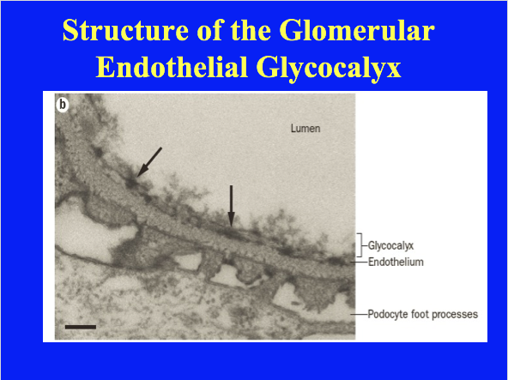
Notes:
The structure of the glycocalyx. a | Schematic representation of the glomerular endothelial glycocalyx. Long hyaluronan molecules that are linked to the basement membrane and endothelial cell membrane interlink with heparan sulfate side chains of proteoglycans, such as syndecans and glypicans. These molecules, together with sialylated glycoproteins, constitute a carbohydrate surface layer to which proteins (transparent blue) and water (not depicted) bind, thus forming a biological hydrogel that covers the glomerular endothelium. b | Electron micrograph (×30,000 magnification) of the glomerulus after cupomeronic blue fixation of the carbohydrate surface layers on cells. The glomerular endothelium shows an electron-dense layer of polysaccharides that fill the fenestrae (arrows).

Slide 5
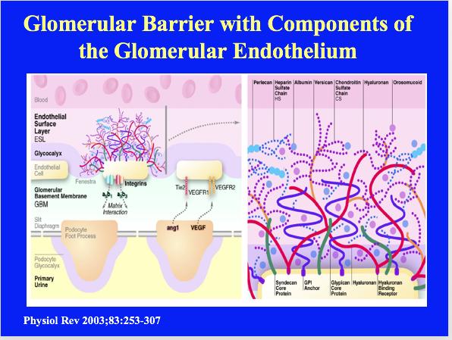
Notes:
FIG. 5. Schematic drawing of the glomerular barrier with components of the glomerular endothelium [e.g., the integrins, Tie2, VEGF receptor 1 (VEGFR1), VEGFR2] and the endothelial cell surface coat (ESL). Several, or all, of the components of the ESL are produced by the endothelium at certain rates and removed to blood or urine at similar rates during steady-state conditions. Membrane-bound proteoglycans (PG), such as syndecan and glypican, which carry chondroitin sulfate (CS) side chains (syndecan) and/or heparan sulfate (HS) side chains (glypican and syndecan) form the glycocalyx. The ESL is formed by secreted proteoglycans such as perlecan (mainly HS) and versican (mainly CS) together with secreted glycosaminoglycans (GAG) (e.g., hyaluronan) and adsorbed plasma proteins (e.g., albumin and orosomucoid). Several other macromolecules not shown in the figure are important components of the ESL and the glycocalyx. The podocytes produce substances such as ang1 and VEGF that affect the endothelial cells. For a more detailed picture of the podocyte biology, please consult Reference 234.
Orosomucoid-α1-Acid glycoprotein; a subgroup of the α1-globulin fraction of blood; increased plasma levels are associated with inflammation.
Serum orosomucoid was compared with clinical activity, routine laboratory tests, intestinal protein loss, and albumin and IgG turnover in 22 cases of ulcerative colitis. Serum orosomucoid was well correlated with clinical activity, haemoglobin and leucocyte counts were not. A significant correlation was present between serum orosomucoid and intestinal protein loss (gastro-intestinal 59Fe-iron dextran clearance), serum albumin, fractional catabolic rates of albumin, and IgG and IgG synthesis rate. No correlation was found between serum orosomucoid and albumin synthesis rate or serum IgG. It is concluded that serum orosomucoid is a highly reliable indicator of disease activity in ulcerative colitis.
Perlecan-(PLC) also known as basement membrane-specific heparan sulfate proteoglycan core protein (HSPG) or heparan sulfate proteoglycan 2 (HSPG2), is a protein that in humans is encoded by the HSPG2 gene.
Versican-is a large extracellular matrix proteoglycan that is present in a variety of human tissues. It is encoded by the VCAN gene. Versican is a large chondroitin sulfate proteoglycan with an apparent molecular mass of more than 1000kDa.
Hyaluronan-hyaluronic acid-A glycosaminoglycan that is found in extracellular tissue space, the synovial fluid of joints, and the vitreous humor of the eyes and acts as a binding, lubricating, and protective agent.

