Slide 1
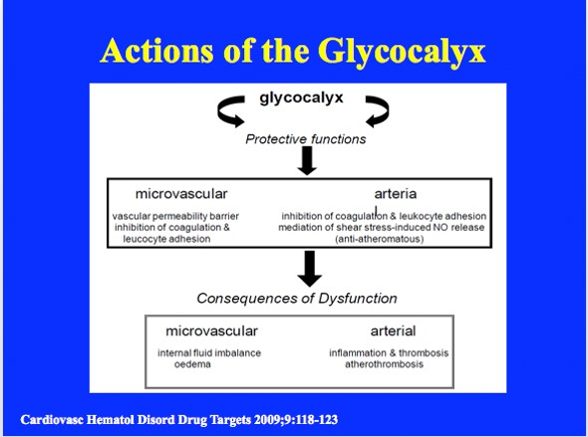
Notes:
Schema of the Action of the Glycocalyx. The protective functions of the vascular glycocalyx are universal throughout the vascular system, but their relative importance varies dependent on the position in the system. Thus, in the crude division in the schema, control of fluid exchange though the filter function of the glycocalyx assumes a dominant role in the microcirculation. By contrast, larger vessels, particularly the arteries in which high blood flow and shear-stress occur, the main protective effect of the gylcocalyx is against atherothrombosis, and protection of the endothelial layer from platelet and kocyte adhesion.

Slide 2
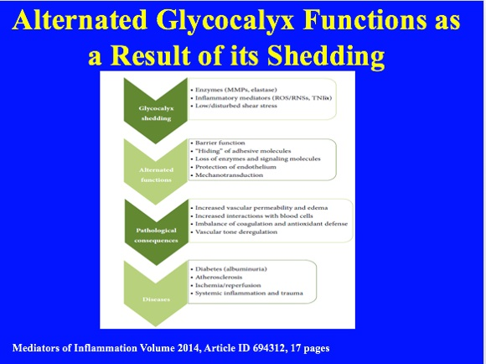
Notes:
Overview of alternated glycocalyx functions as a result of its shedding which could lead to pathological states connected with various diseases. Matrix metalloproteinases (MMPs), reactive oxygen and nitrogen species (ROSs/RNSs), and tumor necrosis factor 𝛼 (TNF-𝛼).

Slide 3
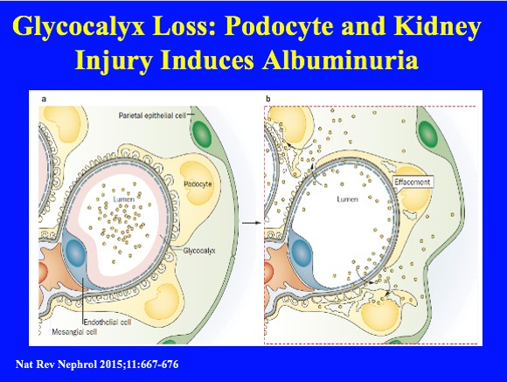
Notes:
Loss of the glycocalyx leads to podocyte and kidney injury. a | Normal glomerular endothelial cell anatomy. The endothelial cell phenotype is controlled by adjacent podocytes and mesangial cells. Parietal epithelial cells cover the Bowman capsule. b | Loss of the glycocalyx allows proteins to enter the subpodocyte space, from where they are taken up by podocytes. This protein uptake induces phenotypic changes in podocytes, including apoptosis, and subsequent effacement of neighbouring podocytes. Albumin in the Bowman space and loss of podocytes stimulate proliferation of parietal
epithelial cells, which become involved in sclerotic repair processes.
We propose that, in patients with conditions that are characterized by increased cardiovascular risk, albuminuria is a secondary consequence of altered endothelial function, particularly loss of the glycocalyx, and contributes to disease progression. Albuminuria that results from loss of this barrier should be distinguished from albuminuria that results from primary podocyte injury or occurs in immunological disease, primary focal segmental glomerulosclerosis and with genetic mutations. This distinction should be made because evidence suggests that the loss of glycocalyx function is reversible upon restoration of endothelial function. This reversibility enables exploration of the use of new and existing treatments to prevent, reduce or reverse albuminuria and the associated progression of renal and cardiovascular disease.

Slide 4
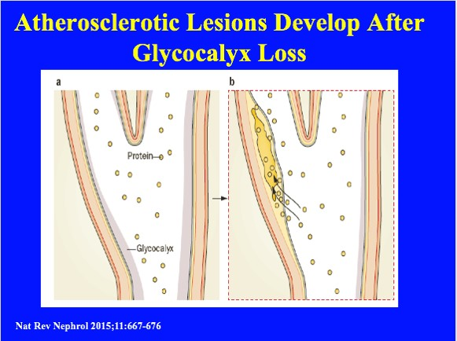
Notes:
Development of atherosclerotic lesions after loss of the glycocalyx. a | Normally, the endothelium (blue) is covered by the glycocalyx, which prevents the passage of proteins and lipoproteins into the subendothelial space. b | Following loss of the glycocalyx, proteins and lipoproteins can enter the subendothelial space. The associated recruitment of inflammatory cells drives formation of atherosclerotic lesions.
Albuminuria in clinical trials
Progressive diabetic kidney disease is associated with a poor prognosis, and the condition and its comorbidities reduce quality of life. 88 Current recommended interventions can marginally attenuate but not stop disease progression; morbidity persists even with treatment, and mortality surpasses that of some types of cancer.89 Albuminuria is an important prognostic factor in this residual risk. 90 In the past decade, trials in diabetic renal and cardiovascular disease have all failed. These trials included ON‑TARGET (dual RAAS); SUN (sulodexide); TREAT (darbepoetin); SHARP for kidney protection (simvastatin plus ezetimibe); ALTITUDE (dual RAAS blockade); VA‑NEPHRON‑D (dual RAAS blockade); BEACON (bardoxolone); ASCEND (avosentan) and EPICC (absorbent, AST‑120).75,76,79,91,92 These trials either aimed to reduce albuminuria or reported the effect of the drug on albuminuria, and concluded that a reduction in albuminuria was not associated with a better renal or cardiovascular outcome, and that a better outcome was not associated with a reduction in albuminuria. These conclusions triggered a debate over whether the reduction of albuminuria itself can still serve as a treatment goal or whether albuminuria is just a consequence of vascular disease with no pathophysiological meaning. However, the conclusions of these studies themselves are questionable. The pathophysiology of albuminuria in these patients (that is, endothelial activation and loss of glycocalyx barrier function) was not the specific target of therapy in these trials and/or patients enrolled in the trials did not have albuminuria to start with and yet the primary end point results were used to argue that albuminuria should not be a therapeutic target.93,94 However, a trial cannot prove or disprove a relationship between a risk factor and outcome unless it is designed specifically to study that relationship. A post hoc analysis of the results across these trials for the subset of patients with albuminuria shows that a reduction in albuminuria is clearly associated with better renal or cardiovascular outcomes.95,96 Nevertheless, this post hoc analysis has not changed the policies of the FDA and European Medicines Agency, and so albuminuria remains an invalid surrogate for renal protective treatment.97 Consequently, pharmaceutical companies are reluctant to invest in approaches that primarily target albuminuria, even though studies of such approaches could prospectively prove the validity of albuminuria as a drug target.
The only solution to this vicious cycle is to conduct a prospective trial that aims to reduce albuminuria with a drug that is proven to reduce albuminuria. The ongoing SONAR study98 stratifies patients according to their antialbuminuric response to the study drug and subsequently randomizes them to receive the active drug or a placebo. This approach enables the relationship between a reduction in albuminuria and clinical outcome to be accurately evaluated. The initial patient stratification also enriches the study population to include those with the greatest antialbuminuric response, which will not only help to achieve optimal use of all trial resources, but will help to determine the true potential of albuminuria as a therapeutic target.
79. Randomized placebo-controlled EPPIC trials of AST‑120 in CKD. J. Am. Soc. Nephrol. 26, 1732–1746 (2015).
95. Mortality and morbidity in relation to changes in albuminuria, glucose status and systolic blood pressure: an analysis of the ONTARGET and TRANSCEND studies. Diabetologia 57, 2019–2029 (2014).
96. Stroke outcomes and renal function in diabetes: a meta-analysis of randomized controlled trials [Poster FR‑PO751]. J. Am. Soc. Nephrol. 25 (Suppl.), 541A (2014).

Slide 5
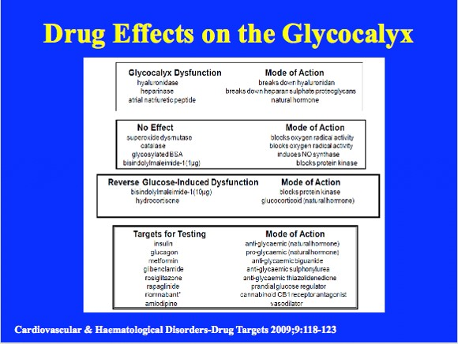
Notes:
Drug Effects on the Glycocalyx. Those drugs which are known to cause dysfunction of the glygocalyx are shown in the top box, next are those which have no effect. In the third box, high dose (10 !g) bisindolylmalemide-1 and hydrocortisone are the only drugs which show promise in reversing glycocalyx dysfunction. In the bottom box, those drugs relevant to diabetes are indicated as first targets for future investigation. Vasodilators may improve glygocalyx by improving blood flow (shear rates). However, the effects of commonly prescribed drugs should be known. There is a need to explore whether it is possible to introduce gel stabilizers into the circulation that can by administered successfully orally, and that can be taken up by the glycocalyx without undesirable effects.
Bisindolylmaleimide I (GF 109203X) is a staurosporine (sc-3510) inspired molecule, which has been shown to display equally potent inhibition, but with vastly superior selectivity, for all of the known isoforms of PKC (IC50 = 8-20 nM). Inhibition is competitive with respect to ATP, which suggests that Bisindolylmaleimide I occupies the ATP binding domain of the PKC isoforms. Bisindolylmaleimide I (GF 109203X) has been used to selectively probe for PKC-mediated pathways for transduction of hormone, cytokine, and growth factor signals. It inhibits PKC within intact platelets and T cells, Fas-mediated apoptosis, and T cell-mediated autoimmune diseases, as well as GSK-3. See sc-24004 for water soluble form of Bisindolylmaleimide I. Bisindolylmaleimide I (GF 109203X) is an inhibitor of PHK/CaM, PKC α, PKC β, PKC δ, PKC ε, PKC γ and SR/HTR3.
Sphingosine1-phosphate induced synthesis of glycocalyx on endothelial cells

Slide 6
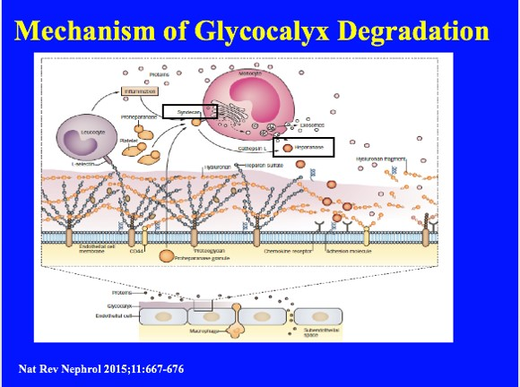
Notes:
Mechanism of glycocalyx degradation. Proheparanase is released by activated endothelial cells and activated platelets and by secretion from leucocytes. Proheparanase is cleaved into active heparanase by cathepsin L. Proteoglycans such as syndecan‑1, but also LDL receptor-related proteins and mannose 6‑phosphate receptors, facilitate recapture of proheparanase by the leucocytes.99 Proteolysis occurs either in the plasma as a result of cathepsin secretion from monocytes, or in the late endosomes and lysosomes of macrophages following internalization of proheparanase. After internal proteolysis, activated heparanase is secreted alongside exosomes, which also contain enzymes involved in extracellular matrix remodelling.100 Heparanase consequently cleaves heparan sulfate in the glycocalyx. Released hyaluron and heparan sulfate fragments promote inflammation.101 Remodelling of the glycocalyx facilitates endothelium–leucocyte interaction. Altogether, this process enables serum proteins, such as albumin and lipoproteins, to enter the subendothelial space.
99. Cellular uptake of mammalian heparanase precursor involves low density lipoprotein receptor-related proteins, mannose 6‑phosphate receptors, and heparan sulfate proteoglycans. J. Biol. Chem. 280, 33141–33148 (2005).
100. Heparanase activates the syndecan–syntenin–ALIX exosome pathway. Cell Res. 25, 412–428 (2015).
101. Soluble heparan sulfate fragments generated by heparanase trigger the release of pro-inflammatory cytokines through TLR‑4. PLoS ONE 9, e109596 (2014).

